Slide 1
CSCI222 Assignment 1
Warehouse Management Tool

Slide 2
Table of Contents
Introduction/Overview
Informal Specifications Elicitation
UML/Class Diagram
General Use Cases
Login Use Case 1 / Activity Workflow
Stock Use Case 2 / Activity Workflow
Summary Use Case / Activity Workflow
Component Diagram
Gantt Chart/Project Timeline
Version Control Software
Summary

Slide 3
Our Vision
Introduction
This system allows the user to keep track of the warehouse stock inventory.
It provides for a better understanding of day-to-day operations with its summary information of how a warehouse is performing.

Slide 4
INTRODUCTION
Overview of Product Features
Users will be allowed to view/search, add, remove or append/edit stock inventory
Users will also be able to generate a summary report
User Classes identified
Warehouse Manager
Stock Takers
Operating Environment
Ubuntu 14.04 LTS operating system

Slide 5
Overview of the System
System Features
Record incoming and outgoing stock
Categorize the stock in relation to their type
Search and display available stock
Search and display stock in accordance to price range and quantity
Generate a Summary Report of incoming and outgoing stock
Encryption of Data Storage
Login authentication encryption/decryption
Unsuccessful login – system locked
Provide stock item alerts for below threshold limit
Main Constraints
System to be implemented in C++ and to run on Linux OS
Capacity of database

Slide 6
Informal Specifications Elicitation
Functional Specifications
Track stock (add, delete, edit)
Categorise and search stock
Display stock according to price range or category/sub-category
User Authentication System & Data Storage Encryption option
Stock item alerts (when stock goes below a specified limit)
Notes:
YTD

Slide 7
Informal Specifications Elicitation
Non-Functional Specifications
Interface: User friendly, and displays the information at a glance
Security Requirements
Encryption
Data Integrity
Lightweight
Periodic Data Backup
Robust System
Notes:
YTD

Slide 8
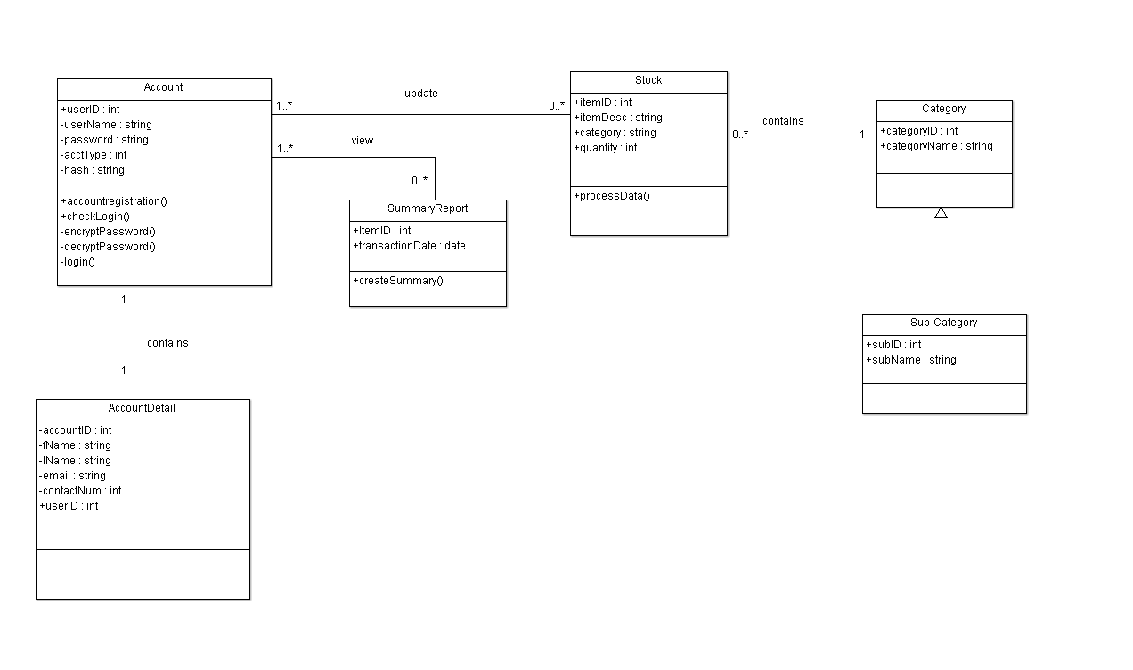
UML/Class Diagram: Iteration 1

Slide 9
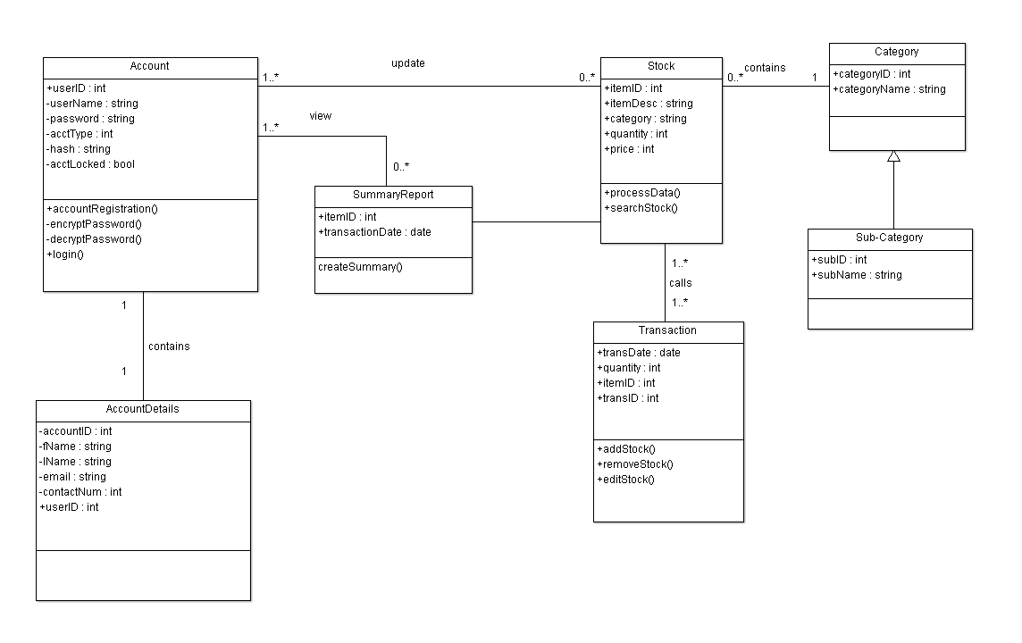
UML/Class Diagram: Iteration 2

Slide 10
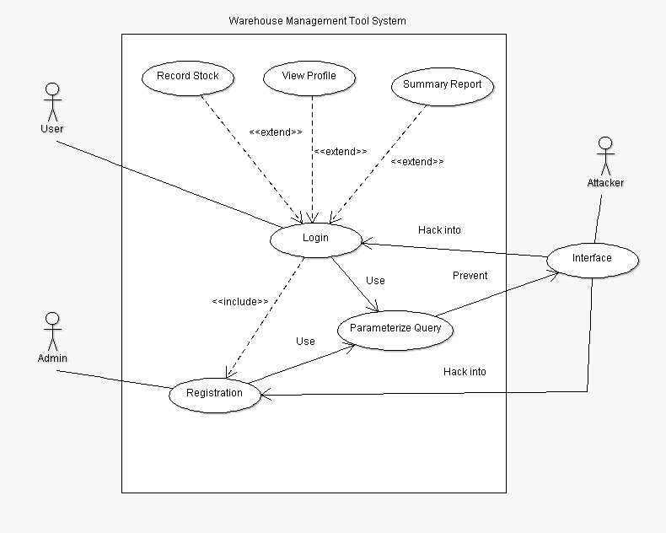
Use Case – Initial

Slide 11
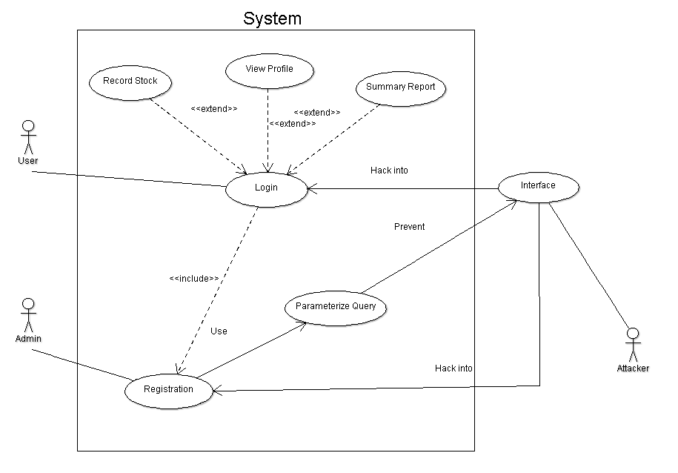
Use Case – General: Iteration 1

Slide 12
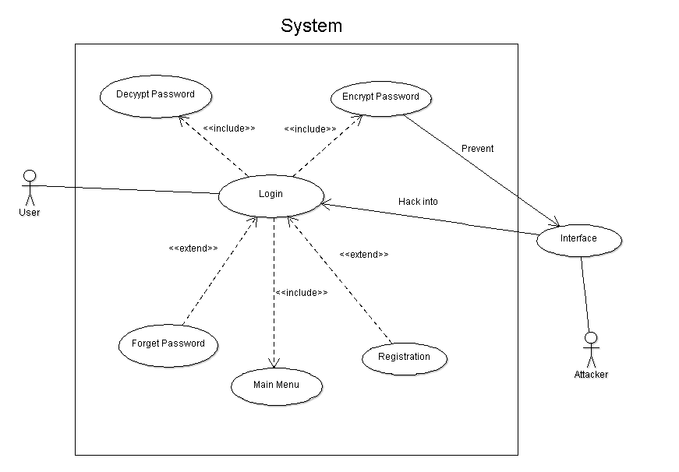
Use Case – Login: Iteration 1

Slide 13
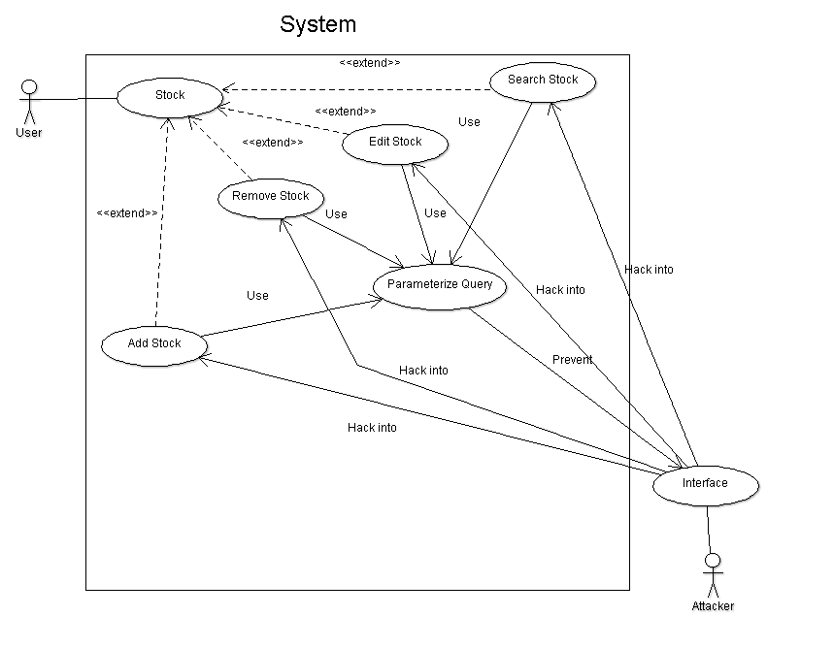
Use Case – Stock: Iteration 1

Slide 14
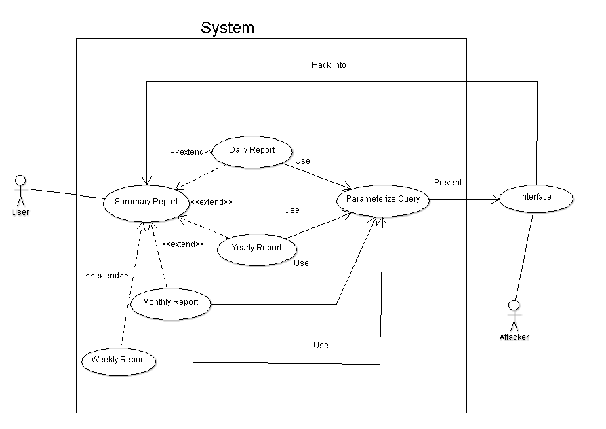
Use Case – Summary: Iteration 1

Slide 15
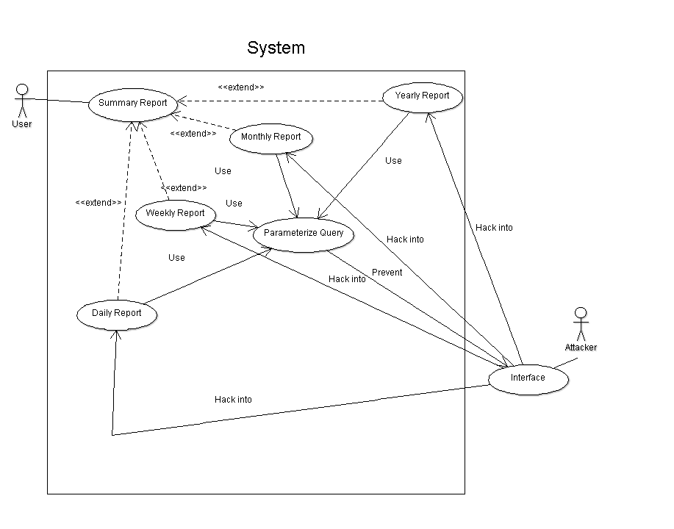
Use Case – Summary: Iteration 2

Slide 16
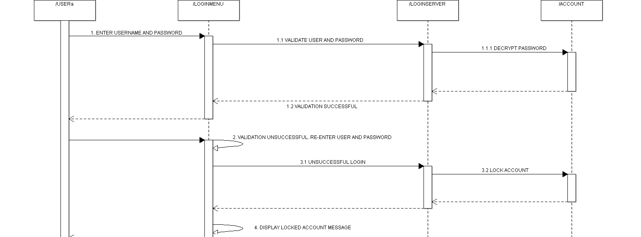
Activity Workflow – Login: Iteration 1

Slide 17
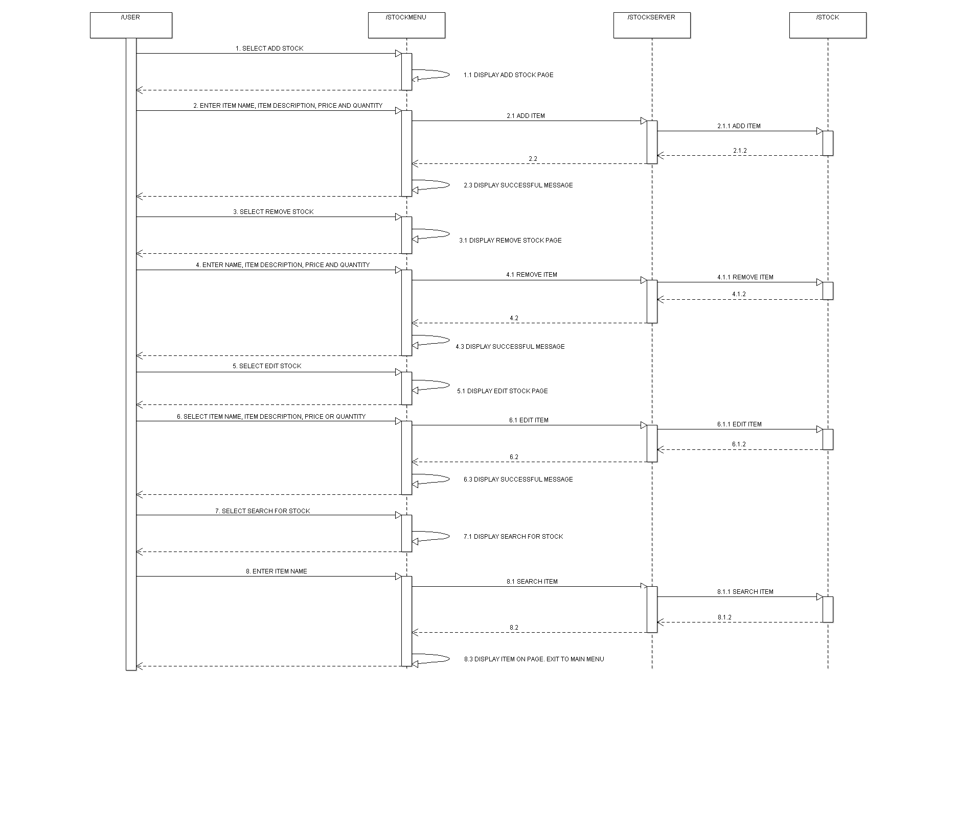
Activity Workflow – Stock: Iteration 1

Slide 18
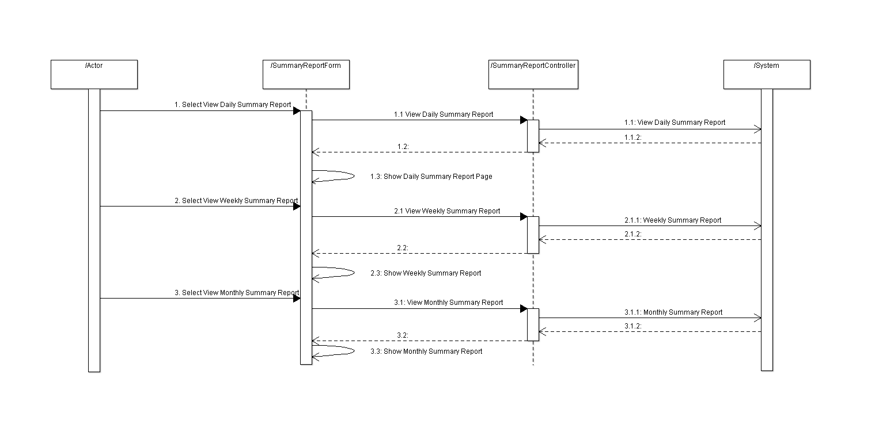
Activity Workflow – Summary Report: Iteration 1

Slide 19
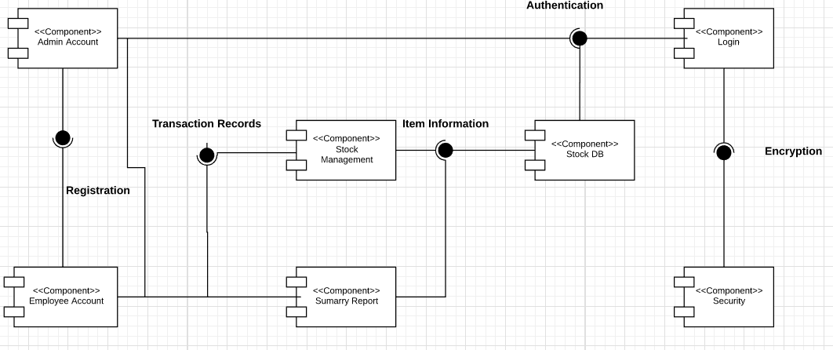
Component Diagram: Iteration 1

Slide 20
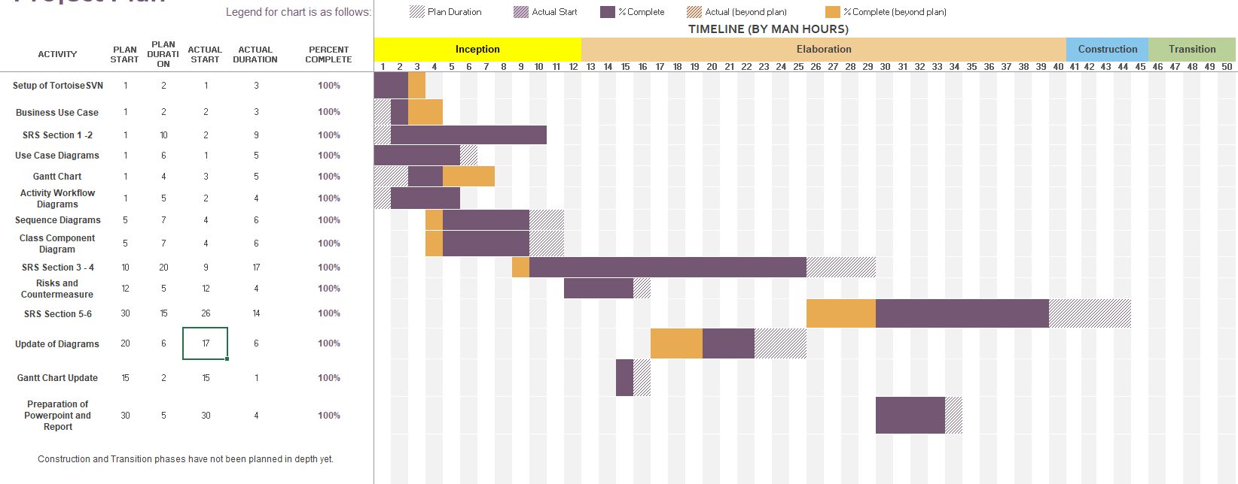
Gantt Chart/Project Timeline

Slide 21
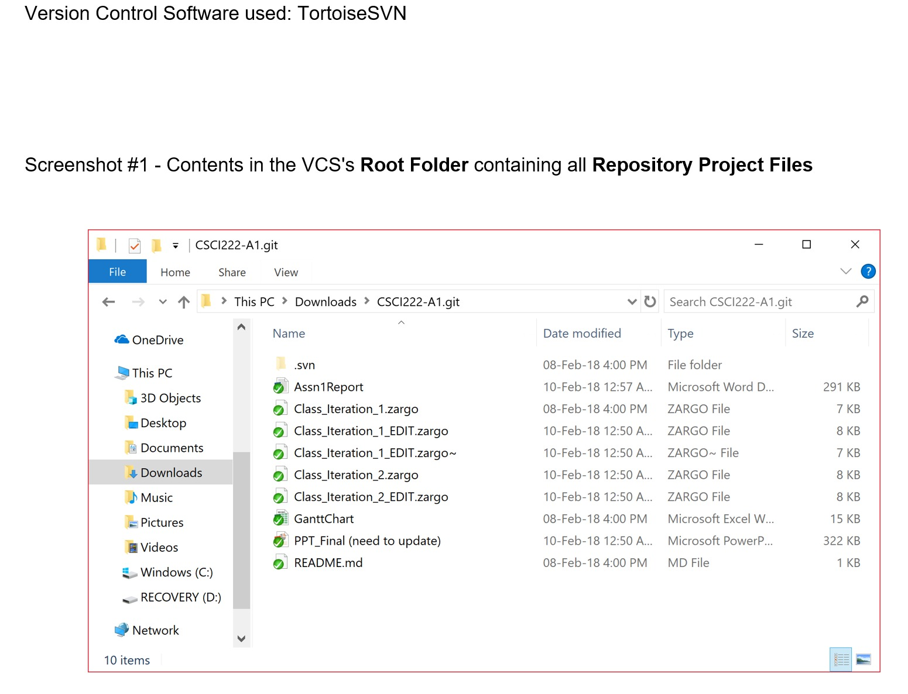
VCS’s Root Folder

Slide 22
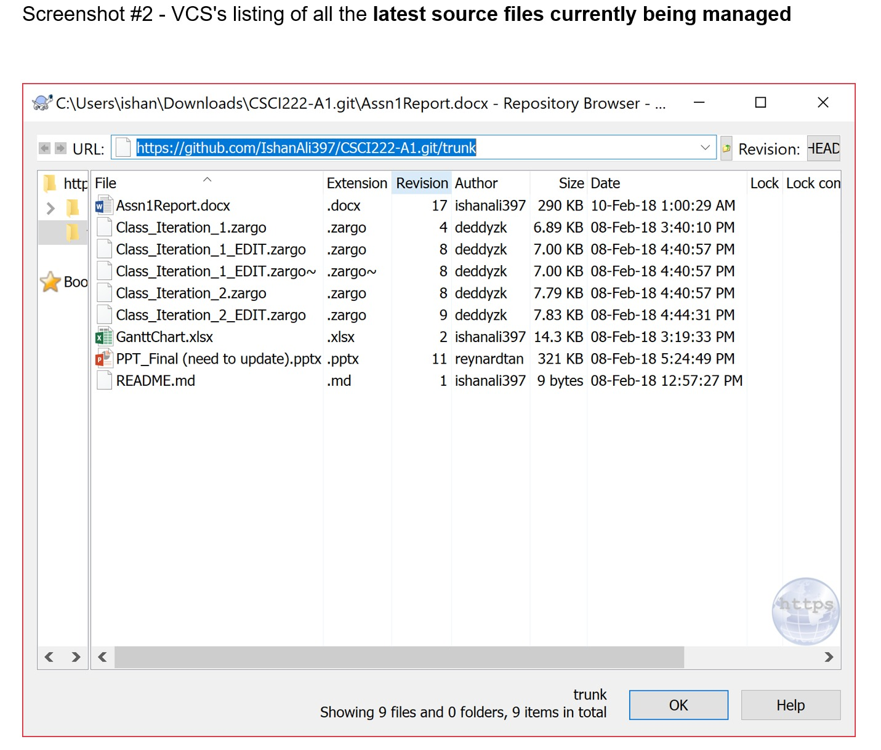
VCS’s Root Folder

Slide 23
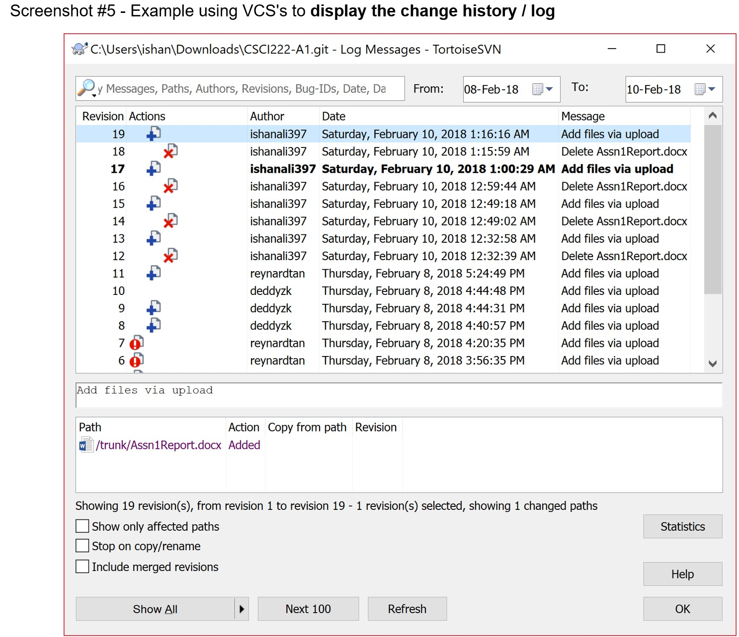
VCS’s Root Folder

Slide 24
THANK YOU

