Slide 1



Firewalls: Workings, Features & Applications
A Seminar on
Name : Ishan Apte
Roll : 41133
ISM Honors

Slide 2

CONTENTs
Definition of Firewall
Features of Firewalls
Types of Firewalls
Simplistic implementation of Firewalls
Case Studies
Conclusion

Slide 3

What is A firewall?
Firewalls are defined as a part of network security device or program that controls incoming and outgoing network traffic based on preset rules and regulations that are set by the user or an organization.
Its primary purpose is to prevent malicious data packets entering a secured network.
It can be in the form of hardware or software or even a cloud-based service (firewall as a service)
In comparison to anti-virus software’s (remove distrustful files), firewalls are preventive and monitor and filter packets of data as they come.

Slide 4
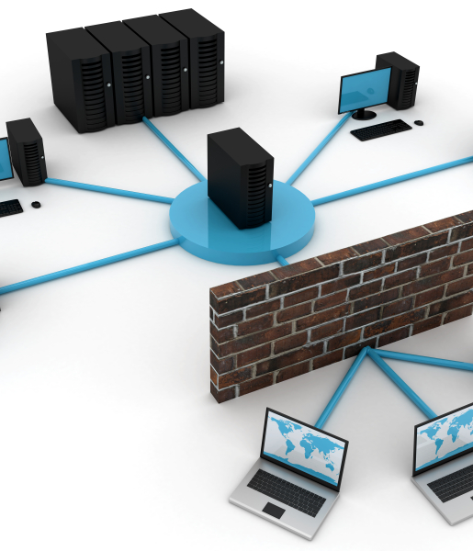
Features Of Firewalls
Bandwidth control and monitoring: Every firewall should have this feature, which is sometimes called traffic shaping. It allows you to control the available bandwidth of your network for sites, applications, and users.
Web filtering: Also known as content filtering, it oversees data packets your computer sends and receives to weed out any compromising, flagged, or forbidden content.
Sandboxing: Sandboxing takes files or executables — a file with instructions or options to complete a function on your device — and opens them in a test environment. This feature essentially opens and runs files to scan for any malware or suspicious activity to protect the end user.
Logging: An effective firewall can log network traffic, giving you updated information about what’s happening. It can show you vulnerabilities and provide information about an attack happening on the web.

Slide 5
Features Of Firewalls
Deep Packet inspection: it is an advanced way of examining and managing network traffic where the firewall takes a close look at the packet that is being passed through. It involves examining contents of packets to make real-time decisions
User and Application Control: This is a type of security technology built into next-generation firewalls that allow for the matching of different types of network traffic to predefined models or applications. This prevents applications from executing actions that put your data at risk of compromise. Similarly, user-based filtering is used to permit or restrict access to the network for users based on their assigned roles.

Slide 6
Types of firewalls
Packet filtering fire walls
A packet filtering firewall is the most basic type of firewall. It acts like a management program that monitors network traffic and filters incoming packets based on configured security rules. These firewalls are designed to block network traffic IP protocols, an IP address, and a port number if a data packet does not match the established rule-set. These types of firewalls do not prevent web-based attacks, they are not the safest.
Circuit Level Gateways
These firewalls don’t check the actual data, instead they inspect the information about transactions. Therefore, if a data contains malware, but follows the correct TCP connection, it will pass through the gateway. That is why circuit-level gateways are not considered safe enough to protect our systems.

Slide 7
Types of firewalls
Application-level Gateways (Proxy Firewalls)
Unlike basic firewalls, these firewalls transfer requests from clients pretending to be original clients on the web-server. This protects the client's identity and other suspicious information, keeping the network safe from potential attacks. Once the connection is established, the proxy firewall inspects data packets coming from the source. If the contents of the incoming data packet are protected, the proxy firewall transfers it to the client
Stateful Multi-layer Inspection (SMLI) Firewalls
Stateful multi-layer inspection firewalls include both packet inspection technology and TCP handshake verification, making SMLI firewalls superior to packet-filtering firewalls or circuit-level gateways. Additionally, these types of firewalls keep track of the status of established connections. Making it more secure than stateless firewalls.

Slide 8
Types of firewalls
Next-generation Firewalls (NGFW)
There is no specific definition for the “next-generation firewalls” but normally means a firewall that is a combination of features and functionalities of other firewalls. NGFW includes higher levels of security than packet-filtering and stateful inspection firewalls. Unlike traditional firewalls, NGFW monitors the entire transaction of data, including packet headers, packet contents, and sources. NGFWs are designed in such a way that they can prevent more sophisticated and evolving security threats such as malware attacks, external threats, and advance intrusion.

Slide 9
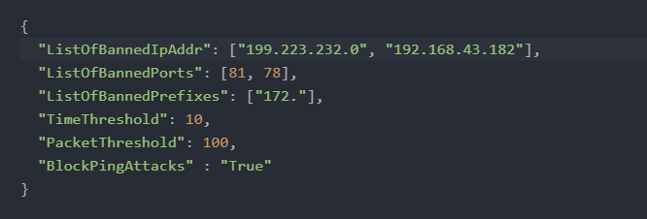
Simplistic implementation
Requirements
netfilterqueue
Scapy
Steps:
Type the following terminal command:
iptables -I INPUT -d 192.168.0.0/24 -j NFQUEUE --queue-num 1
Fill out the rules in the JSON file as follows:
Execute firewall.py using python3

Slide 10
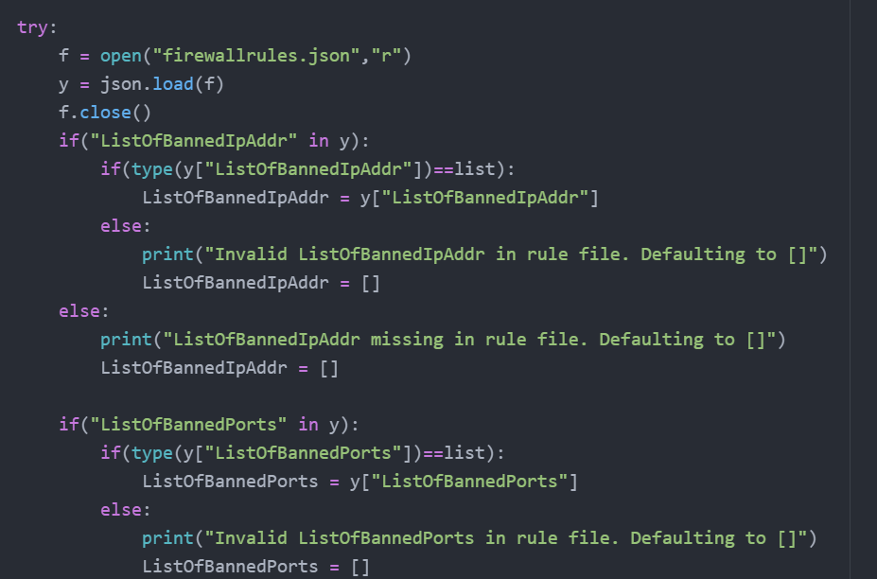
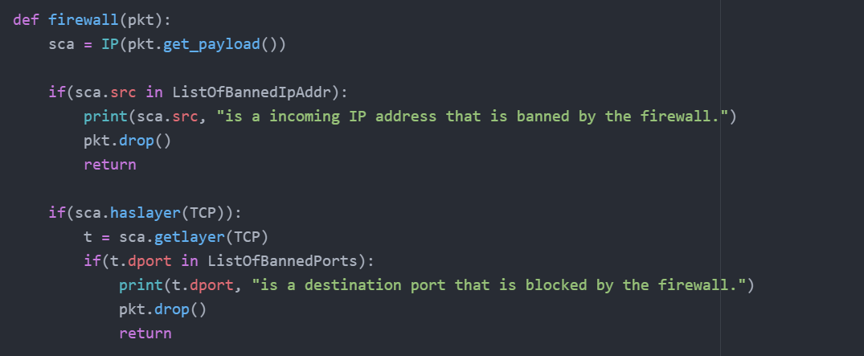
Simplistic implementation

Slide 11
Case studies: Adventist health
A California based company, Adventist health, was faced with the issue of inconsistent firewall policies
The organization contained a network of 24 hospital facilities, 320 clinics, 34,000 employees spanning 350 locations
The inconsistencies caused inefficient management and became a time-consuming affair
The team employed Cisco Firewall Migration software to consolidate all of its firewall tools in one place without any extra programming. The migration tool helped Adventist eliminate the need for manual migration while reducing any chances of human error.

Slide 12

Case studies: Adventist health
Outcomes
Reduced firewall complexities with streamlined system maintenance
Saved up to 144 hours in migrations, downtimes, and manual log management
Improved threat detection ability with an integrated organizational platform
Introduced HIPAA-compliant firewall architecture

Slide 13
Case studies: Lisbon school department
The Lisbon school is composed of 1300 students and a central office controlling multiple departments
The goal was to upgrade the current network infrastructure whilst boosting internet speeds
Lisbon picked Netgate to install a third-party firewall on-site
The solution included deploying four on-premises devices, with an added cold spare for broad connectivity, upgrade to either a Layer 4 or Layer 7 firewall and provide better configuration and support for future hardware failures.

Slide 14
Case studies: Lisbon school department
Outcomes
Reduced incidences of hardware failure
Consistent 1 Gbps of internet speed
Campus-wide VPN accessibility and a single firewall with authentication ability
Secure-proof access to each remote worker and the ability to scale during Lisbon’s October conference

Slide 15
Case studies: great wall
The great firewall is a name given by western media to the collection of tools and services that the government of the People's Republic of China uses to block certain internet content
It is used to control the best interests of the government of China
In addition, the Great Firewall can also effectively block traffic by resetting network connections to a given domain or IP address with an approach known as a Transmission Control Protocol reset attack.
The Great Firewall is in effect a massive form of internet censorship, limiting the ability of those within China to freely access any information source they choose.

Slide 16
Case studies: great wall
How does it work?
Destination IP address blocking
URL filtering
DNS poisoning
TCP reset attacks
Direct VPN Blocking
Man-in-the-Middle Attacks
Active Probing

Slide 17
FIREWALL Vulnerabilities
Firewall Rule Manipulation
Attackers may attempt to manipulate firewall rules to bypass security controls or gain unauthorized access.
This can involve exploiting misconfigurations, weak rule sets, or vulnerabilities in the firewall software itself.
By altering firewall rules, attackers can allow malicious traffic to pass through or disable critical security measures.
Denial-of-Service (DoS) Attacks
Firewalls can become targets of DoS attacks, where attackers overwhelm the firewall with an excessive amount of traffic
exhausting its resources and causing it to become unresponsive.
This can lead to a temporary or permanent disruption of network services and allow attackers to bypass the firewall during the attack.
Port Scanning and Firewall Fingerprinting
Attackers may perform port scanning and firewall fingerprinting to gather information about the firewall’s configuration, rule sets, and potential weaknesses.
This information can be used to devise targeted attacks that exploit specific vulnerabilities or circumvent firewall defences.

Slide 18

Conclusion
Firewalls have been around for 30 years and began as simple packet filtering gateways to networks but have grown in capabilities and have remained of utmost importance. It is a simple idea that has remained fundamental to network security

Slide 19
Thank You For listening AND I’M OPEN TO ANY QUESTIONs

