Slide 1
SSW 565
Final Project
SSW 565: Software Architecture and Component-Based Design (Option 2)
By: Ishan Aryendu
Spring 2022
1

Slide 2
SSW 565
Abstract
Exploration of problem statements P1 and P2
Contributions to open-source libraries are multiplying at an exponential rate. Because developers are increasingly relying on open-source libraries to assemble and build software quickly, these unidentified commits put their products at risk of being audited or hacked. Here I’ll explore ways to automatically identify the architectural attributes that are being affected by commits to large-scale projects in real time, using natural language processing and machine learning techniques. And potentially securing modern software development. The SBERT based classifier achieves promising results on the provided dataset, using the latent information underlying commit messages and bug reports in open source. We will cluster the commits based on their architectural attributes and then add new commits to the existing clusters.
2

Slide 3
SSW 565
I
Introduction
R
Related Work
A
Approach
Table
of
Content
E
Evaluation
Compare USE model with 4 SBERT models, find the statistics by comparing the results to manual labelling and use the best performing model to solve p2.
D
Discussion
C
Conclusion and Future Work
3

Slide 4
SSW 565
Classification problem
Determining whether to use user commit messages is typically treated as a classification problem.
c
d
Determining
Intent
It answers the question of why people are changing the code.
Commits:
Gold mine
of information
Is there a way to get a helpful labeling of commit messages from an unlabeled set of commit messages in an automated way?
i
Auto-clustering
Using unsupervised
learning
I'll describe a method I discovered for automatically clustering short-text message data in order to identify and extract intents.
usl
c
Categorize new
commits
We'll also look at how to categorize new commits using data that has already been labeled.
4

Slide 5
SSW 565
Related Work
Static analysis
Dynamic analysis
Symbolic execution
Machine learning techniques
5

Slide 6
massive x
01.
Language-specific
Static analysis is a method of inspecting source code or binaries without having to run them.
These analyzers, on the other hand,
are language-specific, and they may fail to identify something even in supported languages.
02.
Fail to identify in supported languages
RATS, for example, does not detect Cross-Site Scripting (XSS) or SQL Injection flaws.
03.
False
Positives
When used in real-world projects, these techniques generate a large number of false positives that are difficult to eliminate.
6

Slide 7
massive x
01.
Dynamic Taint Analysis
Dynamic analysis looks at source code by putting it through its paces using real-world inputs.
Track taints during realtime.
02.
Taint Tracking at Runtime
For example, PHP Aspis employs dynamic taint analysis to detect XSS and SQL issues.
03.
Manual Intervention
Required
Requires users to define scan policies before scanning and perform manual penetration testing after scanning
7

Slide 8
massive x
01.
Language-specific
Symbolic execution is a technique for testing a target system's multiple code paths.
Rather than running the target system with concrete input values, a symbolic execution engine replaces the inputs with symbolic variables that might be anything at first, and then executes the target system.
02.
High Code Coverage Input Set
KLEE, an open-source symbolic execution tool for analyzing programs and automatically creating high-code-coverage system input sets
03.
Manual Annotation And Modification
As with most symbolic execution algorithms, runtime grows exponentially with the number of pathways in the program, resulting in path explosion.
8

Slide 9
massive x
Machine learning (ML) allows software applications to improve their prediction accuracy without being expressly designed to do so.
01.
Broader context
Instead of solely focusing on the source code, it detects the vulnerabilities by mining context and semantic information outside of the source code.
Auto-Discovering of Quality Attributes and Vulnerabilities
02.
Finding new and existing vulnerabilities in the source code.
9

Slide 10
SSW 565
Step 4: Lemmatize
This step would help in creating the Dictionary and Corpus needed for Topic Modeling.
4
1
Step 1: Find the relevant Data
The csv file has about 3000 commit messages. Most of it can be discarded safely but, the commit description can be used to train the model.
Building the Topic Model
Model Perplexity and Coherence Score would be computed using this model. The higher the Coherence Score, the stronger the bond between the commits in the cluster.
!
Step 2: Remove emails, tokenize words and Clean-up text
There are many emails, newline, punctuation marks and extra spaces that aren’t necessary for the model.
Step 3: Create Bigram and Trigram Models
Bigrams are two words frequently occurring together in the document. Trigrams are 3 words frequently occurring.
3
2
10

Slide 11
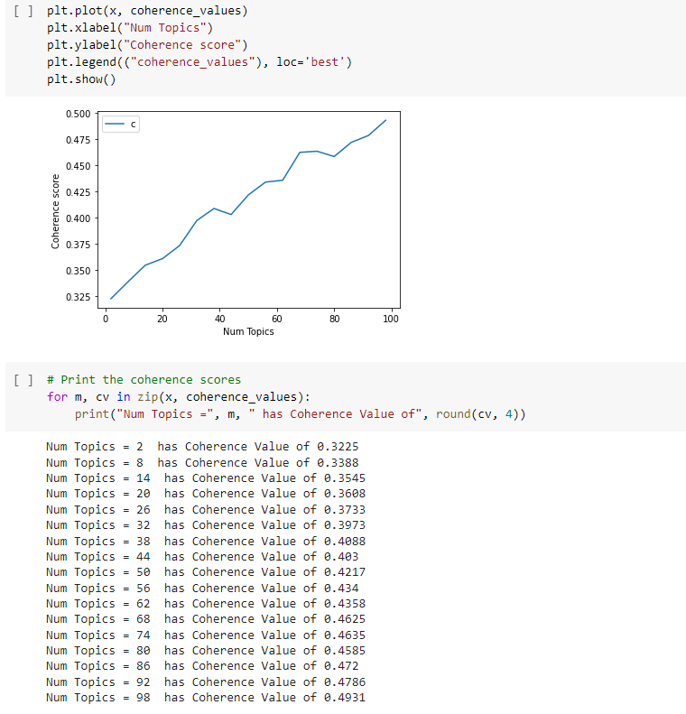
SSW 565
Observation:
Raising the number of subjects appears to improve the dataset's coherence, but this leaves us with little guidance on how many topics to choose.
11

Slide 12
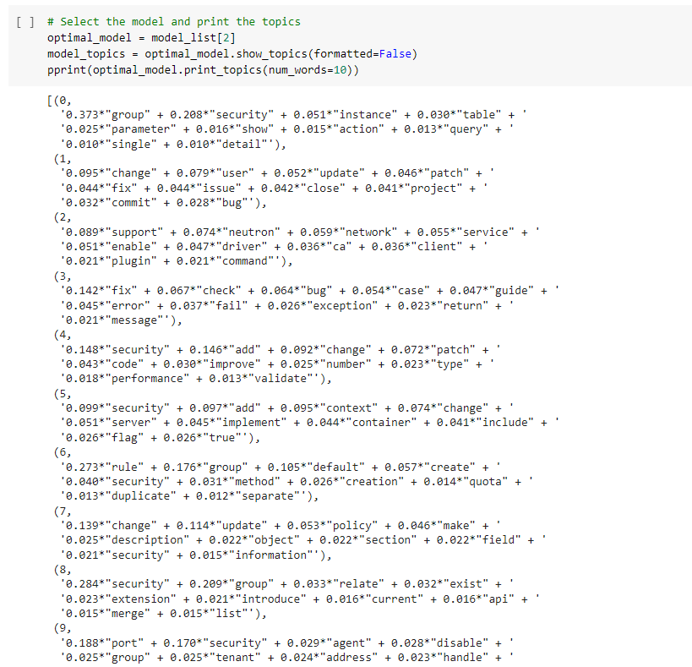
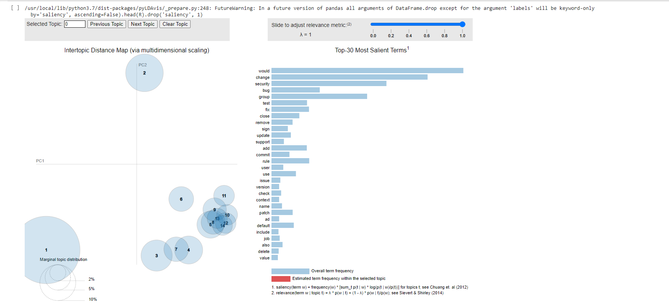
SSW 565
Caution:
Topic models can be difficult to interpret, which adds to the difficulties.
While some of the subjects make sense, others are difficult to comprehend
12
Notes:
Topic models can be difficult to interpret, which adds to the difficulties.
While some of the subjects make sense, others are difficult to comprehend

Slide 13
SSW 565
Step 4: Generating clusters from UMAP + HDBSCAN
4
1
Step 1: Selecting embeddings
Numerically represent the text
Clustering embeddings
Clustering is a well-known technique for resolving the difficulties with unsupervised learning. We’ll use it for evaluating performance, knowing the ground truth labels.
!
Step 2: Dimensionality Reduction
A problem with using the embeddings directly is that distance measures, such as Euclidean and Manhattan, needed for clustering become meaningless at such high dimensions.
Step 3: Selecting a clustering algorithm
Density-based algorithms are a good option here as they do not require specifying the number of clusters and are indifferent to cluster shape. Hierarchical Density-Based Spatial Clustering of Applications with Noise (HDBSCAN) has become popular since it has fewer and more intuitive hyperparameters than DBSCAN and is robust to variable-density clusters.
3
2
13
Notes:
Clustering is a well-known technique for resolving the difficulties with unsupervised learning. We’ll use it for evaluating performance, knowing the ground truth labels.
Convert the sentences into numeric data.
Using the embeddings directly as the distance measures would help us in grouping the commits. But clustering become meaningless at such high dimensions for Euclidean and Manhattan distances.
Density-based algorithms are a good option here as they do not require specifying the number of clusters and are indifferent to cluster shape. Hierarchical Density-Based Spatial Clustering of Applications with Noise (HDBSCAN) has become popular since it has fewer and more intuitive hyperparameters and is robust to variable-density clusters.
To make it easier to tailor to our current problem of intent extraction, we’ll instead directly use the UMAP and HDBSCAN packages for hyperparameter tuning..

Slide 14
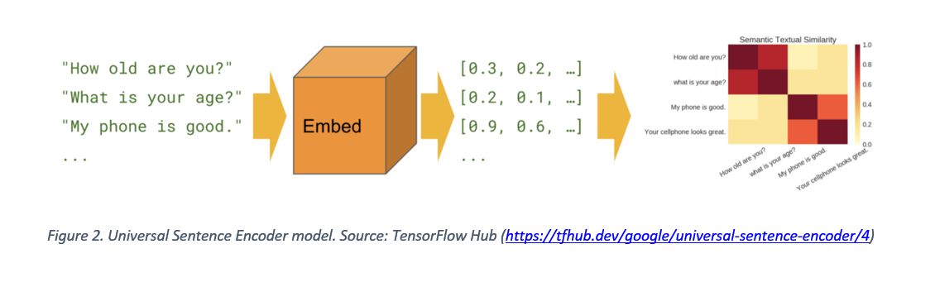
SSW 565
14
Notes:
Text embedding is important before creating any Deep Learning model in Natural Language Processing (NLP).
But What is the purpose of vectorizing text?
A vector is a collection of numbers in a single dimension. A vector of size 5 contains five numbers and can be thought of as a point in five-dimensional space. Two 5-dimensional vectors can be thought of as two points in a 5-dimensional space. As a result, based on the distance between them, we can compute how close or far those two vectors are.

Slide 15
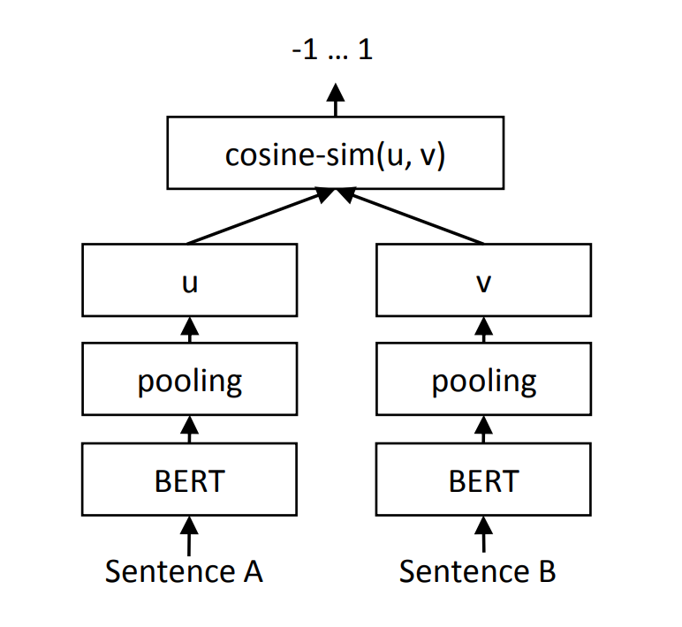
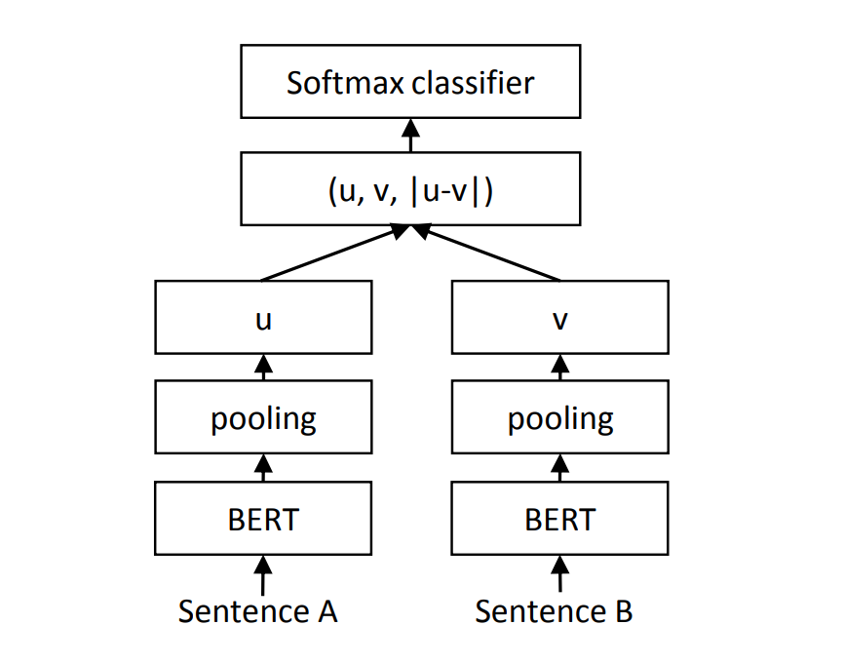
SSW 565
15
Notes:
Sentence-BERT is a “modification of the pretrained BERT network that use siamese and triplet network structures to derive semantically meaningful sentence embeddings that can be compared using cosine-similarity”.
A Siamese neural network (sometimes called a twin neural network) is an artificial neural network that uses the same weights while working in tandem on two different input vectors to compute comparable output vectors.
Cosine similarity measures the similarity between two vectors of an inner product space. It is measured by the cosine of the angle between two vectors and determines whether two vectors are pointing in roughly the same direction. It is often used to measure document similarity in text analysis.

Slide 16
SSW 565
Models used for comparison:
Universal Sentence Encoder
all-mpnet-base-v2
all-MiniLM-L6-v2
all-distilroberta-v1
paraphrase-MiniLM-L6-v2
16

Slide 17
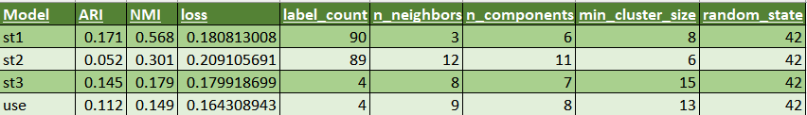
SSW 565
The Adjusted Rand Index (ARI) is frequently used in cluster validation since it is a measure of agreement between two partitions: one given by the clustering process and the other defined by external criteria.
Normalized mutual information (NMI) gives us the reduction in entropy of class labels when we are given the cluster labels. In a sense, NMI tells us how much the uncertainty about class labels decreases when we know the cluster labels. It is like the information gain in decision trees.
17
Notes:
The Adjusted Rand Index (ARI) is frequently used in cluster validation since it is a measure of agreement between two partitions: one given by the clustering process and the other defined by external criteria. In our case the first one is generated by the model and the second one is from my own labels.
Normalized mutual information (NMI) gives us the reduction in entropy of class labels when we are given the cluster labels. In a sense, NMI tells us how much the uncertainty about class labels decreases when we know the cluster labels. It is like the information gain in decision trees.

Slide 18
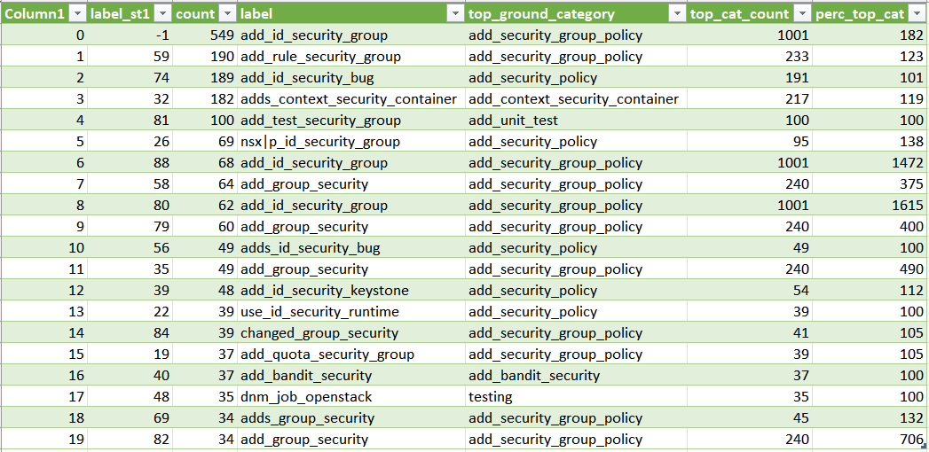
SSW 565
18

Slide 19
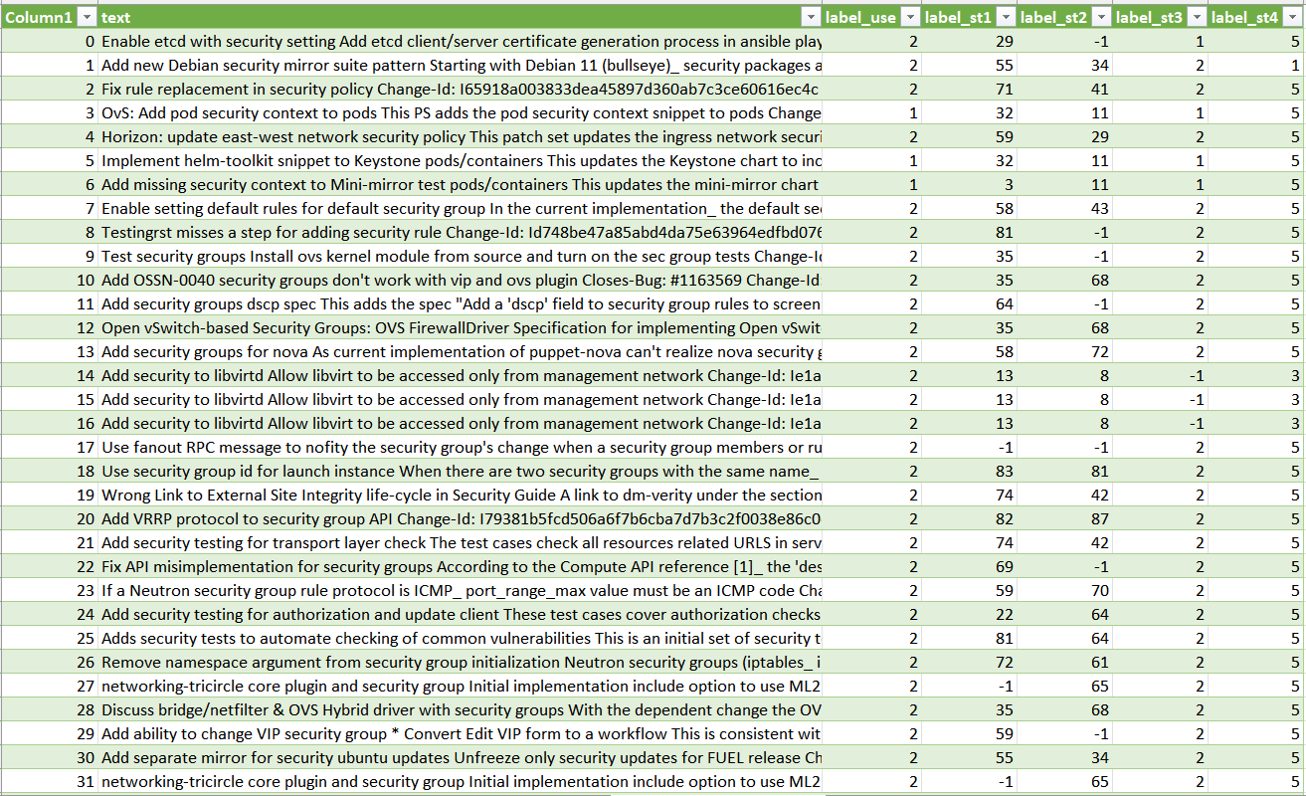
SSW 565
19

Slide 20
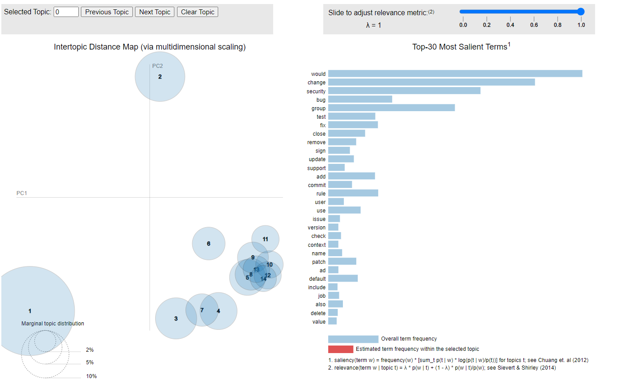
SSW 565
20
Notes:
LDA plot.
Latent Dirichlet Allocation (LDA): The term latent conveys something that exists but is not yet developed. In other words the topics that we want to extract from the data are also “hidden topics”

Slide 21
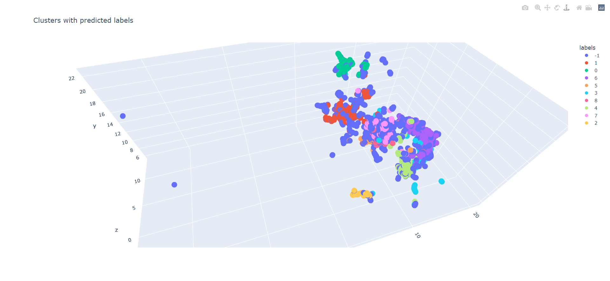
SSW 565
21
Notes:
Model generated cluster labels

Slide 22
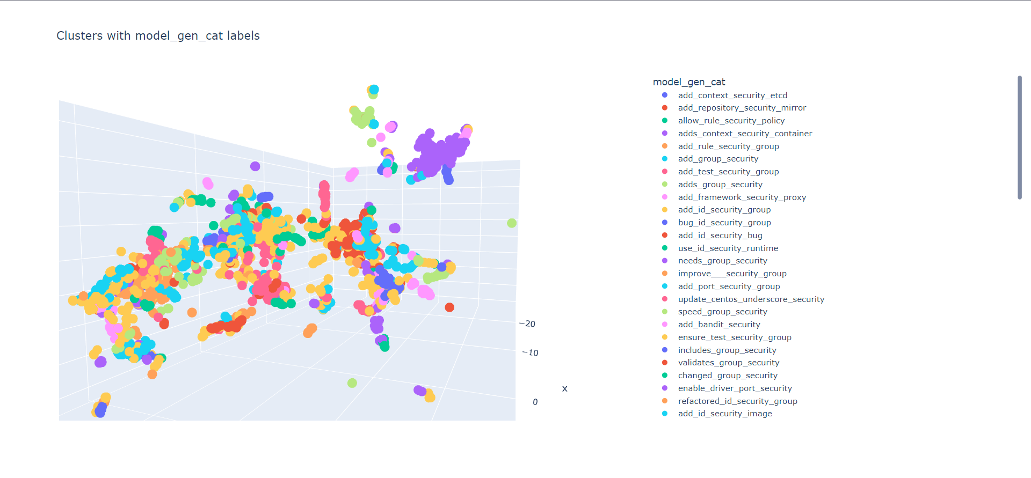
SSW 565
22

Slide 23
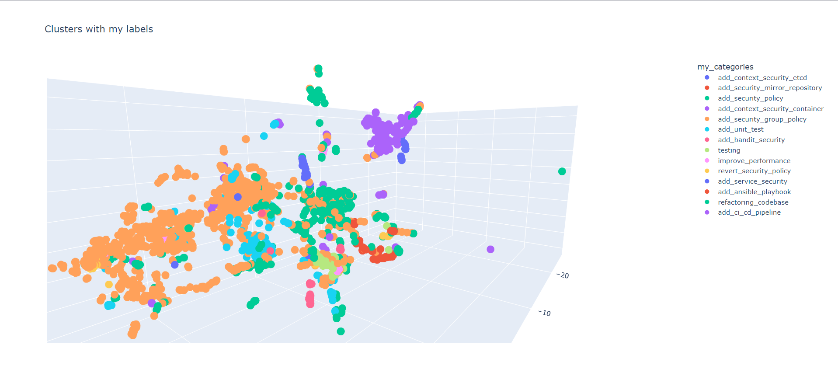
SSW 565
23

Slide 24
SSW 565
P2: Sentence of choice:
"updated the security mirror for the Debian repositories"
24

Slide 25
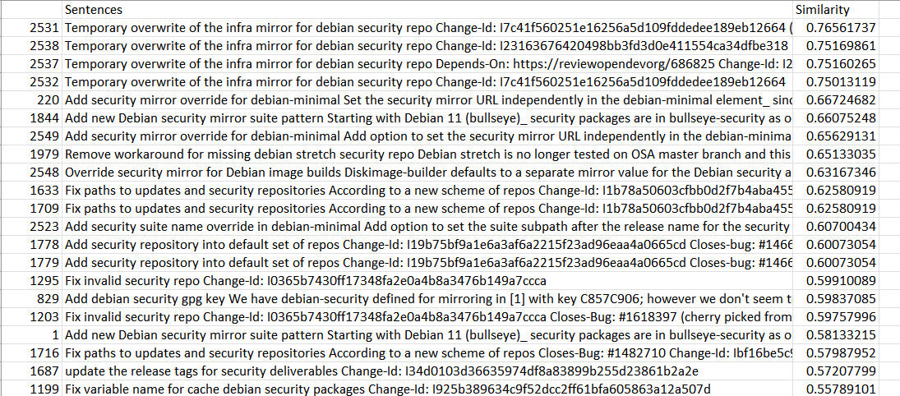
SSW 565
25

Slide 26
SSW 565
Conclusion:
We could apply classification models that do not require complex code analysis and are language agnostic by converting the challenge of categorizing code modifications to the problem of classifying a text containing natural language phrases.
While using a computationally less expensive model and using a much smaller training dataset, our strategy surpasses state-of-the-art approaches.
26

Slide 27

SSW 565
Thank you!
27

