Slide 1
Housing Price Prediction using Lasso Regression
Abhiram Raju (30)
Ishan Bhargava (05)
Jeevan RaviKumar (34)

Slide 2

Why do we need housing price prediction?
Assess the value of the property.
Identify investment opportunities.
Determine the impact of new housing laws
When to sell the house
Evaluate performance of real estate portfolio

Slide 3

Housing Dataset
Compiled by Kaggle.
Residential homes in Ames, Iowa
1460 observations and 81 explanatory variables.
Target variable is ‘sale_price’.

Slide 4
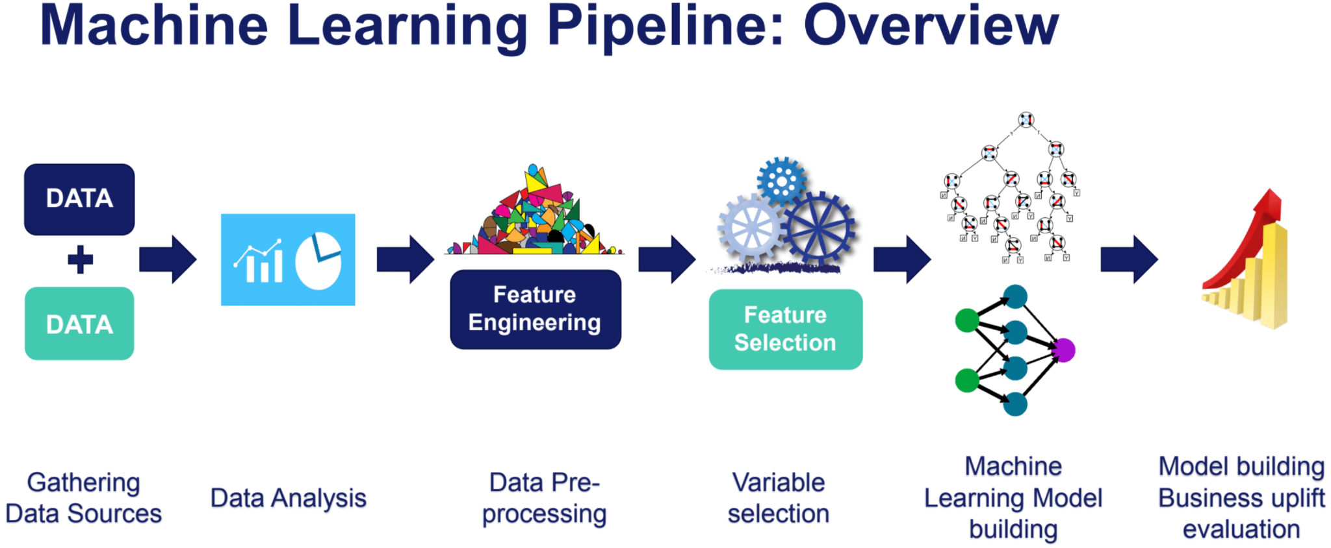
ML Pipeline

Slide 5
What are regularization techniques?
Why do we need it?

Slide 6
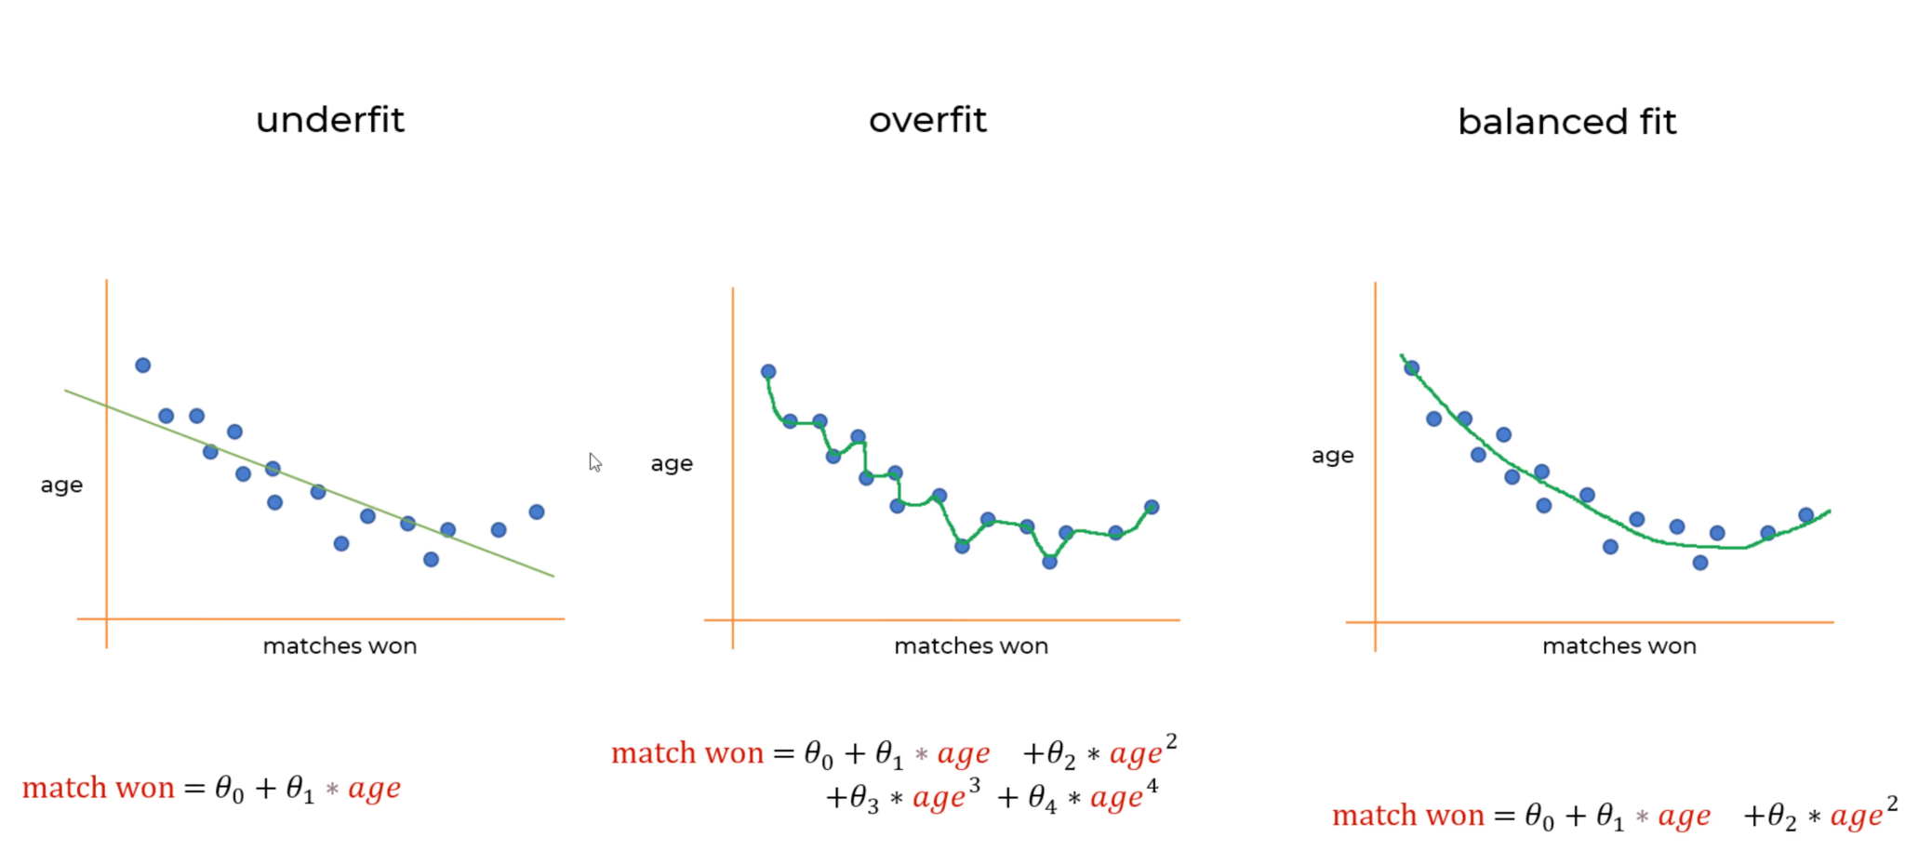

Slide 7
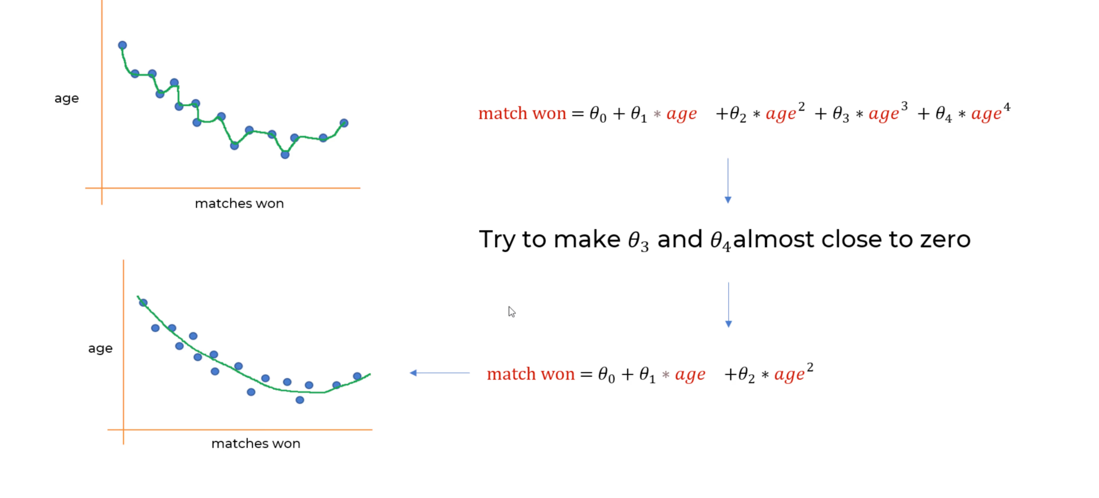

Slide 8
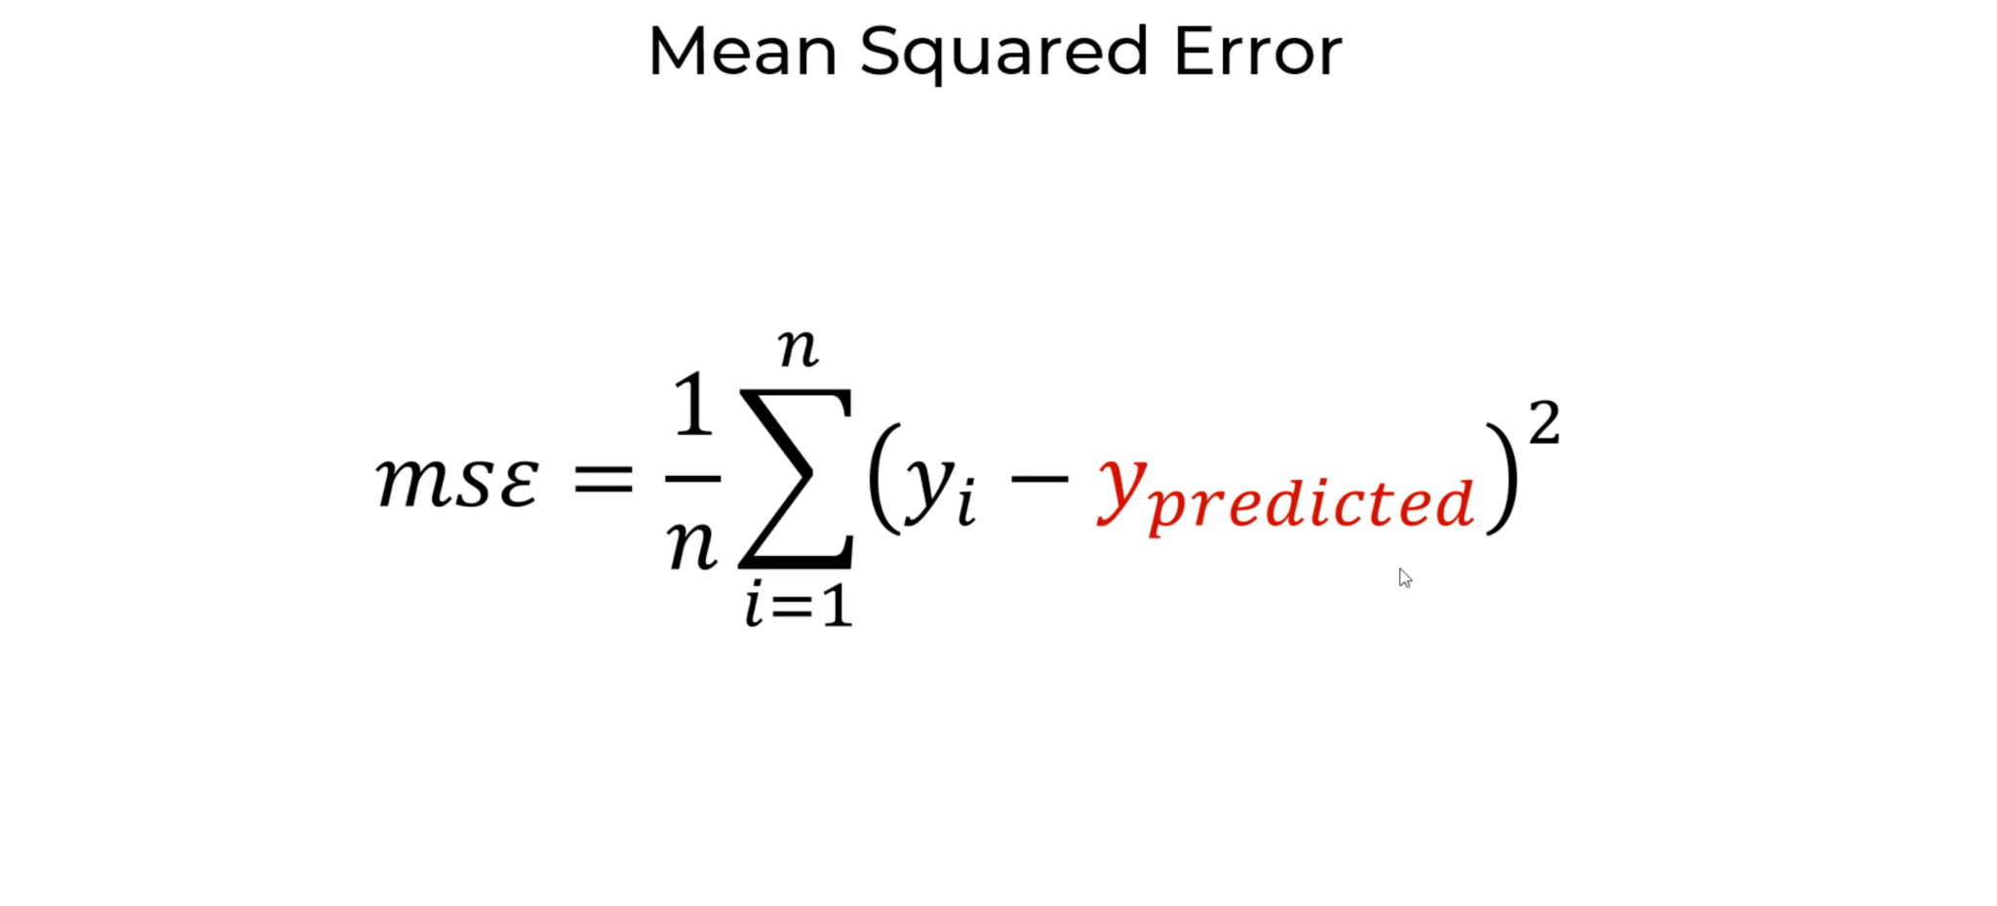

Slide 9
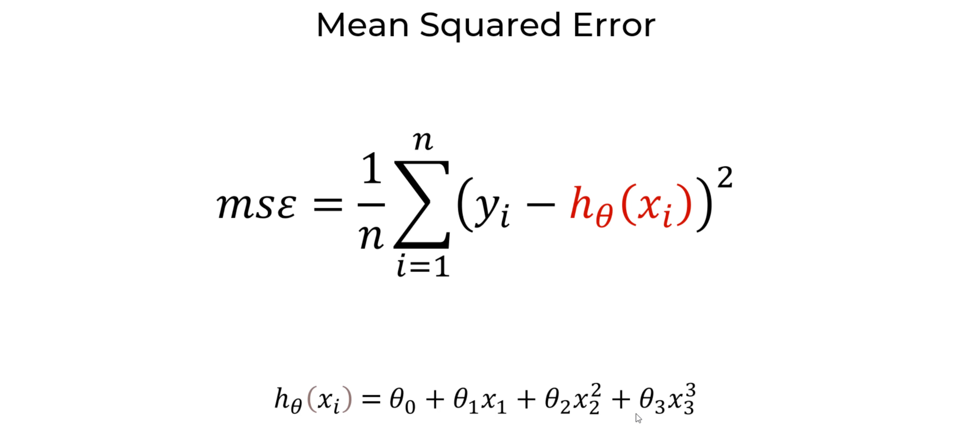

Slide 10
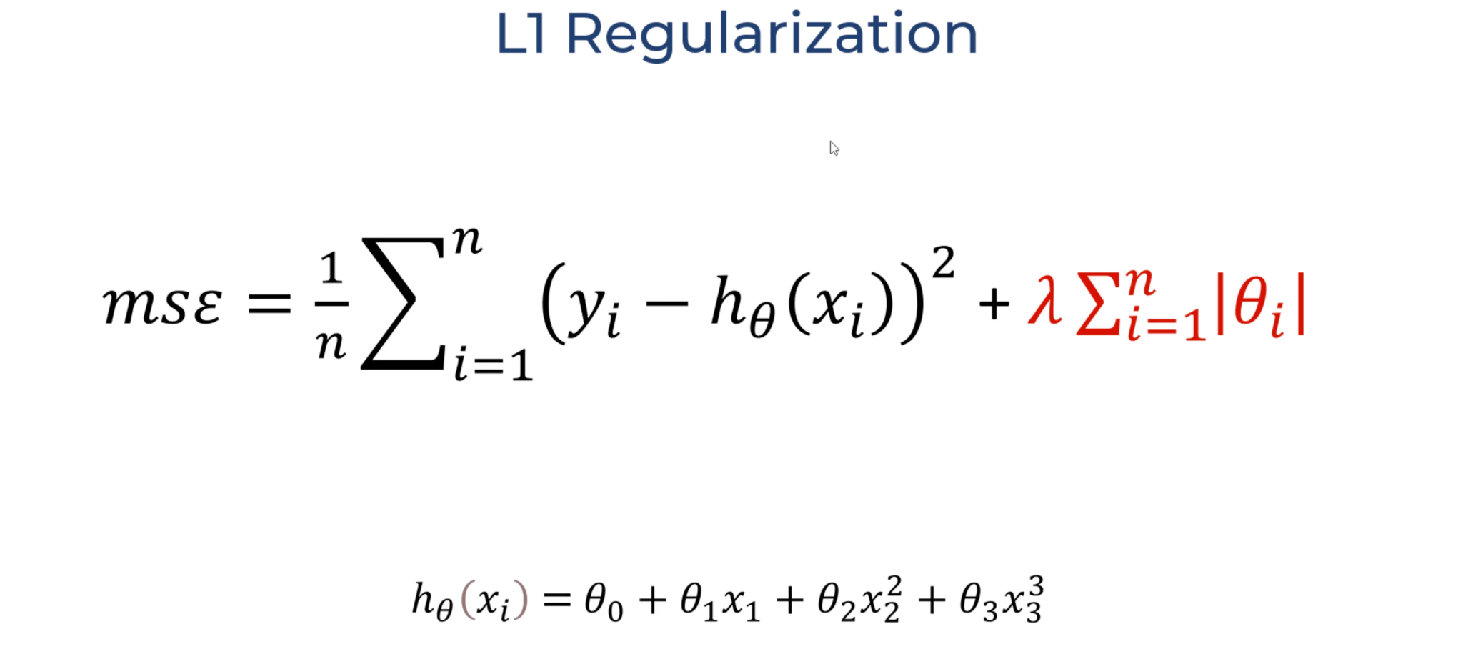

Slide 11


Slide 12

Feature Engineering
Preparing the data in desired form
Simplify and speed-up data transformation
Improve model performance

Slide 13
Missing values
Categorical variables
For >10% nulls = impute ‘missing’
For <10% nulls = impute mode
Numerical variables
Replace the missing values with mean and add a binary missing indicator
Temporal Variables - 4
Replace the years with the time elapsed between the four variables and YrSold

Slide 14
Numerical variable transformation
Logarithmic
Yeo - Johnson on LotArea
Categorical variable transformation
Apply mappings
Removing rare labels and encoding
Notes:
the Yeo-Johnson Power Transformation inflates low variance data and deflates high variance data to create a more uniform dataset. What sets the Yeo-Johnson Power Transformation apart however is the ability to transform data with negative numbers. First, the Y-J transform learns the best exponent to transform the variable from the train set. Next, we apply the transform to the test set with the same parameter
There are categorical variables which have classes of an assigned order based on quality. We will map each variable’s unique class with numerical levels corresponding to their order of quality.
all values of categorical variables that are shared by less than 1% of houses, well be replaced by the string "Rare".
this function will assign discrete values to the strings of the variables, so that the smaller value corresponds to the category that shows the smaller mean house sale price. order the categories in a variable from that with the lowest house sale price, to that with the highest.

Slide 15
Feature Scaling
MinMaxScaler - sklearn
Fit to train and transform the train and test
Feature Selection
SelectFromModel()
Lasso()
Narrowed to 36 from 81 variables
Notes:
First we specify the Lasso Regression model, and we select a suitable alpha (equivalent of penalty).The bigger alpha the less features that will be selected. then we use the selectFromModel object from sklearn, which will select automatically the features which coefficients are non-zero

Slide 16
References -
What is a Yeo-Johnson Power Transformation? | Ready Signal
Lasso Regression Explained, Step by Step (machinelearningcompass.com)
Complete Guide to Feature Engineering: Zero to Hero (analyticsvidhya.com)
House Prices - Advanced Regression Techniques | Kaggle
Regularization Part 2: Lasso (L1) Regression - YouTube

Slide 17
THANK YOU

Slide 18
Any Questions?

