Slide 1
A study in Pune City’s Population and food-services data.
Ishan daga

Slide 2
Introduction
Pune is a fast-growing and upcoming metropolitan city in Maharashtra, India. It is well known as the cultural capital of the state and the de-facto king of the region’s Street food.
Owning a joint in the city is a sure shot form of a stable income, even if it were only a food-truck, the people of the city take to fresh ideas quite well and the street-food culture has only added to itself over the years.
This is a serious business and requires careful planning and consideration on the part of the investor/stakeholder to ensure maximum profits from the business.

Slide 3
Business Problem
If a business would like to open a restaurant/brewery/pub/fast food joint in the city, what would be the optimal place to open said service in order to receive maximum revenue/foot-fall?
Future & prospective Food service/restaurant owners and stake holders should get a clear picture of the city’s habits and the population density in order to open a new place in a suitable locality.

Slide 4
Data
Population Data by Wards (Neighborhoods)
Ward Offices Map Vector Data (GeoJSON and Shape Vectors)
Location-wise Venue data for each sub-locality in Pune
Latitude and Longitude Location Data of Wards and Venues
The Population Data was pulled from the Pune Municipal Corporation’s opendata webpage
http://opendata.punecorporation.org/Citizen/CitizenDatasets/Index
The Location data for the Wards was pulled using the Google Maps Geocoding API sequentially and added to the dataframe.
The venue data was procured using the FourSquare API, which boasts millions of community contributions and is used by 100,000+ developers world-wide.

Slide 5
Methodology
CSV Processing for Population Data and Ward Names
Location Data from Google Maps GeoCoding API
Folium and GeoPandas for Visualization
Venue Data from FourSquare API
Get only Food-related venues and group by frequency of occurrence using One-Hot
Clustering is performed using optimized k-means
Visualize Clusters.

Slide 6
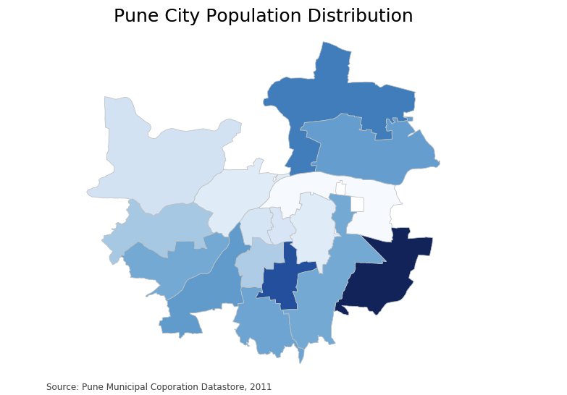
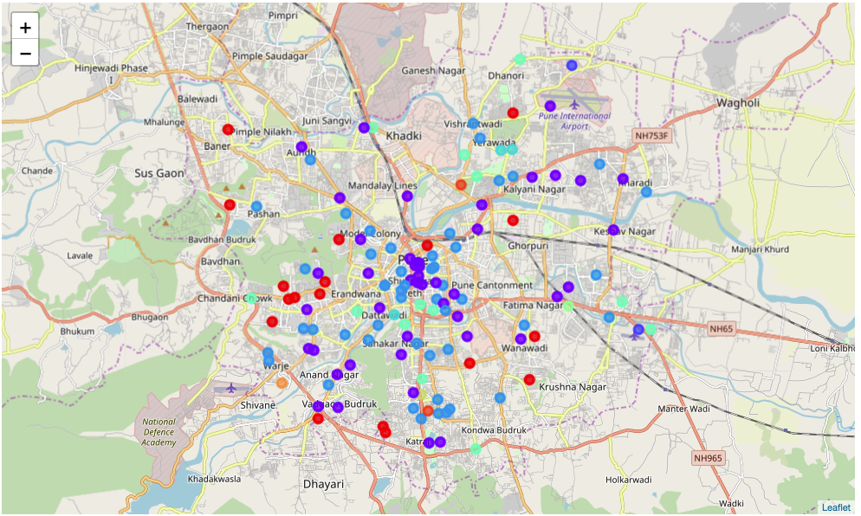
Results – Visualization
Choropleth of Population Data
Clustered venues on Pune Map

Slide 7
Results
The results from the k-means clustering can be interpreted as follows:
Cluster 1,2,3: Colored in Purple [1], Blue [2] and Red [3], in descending order: High presence/density of Food-related venues.
Remaining clusters: Moderate to low presence of the industry.
This, over-layed with the Choropleth Map can give us a clear-cut picture of the optimal place to open a new café/bar, where to station a food truck and the best areas for restaurants.

Slide 8
Discussion and Recommendations
Comparing the two final maps of the Population Choropleth and k-means clustered venues, it is clear that the Hadapsar constituency has the most place available for growth.
Second in line would be the Pune Airport Ward, under the Viman Nagar Ward Office, whose population is 2nd highest, with a purple and a blue [high presence/popularity] of food-venues.
If the business wishes to be a trail-blazer and set a new trend/ experiment with an area with relatively less exposure, but a decent population to support the business, the Aundh-Baner constituency shows promise with 2-3 high profile locations in a relatively large area, which would be appropriate as competition in the locations would be significantly lower, compared to the center of the city with the highest concentration of food-related venues and a moderate population.

Slide 9
Conclusion
Answer to Problem : Cluster 1,2,3 are well established venues and most venues around them tend to flourish too.
Aundh/Baner is the best option for a business looking to be a trail-blazer and exploit untapped areas.
Conclusions drawn here are bound to help stakeholders make well informed decisions.

Slide 10
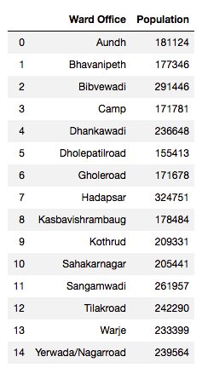
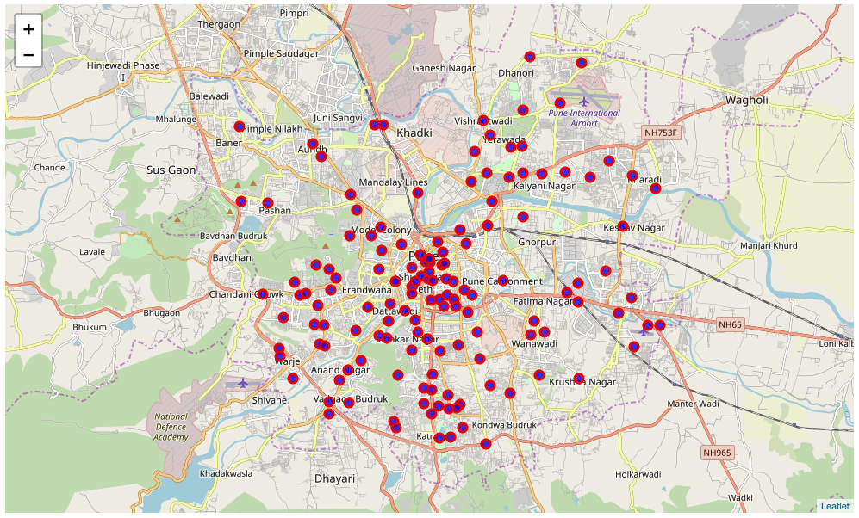
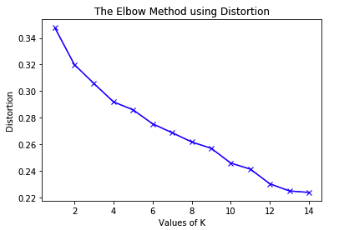
Thank You!

