Slide 1
Computational solution to achieve sustainable development goals
Village management system
Himanshu Singh
Gyanendra Gaurav
Ishan Grover

Slide 2
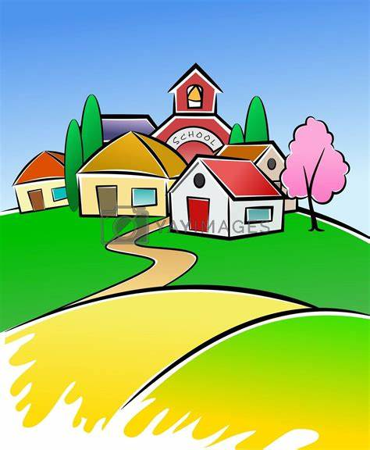
Village management system
Our project will be focusing on the following topics:
Soil report
Irrigation system
Tube well and Solar energy System
Auto Street Light System

Slide 3
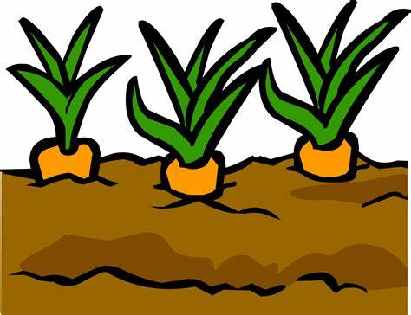
Soil Report
The system will take necessary soil parameters that are texture and colour of the soil.
After analysing the inputs, soil report comes with specifications of pH, nutrient levels in the soil, amount of water and fertiliser required etc.
This result can be used by the farmers to increase the yielding of crops with better efficiency through effective irrigation.

Slide 4
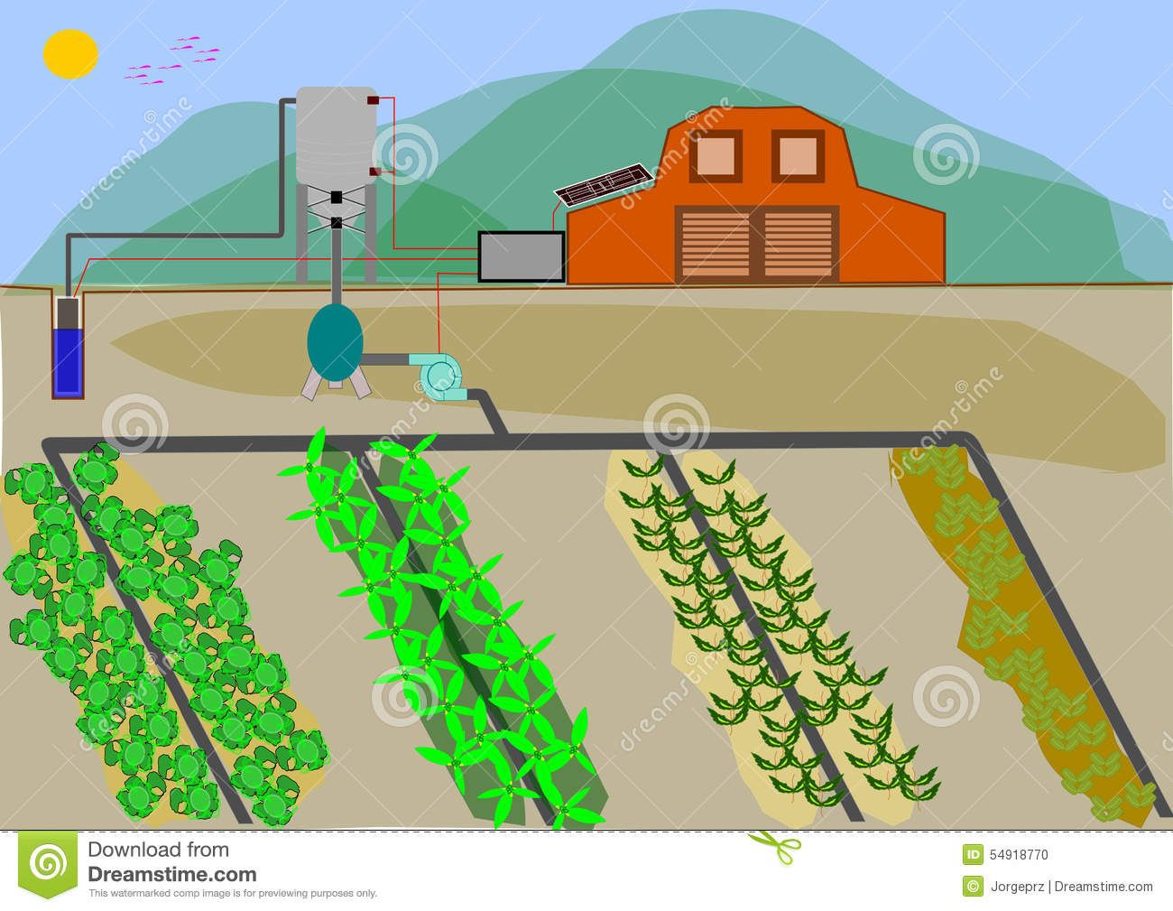
Irrigation System
By using the soil report, the system will know when the crops need the water supply.
It will also calculate what amount of water and fertiliser is required to be supplied to the fields.
It will draw the water from tubewell for the process of irrigation.

Slide 5
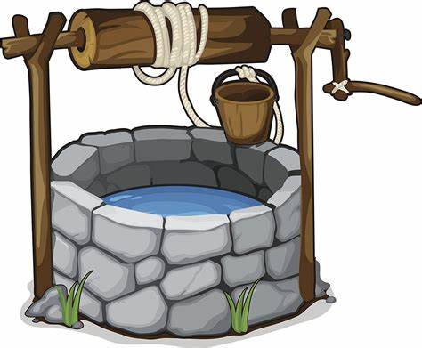
Tube well System powered by Solar Energy
This system will detect for if the level of water is low in tube well, pumps will turn on automatically and refill the tube well.
The tube well will be refilled by the underground water using centrifugal pumps which will be powered by solar energy.
When the batteries supplying current to pumps discharge, it automatically gets charged by solar energy system.

Slide 6
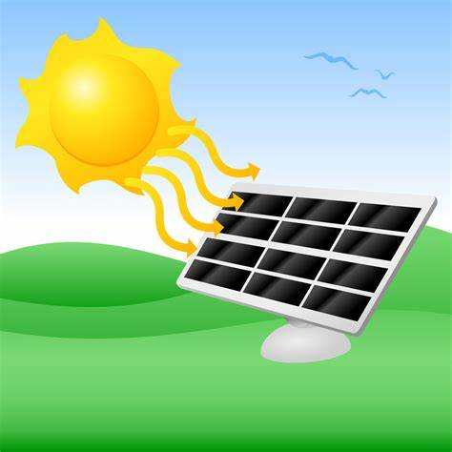
Auto Street Light System
This system is really helpful to the villagers as street lights automatically turn on during the night time and lighten the streets.
Similarly, it turns off during the day time and starts charging itself through solar energy
The input of time will be given by computer automatically and no human interference will be required.

