Slide 1
Domain-Adapted Intelligence on Commodity Hardware
CONFAI 2026 | APPLIED GENERATIVE AI TRACK
SYSTEM ARCHITECTURE
User query or drafting instruction
Intent router: statutes to LOCAL, general to WEB
Dense search
99,243 Act sections
Dense search
5.5M judgment chunks
BM25 lexical
exact citations
Rank-Stabilized LoRA with Federated Hybrid Retrieval
Cross-encoder rerank: top-20 to top-6
Qwen3-VL-8B-Legal (RS-LoRA)
4-bit NF4, 5.96 GB VRAM on RTX 5060
50,000 RS-LoRA fine-tuned pairs | 5.6M federated chunks | Autonomous tool-using agent
Cited answer
grounded in 6 chunks
Agent tools
calculator, .docx export
Plaksha University
THE CHALLENGE: HIGH-STAKES INDIAN JURISPRUDENCE
Statutory precision
2024 legal overhaul
Data privacy
Hardware access
Courts penalize hallucinated citations, yet foundation models invent sections, acts and precedents.
IPC, CrPC and the Evidence Act became BNS, BNSS and BSA. Commercial LLMs lack post-enactment awareness.
Sending case briefs to proprietary cloud APIs risks attorney-client privilege and privacy standards.
Full-parameter models need costly clusters. This work runs an 8B model in under 6 GB VRAM.
Notes:
Indian courts strictly penalize hallucinated citations. In 2024 India replaced the IPC, CrPC and Evidence Act with the BNS, BNSS and BSA. Sending sensitive case briefs to cloud APIs violates attorney-client privilege. Full-parameter models require multi-million-dollar clusters; this work enables domain-adapted 8B inference on commodity 8 GB consumer GPUs (under 6 GB VRAM).

Slide 2
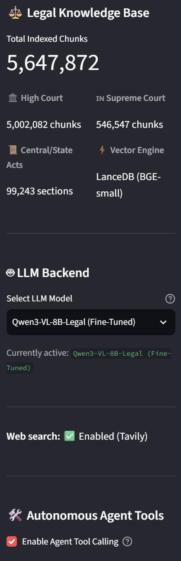
Dual corpus: 50K pairs and 5.6M chunks
DATASET ENGINEERING AND PREPARATION
Supervised fine-tuning corpus
Federated RAG knowledge base
Streamlit sidebar: corpus status and controls
192,000
50,000
5,647,872
raw pairs
curated pairs
indexed legal chunks
Filtered to sequences of 4,096 tokens or fewer
Prefix-hash deduplication pruned 142K redundant or garbled records
Split: 47,500 train, 2,500 validation, 100 unseen test, with zero prompt overlap
Prompt tokens masked (label -100); gradients update only on response tokens
5,002,082
High Court: Bombay, Delhi, Allahabad, Calcutta
546,547
Supreme Court, 1950 to 2025
99,243
Bare Act sections, indexed by Act, Chapter and Section
5.6M passages indexed, fine-tuned 8B model active, Tavily web fallback and agent tools enabled.
LanceDB with 384-dim BGE-small dense embeddings
BM25 index for exact statutory matches
Notes:
Source: Indian Legal Dataset v3. Train 147 MB, validation 8 MB. Sparse index targets citations such as Section 138 NI Act and Order 39 CPC.

Slide 3
RS-LoRA: parameter-efficient domain adaptation
FINE-TUNING METHODOLOGY
Training configuration
THE MATHEMATICS
Adapter forward pass
~32M
7
h = W0·x + γ·(BA)·x
B (d×r) is zero-initialized; A (r×k) is Gaussian-initialized.
trainable parameters
adapted projections
Rank-stabilized scaling
Attention: Wq, Wk, Wv, Wo. MLP: Wgate, Wup, Wdown
99.2% of base weights stay frozen
Plaksha HPC cluster, NVIDIA RTX PRO 6000 Blackwell (MIG 2g.48gb, 48 GB VRAM)
bfloat16, AdamW, cosine LR schedule with warmup
γ = α / √r
Standard LoRA uses α / r, which collapses gradient variance at higher rank. At r = 32, α = 64: γ ≈ 11.31.
Training loss
L = −(1/M) Σ log Pθ(yt | X, y<t)
Cross-entropy over legal response tokens only; prompt tokens are masked.
1.34 → 0.72
Evaluation loss fell from 1.34 to 0.72

Slide 4
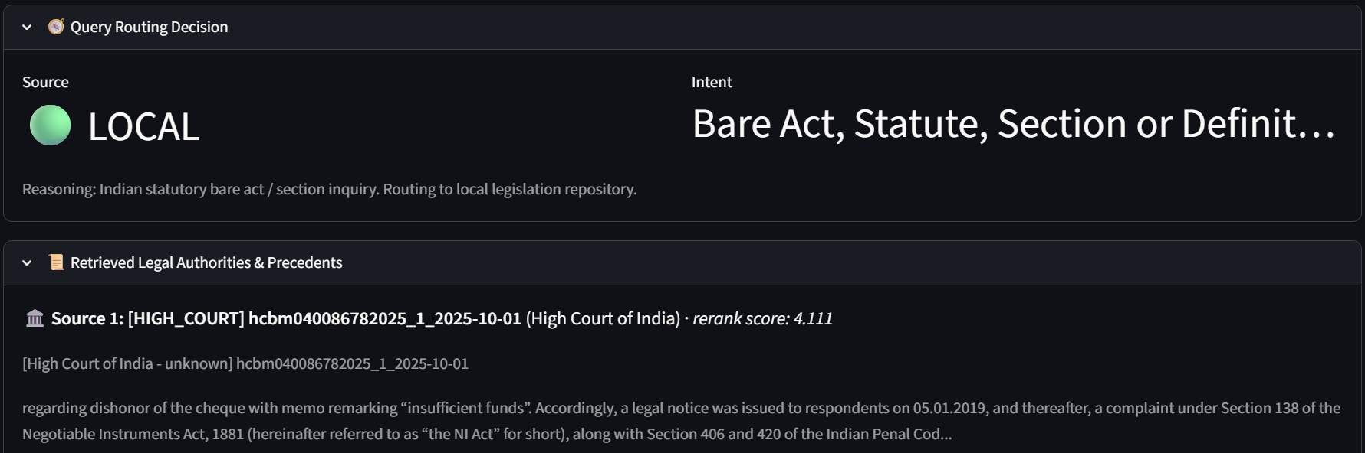
Four-stage hybrid retrieval pipeline
FEDERATED RETRIEVAL ARCHITECTURE
1
Intent router
2
Dense retrieval
3
Sparse retrieval
4
Cross-encoder reranking
Regex heuristic (0 ms) sends general queries to WEB and statute lookups (Section, Article, Order) to LOCAL. An LLM fallback resolves ambiguous queries in under 300 ms.
LanceDB columnar store searches 5.6M passages using 384-dimensional BGE-small embeddings.
BM25 inverted index captures exact citations such as Section 138 NI Act and Order 39 Rule 1 CPC, preventing semantic drift.
ms-marco-MiniLM-L-6-v2 scores full cross-attention over query-candidate pairs instead of bi-encoder cosine approximations.
Dynamic web fallback
If the top local rerank score is below the 0.5 logit threshold, a live Tavily search fetches current gazettes and legal events.
Routing decision and retrieval inspector

Slide 5
Benchmark: 100 strictly unseen legal questions
EMPIRICAL EVALUATION BENCHMARK
All models evaluated on HPC node cn02 in bf16, except Gemini (cloud API).
Model | PPL (↓) | Loss (↓) | ROUGE-2 (↑) | BLEU-4 (↑) | Cit. Recall (↑) | Cit. F1 (↑) | Speed (↑) | Latency (↓) | Peak VRAM
Qwen3-VL-4B (Base) | 3.84 | 1.3442 | 9.33% | 2.74 | 81.11% | 75.97% | 63.2 t/s | 3.16s | 10.70 GB
Qwen3-VL-4B (1-Ep LoRA) | 2.16 | 0.7702 | 14.85% | 4.57 | 78.34% | 79.94% | 33.0 t/s | 5.48s | 10.94 GB
Qwen3-VL-4B (2-Ep LoRA) | 2.14 | 0.7592 | 14.54% | 4.34 | 78.52% | 76.60% | 32.5 t/s | 5.62s | 10.94 GB
Qwen3-VL-4B (4-Ep LoRA) | 2.23 | 0.8011 | 14.57% | 4.42 | 78.71% | 76.95% | 32.1 t/s | 5.64s | 10.94 GB
Qwen3-VL-8B (Base) | 3.63 | 1.2884 | 9.52% | 2.90 | 80.17% | 76.19% | 41.1 t/s | 4.84s | 18.77 GB
Qwen3-VL-8B (Fine-Tuned) | 2.06 | 0.7214 | 13.98% | 4.11 | 74.51% | 74.60% | 32.5 t/s | 5.55s | 19.09 GB
Gemini 3.7 Flash | N/A (API) | N/A (API) | 10.91% | 2.87 | 85.06% | 79.18% | 41.4 t/s | 3.97s | 0.00 GB
−44.3%
+59.2%
+66.8%
Perplexity: 3.84 to 2.14 (4B), 3.63 to 2.06 (8B)
ROUGE-2: 9.33% to 14.85% (4B), 9.52% to 13.98% (8B)
BLEU-4: 2.74 to 4.57 (4B), 2.90 to 4.11 (8B)
Notes:
Domain fine-tuning anchors statutory determinism and captures legal bigrams (anticipatory bail, Section 138, prima facie). The Gemini API failed with host resolution errors on the isolated compute node, which illustrates why local, on-premise deployment is necessary.

Slide 6
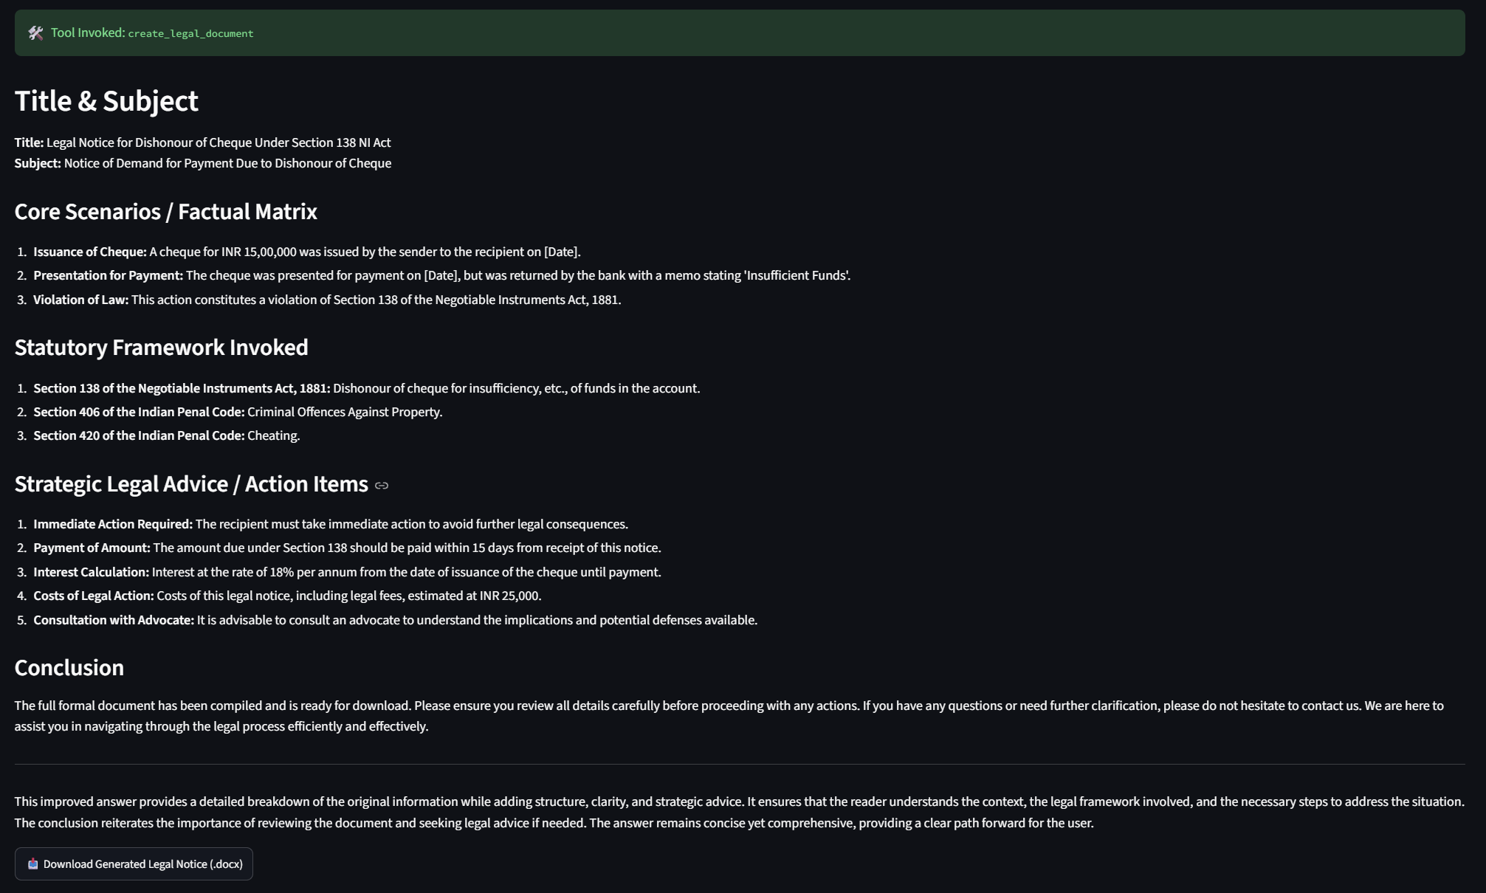
Autonomous agent and Word compilation
AGENTIC SYNTHESIS AND DOCUMENT COMPILATION
Reasoning separated from rendering
Deterministic calculator
Computes damages, Section 34 CPC interest (18% p.a.) and limitation timelines with exact arithmetic.
The LLM reasons over statutory evidence and emits structured JSON tool calls. Rendering and arithmetic run outside the model.
Word document compiler
Supported formats
Exports multi-page .docx files with court letterhead, chronological facts, statutory sections and advocate signature blocks.
Legal Notice of Demand, Legal Opinion, Case Brief and Legal Assessment Report.
5.96 GB
Measured peak VRAM running the full 8B model on an 8 GB RTX 5060 laptop GPU, using 4-bit NormalFloat (NF4) double quantization.
Tool call output and one-click Word download

Slide 7
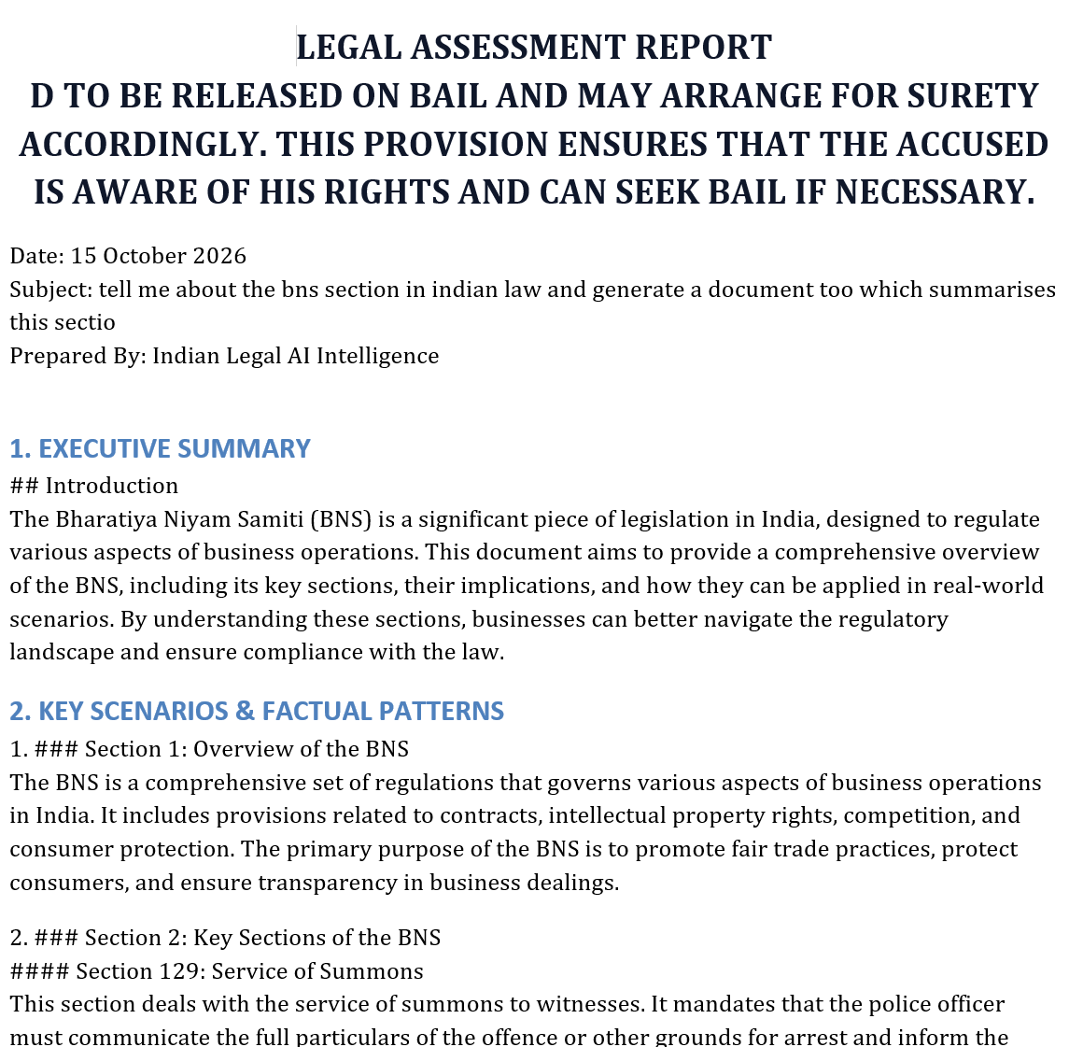
End-to-end demo, impact and roadmap
DEMO WALKTHROUGH AND FUTURE VISION
Case study walkthrough
Impact
Generated legal notice
1
Prompt Draft a legal notice for dishonour of an INR 15,00,000 cheque under Section 138 NI Act.
Private by design: no client data leaves the machine, preserving attorney-client privilege
Accessible: 8B multimodal reasoning on an 8 GB laptop GPU
Grounded: citations drawn from 5.6M passages, curbing hallucinated sections
2
Route Intent classified as STATUTE / LOCAL in 0 ms.
3
Retrieve Sections 138 and 141 NI Act, plus Dashrath Rupsingh Rathod (Supreme Court).
Roadmap
4
Compute Section 34 CPC interest at 18% p.a. gives a total claim of INR 17,70,000.
Multi-agent judicial simulation: judge and advocate debate for trial strategy
Vernacular expansion: Hindi, Marathi, Bengali and Tamil high court records
5
Generate Formatted .docx saved to generated_documents/.

