Slide 1

Airline Passenger Satisfaction
Presenter: Ishan Kuchroo
Date: 4th May 2022

Slide 2

Introduction
Analyze the customer satisfaction survey data for an airline by applying various visualization techniques, to:
Identify factors that are highly correlated to a satisfied (or dissatisfied) passenger
Give the airline an opportunity to improve their services

Slide 3
Data Overview
25 columns
6 numeric
19 categorical
103904 rows
Target – “satisfaction”

Slide 4
Exploratory Data Analysis
In this section, we’ll cover:
Pre-Processing data
Correlation Matrix
Outlier Detection
Principal Component Analysis
Normality Test

Slide 5

Pre-Processing
Removing ID columns from the data
Columns "id“ and " Unnamed: 0“ from dataframe. This done because their value varies from one sample to another, they are irrelevant to any useful pattern and have no predictive power over the target.
Remaining numeric columns = 4
Removing NAN values:

Slide 6
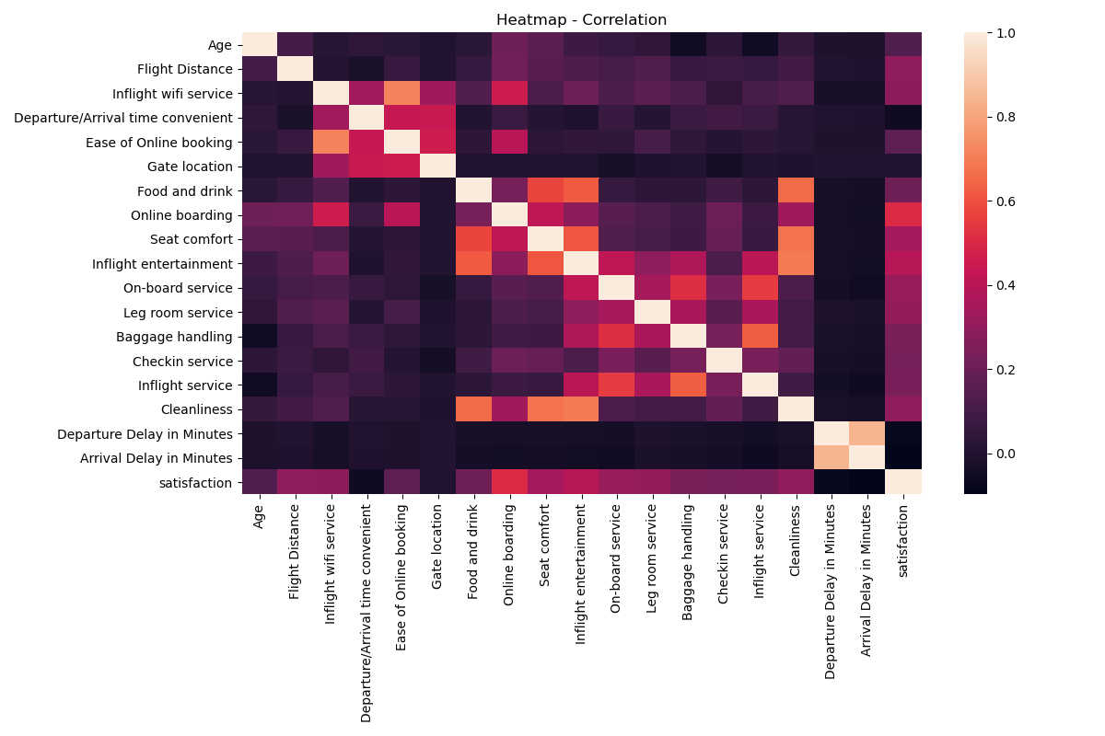
Correlation Matrix

Slide 7
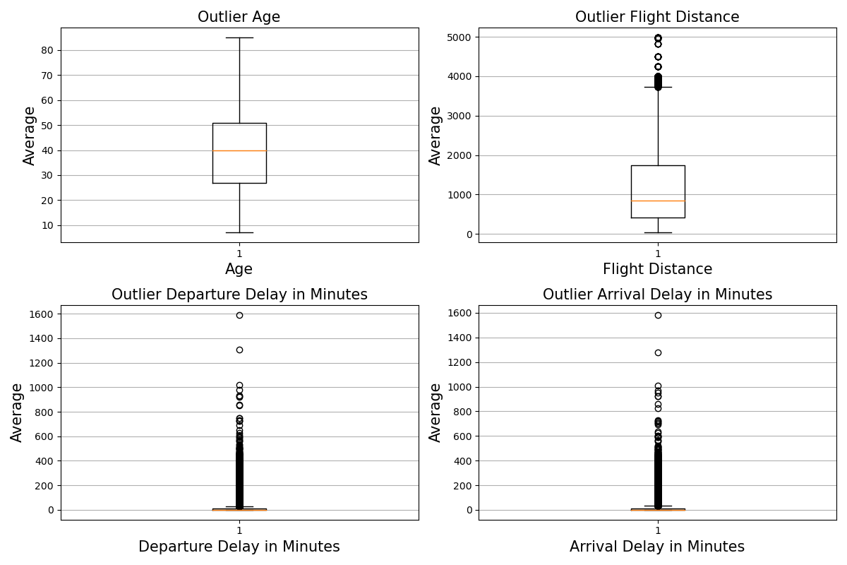

Outlier Detection
Inter-Quartile Range (IQR) method to detect and remove outliers
4 numeric columns
Flight Distance, Departure Delay and Arrival Delay have outliers
Age does not have outliers
Removal
If a value is greater than up_lim, we impute the said value with up_lim. If it is less than low_lim, then we impute the value with low_lim

Slide 8
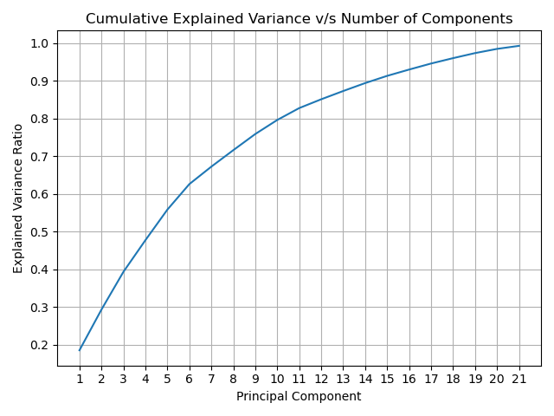
Principal Component Analysis (PCA)
Dimensionality reduction technique
Goal: To find a smaller number of components to explain as much of the variance possible
Deal with multi-collinearity in our dataset
15 components can explain more than 90% of the variance in our data

Slide 9
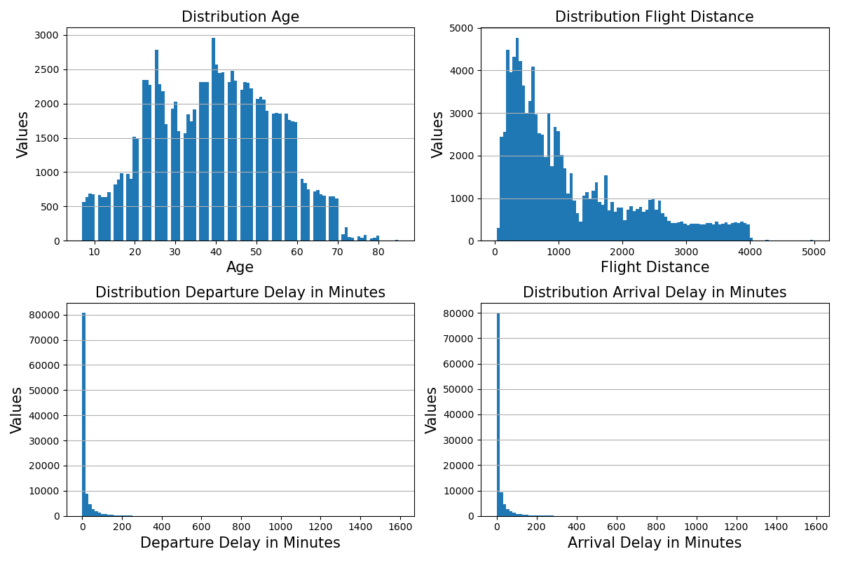
Normality Checks
Normality refers to a statistical distribution called a normal distribution, or sometimes the Gaussian distribution or bell-shaped curve is a symmetrical continuous distribution defined by the mean and standard deviation of the data.
We will be testing for normality on the numeric columns in our data

Slide 10
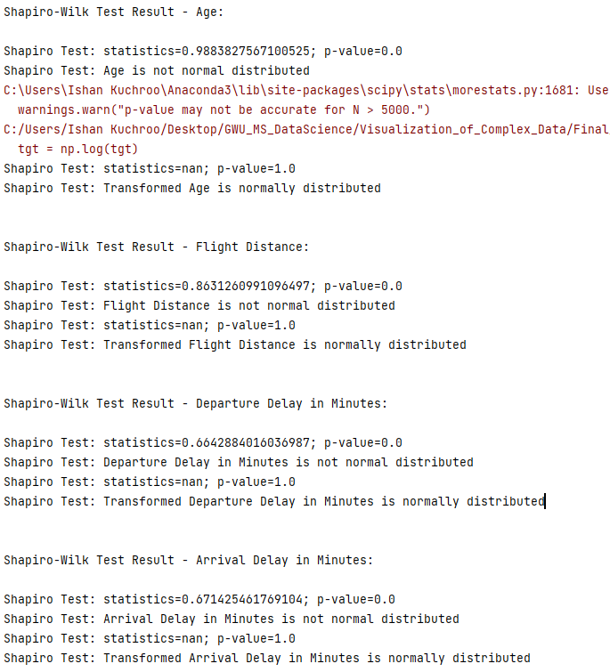
Normal Transformation - Summary
As seen from the results, the data was not normally distributed.
We used stats.norm.ppf followed by a log transformation to make the data normally distributed.

Slide 11
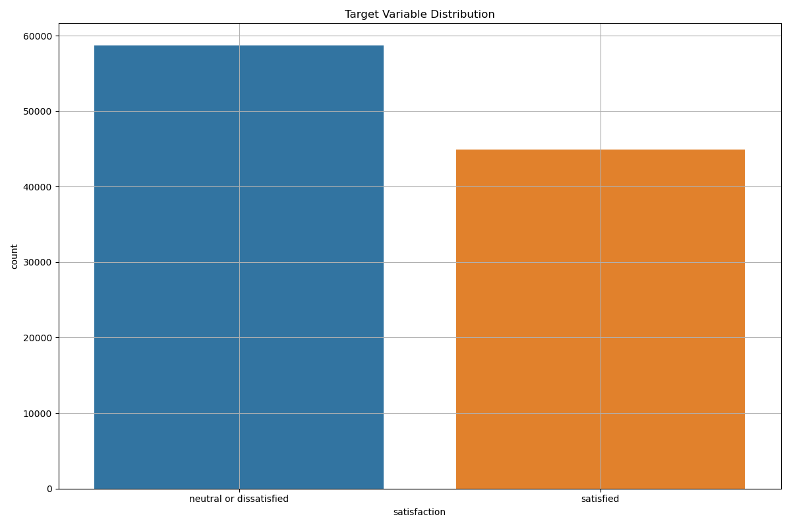
Target Variable Analysis
Mostly customers are not satisfied with the airline

Slide 12

Customer Satisfaction Factors

Slide 13
Feature Overview
Features have been split into following categories:
Customer Demographics
Pre-Boarding Factors
On-board Factors
Post-flight Factors
Customer demographics will be used to understand how pre-boarding, on-board and post-flight factors impact the overall “satisfaction” of a customer.
Assumption: A higher rating of each factor contributes to a “satisfied” customer

Slide 14
Customer Demographics
Gender
Class of Travel
Type of Travel
Customer Type
Age

Slide 15
Pre-Boarding Factors
Ease of Online booking
Gate Location
Online Boarding
Check-in Service
Departure Delay
Departure/Arrival Time Convenient

Slide 16
Ease of Online Booking
Around 20% customers are not happy with the service
Mostly “Average” or “Good” reviews are given

Slide 17
Gate Location
Most customers have rated the Gate Location “Good” and overall more than 60% are happy with it.
Female customers have given more reviews in every category

Slide 18
Online Boarding
Very positive factor for the airline. 70% of customers have given a positive feedback for this service.
Airlines loyal customers have given more reviews.

Slide 19
Check-in service
Customers are largely happy with the check-in service

Slide 20
Departure Delay
Independent of demographics
No significant impact visible on overall customer satisfaction

Slide 21
Departure/Arrival Time Convenient
Largely customers seem happy with the timings of the flight
1/5th of customers are not happy with flight timings

Slide 22
On-Board Factors
Inflight wi-fi service
Food and drink
Seat comfort
Inflight entertainment
On-board service
Leg room
Inflight service
Cleanliness

Slide 23
Inflight Wi-fi
Inflight wi-fi service seems to have received largely “average” reviews.
Close to 20% don’t find the wi-fi fast enough.

Slide 24
Food and Drinks
Food and drinks facilities offered is very highly rated with over 60% customer liking the service
Only 12% of “bad” reviews

Slide 25
Seat Comfort
Mostly customers are happy with the seat comfort, especially business class passengers.
Customers from economy class are leading the “bad” or “average” rating

Slide 26
Inflight Entertainment
A highly rated service with mostly happy reviews (~70%)

Slide 27
On-board Service
More than 75% of customers have given a high rating for airlines on-board service

Slide 28
Leg room
Plenty of leg-room on the airline
Economy class passengers have also rated the leg-room very highly

Slide 29
Cleanliness
Flight cleanliness is very high rated
Lot of economy class passengers have rated “bad” or “average”

Slide 30
Post-flight Factors
Baggage handling
Arrival Delay

Slide 31
Baggage Handling
Great reviews about baggage handling by the airline

Slide 32
Arrival Delay
Dependent on Departure Delay
Independent of demographics
No significant impact visible on overall customer satisfaction

Slide 33
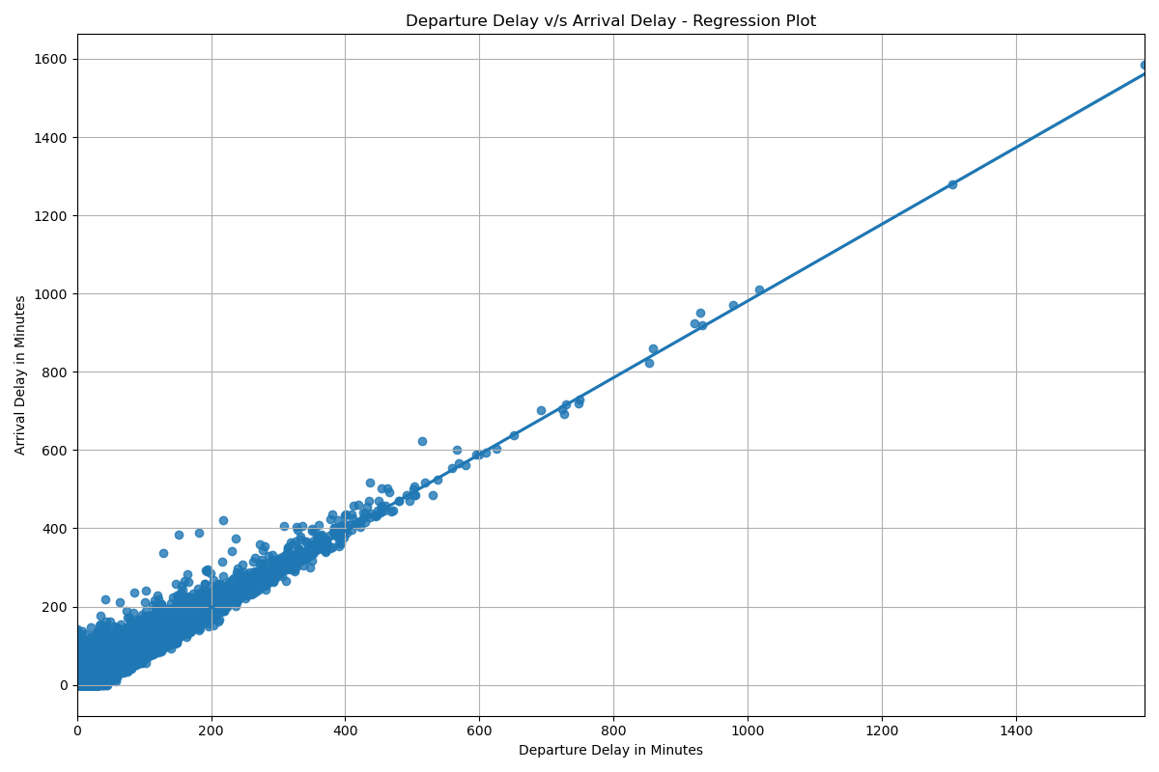
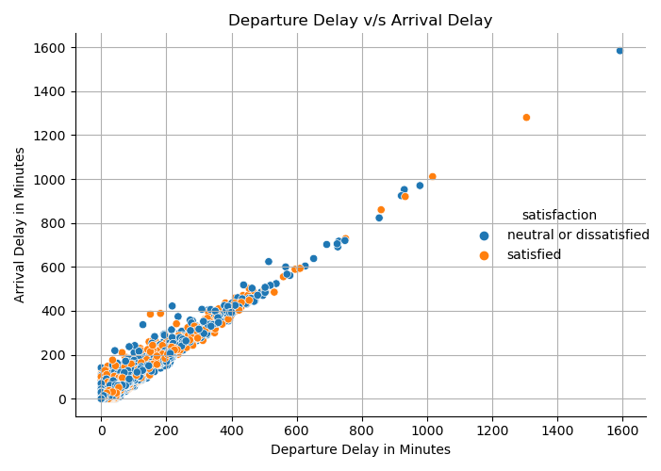
Departure Delay v/s Arrival Delay

Slide 34
Recommendation
Each factor is important in contributing towards a “satisfied” customers
Any category with “Very Bad” reviews needs to be reviewed and improved
Positive impact
Online boarding
Food and Drinks
In-flight entertainment
Requires improvement
In-flight Wi-fi
Ease of Online Booking
Departure Delay

Slide 35
Future Work
Gather more factors like cost of ticket, flight duration, accessibility, Routes offered, lounge access, etc.
Develop a classification model to better map features that impact the customer satisfaction
More robust app to include reviews and analysis of multiple airlines.

Slide 36

Dash App
Click Here

Slide 37

Thank You!

