Slide 1
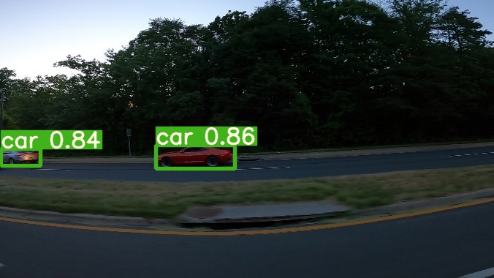
CAR OBJECT DETECTION
GROUP# 1
Ishan Kuchroo
Hemangi Kinger

Slide 2
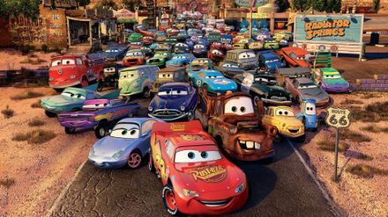
Problem Statement
Analyze images of cars to train a model for car object identification and classification

Slide 3
What Is Object Detection?
“Object Detection” uses digital images from cameras and videos and deep learning models so machines can accurately identify and classify objects — and then react to what they “see.”
Object Detection is widely used by organizations working on self-driving vehicles or automatic cruise control, like Tesla.

Slide 4

Convolutional Neural Network (CNN)
CNN is a Deep Learning algorithm which can take in an input image, assign importance (learnable weights and biases) to various aspects/objects in the image and be able to differentiate one from the other.
The architecture performs a better fitting to the image dataset due to the reduction in the number of parameters involved and reusability of weights.

Slide 5
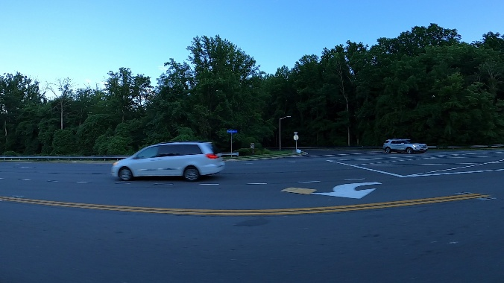
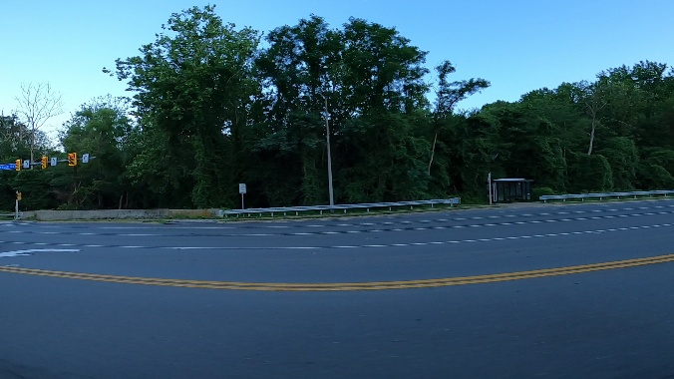
About the dataset
The dataset contains images of cars in all views. We have following data subsets:
Training Images
Set of 1000 files
Testing images
Set of 175 files
Train_solution_bounding_box
Contains name of images and the dimensions which has the object “Car”, in the training set.

Slide 6
Preprocessing
Train_solution_bounding_box
Car
No Car
We have resized, prefetched and shuffled the data in order to get the data in predefined format for the model

Slide 7
Transfer Learning
ResNet-50 is a convolutional neural network that is 50 layers deep. You can load a pretrained version of the network trained on more than a million images from the ImageNet database.
The pretrained network can classify images into 1000 object categories, such as keyboard, mouse, pencil, and many animals.
The network has an image input size of 224-by-224.

Slide 8
Stochastic Gradient Descent (SGD) Optimizer
SGD algorithm is an extension of the Gradient Descent
Stochastic gradient descent maintains a single learning rate (termed alpha) for all weight updates and the learning rate does not change during training.
In Python, SGD optimizer is a part of tf.keras.optimizers.SGD

Slide 9
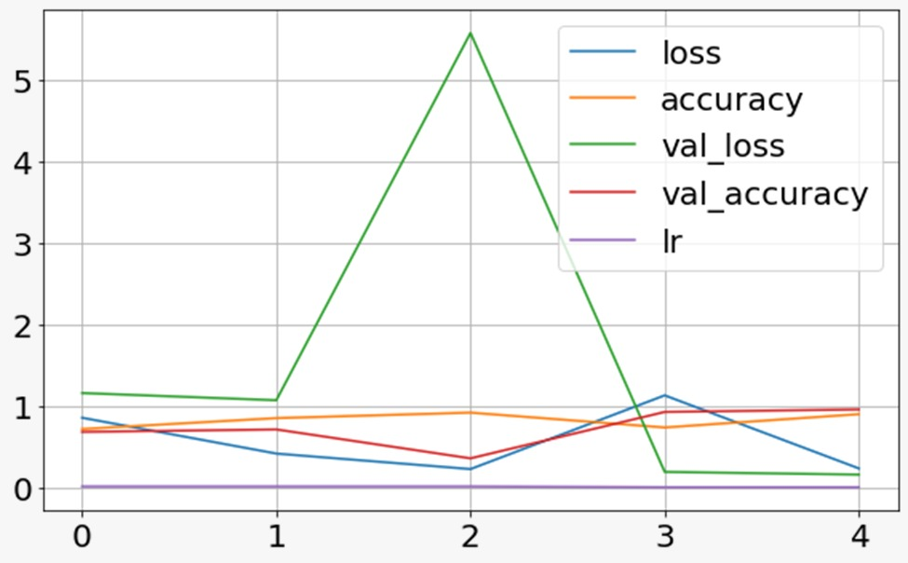
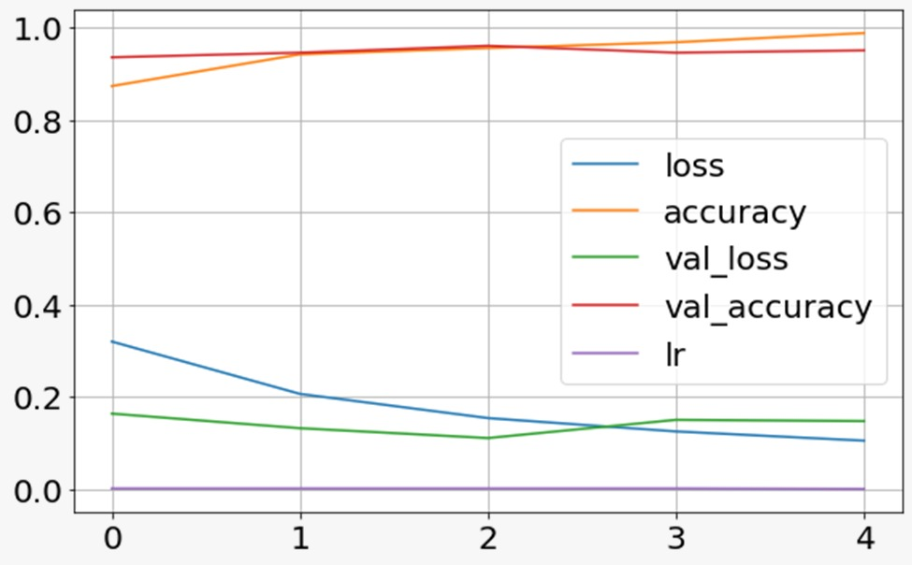
Training and Validation Accuracy - SGD
Freeze Layers
Unfreeze Layers
Accuracy: 79.76%
Validation Accuracy: 95.50%
Accuracy: 95.51%
Validation Accuracy: 96.00%

Slide 10
ADAM Optimizer
Adam is a replacement optimization algorithm for stochastic gradient descent for training deep learning models.
The method computes individual adaptive learning rates for different parameters (network weight) from estimates of first and second moments of the gradients.
In Python, Adam optimizer is a part of tf.keras.optimizers.Adam

Slide 11
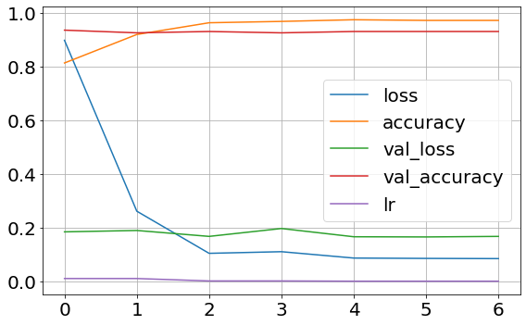
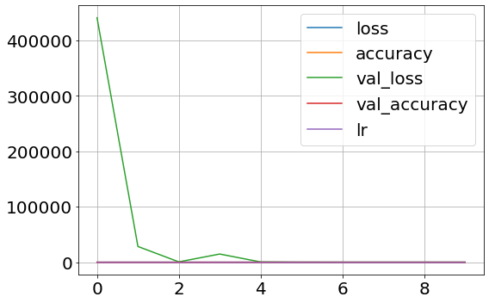
Training and Validation Accuracy - Adam
Freeze Layers
Unfreeze Layers
Accuracy: 97.13%
Validation Accuracy: 93.00%
Accuracy: 97.88%
Validation Accuracy: 96.00%

Slide 12
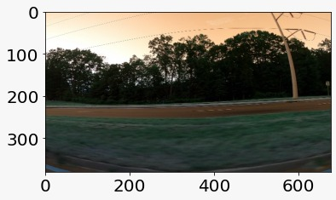
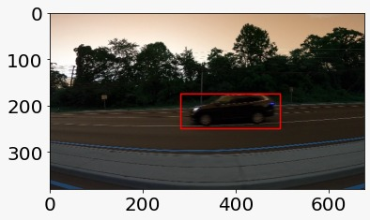
Test Accuracy
SGD
Test Accuracy: 86.57%
Adam
Test Accuracy: 78.00%

Slide 13
Conclusion
Object Detection is widely used by organizations interested in
Automated vehicle systems
Surveillance
Security
Using CNN allows us the ability to build networks (models) that correctly identify and classify any given object.
The ResNet50 model was able to identify “Car” with a very good accuracy of close to 86.57%.

Slide 14
Future Work
Advanced algorithms used for object detection include
Convolutional Neural Networks (R-CNN, Region-Based CNN)
Fast R-CNN
YOLO (You Only Look Once)
Faster computers and bigger GPU’s we can also try many more combination of learning rate and epochs
We can also combine this project with “highway lane detection” to create a mini-automated vehicle cruise system.

Slide 15
Thank You

