Slide 1


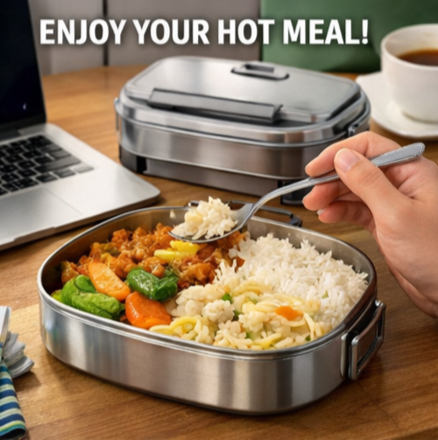
Tinkering & Mentoring - VACC 201
Final Project Presentation &
Demonstration
TapTiff- Reusable self-heating tiffin
Microwave ki chhutti, Tiffin ki duty!!
Date (05/05/2026)
Name of the Presenter: Brahmbhatt Diya
Email Id: 25sc02009@gsfcuniversity.ac.in
Mobile No.: 7383034281
Faculty Mentor Name: Ms. Khushbu Verma
Team No.: SoS_ team 2
Semester: 2nd
Program: B.Sc Biotechnology
School: School of Science

Slide 2
Reusable self-heating tiffin
Student Team
Name | Enrollment No. | Key Responsibility
Bodhwani Sanjay | 25SC02007 | Research and product development
Borse Janvi | 25SC02008 | Literature Review and Experiment Conduction
Brahmbhatt Diya | 25SC02009 | Ideation, Review literature and development, Feedback from users
Chaturvedi Amrita | 25SC02010 | Procurement of Raw Materials and Logistics
Chhatriwala Keya | 25SC02011 | Literature Review, Research and Experiment Conduction
Dabgar Het | 25SC02012 | Literature Review, Research and Experiment Conduction

Slide 3
Reusable self-heating tiffin
Faculty Mentor
Name | Designation | Department, School
Ms. Khushbu Verma | Assistant Professor | Life sciences, School of science (SOS)

Slide 4
Reusable self-heating tiffin
Introduction of Tinkering Project
Title of Tinkering Project: Reusable Self-Heating Tiffin Using Sodium Acetate Crystallization
Sector:Food Technology and Thermal Energy Storage
Background of the project | Problem statement | Proposed Approach | Importance/Relevance of the problem
Students, office-goers, and field workers rely on packed meals. Long travel & irregular schedules lead to cold food. Limited access to reheating devices while commuting. | Need for a portable, safe, reusable self-heating tiffin. Should work without electricity or gas. Must maintain food safety and quality. | Availability of reusable heat-generating materials (PCMs) Scope to integrate controlled exothermic reactions Potential for eco-friendly, cost-effective design. | Improves comfort and food hygiene on the go Reduces dependence on electricity & single-use heaters. Promotes sustainable product design. Useful for workers, travelers & emergency use.

Slide 5
Reusable self-heating tiffin
Methodology and Tinkering Process
Preparation of supersaturated sodium acetate solution by dissolving sodium acetate in hot distilled water (~80–90°C).
Ensuring complete dissolution to obtain a clear homogeneous solution.
Hot filtration (if required) to remove impurities and prevent premature nucleation.
Controlled undisturbed cooling to achieve a metastable supersaturated state.
Transfer of solution into a heat-resistant pouch (≈200 micron).
Incorporation of a metal trigger mechanism for controlled nucleation.
Sealing of pouch to make it leak-proof and portable.
Activation by mechanical triggering, initiating crystallization and heat release.
Evaluation of heat output and efficiency for food warming application.

Slide 6
Reusable self-heating tiffin
Tools and Technology Used
Materials / Chemicals
Sodium Acetate Anhydrous Distilled water
Metal Plate
Silicon Ziplock bag
Tools
Weighing balance
Magnetic Stirrer
Waterbath and Refrigerator
Glass wares (beaker, glass rod, measuring cylinder)
Technology Used
Exothermic crystallization process Supersaturation technique

Slide 7

Reusable self-heating tiffin
Project Outcome & Development
Successfully developed a reusable self-heating system using supersaturated sodium acetate.
Achieved controlled heat generation (~40 kJ) through crystallization.
Demonstrated effective temperature rise (~15–20°C) for food warming.
Designed a portable and lightweight heating pouch (~150 g).
Established a safe and user-friendly activation mechanism (metal trigger).
Proved reusability through reheating and repeated cycles.
Identified key factors affecting performance (heat loss, nucleation control, insulation).
Proposed an eco-friendly alternative to conventional heating methods.
Gained practical understanding of supersaturation and nucleation concepts.

Slide 8
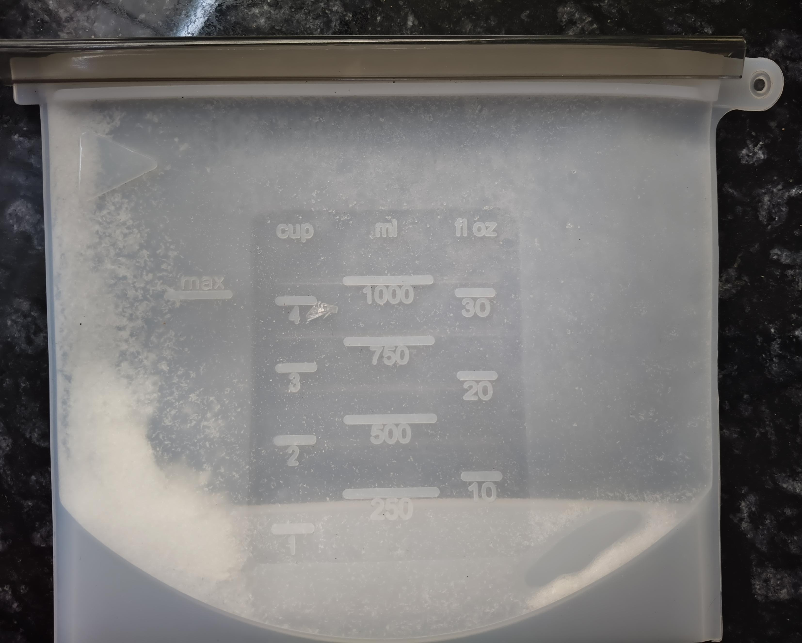
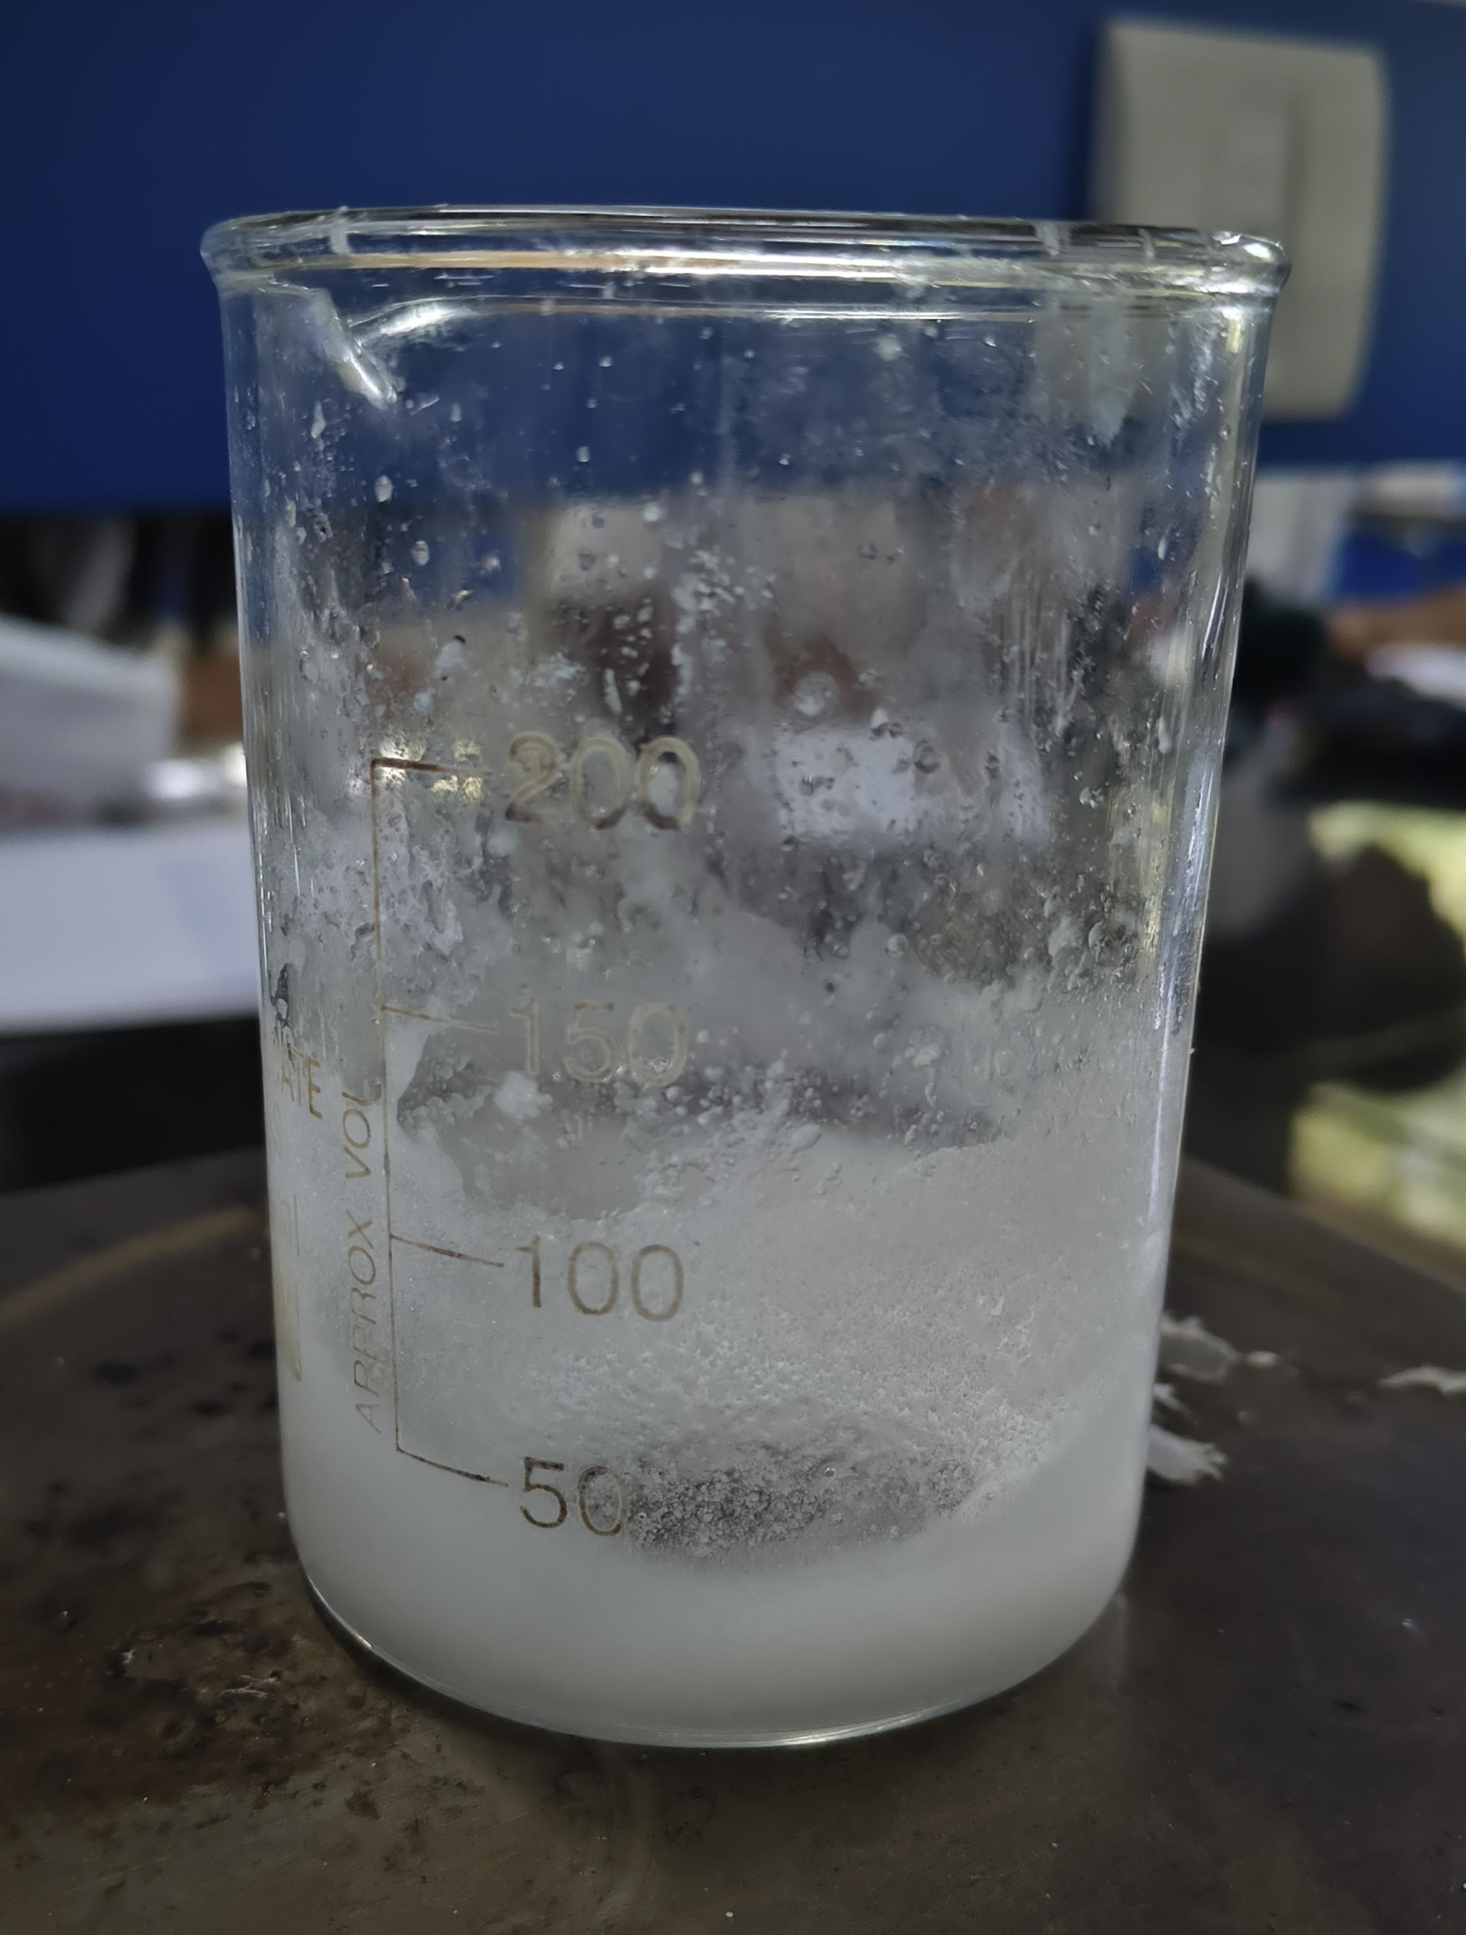
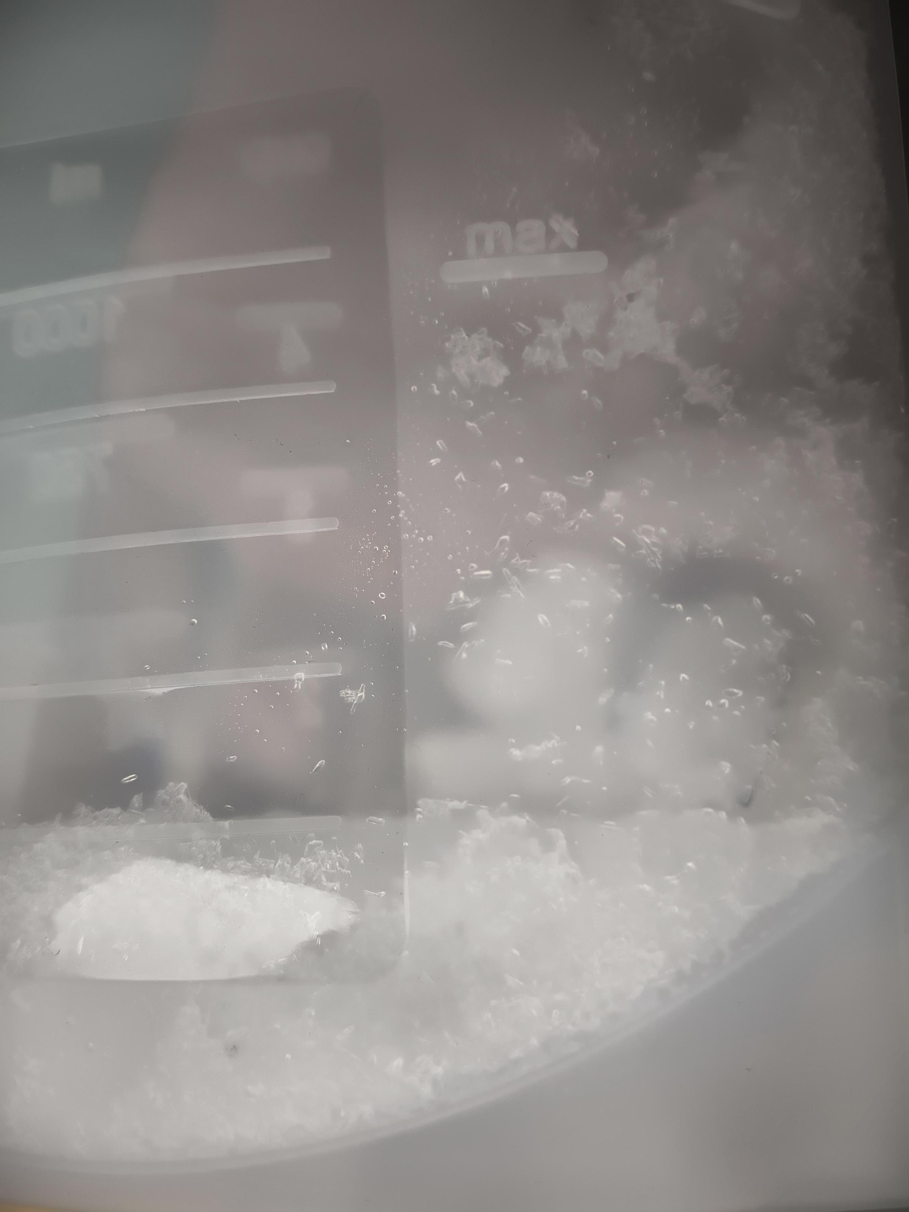
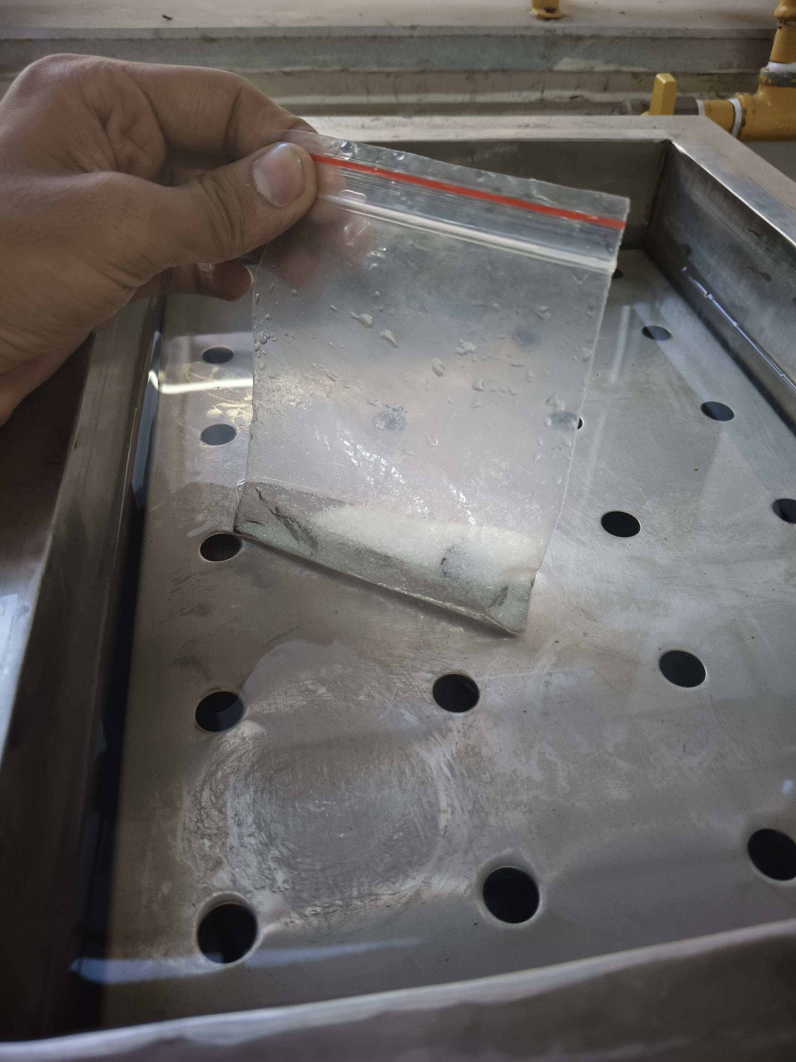
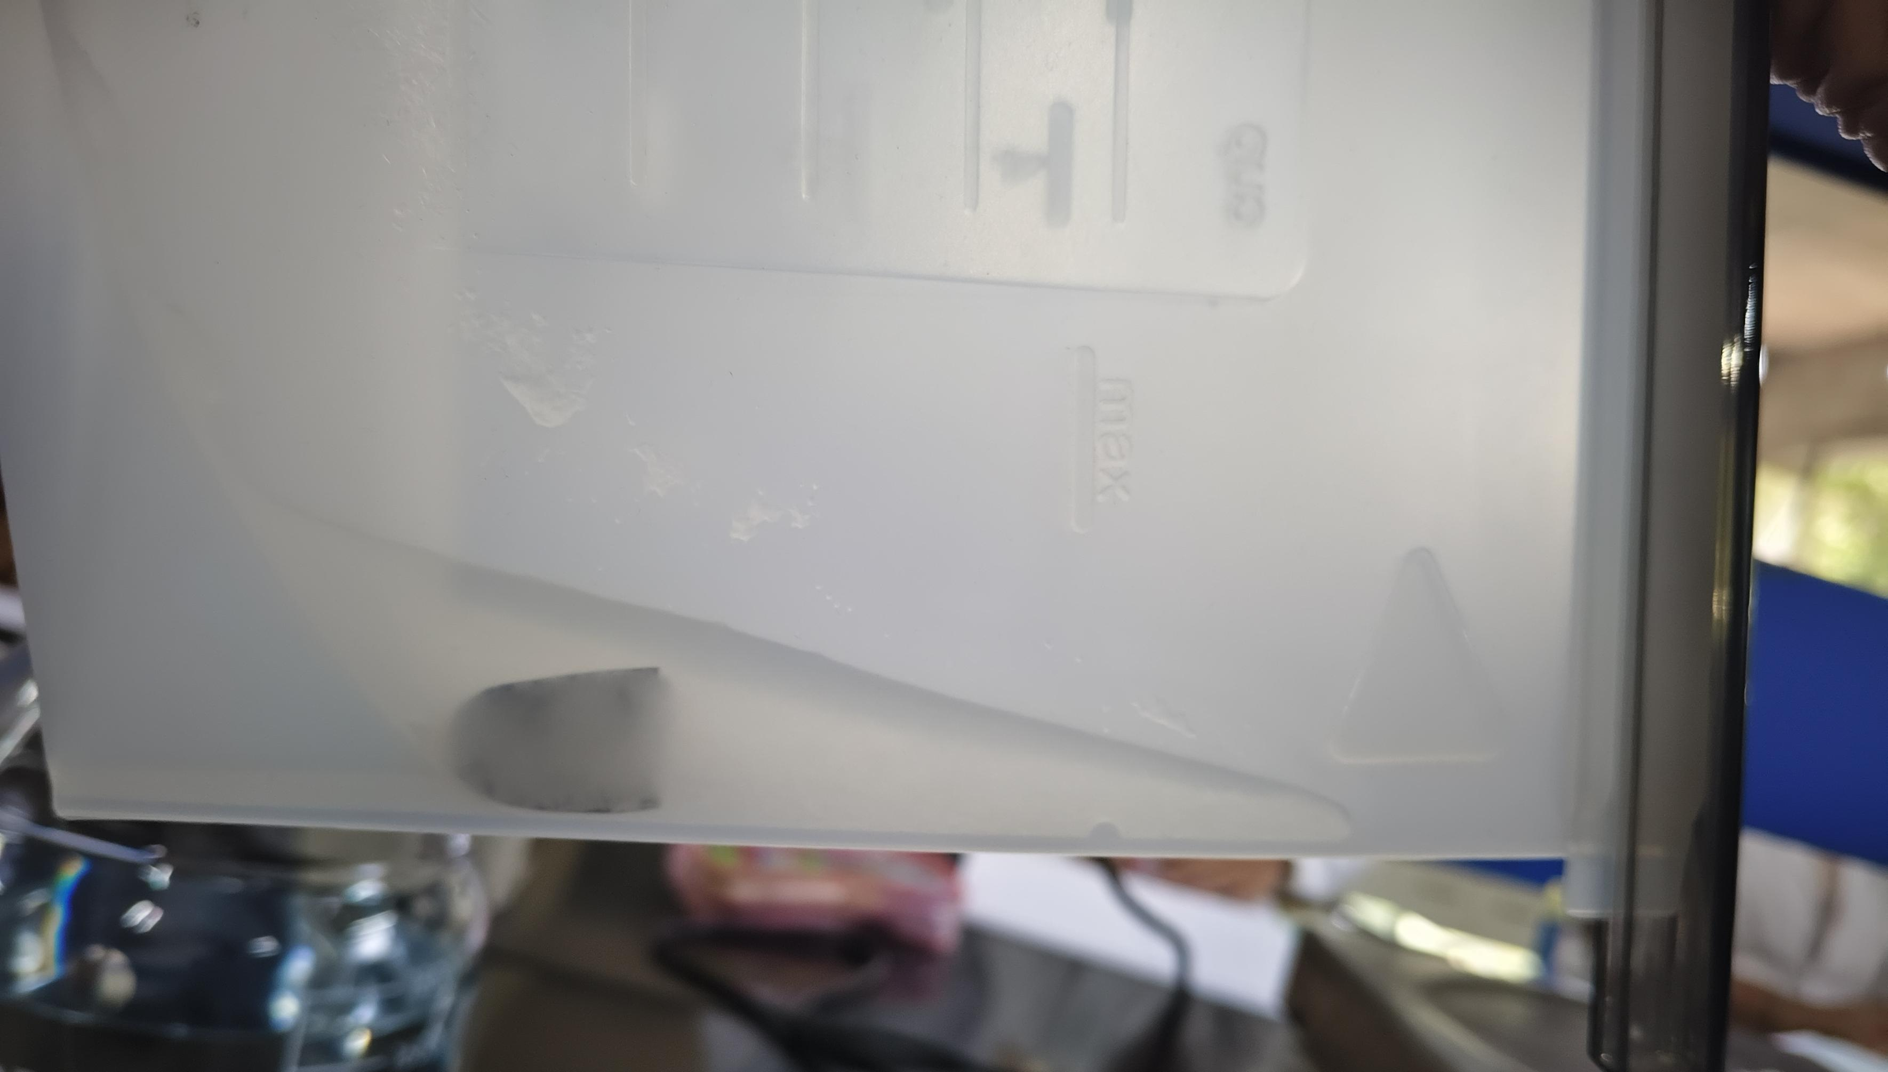
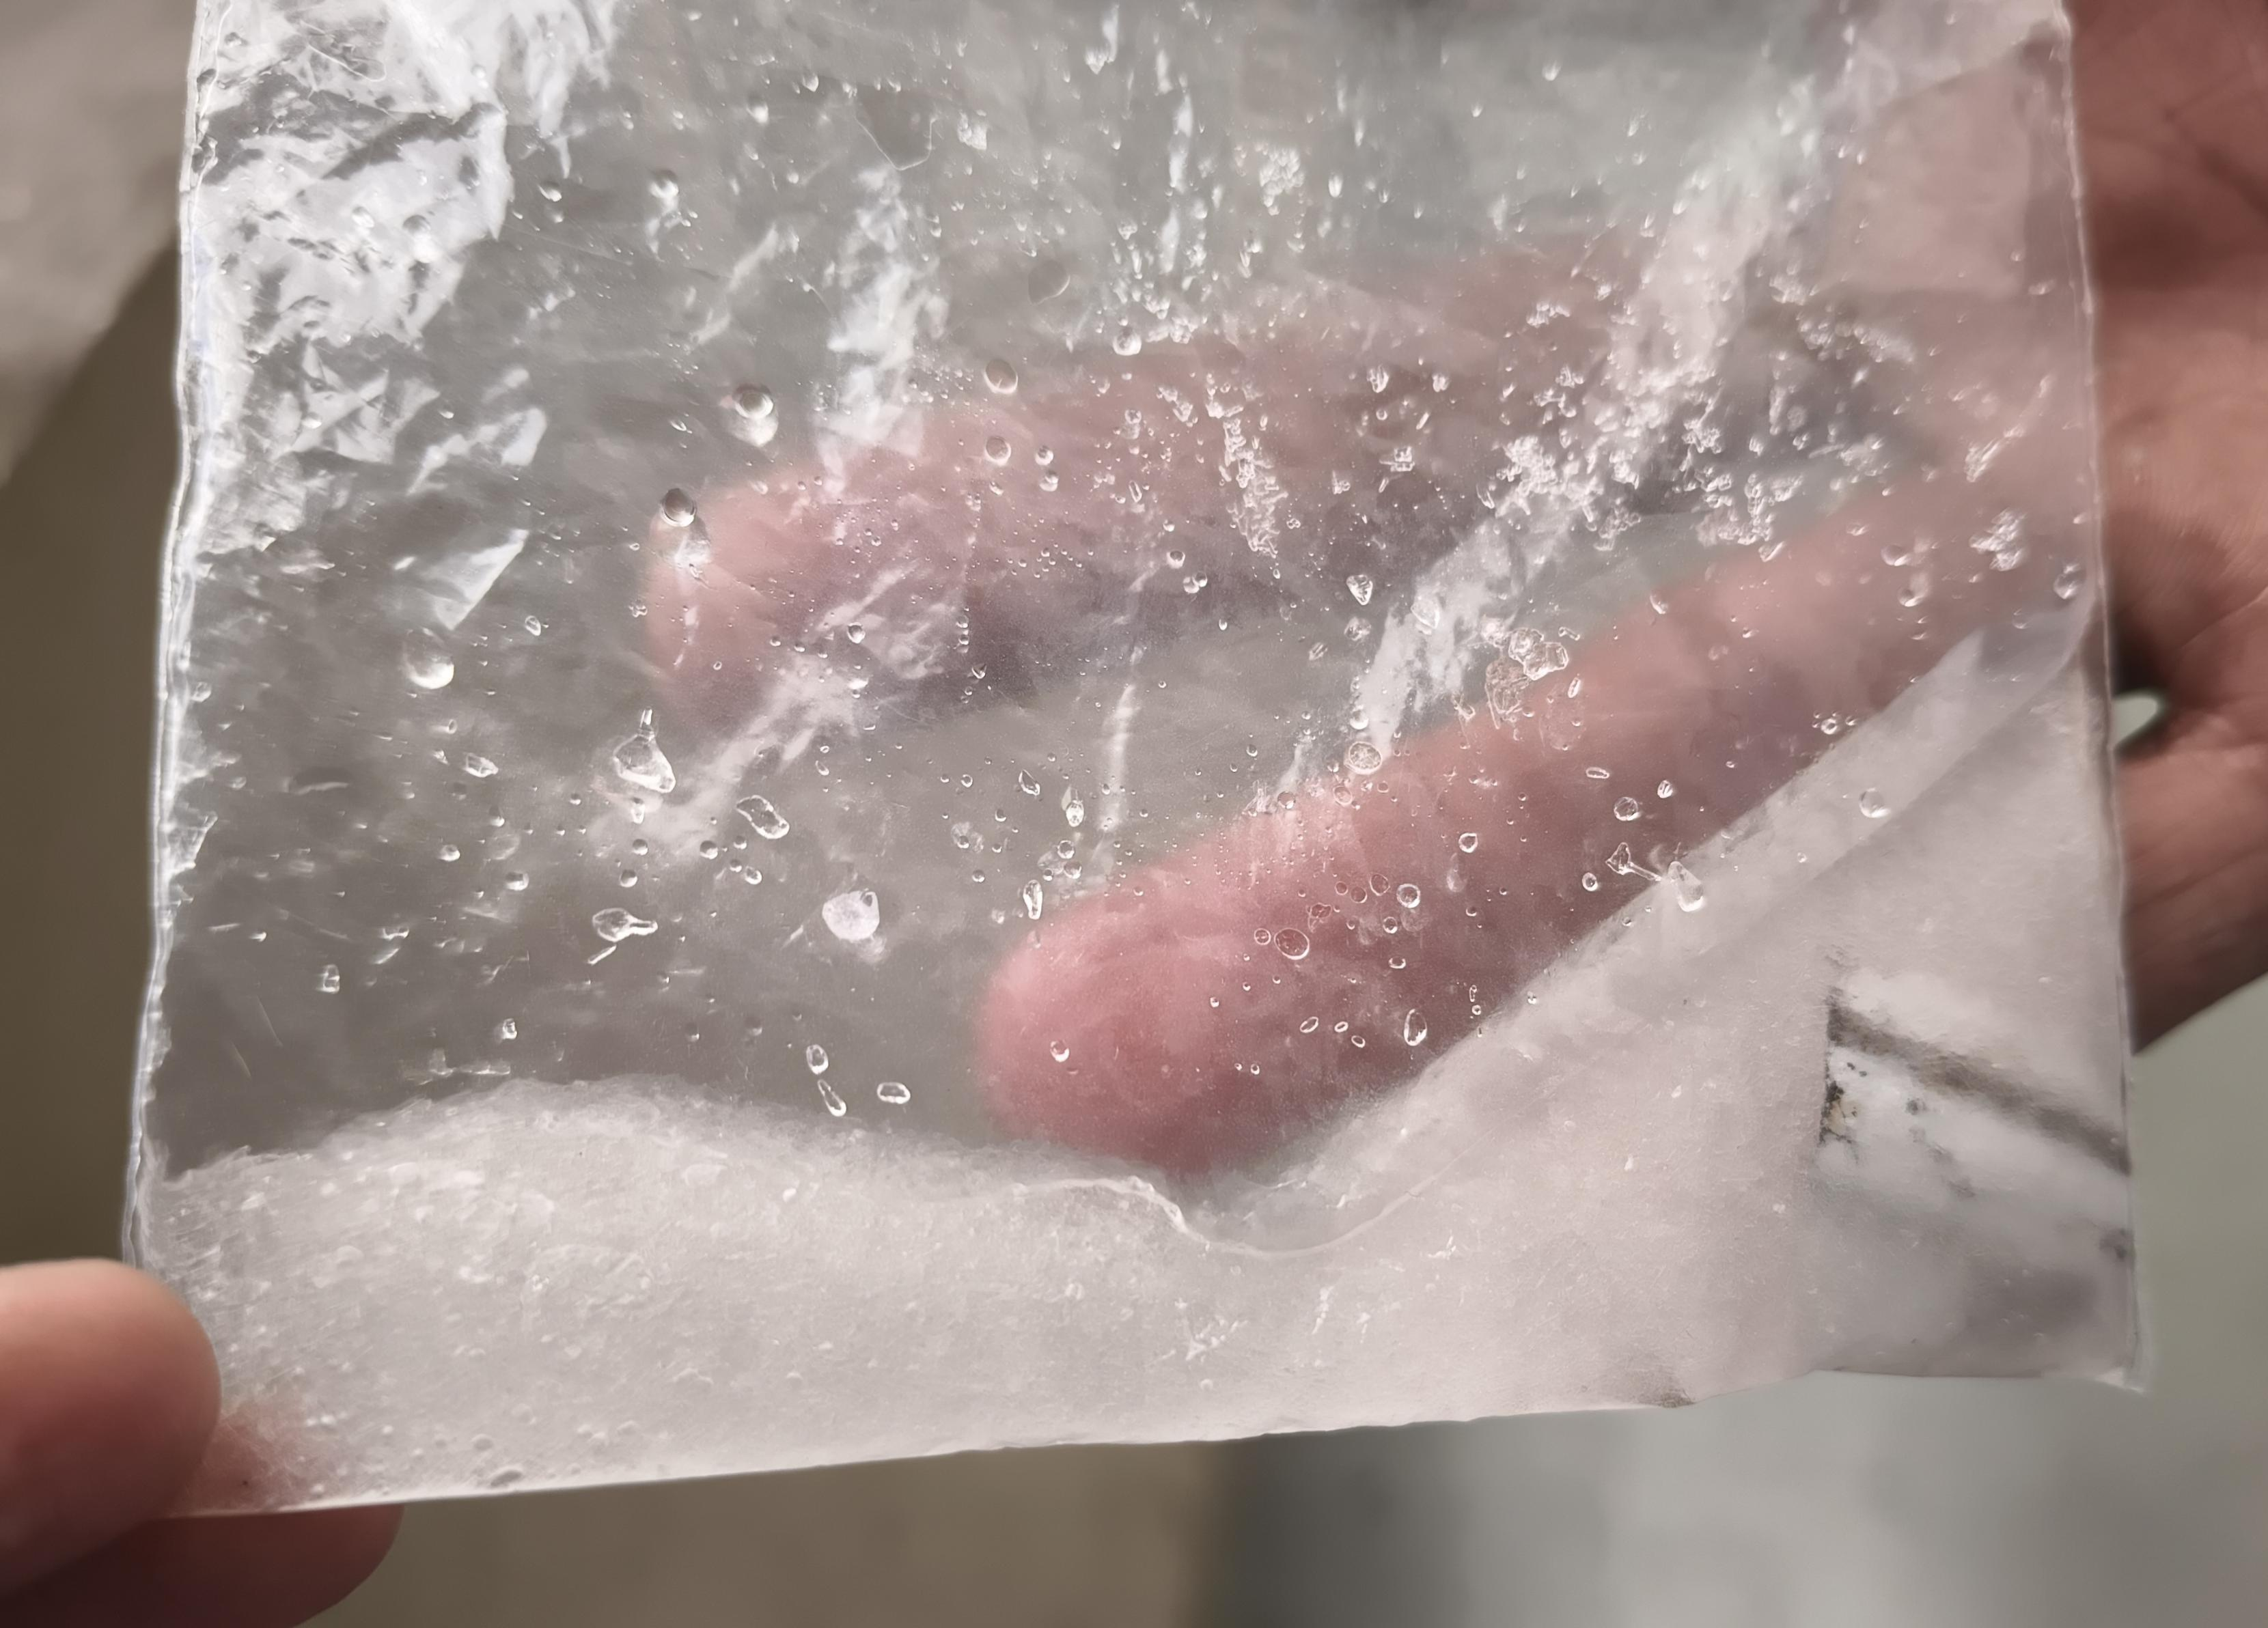
Reusable self-heating tiffin
Prototype Images

Slide 9
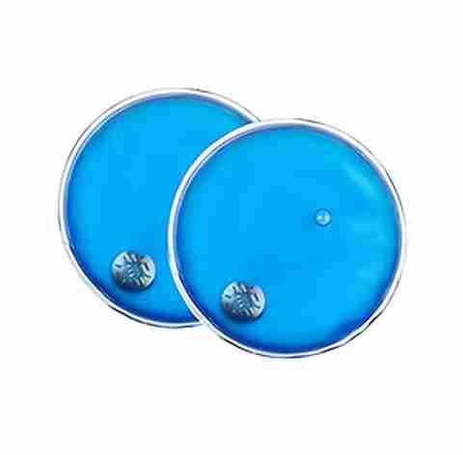
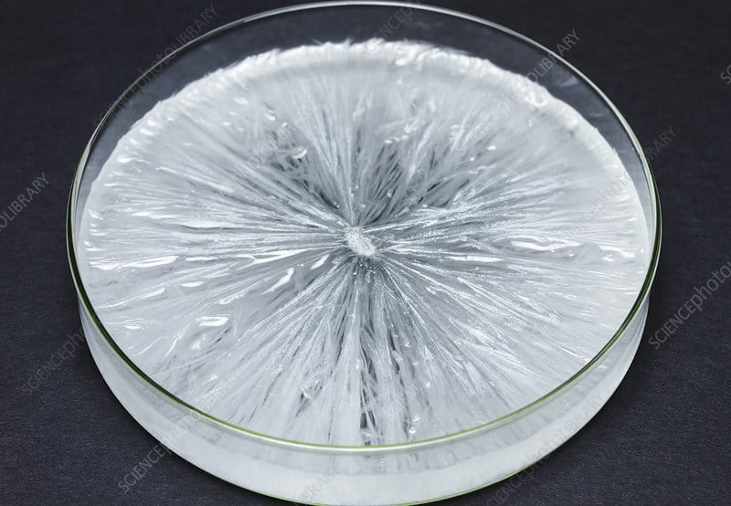
Reusable self-heating tiffin
Prototype Images
Reference: https://www.google.com/search?client=ms-android-vivo-terr1-rso2&hs=cRjp&sca_esv=729a2d5b976b9e39&sxsrf=ANbL-n6g80EfsCO30AAc2p31Pniq-psA8w:1776530355884&udm=2&fbs=ADc_l-ZMtfrlQ0SU6L2D0-D344flsprUi5NYvvJVflrdjdmmndzc87yxCU-u2_IZZ9ETkTNdPcVy6eKInZaxaHX9ndC8ftFG1RAVcS-DPb2pkC6gl9Y7RYCl5u7Ylgp83-XiOv79YsN0EakP-WOe20lwLUj_9nFINDFL3vpTxXsuOvAdpUWgg3ZpL4X1FmXaVoBbpno8Q9Yo_Efz0tNmVB83JEC_Ci7qoXl9rnOVOR5lG3urUPrlZDc&q=sodium+acetate+trihydrate+crystallization&sa=X&ved=2ahUKEwjB-K2m6_eTAxVsh68BHZ-4M_8QtKgLegQIDxAB&biw=392&bih=758&dpr=2.75#ip=1&sv=CAMSVxoyKhBlLXphaWhIdERhR3dLbWJNMg56YWloSHREYUd3S21iTToOQzh5RmMyOERQT1BjWE0gBCoXCgFzEhBlLXphaWhIdERhR3dLbWJNGAEwAUoECAEQAhgHIJGMs9QDSggQAhgBIAIoAQ
Reference: https://www.google.com/search?client=ms-android-vivo-terr1-rso2&hs=ImO&sca_esv=729a2d5b976b9e39&sxsrf=ANbL-n5BbkQaK2nB16CXYNclrENtMZo6Cg:1776530237150&udm=2&fbs=ADc_l-aHJKCxetkbp8HihrVlWP2E1iNtw1c6Bqm2EL8gFYaWSYxrIPO0Uw9d1XjTJ7RJppJKRCzubuWABMtzDYJZwTlTqhqCv98YggpFCTMIa0qy_4bgUggaNKH0vxtO79W1aEDb6cWHVQkDptBf3VkSg0ozYd6RkW4h2B4c7rmzTnEsRfLF1VHx47XodDzroWmL2PpQHLu-cgVi_AYYil5ukA-Y4AoXCSv-pBh7zedYSawxByWJ7YU&q=reusable+hand+warmers&sa=X&ved=2ahUKEwjbgN_t6veTAxUVcPUHHSpVJSwQtKgLegQIFhAB&biw=392&bih=758&dpr=2.75#ip=1&sv=CAMSVxoyKhBlLTE4am9xWlhZemc1bHRNMg4xOGpvcVpYWXpnNWx0TToObmpmSldQc1MyWUIwX00gBCoXCgFzEhBlLTE4am9xWlhZemc1bHRNGAEwAUoECAEQAhgHIKnStsMDSggQAhgBIAIoAQ

Slide 10
Reusable self-heating tiffin
Learning Outcome
Developed hands-on laboratory skills and experience with basic instruments. Improved problem-solving and experimental thinking through trial and observation. Learned project planning and execution from idea to initial experimentation. Enhanced teamwork and collaboration skills while working in a group. Built adaptability and learning from failures during experiments. Benefited from mentoring sessions and feedback for idea improvement.

Slide 11
Reusable self-heating tiffin
Conclusion & Future Scope
The project focused on understanding and developing the concept of a self-heating tiffin using sodium acetate.
Develop a compact and portable design suitable for daily use.
Convert the idea into a market-ready product for students and travelers.
Scale the project for large-scale production and real-world use.

Slide 12
Reusable self-heating tiffin
Do you want to apply for PoC/Prototype Development support under Students Startup and Innovation Policy (SSIP 2.0) under GUIITAR Council?
Currently, we do not plan to pursue this project as a startup
However, the idea may be explored further in the future if developed successfully

Slide 13
Thank You..

