Slide 1

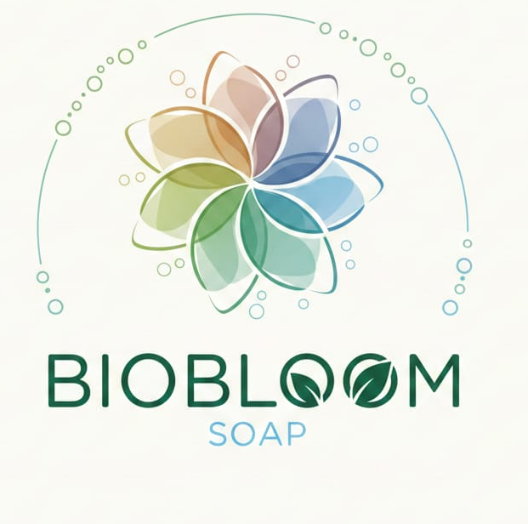
Tinkering & Mentoring - VACC 201
Final Project Presentation &
Demonstration
Soap making from Saponification
Date : 05/05/2026
Name of the Presenter: RENA DHARSANDIA
Email Id: 25SC02014@gsfcuniversity.ac.in
Mobile No.: 7573007567
Faculty Mentor Name: Dr. Prasad Andhare
“Freshness in every Bloom”
Team No.: SOS_03
Semester: 2nd
Program: BSc. Biotechnology
School: School of Science

Slide 2
Soap making from Saponification
Student Team
Name | Enrollment No. | Key Responsibility
DADHICH MITWA BRAHMANAND | 25SC02013 | Idea and collecting raw materials
DHARSANDIA RENA HEMAL | 25SC02014 | Presenter
DHRUVI ASHWIN SATROLA | 25SC02015 | Lab work
FORAM KAUSHIKKUMAR PARMAR | 25SC02016 | Documentation
GARGI SAHRAM | 25SC02017 | Idea and collecting raw materials
GOHEL KARAN JITENDRA | 25SC02018 | Lab work

Slide 3
Soap making from Saponification
Faculty Mentor
Name | Designation | Department, School
Dr. PRASAD ANDHARE | Assistant Professor | Department of Life Sciences, School of Science, GSFC University

Slide 4
Soap making from Saponification
Introduction of Tinkering Project
Title of Tinkering Project: Soap making by Saponification
Sector: Cosmetics / Herbal Personal Care
Brief:
Development of eco-friendly herbal soap using natural and sustainable ingredients. Focus on plant-based extracts like aloe vera and citrus components. Application of saponification process for product formulation. Aim to create safe, skin-friendly, and cost-effective alternatives to chemical soaps. Integrates biotechnology concepts with practical product development and innovation.

Slide 5
Soap making from Saponification
Methodology and Tinkering Process
Adopted a systematic lab-based approach using the saponification process
Selected natural ingredients and followed controlled formulation steps
Performed multiple experimental trials to refine the soap formulation
Continuously modified concentration, temperature, and mixing techniques
Observed results at each stage and improved based on trial outcomes
Addressed issues like texture inconsistency and improper setting through iteration
Maintained proper documentation for each experiment and modification
Incorporated mentor feedback to improve accuracy, quality, and process flow
Mentoring support helped in troubleshooting, quality control, and structured development

Slide 6
Soap making from Saponification
Tools and Technology Used
Laboratory Glassware (conical flask, measuring cylinder): Used for accurate measurement and mixing of ingredients, ensuring proper formulation. Glass Rod: Enabled uniform stirring and proper blending of oil and KOH solution. Chemical Reagents (oil, alcoholic KOH): Essential for saponification process to convert oil into soap. Natural Additives (aloe vera gel, orange extract, colors): Provided herbal properties, fragrance, and aesthetic appeal. Silicone Molds/Trays: Used for shaping soap and easy removal after solidification. Controlled Heating & Cooling Process: Helped maintain reaction conditions and proper curing of soap. Basic Formulation Techniques: Ensured consistency, stability, and quality of the final product.

Slide 7

Soap making from Saponification
Project Outcome & Development
Use Case: Herbal soap for daily personal hygiene. Suitable for skin-friendly and eco-conscious users .Can be positioned as a low-cost, natural alternative to commercial soaps.
Description of Developed Outcome:
Successfully developed herbal soap prototype (aloe vera & orange variants) Solid soap obtained after proper curing with acceptable texture and appearance Product contains natural additives for improved skin benefits
Development Process:
Preparation using saponification method in laboratory conditions Mixing oil with alcoholic KOH followed by addition of natural extracts Pouring into molds and curing for 24–48 hours Iterative improvements based on observations and testing
Challenges Faced:
Maintaining correct chemical concentration for safe formulation Controlling temperature during reaction Achieving uniform mixing of herbal ingredients Optimizing curing time for hardness and durability Initial inconsistencies in texture and appearance

Slide 8
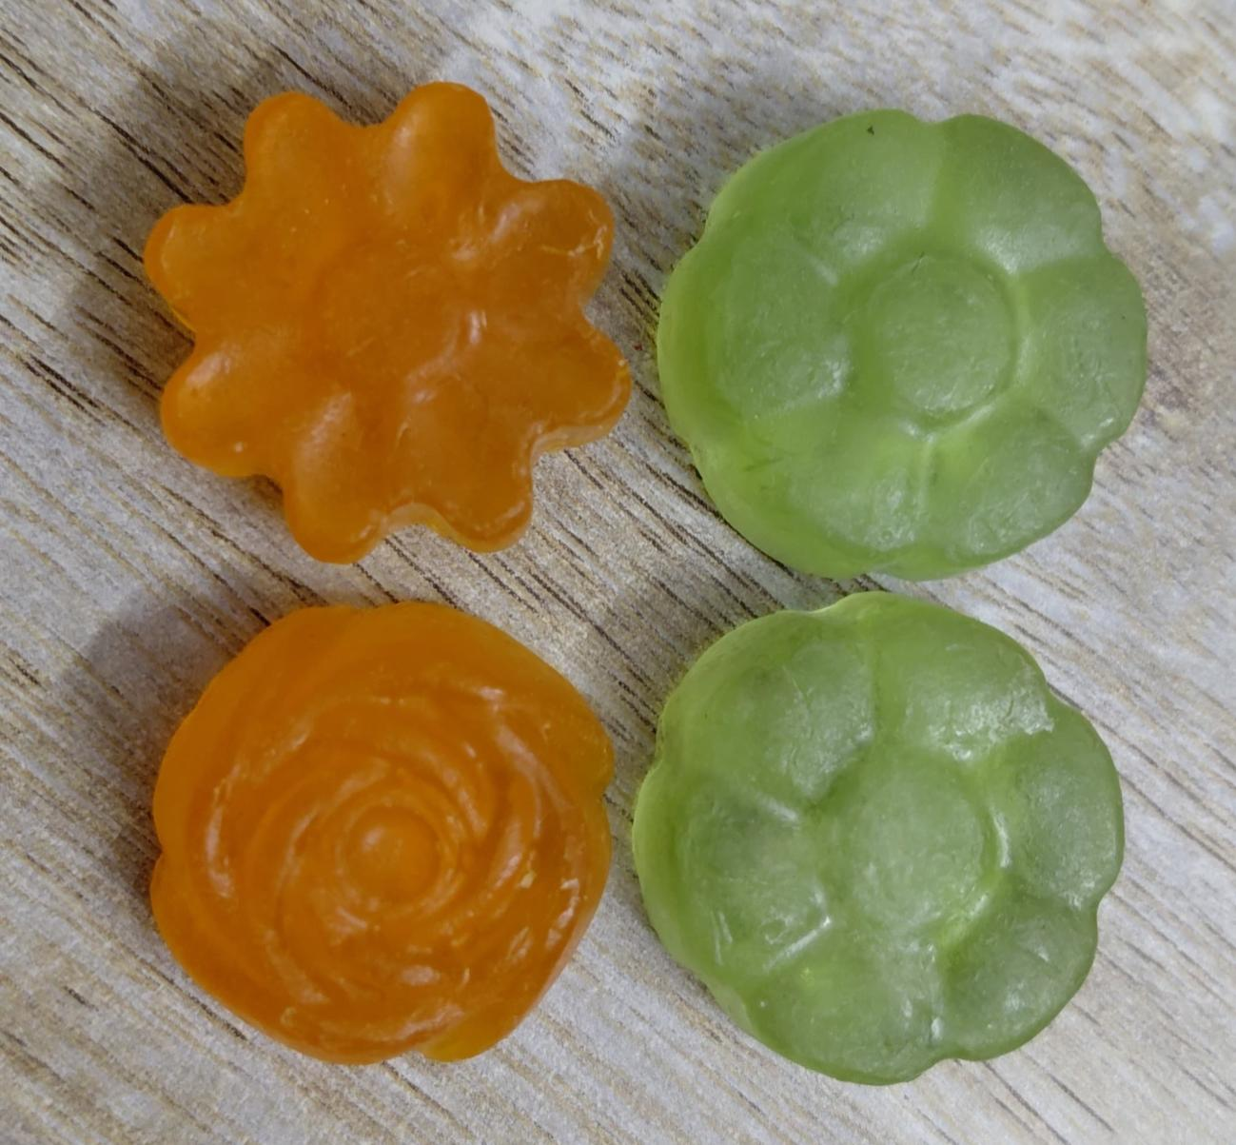
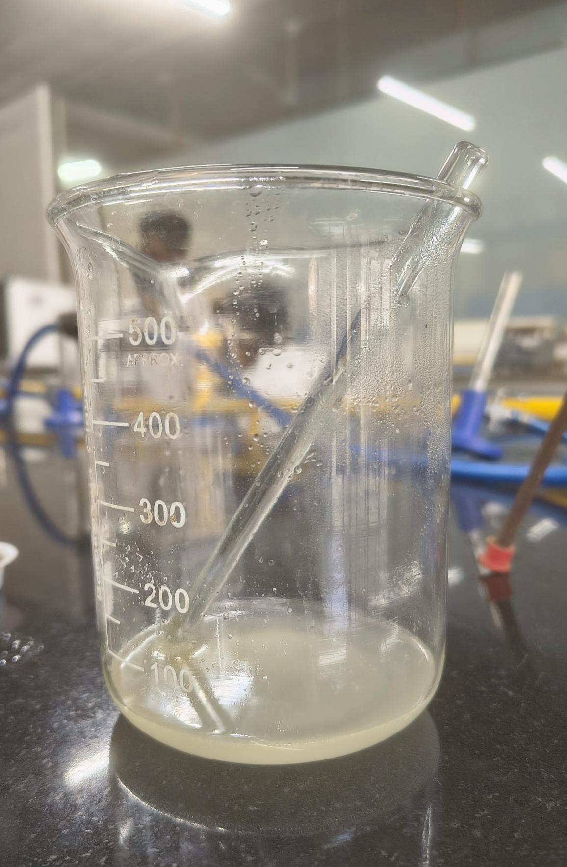
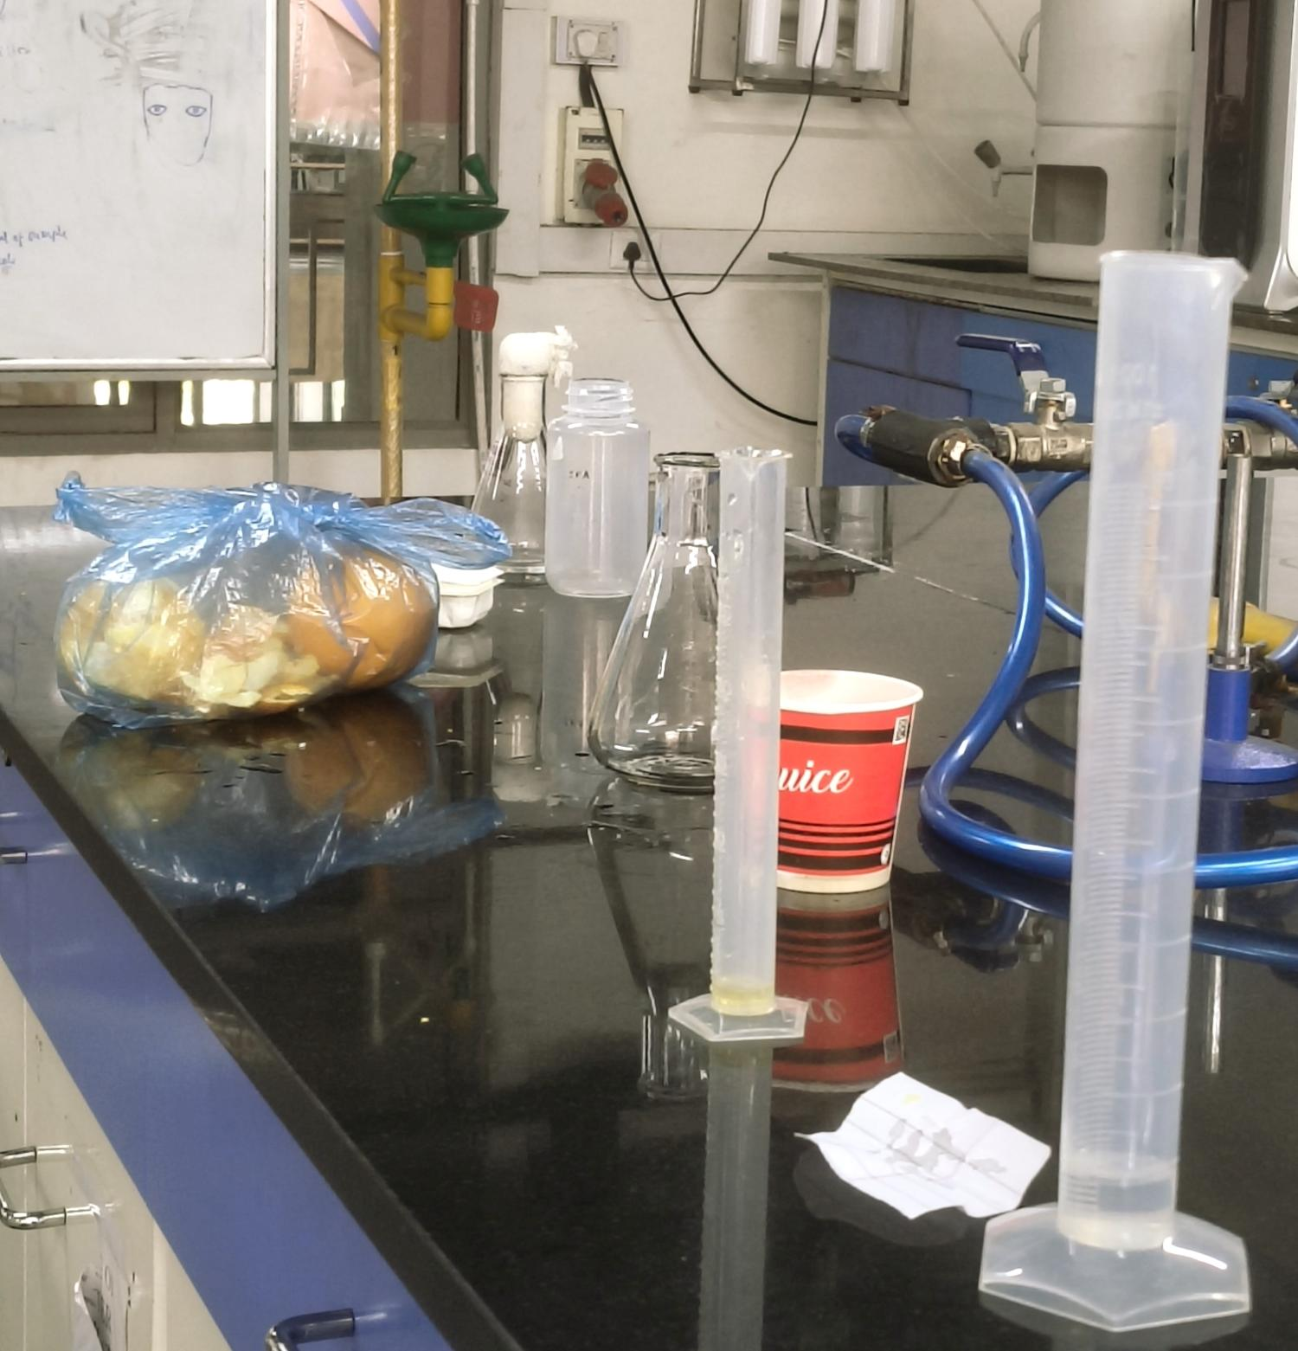
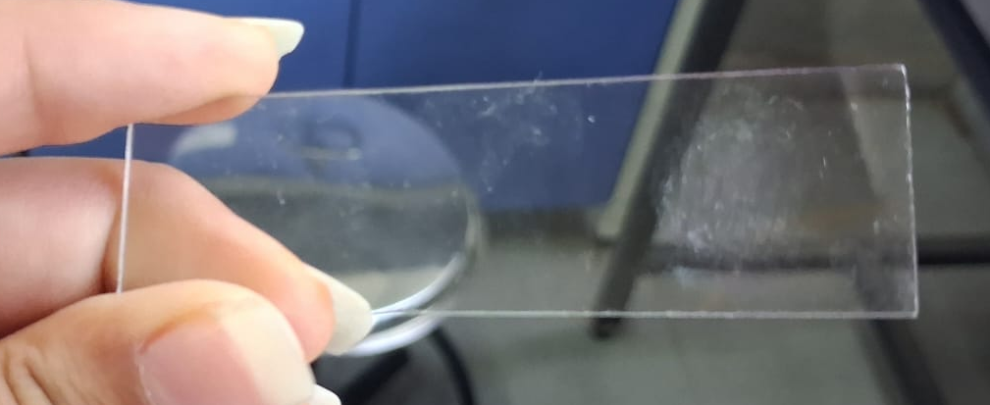
Soap making from Saponification
Prototype Images
Orange and Aloevera Soap
Materials
Soap base
Dirt on slide

Slide 9
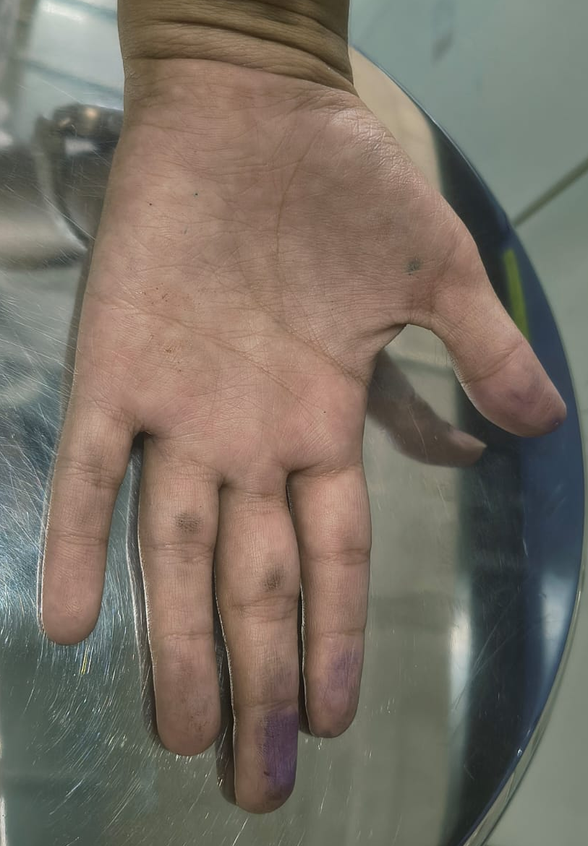
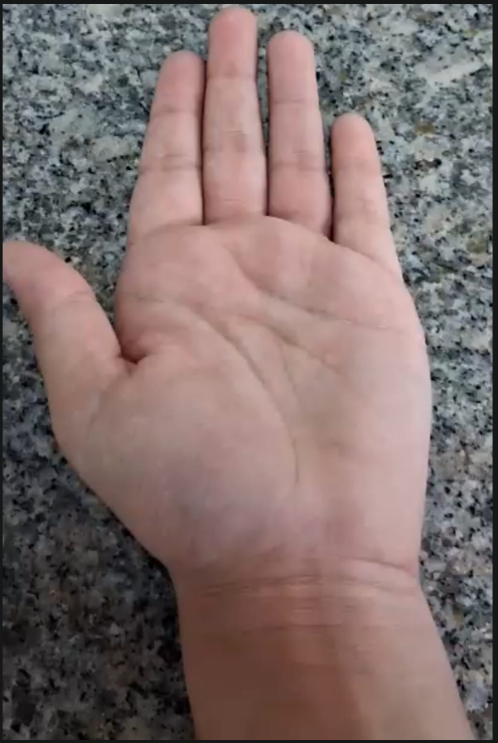
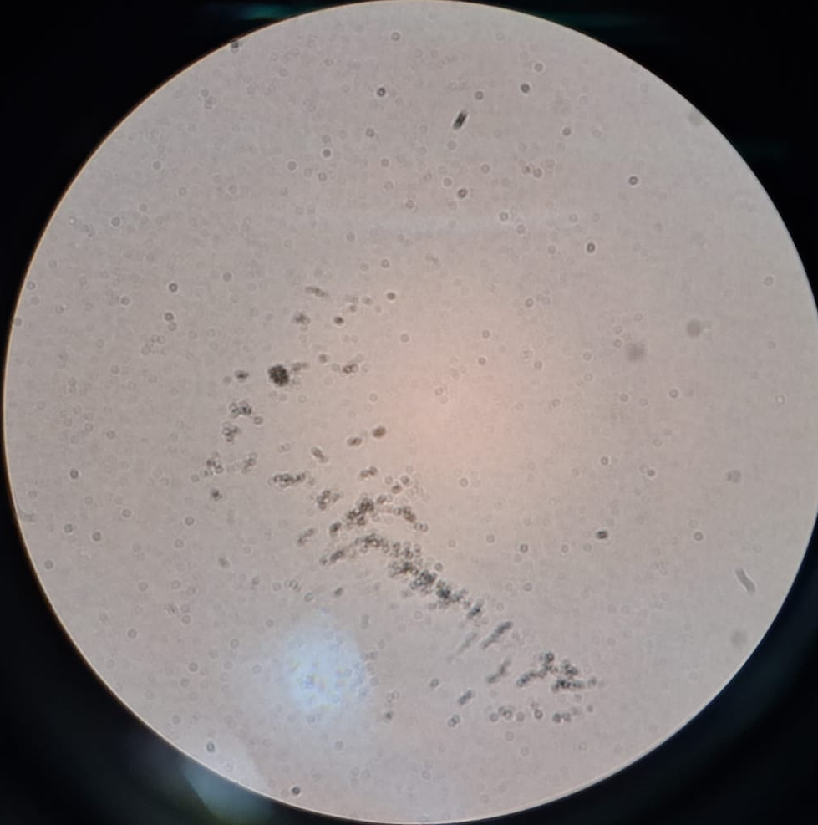
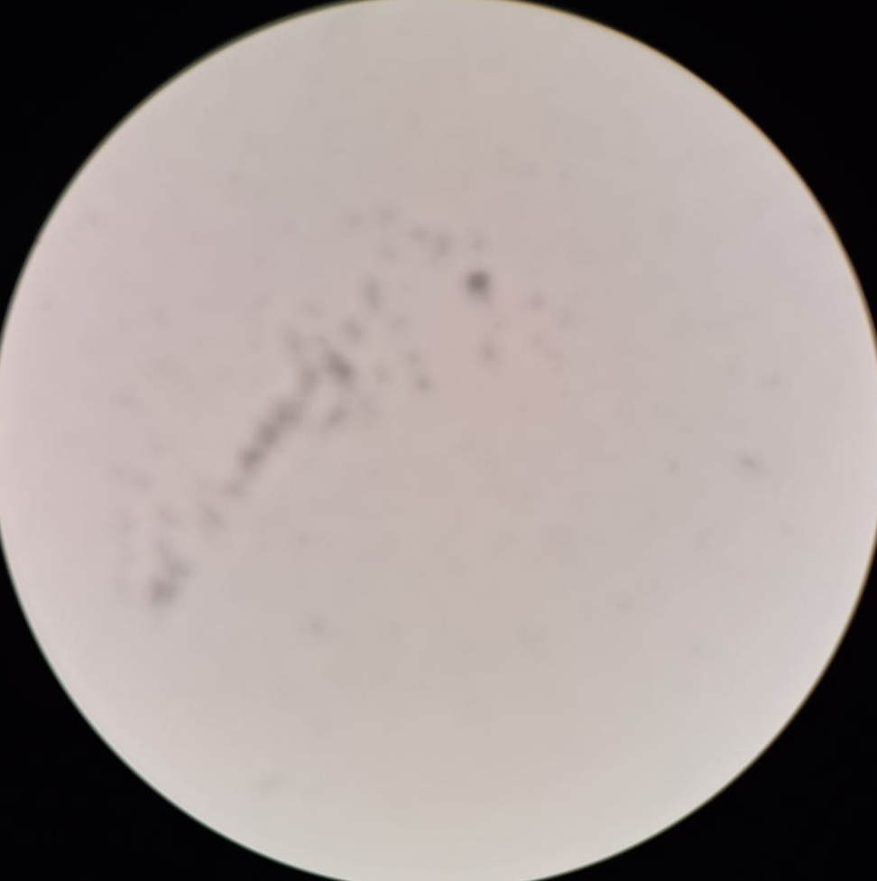
Soap making from Saponification
Prototype Images
Dust Particles
Dust Particles
Before
After

Slide 10
Soap making from Saponification
Learning Outcome
Gained practical understanding of saponification and soap formulation Developed knowledge of natural ingredients and their role in skincare products Improved laboratory skills including measurement, mixing, and handling chemicals Learned to identify and resolve issues related to concentration, temperature, and consistency Enhanced problem-solving through iterative testing and refinement Understood importance of quality control parameters like texture, stability, and safety Applied mentor feedback to improve formulation accuracy and product quality Strengthened documentation and analytical thinking during experimentation Developed teamwork, coordination, and task-sharing skills during project execution

Slide 11
Soap making from Saponification
Conclusion & Future Scope
Successfully developed eco-friendly herbal soap using saponification process Achieved a functional prototype with acceptable texture, appearance, and usability Demonstrated application of biotechnology concepts in real product development Gained hands-on experience in formulation, testing, and process optimization Identified scope for improving fragrance, texture, and overall product quality Future enhancements include pH testing, skin compatibility, and stability analysis Potential to develop multiple herbal variants using different natural extracts Scope for packaging, branding, and commercialization as a sustainable product Overall project provided valuable practical learning and innovation experience

Slide 12
Soap making from Saponification
Do you want to apply for PoC/Prototype Development support under Students Startup and Innovation Policy (SSIP 2.0) under GUIITAR Council?
No, we are not planning to apply for PoC/Prototype Development support under the SSIP 2.0 initiative of the GUIITAR Council at this stage. Currently, our focus is on academic learning, completing the project objectives, and gaining practical experience in formulation and product development.

Slide 13
Thank You..

