Slide 1


Tinkering & Mentoring - VACC 201
Final Project Presentation &
Demonstration
Bioplastic from banana peels
Date (18/04/2026)
Name of the Presenter: Yashvi Patel
Email Id:25sc02062@gsfcuniversity.ac.in
Mobile No. 8849390683
Faculty Mentor Name: Dr.Swati Jayswal
Team No.: 11
Semester: 2nd
Program: Bsc Biotechnology
School: School of Science
1

Slide 2

bioplstic from banana peels
Student Team
Name | Enrollment No. | Key Responsibility
Yashvi Patel | 25sc02062 | Taking care of requirements and availability responsibilities
Mansi Patil | 25sc02063 | Taking care of requirements and availability responsibilities
Pragati Limbachiya | 25sc02064 | Material management
Prusti Purohit | 25sc02065 | Material and status management of project
Hiloni Purohit | 25sc02066 | Lab responsibilities
Jaypalsingh Rajpurohit | 25sc02068 | Lab responsibilities
08-04-2026
2

Slide 3
bioplastic from banana peels
Faculty Mentor
Name | Designation | Department, School
Dr. Swati Jayswal | Assistant professor | Life science , School of Science
08-04-2026
3

Slide 4
bioplastic from banana peels
Introduction of Tinkering Project
Title of Tinkering Project: Bioplastic from Banana Peels
Sector: Sustainability / Environmental Biotechnology
Brief: Plastic pollution is one of the biggest environmental problems today. In this project, we explored how waste banana peels can be converted into biodegradable plastic. This not only reduces waste but also provides an eco-friendly alternative to harmful synthetic plastics. The idea is simple, affordable, and suitable for small-scale production.
08-04-2026
4

Slide 5
bioplastic from banana peels
Methodology and Tinkering Process
Project Approach: We collected banana peels, cleaned and dried them, and then processed them to extract starch. Tinkering Journey: Tried different ratios of ingredients
Tested flexibility and strength
Improved the quality by adjusting components
Role of Mentoring: Mentors guided us in improving the composition, avoiding cracks, and making stronger bioplastic.
08-04-2026
5

Slide 6
Tools and Technology Used
Mixer/Grinder – for making banana peel paste
Heating plate – to cook the mixture
Beaker & stirrer – for mixing
Molds – to shape the plastic
Natural additives (like honey/glycerain) – for flexibility
08-04-2026
6

Slide 7

bioplastic from banana peels
Project Outcome & Development
Use Case:
Packaging material
Disposable items
Eco-friendly sheets
Developed Outcome: We successfully created a flexible and biodegradable plastic sheet from banana peels.
Challenges:
Cracking during drying
Balancing flexibility and strength
Moisture control
08-04-2026
7

Slide 8
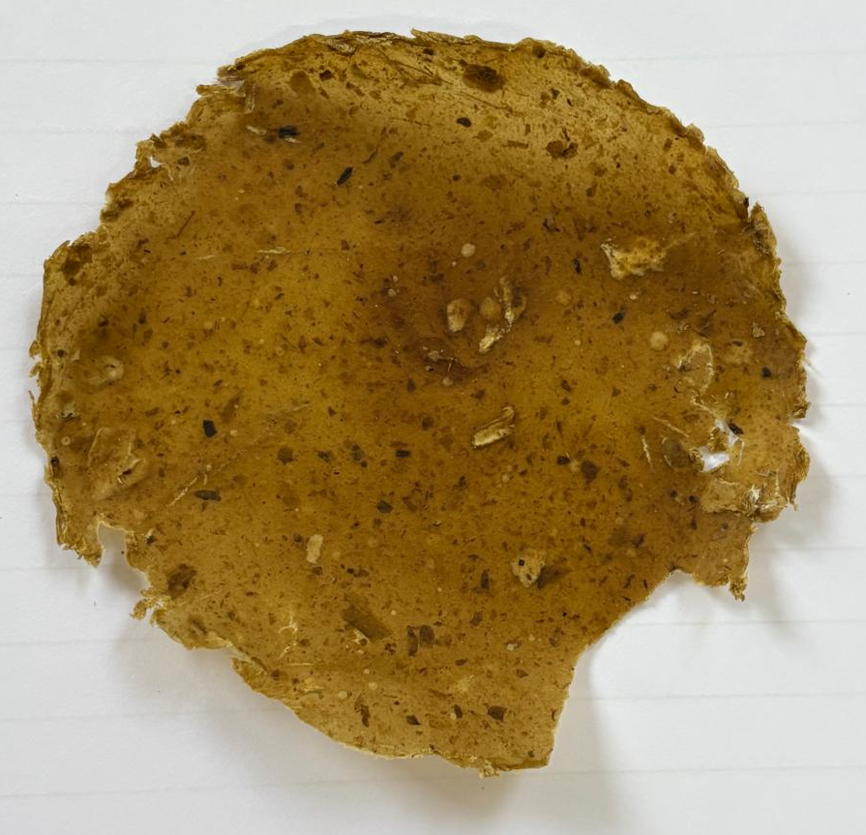
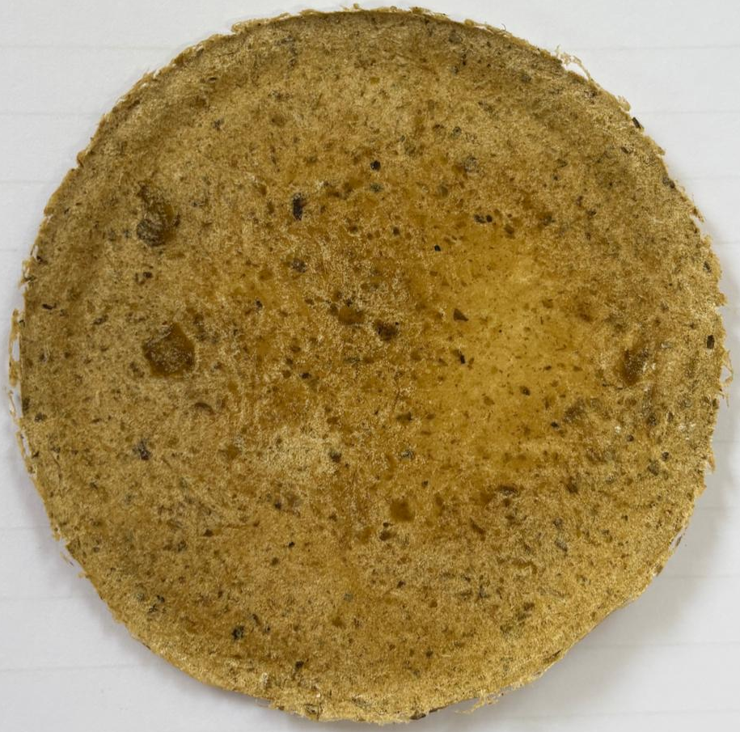
Bioplastic from banana peel
Prototype Image
With Paper Pulp
Without Paper Pulp
08-04-2026
8

Slide 9
Bioplastic from banana peel
Learning Outcome
Learned about biodegradable materials
Understood real-life application of biotechnology
Developed problem-solving skills
Improved teamwork and coordination
Learned from trial and error and mentor feedback
08-04-2026
9

Slide 10
Bioplastic from banana peels
Conclusion & Future Scope
Conclusion: This project shows that banana peels, which are usually thrown away, can be turned into useful bioplastic. It is a small step toward reducing plastic pollution.
Future Scope:
Improve strength and durability
Make waterproof bioplastic
Scale for industrial use
Replace single-use plastics
08-04-2026
10

Slide 11
Bioplastic from Banana peels
Do you want to apply for PoC/Prototype Development support
under Students Startup and Innovation Policy (SSIP 2.0)
under GUIITAR Council?
Yes, this idea has potential for startup support because:
Low-cost raw material
Eco-friendly product
High demand in sustainable markets
08-04-2026
11

Slide 12
Thank You..
08-04-2026
12

