Slide 1




Tinkering & Mentoring - VACC 201
Methodology :
Preparation of Organic Mosquito Repellent (Room / Cloth Spray)
Date (28/04/2026)
Name of the Presenter: Payal Y Saindane
Email Id: 25sc02071@gsfcuniversity.ac.in
Faculty Mentor Name: Dr.Sankara Narayan
Team No.:
Semester: 2nd
Program: B sc - Biotechnology
School: School of Science
1

Slide 2
Methodology :
Preparation of Organic Mosquito Repellent (Room / Cloth Spray)
Student Team
Name | Enrollment No. | Key Responsibility
RAJVI PATEL | 25SC02069 | Neem abstract
SAMARTH RAVAL | 25SC02070 | Lavender oil and prototype preparation
PAYAL SAINDANE | 25SC02071 | Clove abstract, ppt and prototype preparation
SANIYA SIDDHKI | 25SC02072 | Ideation and prototype preparation
BUSHRA SELOT | 25SC02073 | Review report
SIDDHI SHAH | 25SC02074 | Presentation
Reference: Please write / cite the references used (If any) for this slide (Font: Verdana, Size: 09, Color: Black)
29-04-2026
Name of the Presenter
2

Slide 3
Methodology :
Preparation of Organic Mosquito Repellent (Room / Cloth Spray)
Faculty Mentor
Name | Designation | Department, School
DR. SHANKARA NARAYAN | Associate professor | Life sciences
Reference: Please write / cite the references used (If any) for this slide (Font: Verdana, Size: 09, Color: Black)
29-04-2026
Name of the Presenter
3

Slide 4
Methodology :
Preparation of Organic Mosquito Repellent (Room / Cloth Spray)
Brief of Tinkering Project
Natural plant based mosquito repellent spray
A safe eco friendly solution for everyday protection.
Introduction
Mosquito-borne diseases like dengue, malaria, and chikungunya remain a serious public health concern. Most commercial repellents contain harmful chemicals such as DEET, which may cause skin irritation and environmental damage.
This project proposes a natural, plant-based mosquito repellent spray that is safe, effective, affordable, and eco-friendly.
Reference: Please write / cite the references used (If any) for this slide (Font: Verdana, Size: 09, Color: Black)
29-04-2026
Name of the Presenter & Department
4

Slide 5
Organic mosquito repellent spray VS. Chemical mosquito repellent spray
- Effectiveness
in organic is moderate ( 2-3 hr) .
In chemical once it is high 4-5 hours .
- Safety
It iis safe for kids and skin in organic .
And May cause irritation; avoid eyes/mouth in chemical .
- Smell
In organic repellent Natural/herbal.
In chemical strong chemical odor.
-Environmental Impact
In organic Biodegradable, eco-friendly.
And in chemical Can harm aquatic life & beneficial insects.
- Active Ingredients
In organic natural neem abstract , clove abstract and lavender oil (citronella, eucalyptus).
And in chemical DEET, Picaridin, Permethrin such chemicals are used .

Slide 6
Methodology :
Preparation of Organic Mosquito Repellent (Room / Cloth Spray)
1.Aim
To prepare an eco-friendly mosquito repellent spray using plant-based ingredients for use in rooms and on curtains.
Reference: Please write / cite the references used (If any) for this slide (Font: Verdana, Size: 09, Color: Black)
29-04-2026
Name of the Presenter & Department
5

Slide 7
Methodology :
Preparation of Organic Mosquito Repellent (Room / Cloth Spray)
2. Materials Required
Fresh neem leaves (25-30 leaves)
Cloves (10-12 pieces)
Lavander oil
Distilled Water (200 ml)
Propanol (20-30 ml) (helps quick evaporation & preservation)
Spray bottle (preferably dark –colored)
Saucepan / beaker
Filter cloth or filter paper
Mortar & pestle ( for crushing cloves)
Reference: Please write / cite the references used (If any) for this slide (Font: Verdana, Size: 09, Color: Black)
29-04-2026
Name of the Presenter & Department
6

Slide 8


Methodology :
Preparation of Organic Mosquito Repellent (Room / Cloth Spray)
3. Preparation of Extracts
Step 1 : Neem Extracts
Wash neem leaves thoroughly.
Boil in 100 ml distilled water for 15 minutes
Cool and filter collect clear neem extract
Step 2 : Clove Extract
Crush cloves lightly to release oil (eugenol)
Boil in 50 ml water for 10 minutes
Cool and filter obtain clove extract.
Reference: Please write / cite the references used (If any) for this slide (Font: Verdana, Size: 09, Color: Black)
29-04-2026
Name of the Presenter & Department
7

Slide 9

Methodology :
Preparation of Organic Mosquito Repellent (Room / Cloth Spray)
4 : Lavender
Add lavender
Cover and steep for 10-15 minutes
Filter collect aromatic extract
Reference: Please write / cite the references used (If any) for this slide (Font: Verdana, Size: 09, Color: Black)
29-04-2026
Name of the Presenter & Department
8

Slide 10
Methodology :
Preparation of Organic Mosquito Repellent (Room / Cloth Spray)
5 : Preparation of Spray Solution
1. Take a clean beaker and mix :
* 80 ml neem extract
* 40 ml clove extract
* 40 ml lavender oil
2. Add :
* 20 - 30 ml Propanol (acts a preservative & helps spraying)
Reference: Please write / cite the references used (If any) for this slide (Font: Verdana, Size: 09, Color: Black)
29-04-2026
Name of the Presenter & Department
9

Slide 11
Methodology :
Preparation of Organic Mosquito Repellent (Room / Cloth Spray)
7. Application
For Room spray
Spray in corners, under furniture, curtains, and near windows
Use 2-3 times daily, especially in evening
Reference: Please write / cite the references used (If any) for this slide (Font: Verdana, Size: 09, Color: Black)
29-04-2026
Name of the Presenter & Department
11

Slide 12

Methodology :
Preparation of Organic Mosquito Repellent (Room / Cloth Spray)
8. Working Principle
Neem (Azadirachtin) : disrupts mosquito feeding and growth
Clove (Eugenol) : strong odor repels mosquitoes effectively
Levender : masks human scent and repels insects
Reference: Please write / cite the references used (If any) for this slide (Font: Verdana, Size: 09, Color: Black)
29-04-2026
Name of the Presenter & Department
13

Slide 13
Methodology :
Preparation of Organic Mosquito Repellent (Room / Cloth Spray)
9. Precautions
Do not spray directly on face or eyes
Test on fabric to avoid staining
Store in a cool, dark place
Use within 5-7 days (natural products, no strong preservatives)
Shake well before use.
Reference: Please write / cite the references used (If any) for this slide (Font: Verdana, Size: 09, Color: Black)
29-04-2026
Name of the Presenter & Department
14

Slide 14
Methodology :
Preparation of Organic Mosquito Repellent (Room / Cloth Spray)
10. Expected Result
Reduction in Mosquito Presence in room
Pleasant herbal fragrance
Safe for indoor and fabric use
Reference: Please write / cite the references used (If any) for this slide (Font: Verdana, Size: 09, Color: Black)
29-04-2026
Name of the Presenter & Department
15

Slide 15
Methodology :
Preparation of Organic Mosquito Repellent (Room / Cloth Spray)
11. Conclusion
The prepared spray is an effective, natural and eco-friendly mosquito repellent suitable for both room and cloth application, through it required frequent reapplication due to volatility of natural compounds.
Reference: Please write / cite the references used (If any) for this slide (Font: Verdana, Size: 09, Color: Black)
29-04-2026
Name of the Presenter & Department
16

Slide 16
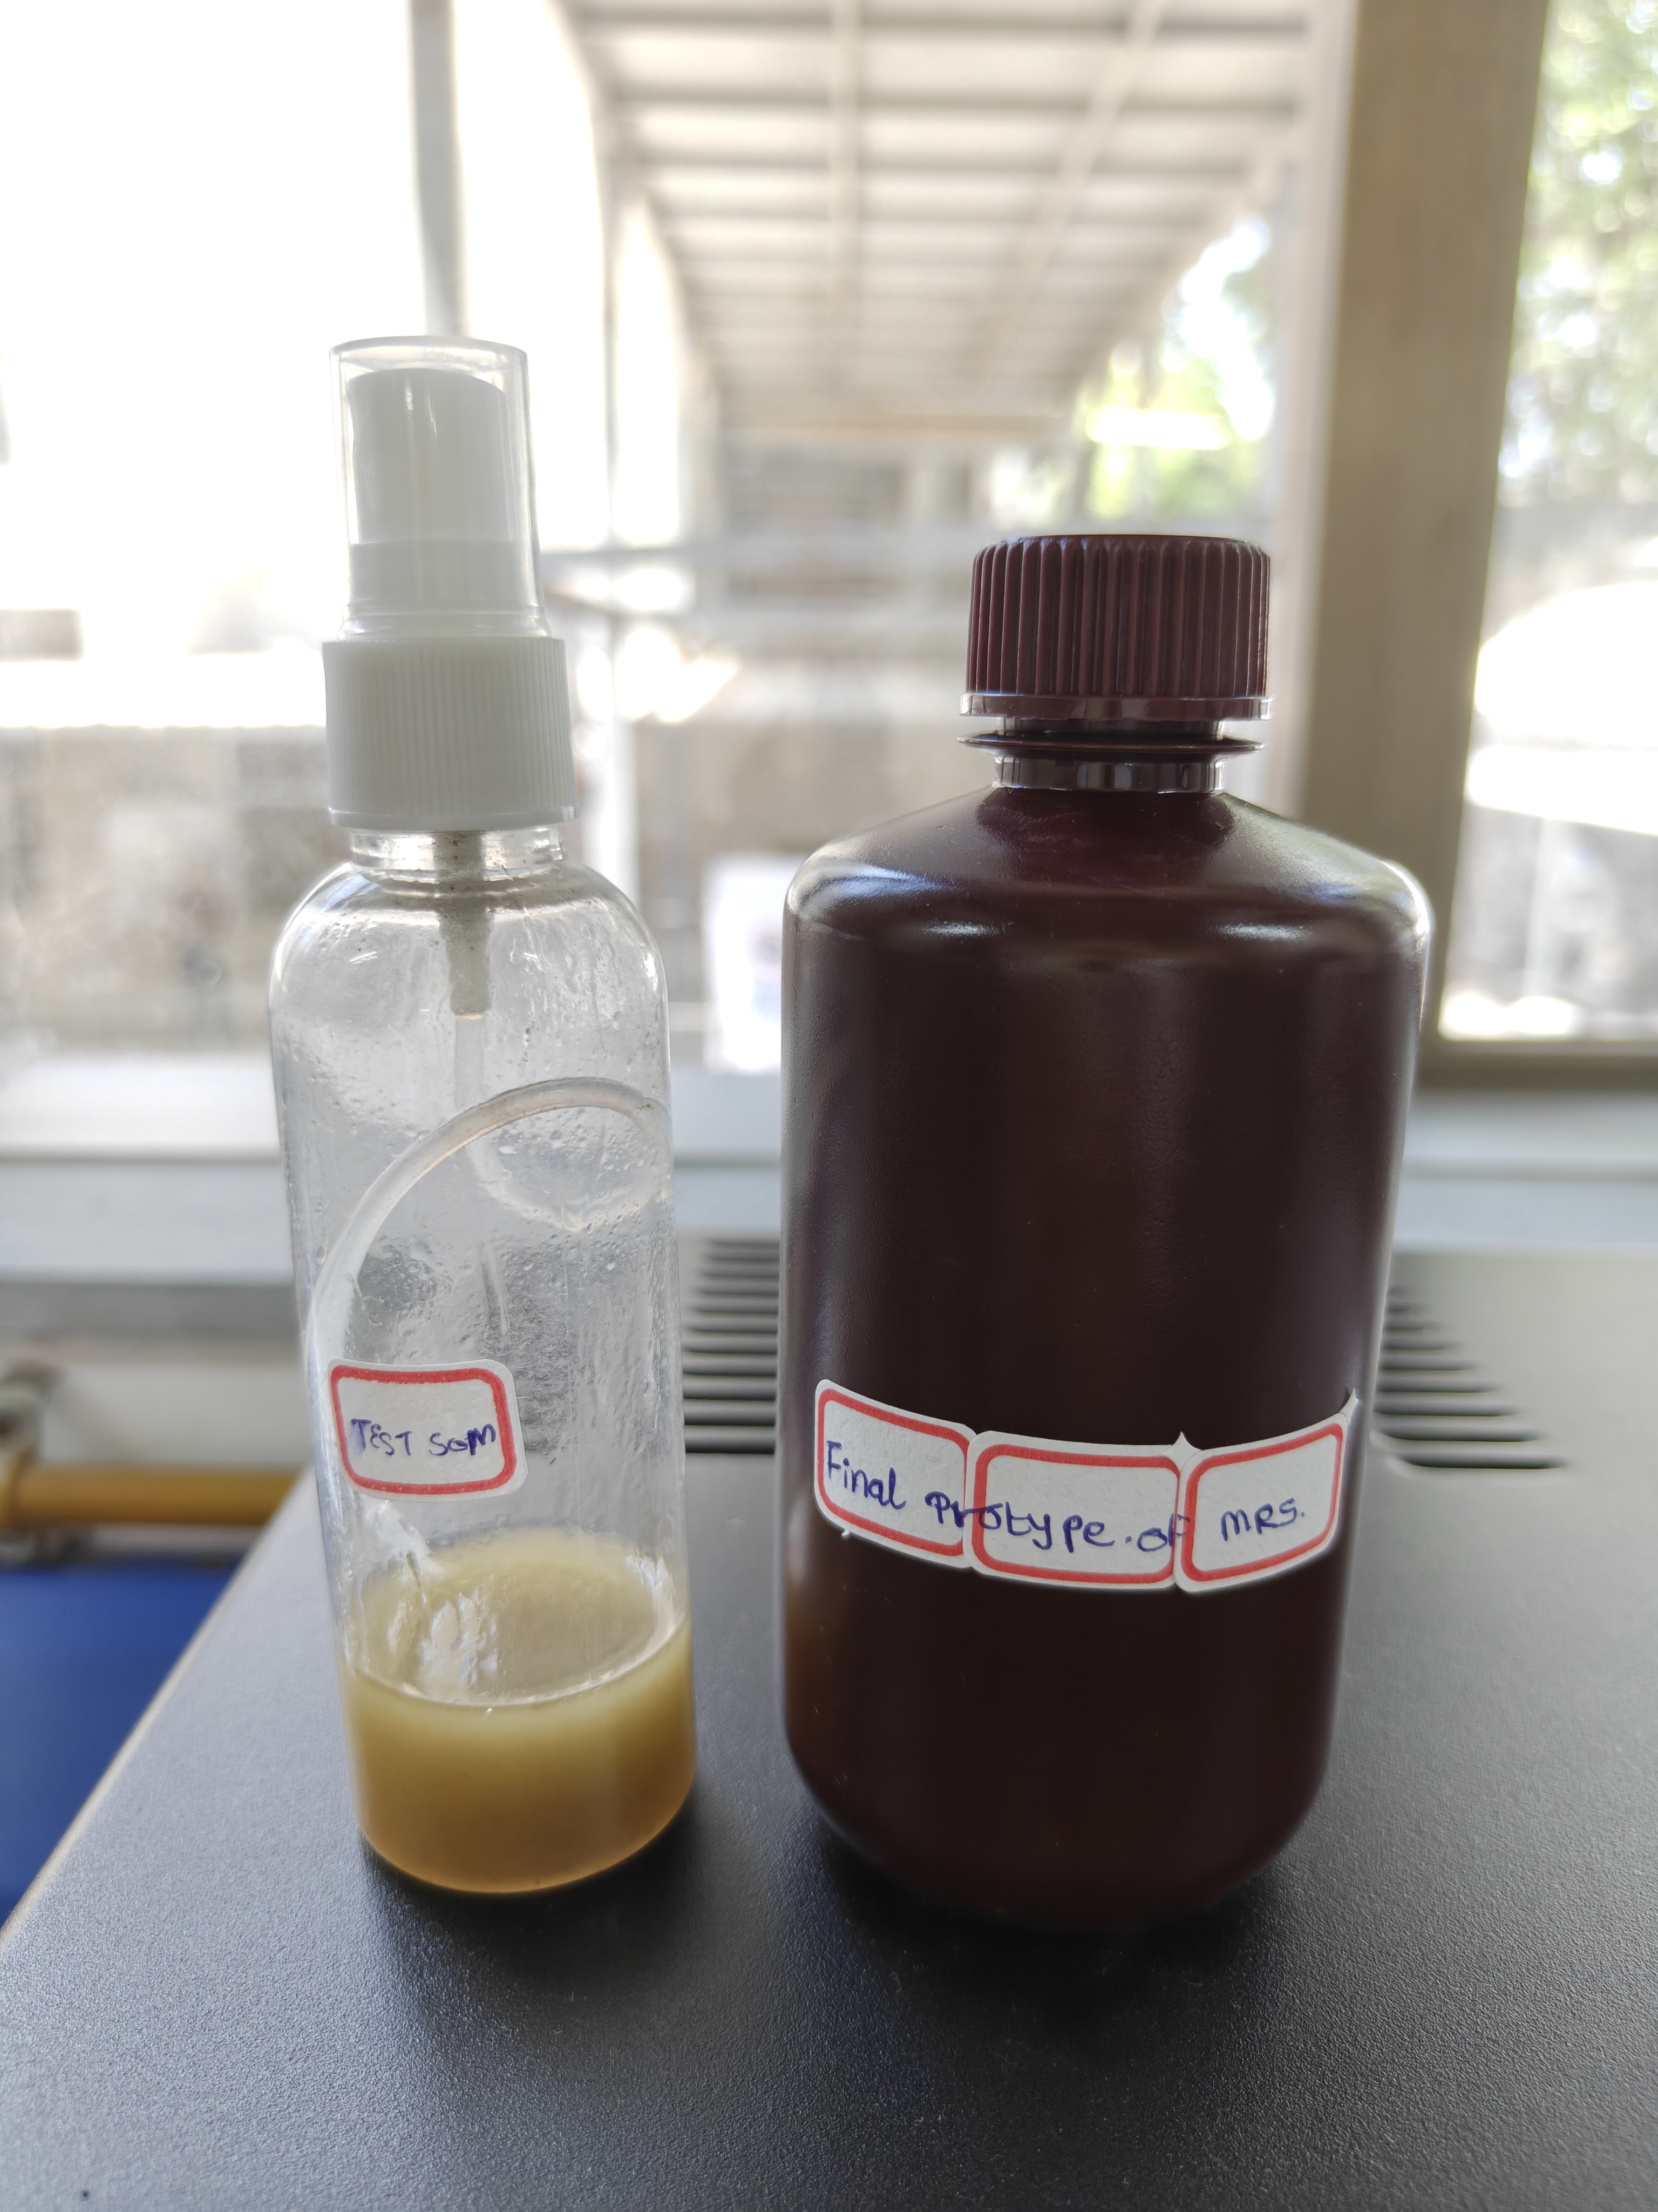
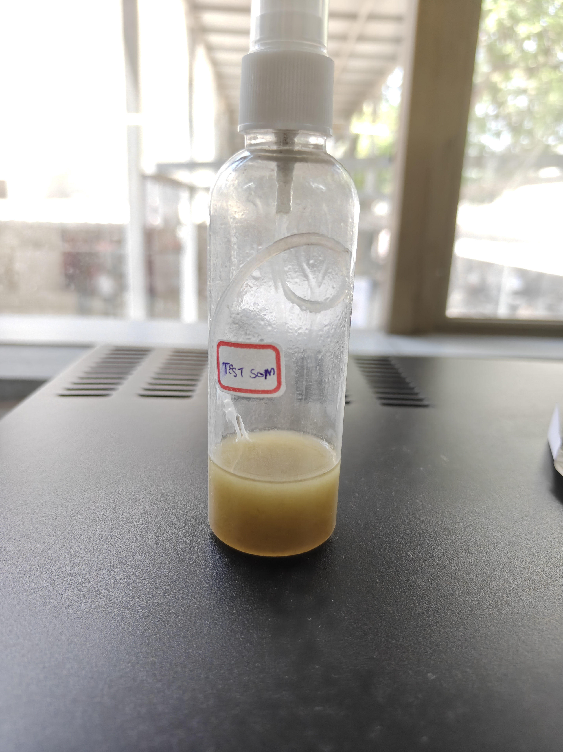
The final prototype in the spray bottle it is for testing on mosquito and in dark bottle you have to store to preserve it .

Slide 17
Thank You..
29-04-2026
Name of the Presenter
17

