Slide 1

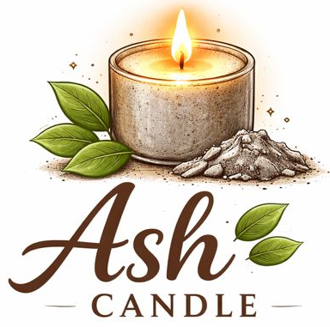
Tinkering & Mentoring - VACC 201
Final Project Presentation &
Demonstration
Ash Candles
Raakh ka kamaal, roshni bemisaal!
Date (19/04/2026)
Name of the Presenter: Srishti Dewangana
Email Id: srishtidewangan03@gmail.com
Mobile No.: 9601593070
Faculty Mentor Name: Ms. Khushbu Verma
Team No.: 14
Semester: 2nd
Program: Biotechnology
School: School of Science

Slide 2
Ash Candle
Student Team
Name | Enrollment No. | Key Responsibility
Parth Solanki | 25SC02081 | Research and product developments
Heny Soni | 25SC02082 | Literature review and experiment conduct
Sneh Soni | 25SC02083 | Ideation, review and feedback
Srishti Dewangan | 25SC02084 | Procurement of raw material
Isha Suthar | 25SC02085 | Research and experiment
Swathi Girish | 25SC02086 | Literature and experiment conduction
Parth Solanki | 25SC02081 | Literature review and product development

Slide 3
Ash Candle
Faculty Mentor
Name | Designation | Department, School
Ms. Khushbu Verma | Assistant professor | Life sciences, school of science

Slide 4
Ash Candle
Introduction of Tinkering Project
Title of Tinkering Project: AgniAura - ash candle
Sector: : Waste Management and Greer Consumer Goods
Brief:
Background of the project | Problem statement | Department, School | Importance/Relevance of the problem
To make asthesthetic low buget candle from agarbatti ash, wax for room decorators, mosquito repellent and make room aromatic | All the ashes are thrown in the water body which may cause the damage to the marign environment | Help in waste management Recycling from old scratch low cost design, eco friendly, made from scratch | Make the room decorative, repel mosquito, long lasting candles, pleasing smell

Slide 5
Ash Candle
Methodology and Tinkering Process
1. Project Approach
The project aims to develop eco-friendly ash-based candles by converting waste ash into a sustainable decorative product. The methodology includes collection and processing of ash, mixing with suitable wax materials, prototype development, performance testing (burn time, smoke emission, stability), and refinement of the product for commercial readiness.
2. The Tinkering Journey (Iterative Process)
The project follows an iterative experimentation process. Multiple prototypes will be prepared by varying ash composition, wax type, and wick size. Each prototype will be tested and analyzed, and improvements will be made based on observations until an optimized and standardized product formulation is achieved.
3. Role of Mentoring in the Process
Mentors will guide technical development, product optimization, and startup planning. Faculty mentors will assist in material selection and testing, while incubation mentors will support business modeling, market validation, and commercialization strategies to align the project with innovation and entrepreneurship goals.

Slide 6
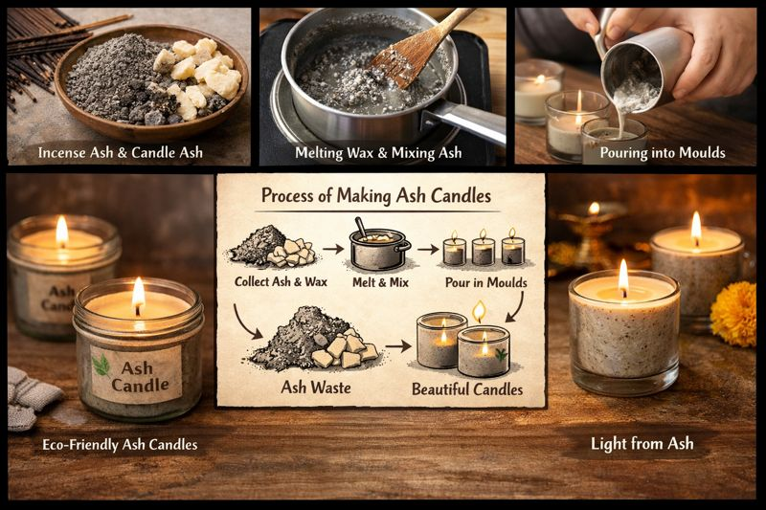
Ash Candle
Tools and Technology Used
Wax Melting Unit / Double Boiler: Controlled melting of wax.
Sieving & Filtration Setup: Purification of ash particles.
Mixing Equipment: Uniform blending of ash and wax.
Candle Molds: Shaping standardized candle prototypes.
Wick Centering Tools: Ensures uniform burning performance.
Temperature Control Tools: Maintains proper processing conditions.
Testing Methods: Burn time, smoke emission, and product quality evaluation.

Slide 7

Ash Candle
Project Outcome & Development
Project Outcome & Development, Use Case
Description of Developed Outcome (Prototype/Model)
An eco-friendly ash-based candle prototype developed using recycled ash blended with wax and natural additives. The product demonstrates sustainable waste utilization while ensuring aesthetic appearance, stable burning performance, and commercial suitability as a decorative and wellness candle.
Development Process
Collection, drying, and sieving of ash.
Selection of appropriate wax and wick.
Preparation of ash-wax mixture and mold casting.
Controlled cooling for prototype formation.
Testing for burn time, smoke emission, and structural stability.
Iterative refinement based on testing outcomes.

Slide 8

Ash Candle
Continue ..
Use Case
Sustainable home décor and gifting products.
Eco-friendly festival and religious candles.
Waste-to-value solution supporting circular economy practices.
Opportunity for small-scale student startup and livelihood generation.
Challenges Faced
Optimizing ash-wax ratio for smooth texture.
Preventing cracking and uneven burning.
Maintaining fragrance retention and aesthetic quality.
Standardizing formulation for scalable production.

Slide 9
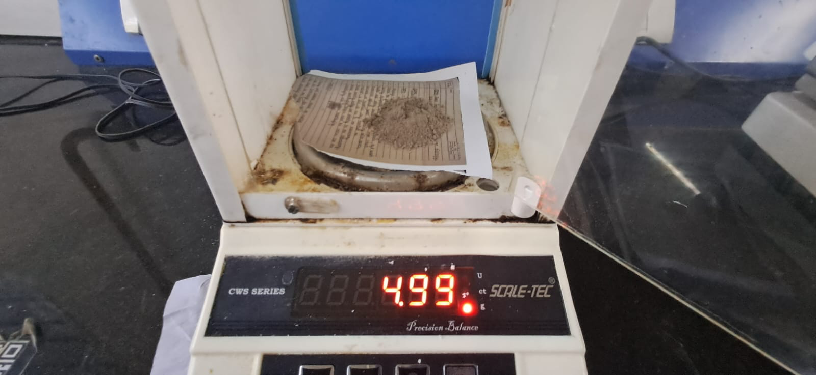
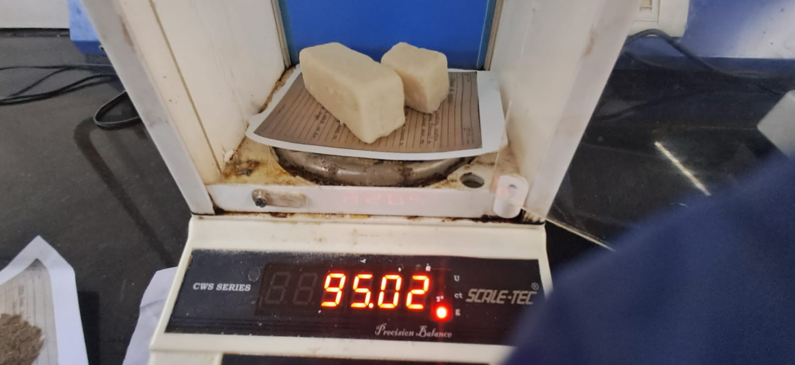
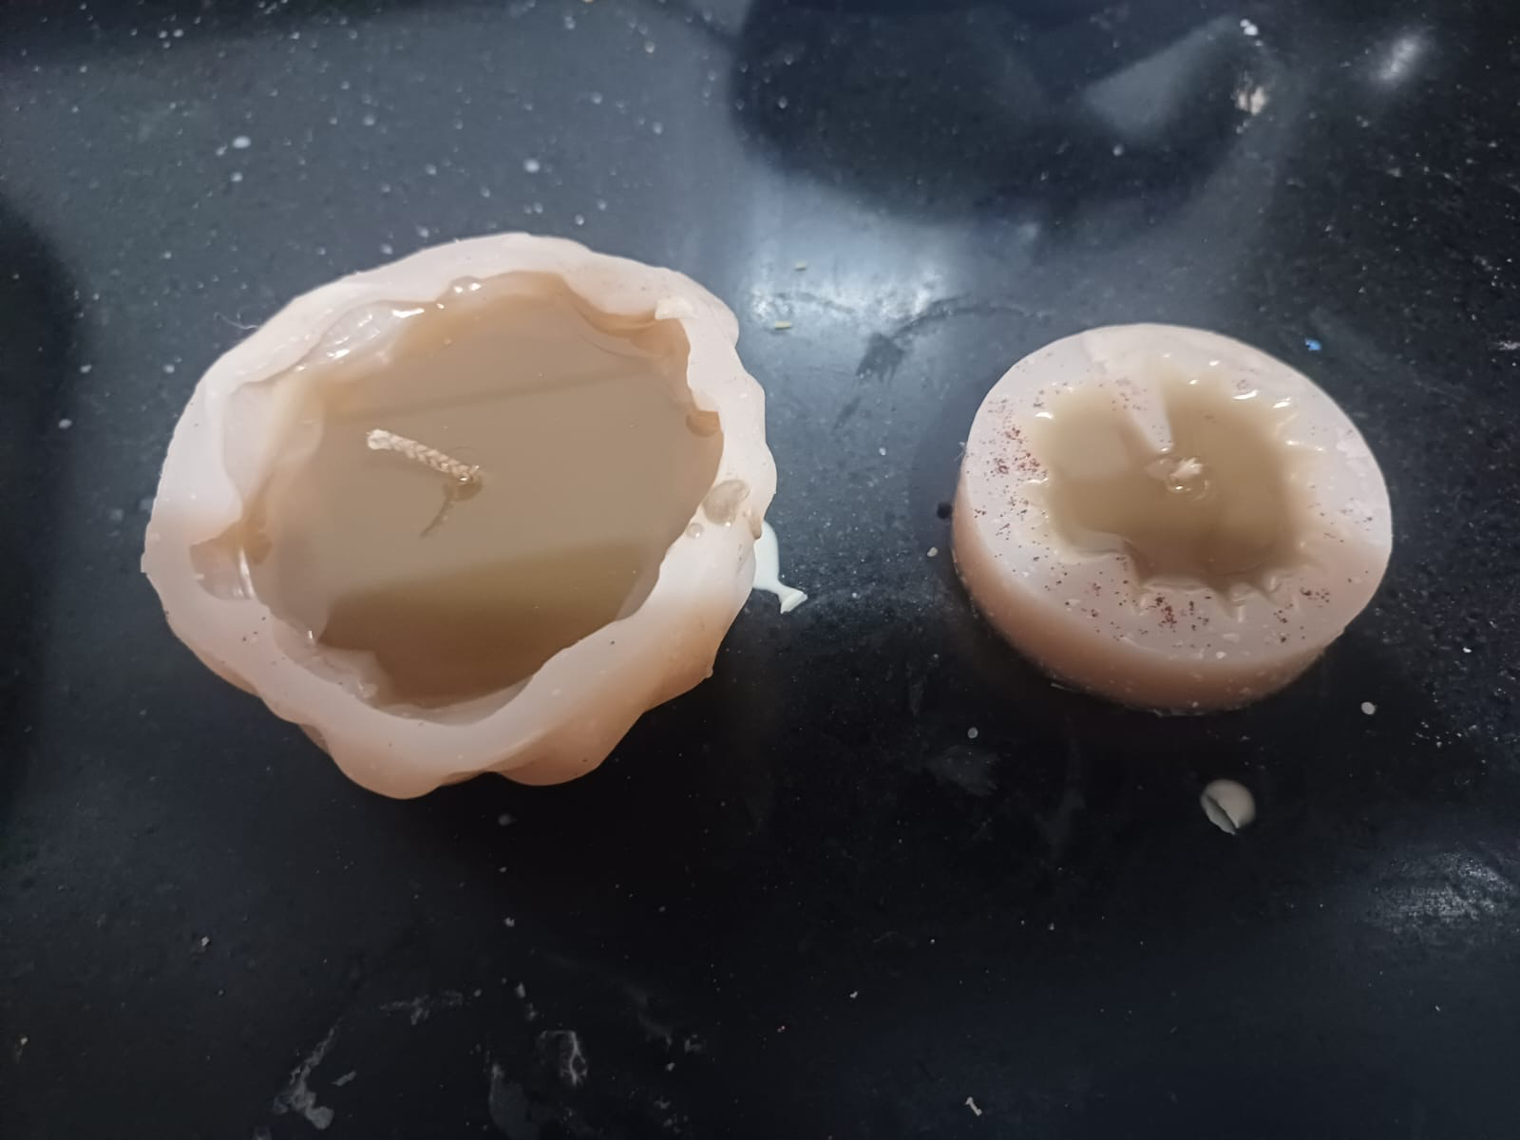
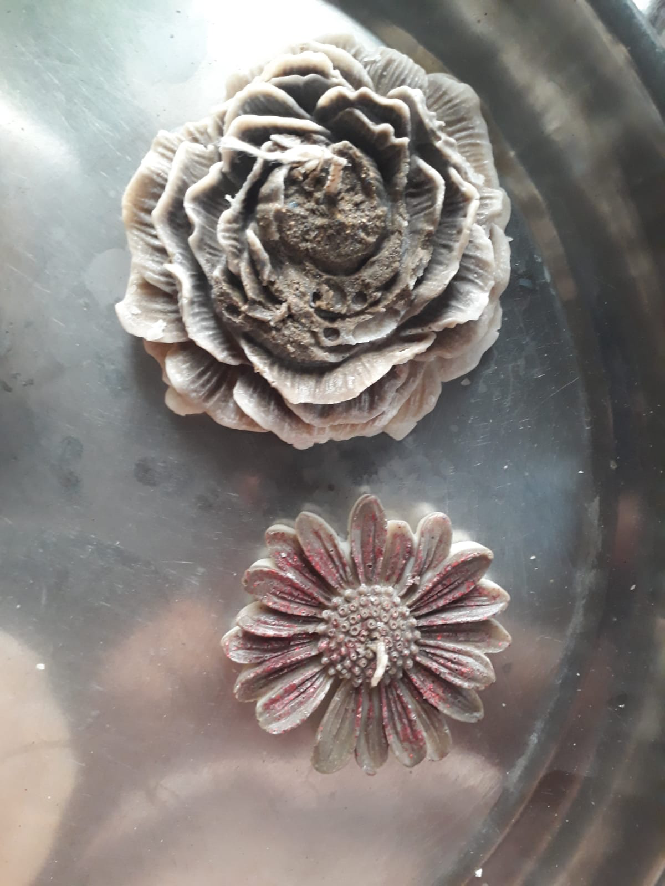
Ash Candle
Prototype Image/Video

Slide 10
Ash Candle
Learning Outcome
Technical/Conceptual Learning
Gained knowledge about sustainable material utilization, candle manufacturing techniques, material compatibility, temperature control, and prototype testing methods related to eco-friendly product development.
Problem-Solving and Tinkering Skills Developed
Developed experimentation and analytical skills through iterative testing, optimization of ash-wax ratios, improvement of burning performance, and troubleshooting issues such as cracking and uneven combustion.
Learning from Mentoring Sessions and Feedback
Mentoring sessions provided guidance in product refinement, quality improvement, innovation thinking, and understanding commercialization strategies, helping align the project with startup and sustainability goals.
Teamwork and Collaboration
The project encouraged collaborative learning through idea sharing, task distribution, coordinated experimentation, and collective decision-making during prototype development.

Slide 11
Ash Candle
Conclusion & Future Scope
Conclusion and Summary of Achievements
The project successfully developed an eco-friendly ash-based candle prototype by converting waste ash into a value-added product. The prototype demonstrated sustainable material utilization, acceptable burning performance, aesthetic appeal, and feasibility for commercialization as a green lifestyle product.
Future Enhancements and Applications
Improvement in fragrance retention and burn efficiency.
Development of scented, decorative, and customized candle variants.
Scaling production using semi-automated methods.
Exploration of eco-packaging and branding strategies.
Expansion into sustainable gifting, wellness, and festival markets.
Reflection on the Project Experience
The project provided practical exposure to innovation, material experimentation, and prototype development. It enhanced problem-solving ability, entrepreneurial thinking, sustainability awareness, and understanding of converting an idea into a market-oriented product.

Slide 12
Ash Candle
Do you want to apply for PoC/Prototype Development support under Students Startup and Innovation Policy (SSIP 2.0) under GUIITAR Council?
No, we don’t want to apply for PoC/Prototype Development support under Students Startup and Innovation Policy (SSIP 2.0) under GUIITAR Council

Slide 13
Thank You..

