Slide 1
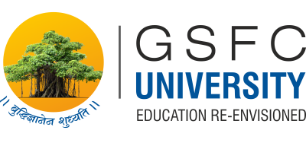
Tinkering & Mentoring - VACC 201
Final Project Presentation &
Demonstration
Self Healing Bio Strip
Date (30/04/2026)
Name of the Presenter: Vallari Kanade
Swera Nagar
Email Id:25SC02087@gsfcuniversity.ac.in
25SC02092@gsfcuniversity.ac.in
Mobile No.:9157222633
9825573341
Faculty Mentor Name: Dr. Prasad Andhare
Team No.: SOS_15
Semester: 2nd
Program: B.sc Biotechnology
School: School of Science

Slide 2
Self Healing Bio Strip
Student Team
Name | Enrollment No. | Key Responsibility
Swera Nagar | 25SC02087 | Presenter
Aditya Tanikella | 25SC02088 | Base Material Development
Vansh Umrigar | 25SC02089 | Treasurer
Hetvika Vaghela | 25SC02090 | Documentation Lead
Vedika Vaghela | 25SC02091 | Bio Active Additives
Vallari Kanade | 25SC02092 | Presenter

Slide 3
Self Healing Bio Strip
Faculty Mentor
Name | Designation | Department, School
Dr. Prasad Andhare | Assistant Professor | Department of Life Sciences, School of Science, GSFC University

Slide 4
Self Healing Bio Strip
Introduction of Tinkering Project
Title of Tinkering Project: Self Healing Bio Strip
Sector: Sustainability
Brief: Brief of Tinkering Project-
This tinkering project focuses on the development of a bio-based self-healing material using sustainable, naturally derived, and easily available components such as gelatin and chitosan.
The project explores the fabrication of a soft, dry but moisture bound strip capable of restoring its structural integrity after minor mechanical damage, while exhibiting properties comparable to conventional protective dressings.
The aim is to demonstrate a low-cost, 100% biodegradable, plasticized matrix designed to provide durable surface protection as an eco-friendly alternative to synthetic medical adhesives by applying fundamental principles of biomaterials science, polymer interactions, and material performance evaluation.

Slide 5
Self Healing Bio Strip
Methodology and Tinkering Process
Project Approach
We noticed that most wound dressings available today are made from synthetic materials that do not break down naturally and offer no active healing benefit. This led us to explore whether a natural, plant-based material could serve the same purpose in a more sustainable and skin-friendly way. Our approach was to identify naturally available ingredients that are known to be gentle on the body, biodegradable, and capable of supporting wound healing without any synthetic chemicals. From the beginning we focused on keeping the project realistic and honest about what a student prototype could achieve.
The Tinkering Journey
Our process was iterative we did not design everything upfront and execute it perfectly. In the first week we explored the problem and researched natural materials relevant to wound care. The second week was spent deciding which ingredients to use and understanding the role each one would play. In the third week we attempted our first prototype, mixing the ingredients and casting them into a flat mold to dry. What we observed from that first attempt informed changes we made in the fourth week, where we adjusted the balance of ingredients until the material behaved the way we intended. Each failure taught us something more useful than a perfect result would have.
Role of Mentoring
Our mentor played a central role throughout the project. Rather than providing direct answers, he guided us to think through problems ourselves. When our early attempts did not produce the results we expected, he helped us identify what was going wrong and encouraged us to revise our approach. His most important contribution was keeping our claims grounded consistently reminding us to describe only what we actually observed rather than assuming results we had not tested. This shaped not just the project but the way we approach scientific thinking in general.

Slide 6
Self Healing Bio Strip
Tools and Technology Used
We worked with standard laboratory equipment throughout this project, which was an important part of keeping it accessible and realistic for a student setting. Mixing equipment such as a glass rod and beakers allowed us to combine our ingredients thoroughly and evenly.
A weighing scale and measuring cylinder ensured we added each ingredient in consistent amounts across different attempts, which was essential for comparing results fairly.
A flat petri dish served as our casting mould, giving the material a level surface to dry into a uniform thin film. We controlled the drying environment carefully, avoiding high temperatures to protect the natural ingredients from losing their properties during the process.
For testing, we used simple hand-based observations bending and folding the film to assess flexibility, and a basic cut-and-press test to observe whether the material showed any tendency to rejoin at a point of damage. All raw materials were sourced from local suppliers, and no specialised or synthetic chemicals were required at any stage.

Slide 7

Self Healing Bio Strip
Project Outcome & Development
Description of the Prototype
Our prototype is a thin, flexible film made entirely from natural ingredients. It is designed to be placed over a wound to protect it, maintain a comfortable environment for healing, and provide some natural resistance to bacterial growth. The film is soft enough to conform to the surface of skin and is made from materials that break down naturally over time without leaving harmful residue. One of its most notable characteristics is that when a small cut or crack forms in the film, placing the two sides back in contact with a little moisture allows them to gradually rejoin. This self-healing behaviour arises from the natural bonding properties of the base material we used. The film is not fully sealed it allows a small amount of air to pass through, which is important for healthy wound recovery.
Development Process and Challenges
We began by dissolving our natural polymer base in a mild liquid that allowed it to break down evenly into a smooth solution. We then added a plant gel extract and a natural softening agent before pouring the mixture into a flat mold to dry slowly at a low temperature. The process itself was straightforward, but getting the results right took several attempts. Our first film cracked easily when bent, which we addressed by adjusting the amount of softening agent. A later attempt produced a film that was too weak because we had added too much plant extract, so we reduced that amount until we found a better balance. Air bubbles trapped in the solution caused surface defects in one batch, which we solved by allowing the mixture to rest before pouring. Drying at too high a temperature caused surface cracking in another attempt, so we switched to slower room-temperature drying throughout. Each of these problems taught us to think more carefully about cause and effect in material preparation.

Slide 8
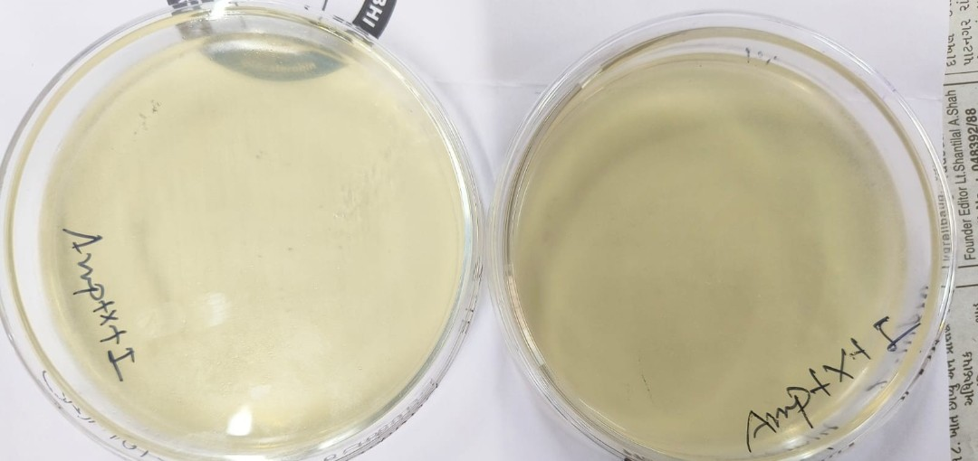
Prototype Image/Video

Slide 9
Self Healing Bio Strip
Learning Outcome
Technical and Conceptual Learning
We developed a solid understanding of how natural polymers behave and why certain ingredients are suited for wound care applications. We also learned about the basic principles of wound healing in particular why maintaining a moist environment at the wound surface supports faster recovery and how material properties like flexibility, biodegradability, and natural antimicrobial behaviour all contribute to that goal.
Problem-Solving and Tinkering Skills
The most significant skill we developed was the ability to observe a problem, think about its likely cause, and make a specific targeted change rather than starting the entire process over. Every challenge we encountered brittleness, structural weakness, drying defects trained us to treat material design as an ongoing process of refinement rather than a single fixed solution. This is the core mindset of tinkering.
Learning from Mentoring Sessions and Feedback
Our mentor taught us the difference between what we designed on paper and what we could honestly claim from our actual observations. This introduced us to the concept of scientific integrity presenting work accurately, acknowledging limitations openly, and describing findings without overstating them. This was arguably the most valuable lesson of the entire project because it applies far beyond this one experiment.
Teamwork and Collaboration
We divided responsibilities across the team so that each person contributed to a different aspect of the project preparation, observation, documentation, and presentation. Decisions about changes to the formulation were made together, which made the process more balanced and ensured that no single person's assumption drove the outcome. Working collaboratively also meant that when one person missed something during an observation, another person caught it.

Slide 10
Self Healing Bio Strip
Conclusion & Future Scope
Conclusion and Summary of Achievements
Through this project we successfully designed and produced a prototype of a natural, biodegradable wound support film using plant-based and skin-friendly ingredients. The material demonstrated flexibility, a tendency to partially rejoin when damaged and exposed to moisture, and properties consistent with supporting wound healing — all without synthetic chemicals or pharmaceutical additives. We are satisfied that the concept is sound and that the prototype meaningfully represents the idea we set out to explore.\
Future Enhancements and Applications
Going forward we would like to carry out proper laboratory testing to measure the film's actual performance — including how well it allows air to pass through, how effectively it resists bacterial growth, and how safely it breaks down over time. We also see potential to improve the material's mechanical strength and explore whether it could be adapted for different wound types. With further development and clinical validation, a material like this could be a meaningful contribution to sustainable healthcare, particularly in settings where access to expensive synthetic dressings is limited.
Reflection on the Project Experience
The most important thing this project taught us is that design is never finished on the first attempt. Every time something did not work the way we expected, we learned something more useful than if it had gone perfectly. We also learned that being honest about what you do not know is just as important as demonstrating what you do know. This project gave us practical experience with the kind of thinking that real scientific and engineering work actually requires — patience, observation, revision, and intellectual honesty.

Slide 11
Thank You..

