Slide 1

ॐ श्रीगणेश-शारदा-गुरुभ्यो नमः॥ CS698F Final Demo
TEAM 1:
ASHWIN SHENAI (180156)
ISHANH MISRA (180313)

Slide 2
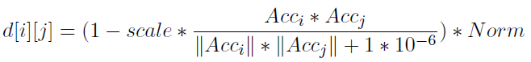
Gesture Recognition
Basic DTW implemented for recognizing simple gestures.
Decision for “Distance” metric d(x_{i}, y_{j}):
Cosine Similarity Metric:
Gestures we've worked with:
Hand going forward/backward, making a cross and a wave.
up/down, right/left, rotational hand movement

Slide 3
Data Collection
Used Physics Toolbox to collect accelerometer data for the following gestures:
Forward, Backward, Wave, Cross
Bow up, Bow down, Flip, Flop
Up, Down, Left, Right
Gestures were recorded at low speed – each gesture spans about 5 seconds
Data was recorded at minimum possible sampling rate – 100 Hz frequency
Multi Record feature used to simultaneously record accelerometer data

Slide 4
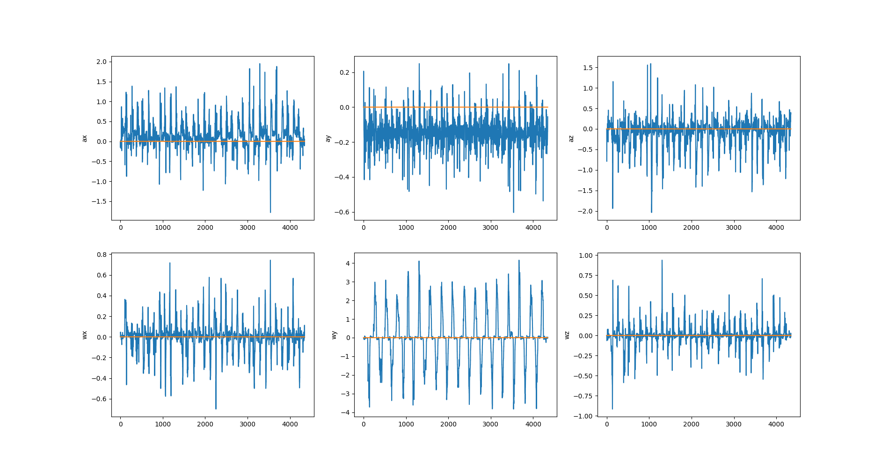
Data: Flip / Flop

Slide 5
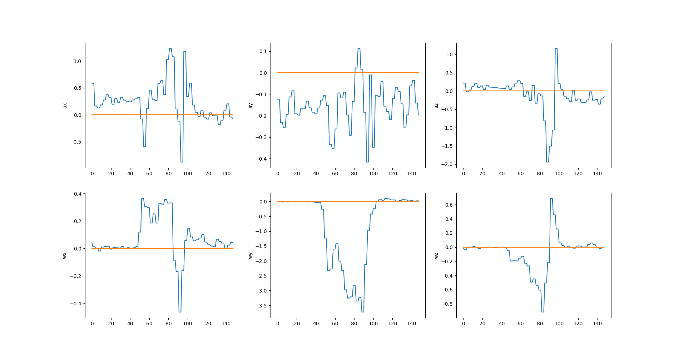

Slide 6
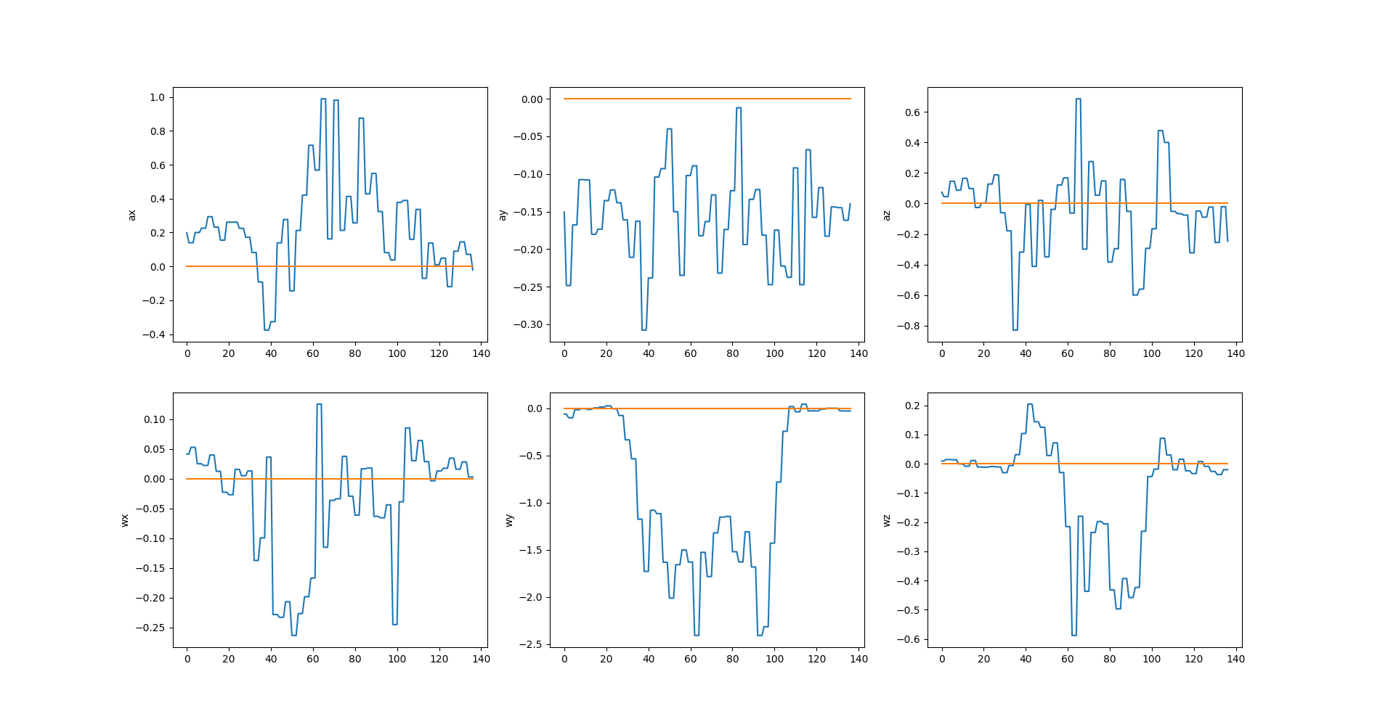

Slide 7
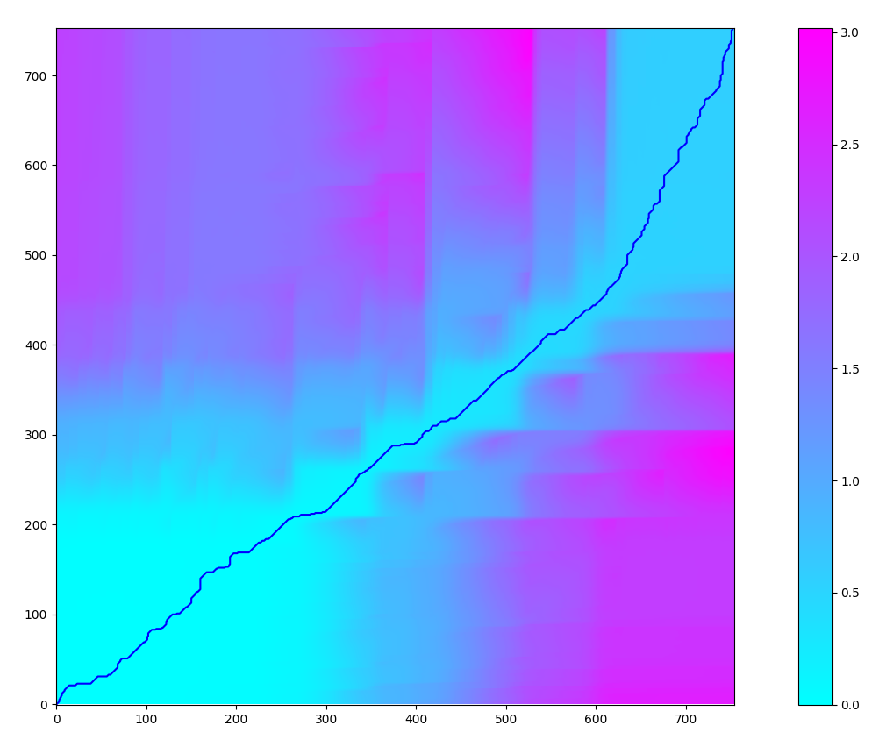

Basic DTW
O(MN) runtime
All combinations need not be checked
Impose global constraints
Approximate optimal solutions acceptable
DTW path (matching signal) from Cosine Metric

Slide 8
Key Focus: Optimizing DTW

Slide 9
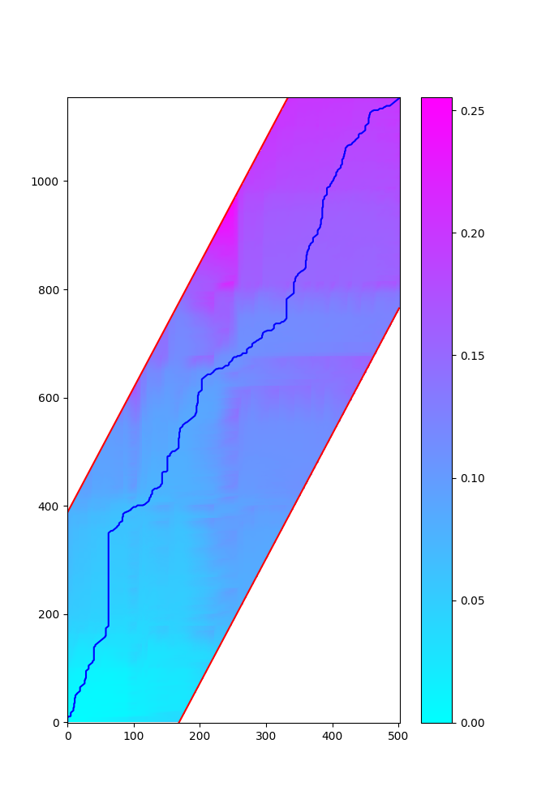
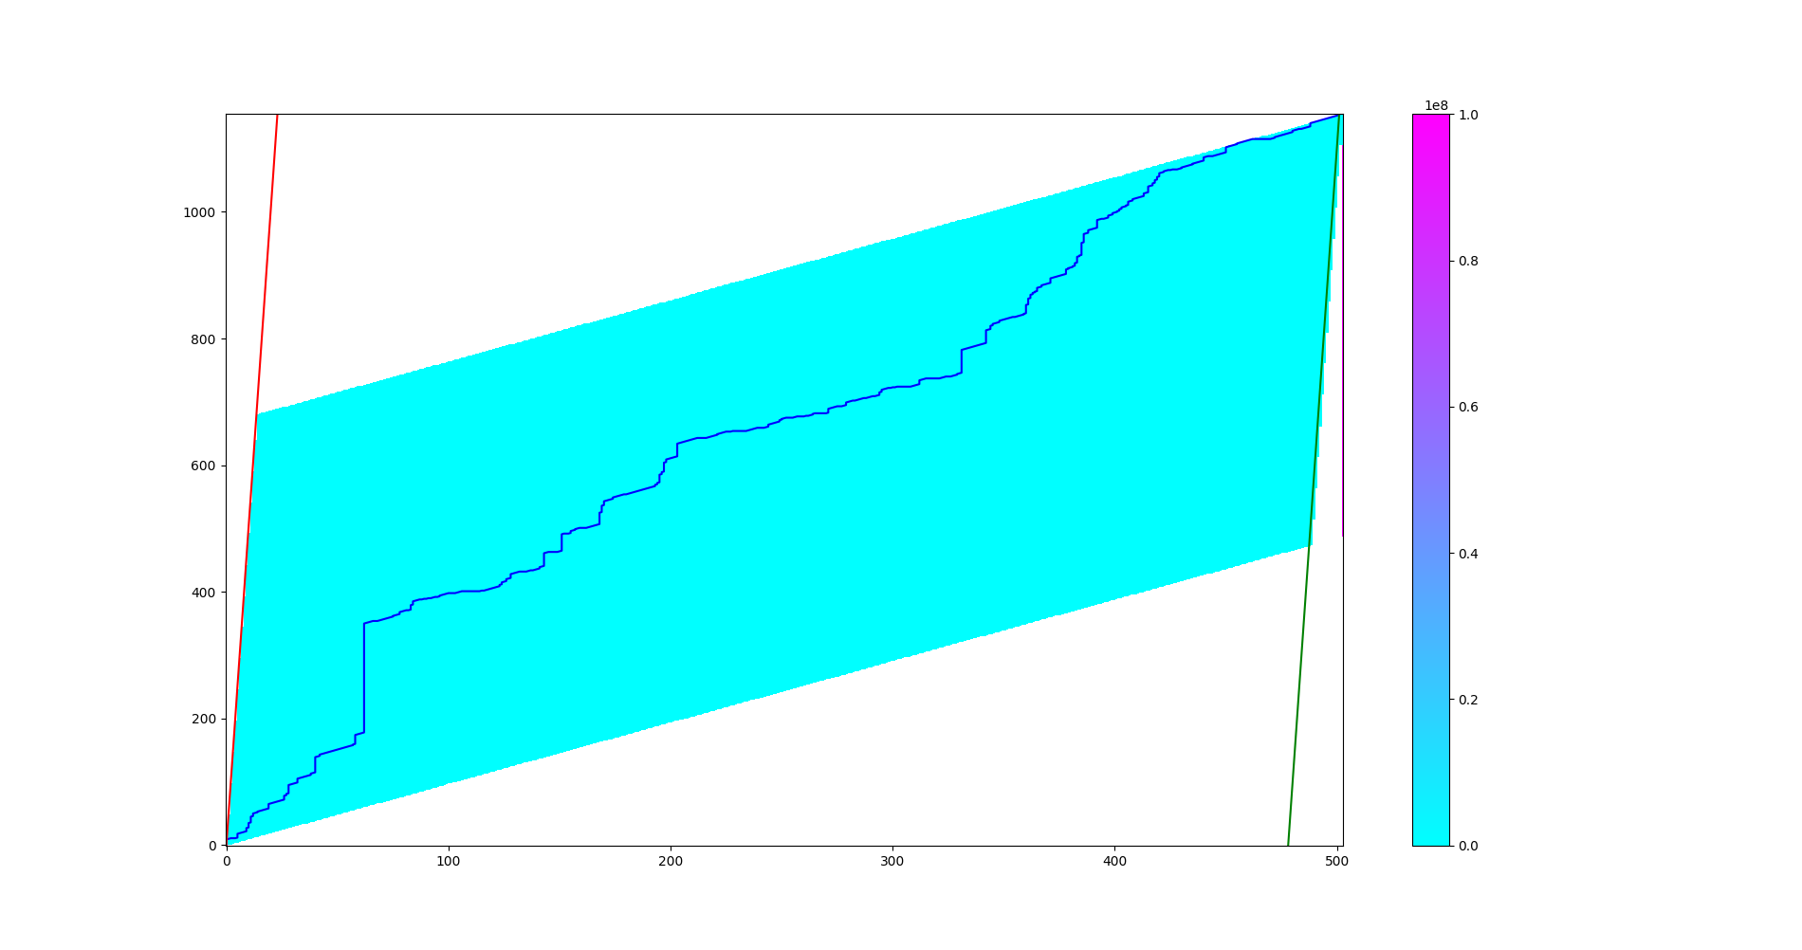
Sakoe Chiba Band
Itakura Parallelogram

Slide 10
Runtime Comparison
Variant | Length of X | Length of Y | Average Runtime (s)
Vanilla | 502 | 1154 | 5.65
Vanilla | 753 | 1154 | 7.99
Sakoe Chiba | 502 | 1154 | 3.43
Sakoe Chiba | 753 | 1154 | 4.75
Itakura | 502 | 1154 | 5.61
Itakura | 753 | 1154 | 7.17
Can try to analyze/graph asymptotic behaviour – will attempt to include in the report

Slide 11
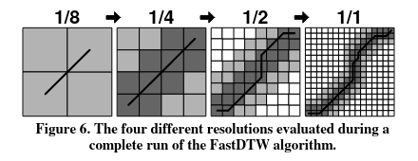
FastDTW
Approximate DTW in linear time and space
Recursively applies DTW at different granularities
Overall recursion is bounded in O(N)
Additionally applies global constraints for more speedup
Alignment is not straightforward to compute, only total cost is readily accessible

Slide 12
Improving Data

Slide 13
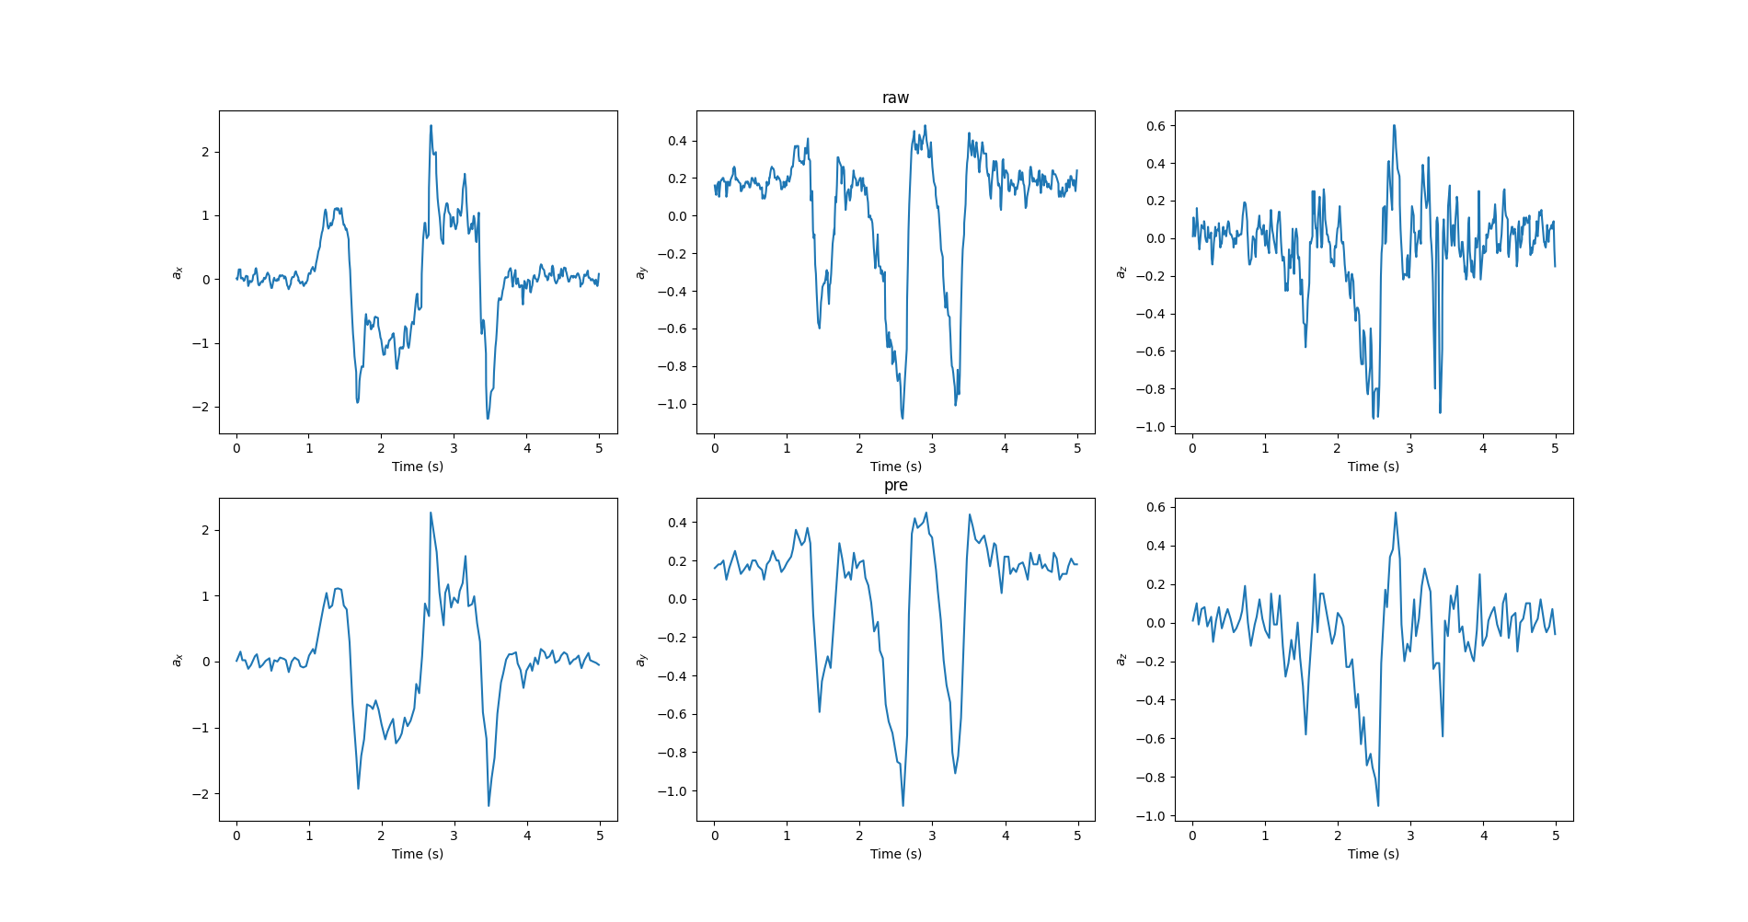
Downsampling

Slide 14
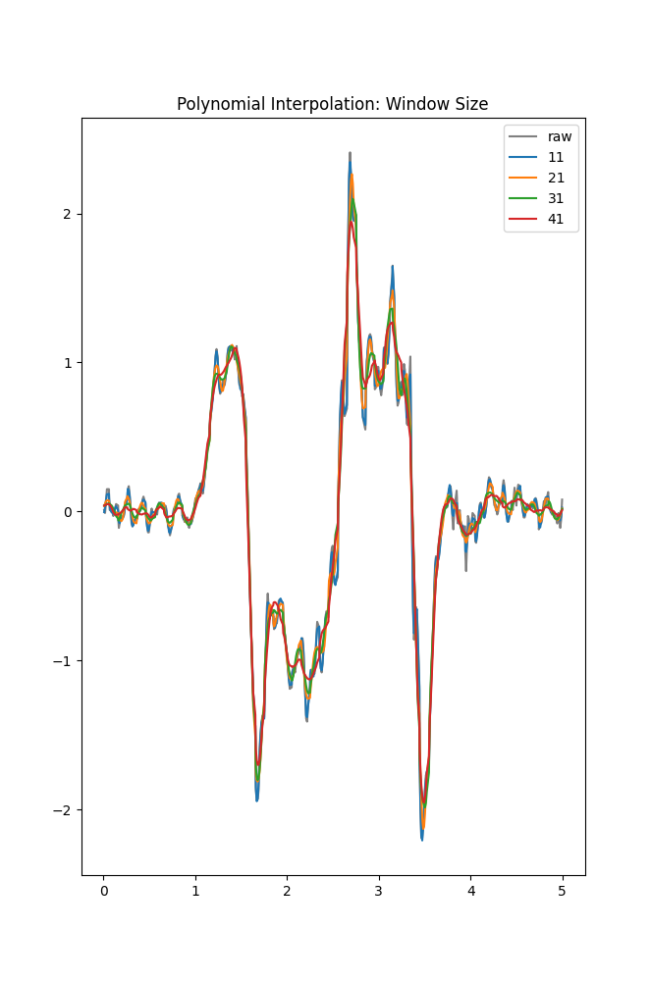
Polynomial Interpolation
Savitzky-Golay Filter
Essentially polynomial interpolation
Fits successive subsets of adjacent data points with a low-degree polynomial by the method of linear least squares
Window and polynomial order must be tuned
We apply moving average smoothing in addition to this

Slide 15
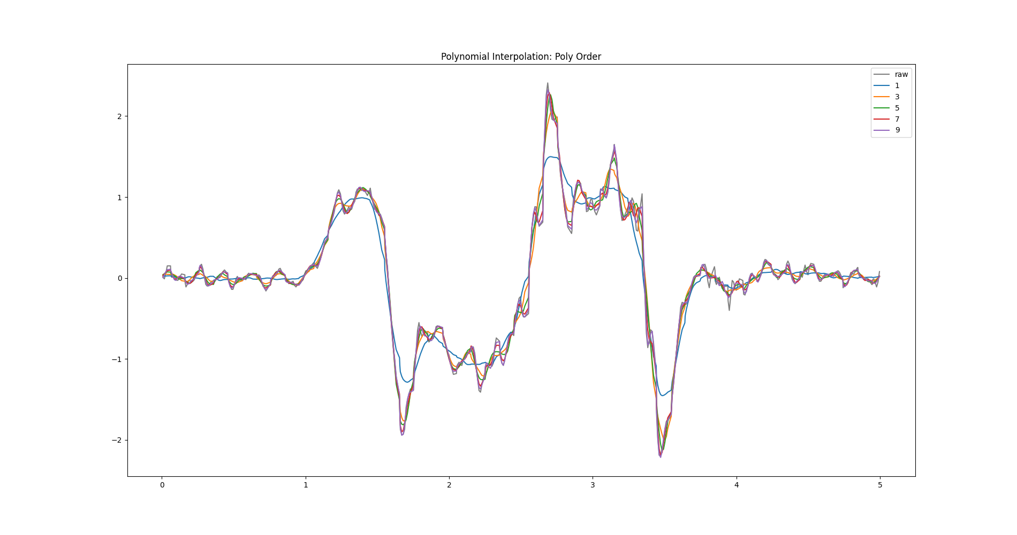

Slide 16
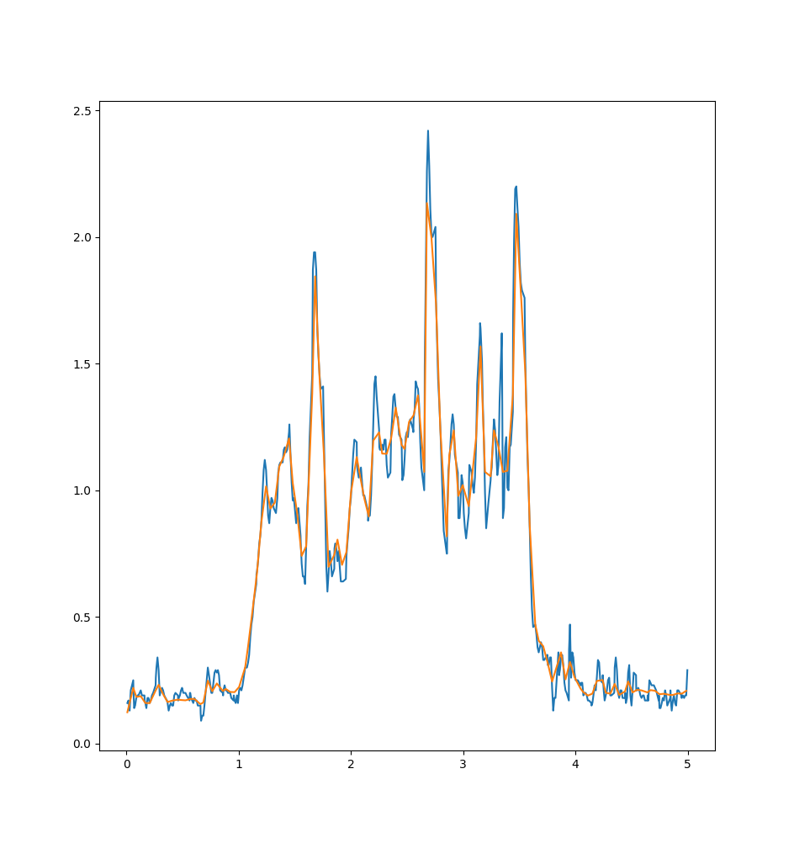
Wavelet Denoising
Uses the Wavelet transform
STFT-like operation – convolve signal with shifted, scaled wavelets
Better at preserving time-related features
Relatively expensive to compute
Denoising – take the transform, threshold coefficients and invert

Slide 17
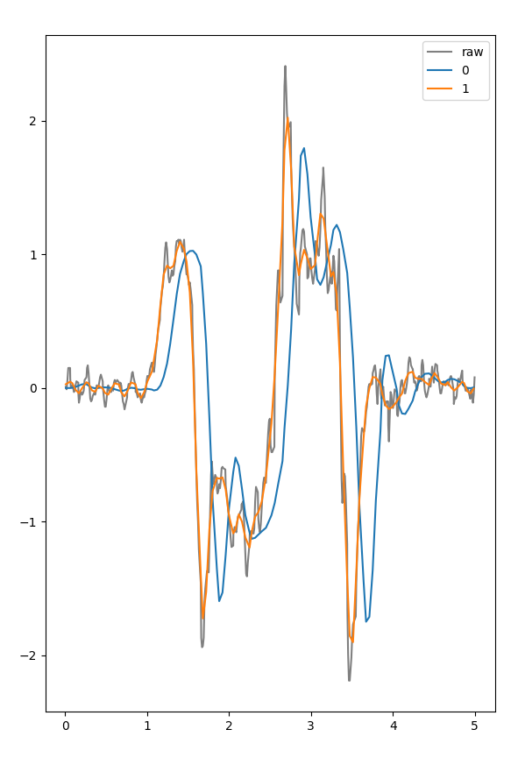
Low Pass Filtering
Butterworth Filter
Very widely used for denoising in signal processing
Designed to have a flat response in the passband
Cutoff frequency and order can be controlled
Used in low pass mode - high frequency noise attuned out
Applying the filter inevitably causes a time shift
Increases with filter order

Slide 18
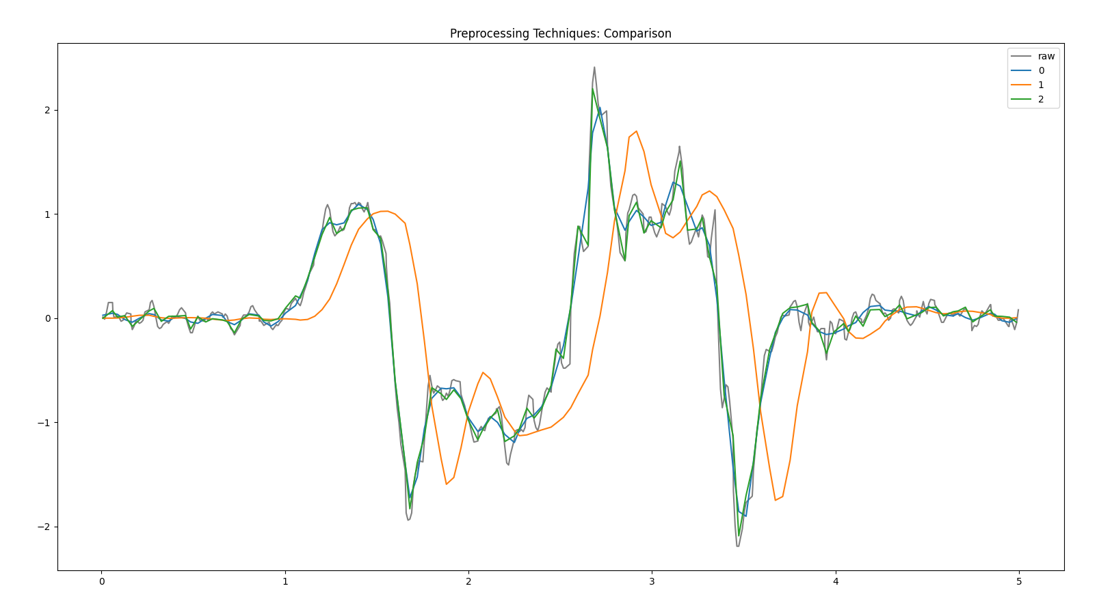
Comparisons

Slide 19
Runtime Comparison
Variant | Length of X | Length of Y | Average Runtime (s)
Vanilla | 753 | 1154 | 7.99
Vanilla (DS) | 188 | 289 | 1.45
Sakoe Chiba | 753 | 1154 | 3.43
Sakoe Chiba (DS) | 188 | 289 | 0.285
Itakura | 753 | 1154 | 5.61
Itakura (DS) | 188 | 289 | 0.387
FastDTW | 753 | 1154 | 0.266
FastDTW (DS) | 188 | 289 | 0.069

Slide 20
SoftDTW
Current DTW techniques ; discrete in nature (signal values as discrete times)
What about continuous case? (Is this unrealistic?)
ML and NN techniques prefer differentiable loss functions
Soft DTW computes value and gradient of this loss in quadratic time and quadratic space
Original paper: Soft-DTW: a Differentiable Loss Function for Time-Series (arxiv.org)
Code picked from https://github.com/Maghoumi/pytorch-softdtw-cuda as is (quite well-written)
Offers CUDA (parallel programming library for NVIDIA GPUs) support
Tried computing SoftDTW for our project : remarkably fast code
24800 loss computations in 102.4 seconds
Drawback: original data from other member of 3 dimensions, while softDTW tested on 6 dimensions
Three extra dimensions for gyroscope (could not devote much time to compute bias)

Slide 21
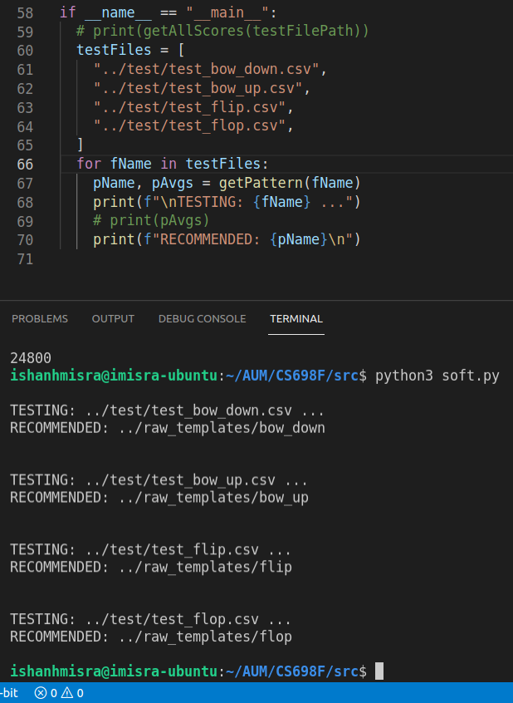
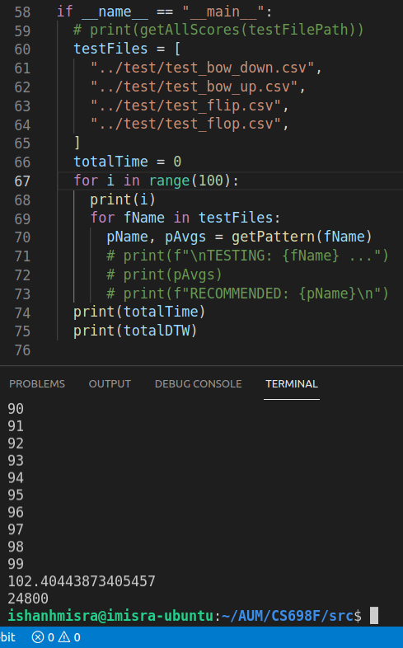

Slide 22
DEMO: Windowed DTW

Slide 23
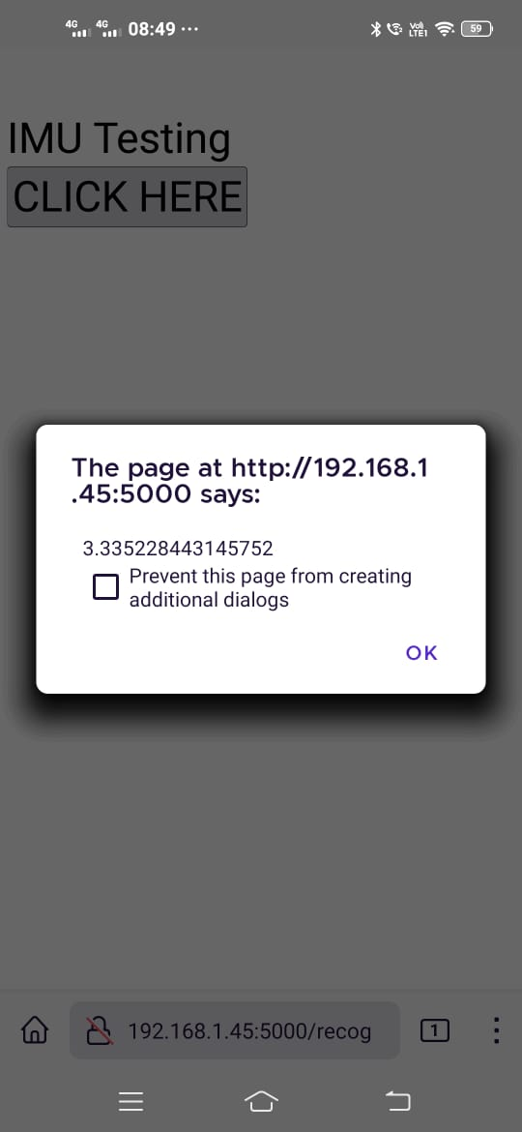
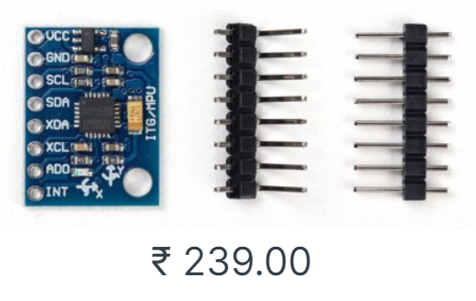
Overall System Limitations
No single representative template for gestures – match with entire dictionary
Not user agnostic : separately tested by respective members on their own devices
Tried developing a web application for (near) real time inference : some success
Flask (Python3) server. Debugging problems on mobile caused limitations
Could have used actual hardware (standalone IMU chips)
MPU-6050 (not very costly, off-the-shelf)

