Slide 1

ॐ श्रीगणेश-शारदा-गुरुभ्यो नमः॥ CS698F Project Ideas
TEAM 1:
ASHWIN SHENAI (180156)
ISHANH MISRA (180313)

Slide 2
Gesture Recognition
Existing technologies like PhonePoint Pen (see [2]).
Used accelerometer to write short messages or even draw simple diagrams in the air.
Lacked use of gyroscope.
Two main issues: Coping with background vibration (noise); Computing displacement of phone.
Background noise: Mostly natural hand vibrations. Also, measurement errors.
Coping Strategy: Moving Average of n = 7 units.
Double integration model - needs resetting of velocity periodically.
Pause detection done every n = 7 time units. Residual velocity reset to 0 at beginning of every pause interval.

Slide 3
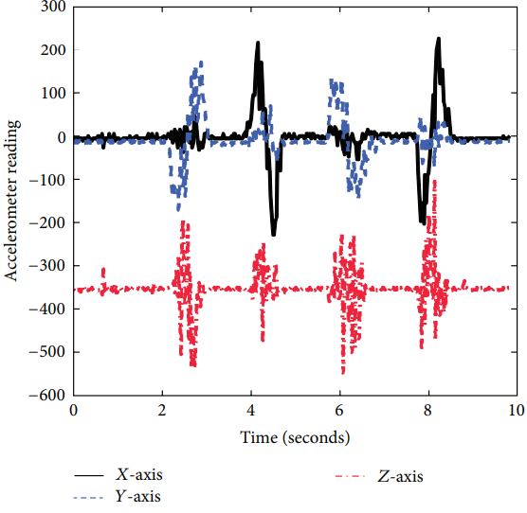
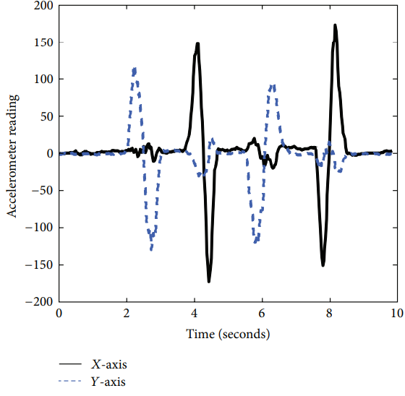
Gesture Recognition (Contd…)
Raw Accelerometer Data (z = up)
Noise Smoothing (sliding window average)

Slide 4
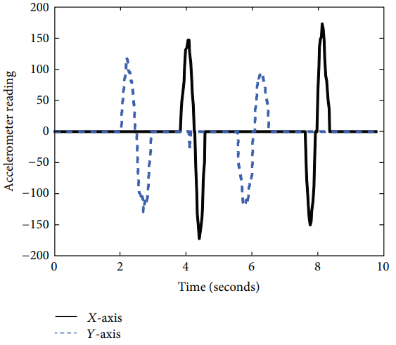
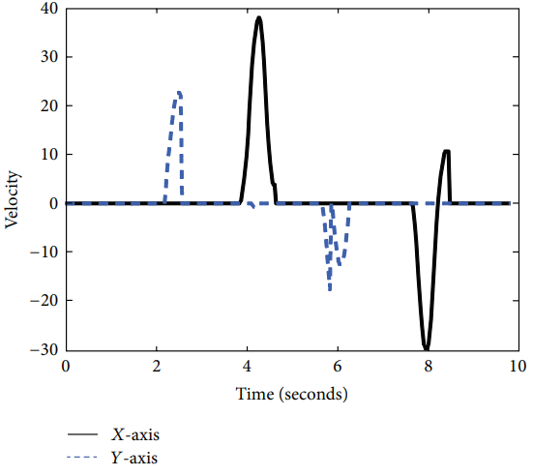
Gesture Recognition (Contd…)
Smoothening and Suppression
Avoiding velocity-drifts by resetting velocity to 0.

Slide 5
Gesture Recognition (Proposal)
Identify and work on only a set of recognizable gestures.
For example, palm going forward/backward, rotating palm, etc.
Focusing on hand-operated mega-machines.
Cranes, fire trucks, mechanized staircases, maybe robot surgeries, AR/VR controls, etc.
Help in remote operation of the above.
Planning use of gyroscope (especially in case of rotation based gestures).
Gyroscope may require similar noise removal, smoothening and angular velocity resetting after each pause.
Instructor’s Suggestion: Gyroscope may require offset detection.
Not planning on real-time analysis for now. Will see feasibility later.
Extracting signal in real-time requires developing a dedicated android app.

Slide 6
Position Tracking
Goal: Accurately track the trajectory of a walking user using mobile sensor data.
Accelerometer Data: Double integration gives an estimate of the position
Suffers from drift issues – need independent inputs for correction
Counting steps: An independent method of estimating distance travelled by walking
Need to estimate step size accurately to calculate distance
GPS: Provides absolute location data
May not be precise enough depending on the environment
Can be replaced by WiFi localization, but lack of APs can become a new issue

Slide 7
Position Tracking (Contd.)
Magnetometer: Provides absolute heading data – direction in which the device is facing
When the walking user takes a turn, these readings should change substantially
Proposal:
Collect data from all the above mentioned varied sensors
Use a Kalman Filtering approach (Multi-Sensor Frameworks if time permits) to combine these independent position estimates into an accurate and robust position tracker.
Specific focus on walking behaviour.

Slide 8
Other Ideas
Identify keys typed on smartphone using accelerometer data.
Also gave a thought on Time-of-Arrival (ToA) based localization.
Can try implementing – but won’t work indoors since signal travelling time << processing time.
Better to use simulation based approaches.
Thought about Beamforming
Problem of generating signal generation using an antenna array.
Buying an antenna array is a problem, a bigger problem is proper timing of signals’ phases.
Need a dataset on beamforming. A new technology – datasets not available very easily.

Slide 9
References
[1] Liu M. A Study of Mobile Sensing Using Smartphones. International Journal of Distributed Sensor Networks. March 2013. doi:10.1155/2013/272916
[2] S. Agrawal, I. Constandache, and S. Gaonkar, “PhonePoint pen: using mobile phones to write in air,” in Proceedings of the 1st ACM Workshop on Networking, Systems, and Applications for Mobile Handhelds, pp. 1–6, Barcelona, Spain, 2009.

