Slide 1


SMART HOME
SECURITY SYSTEM
An IoT-Based Intrusion Detection Framework using ESP32-CAM
Siliguri Institute of Technology
Academic Year 2025-2026
Presented by:
Ishanjit Nandi • Onkar Chowdhury • Biky Roy • Arghyo Kumar Saha
Department of Electronics & Communication Engineering

Slide 2

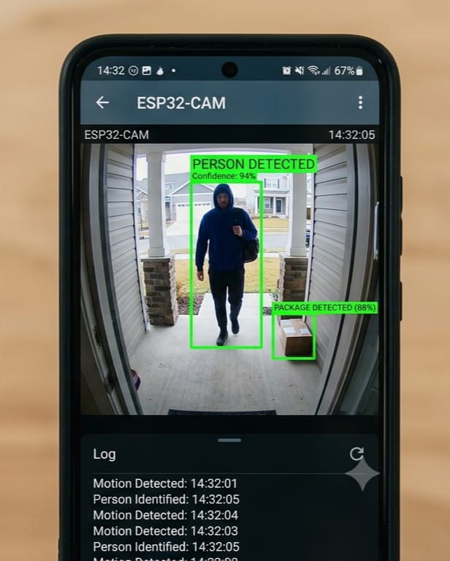
Introduction
Home security has become an important concern due to the increasing number of thefts and unauthorized intrusions. Traditional alarm systems only provide local alerts, whereas our project provides real-time remote monitoring using the Internet of Things (IoT).
Our project aims to develop a low-cost, reliable, and smart home security system using an ESP32 microcontroller.

Slide 3





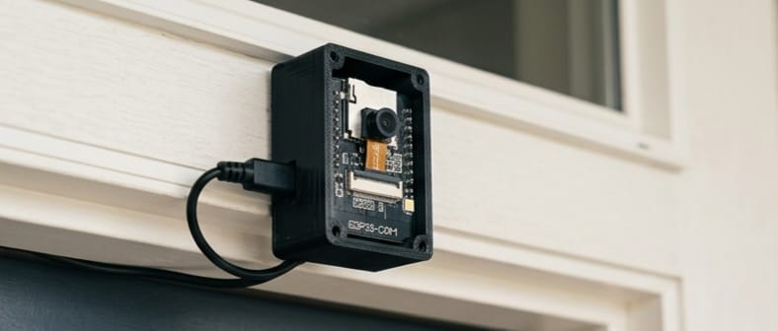
PROJECT OBJECTIVES
Hardware Integration
Real-Time Response
Interface high-sensitivity PIR sensors with the ESP32-CAM module for precise motion detection.
Implement firmware logic that triggers high-resolution image capture immediately upon intrusion detection.
Cloud Connectivity
Local Deterrence
Establish secure Wi-Fi transmission to deliver multimedia alerts via the Telegram Bot API.
Activate local audible and visual alarms (Buzzer and LED) to deter intruders on-site.
Primary Goal: To develop a robust, low-cost (₹900), and intelligent security system.

Slide 4
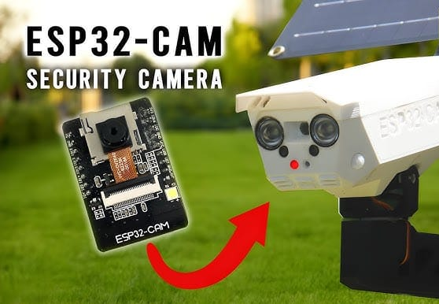
MODERN SECURITY CHALLENGES
High Ownership Costs
Visual Verification Gap
Rapid urbanization and evolving threats have rendered traditional reactive measures insufficient, creating a critical need for proactive, real-time monitoring solutions.
Professional CCTV systems involve substantial initial hardware investments and recurring monthly subscription fees.
Standard motion sensors often trigger false alarms (pets, curtains) without visual context, leading to alarm fatigue.
The IoT Paradigm Shift
Leveraging physical-to-digital connectivity enables remote monitoring and automated decision-making beyond physical barriers.
Installation Complexity
Wired setups are often intrusive and unsuitable for rental properties or existing home infrastructures.

Slide 5
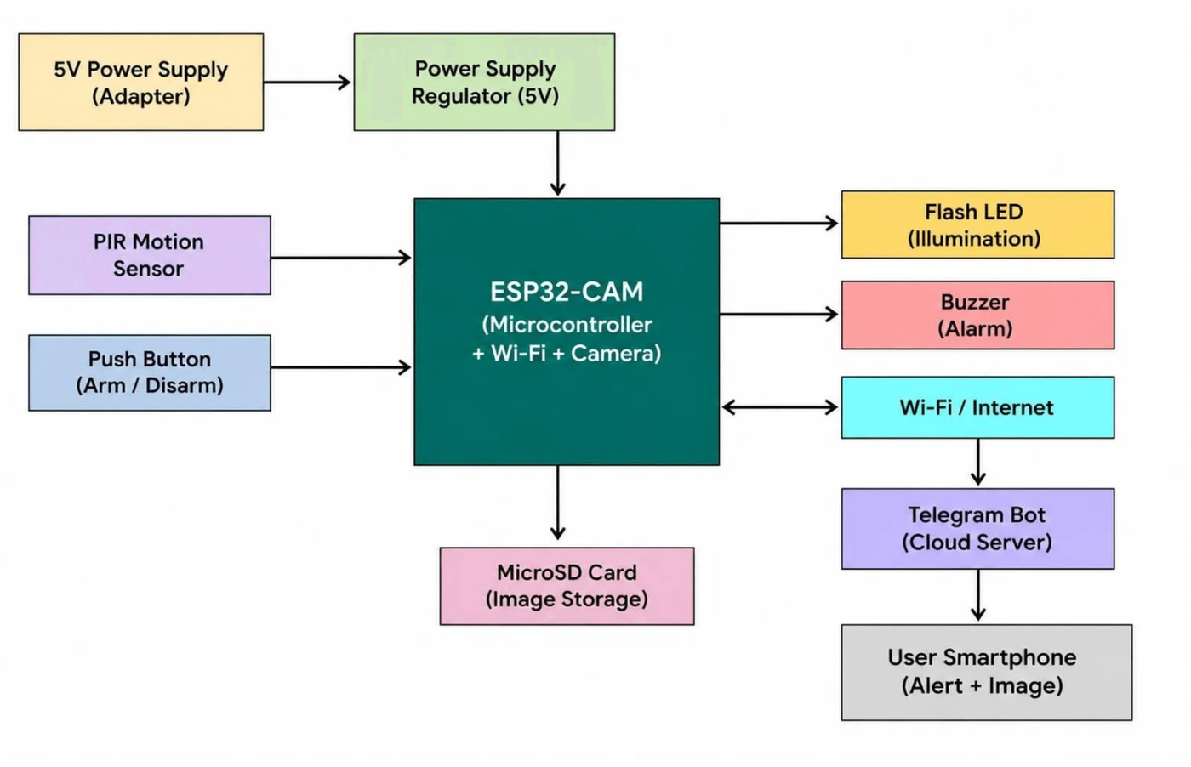
SYSTEM
ARCHITECTURE
CORE PROCESSING
ESP32-CAM serves as the central hub for sensor interfacing and Wi-Fi communication.
DETECTION LAYER
HC-SR501 PIR sensor monitors infrared changes to trigger the system.
VISUAL LAYER
OV2640 module captures high-resolution JPEG frames upon detection.
CLOUD GATEWAY
Telegram Bot API provides the secure bridge for real-time mobile alerts.

Slide 6
HARDWARE COMPONENTS OVERVIEW
COMPONENT
FUNCTION
KEY FEATURES
ESP32-CAM
Core Processing Hub
Dual-core CPU, Integrated Wi-Fi/BT,
for image buffering.
4MB PSRAM
PIR Sensor (HC-SR501)
Motion Detection
120° detection angle,
7-meter range
, adjustable sensitivity and delay.
OV2640 Camera
Visual Verification
2MP resolution, JPEG compression,
default capture.
VGA (640x480)
Piezo Buzzer
Local Deterrence
Audible alarm triggered immediately upon
.
unauthorized presence
5V Power System
Energy Management
Stable supply for sensitive electronics,
low-power monitoring

Slide 7

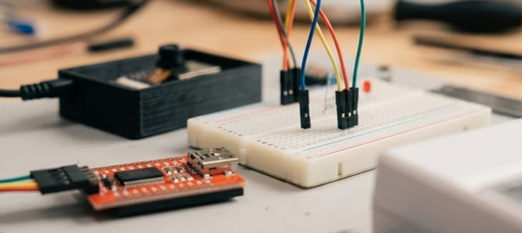
SYSTEM WORKING PRINCIPLE
01
02
03
Initialization
Monitoring
Alerting
Configure GPIO pins and camera parameters.
PIR sensor scans for infrared radiation changes.
Motion detected (PIR signal HIGH).
Activate local Buzzer and Flash LED.
Establish secure Wi-Fi connection.
System enters low-power monitoring loop.
Capture and transmit image via HTTP POST.
Initialize Telegram Bot API handshake.
Continuous Wi-Fi health check and auto-reconnect.
Lockout Period: A 10-second delay is implemented post-alert to prevent duplicate notifications for the same event.

Slide 8
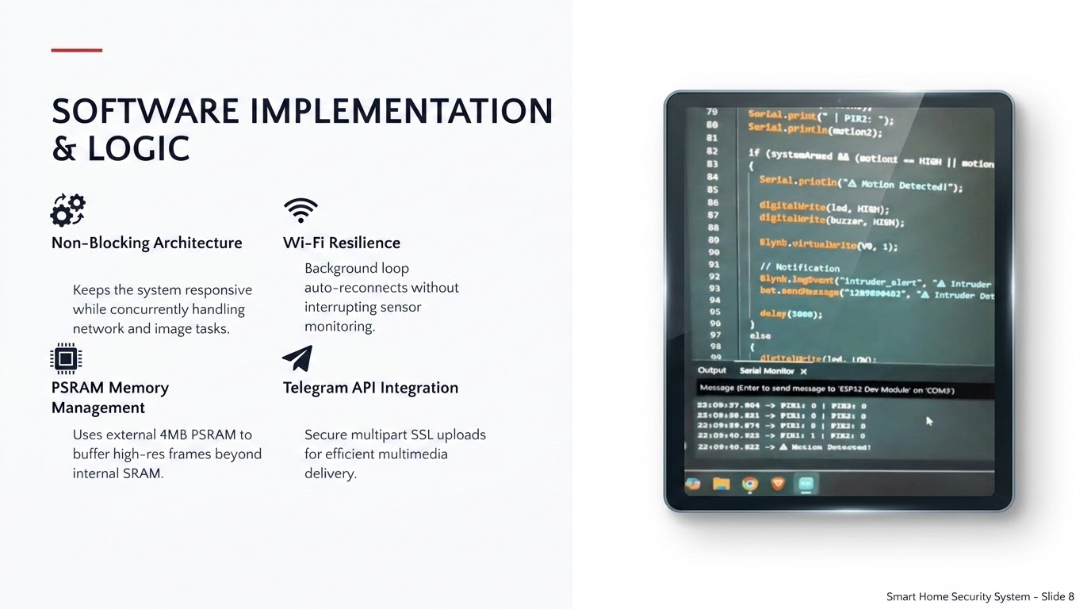

Slide 9
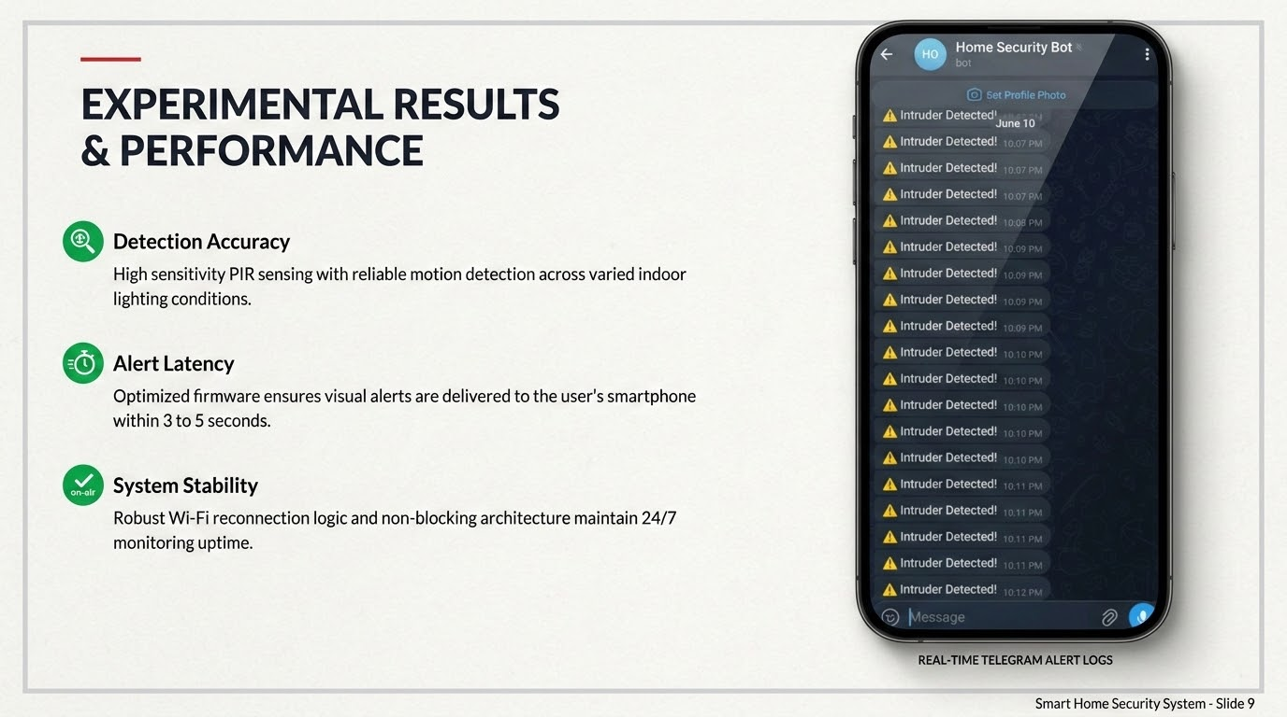

Slide 10








MERITS AND DEMERITS
KEY MERITS
CHALLENGES
Cost Efficiency
Network Dependency
Extremely low-cost prototype (₹900) compared to professional CCTV systems.
System performance is heavily reliant on stable Wi-Fi and internet connectivity.
Wireless & Compact
Night Vision Limits
Small form factor and Wi-Fi connectivity make it easy to install in any environment.
Requires external IR illumination for effective monitoring in total darkness.
Visual Verification
Latency Risks
Real-time image capture significantly reduces false alarm fatigue for the user.
Alert delivery may be delayed in areas with poor network infrastructure.

Slide 11



CONCLUSION & FUTURE SCOPE
The project successfully demonstrates a functional, low-cost IoT security prototype that addresses the limitations of traditional systems through real-time visual verification and cloud-based alerting.
THE ROADMAP AHEAD
AI-Based Face Recognition
Implementing on-device machine learning to distinguish
between residents and unauthorized intruders.
Multi-Sensor Fusion
Integrating smoke, gas, and ultrasonic sensors for a
comprehensive home monitoring ecosystem.
Energy Autonomy
Developing solar-powered variants for off-grid operation in
remote or rural installations.

Slide 12

THANK YOU
Any Questions?

