Slide 1
Title: Detecting landslide-prone areas of the country by creating a DEM.
Problem Statement: Areas with high altitudes and steep slopes are likely to lie in the landslide-prone area. These areas can be detected by using the Digital elevation model.
Presented by: Ishan Pandhare (20124052) and Aishwarya Pathe (20124056)

Slide 2
Project flow:
Data was taken from Google Earth, and imported into QGIS as a .csv file by creating a vector layer “dem_points” with projection system EPSG:4326 - WGS 84
Grid interpolation was done on “dem_points” using the Saga Natural Neighbour tool. Cell size was taken as 0.005 degrees. After the process was completed, the raster layer “DEM” was obtained.
Contour layer was created to show the elevation for the created DEM.
Next, the slope was calculated using the Slope algorithm plugin of Raster terrain analysis. A new raster layer “slope” was created.
To identify places with high altitudes and steep slopes, a raster calculator was used. The following expression was used:
"DEM@1">2000 AND "slope@1">45
This created the final layer “landslide_prone”, which gives the area which is highly vulnerable to landslides
This project can also be extended to find other results such as the flow of rivers, patterns for agriculture, etc.

Slide 3
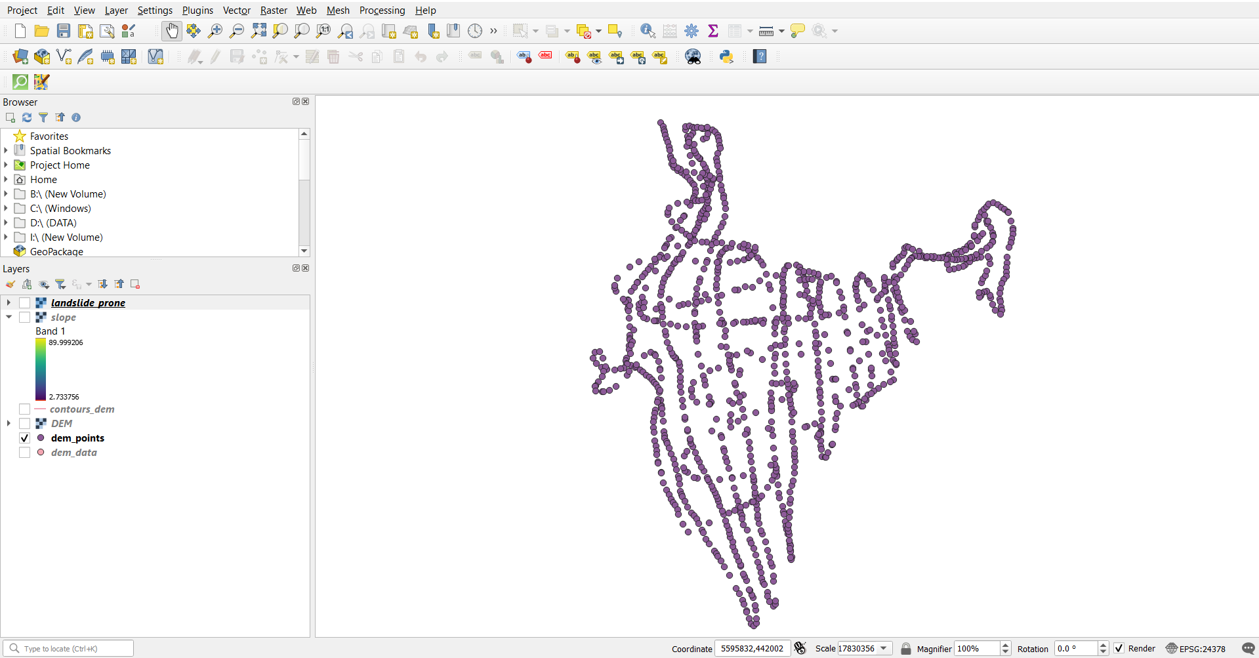
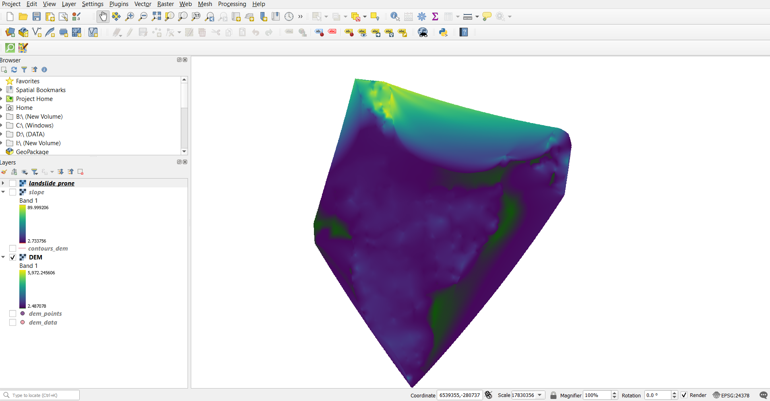
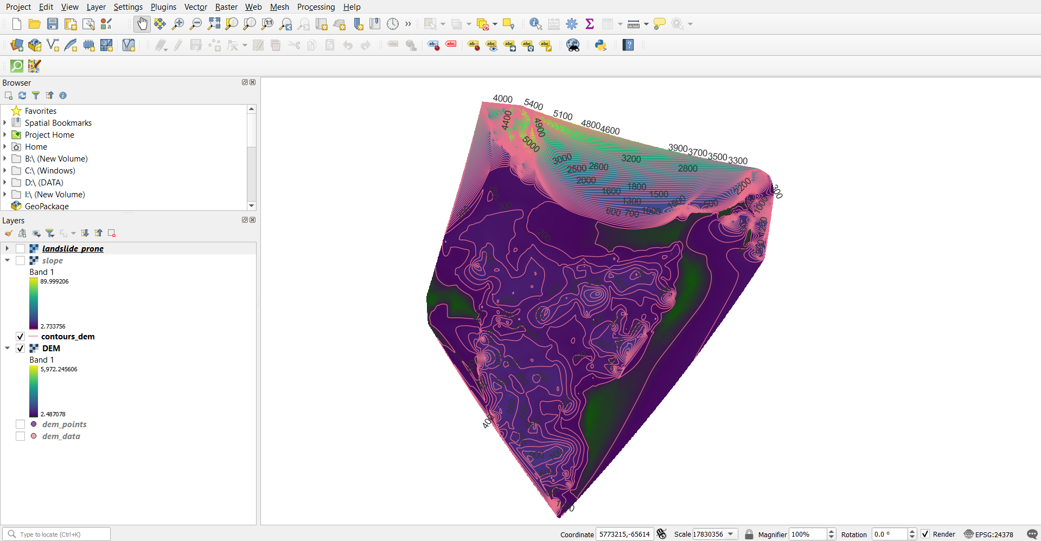
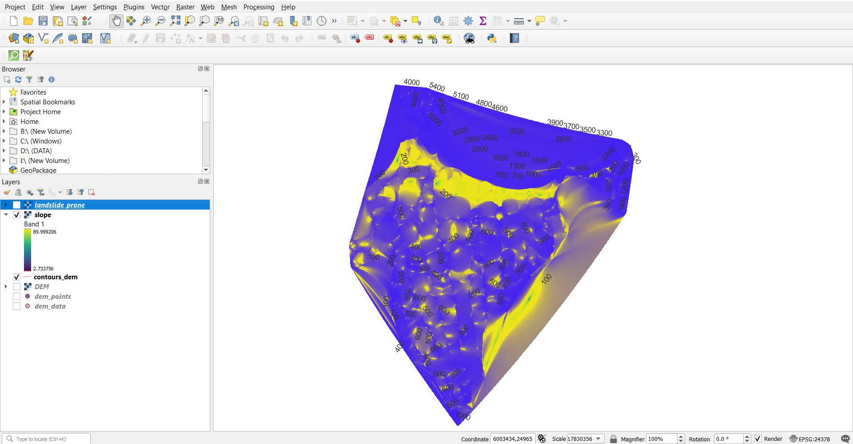
dem_points (vector)
DEM (raster)
contours_dem (vector)
Slope (raster)

Slide 4
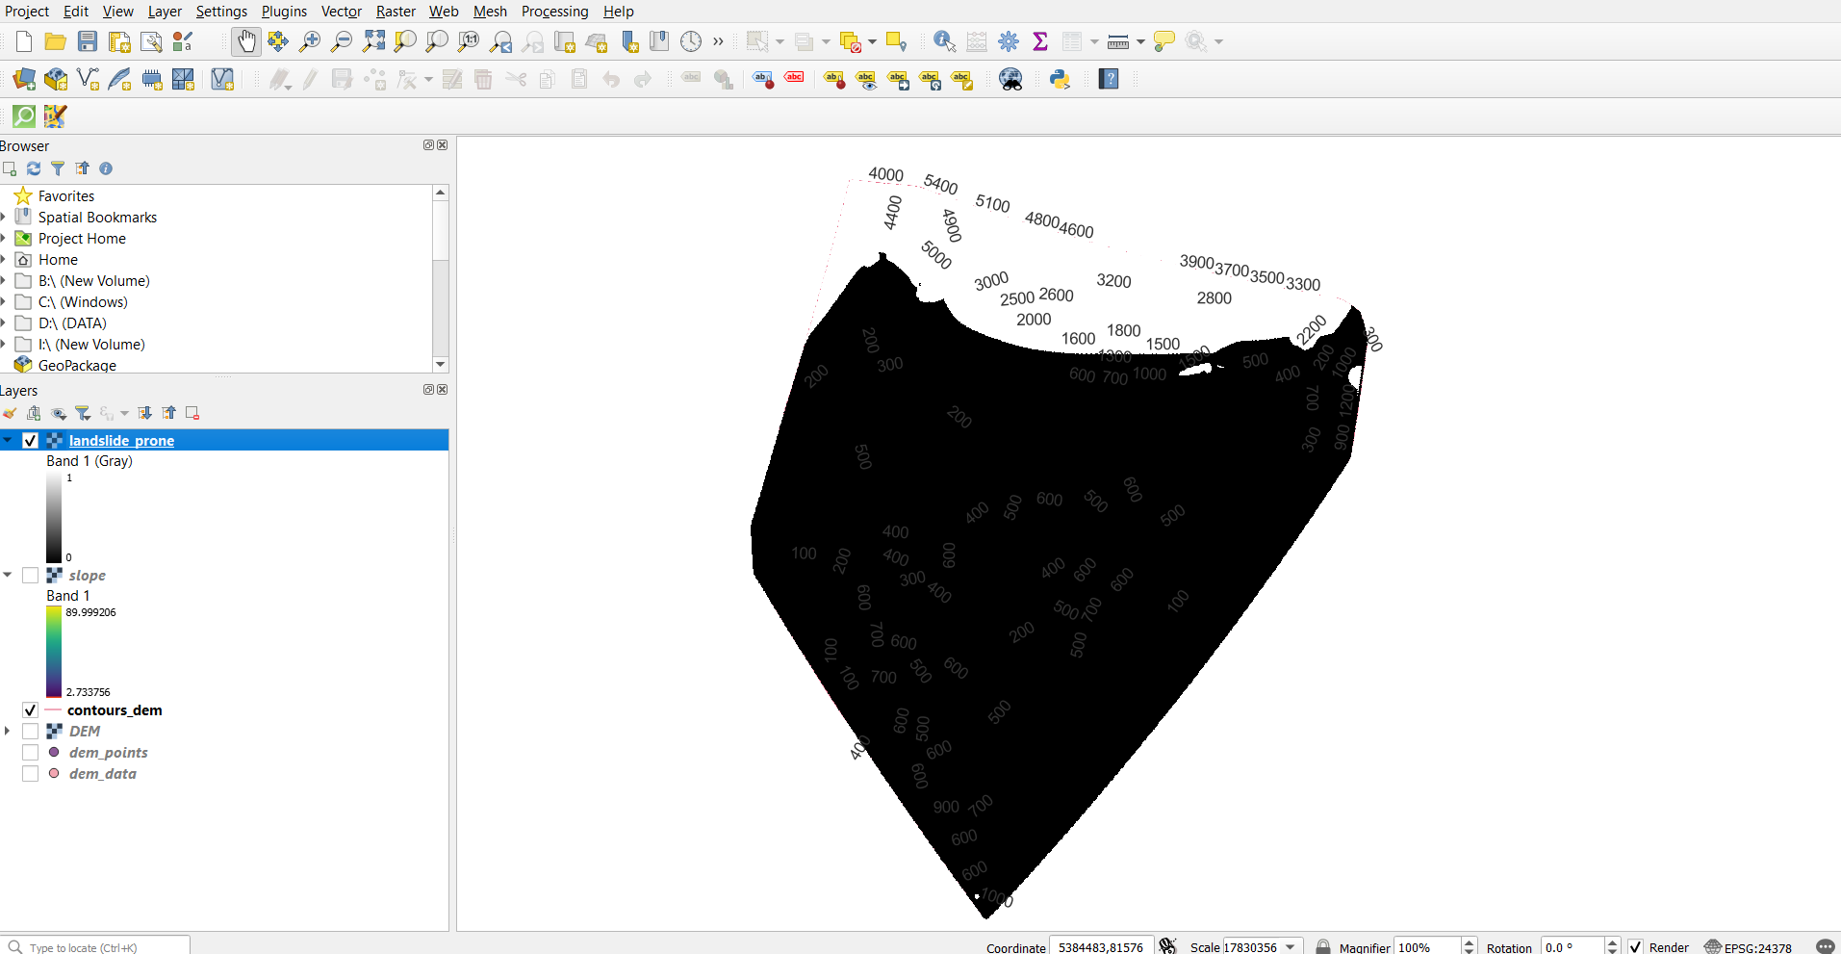
landslide_prone (raster)

