Slide 1

BioBytes Summer Project (BioSoc)
DRUG DISCOVERY
Mentors:
Nischay Patel
Sikha Vamsi
Presented By : Group 3

Slide 2
1
OVERVIEW
01
02
Data preprocessing
Use of Machine Learning in Drug Discovery
03
Model fitting-KNN
04
Results

Slide 3

2
Drug discovery is the process by which new candidate medications are discovered.
DRUG DISCOVERY AND MACHINE LEARNING:
A molecule (often a protein) is identified that is involved in a disease process and can be targeted by a drug.
The next step is screening chemical libraries to find compounds that interact with the target.
Machine Learning, by leveraging large datasets ,can accelerate the identification of potential drug candidates.

Slide 4
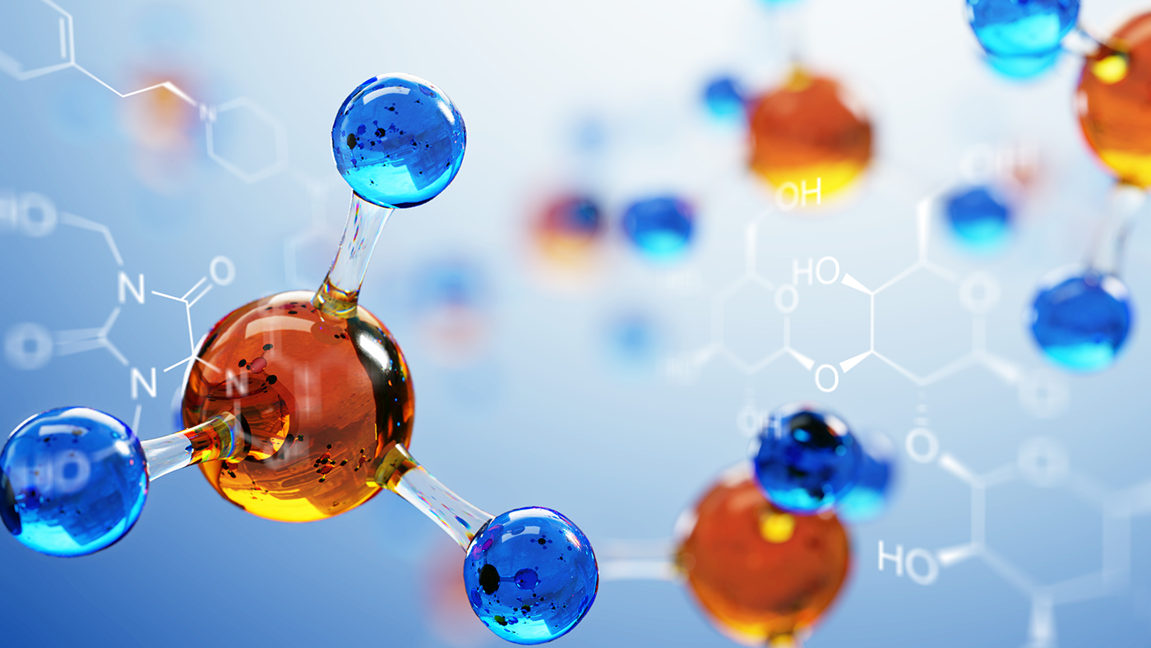
3
We use data on existing drugs and their known interactions with proteins.
FLOW OF THE PROJECT:
We use data from the CHEMBL website. The chemical structures are in SMILES notation.
We train a KNN model to recognize patterns in the interactions between drug structures and protein binding sites.
Goal-to rank the drugs based on their efficiency scores and predict how well a drug will bind to the protein.

Slide 5
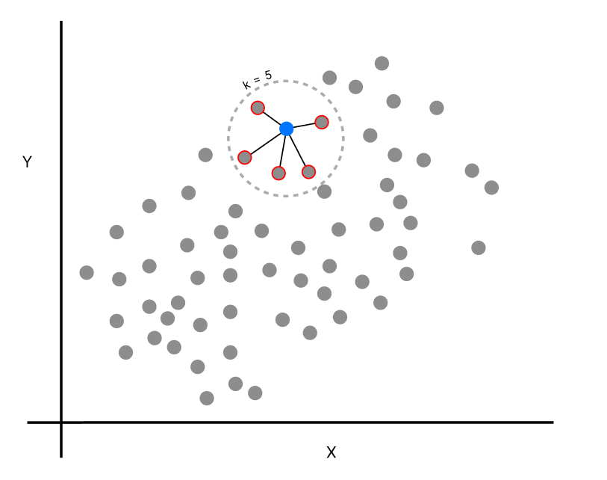
3
Model: K-Nearest Neighbors
k-NN regression predicts a continuous variable(y) based on the values of the k-nearest neighbors in the training dataset.
k-NN regression identifies the k closest training examples (neighbors) using a distance metric.
The predicted value is the average of the target values of these k-nearest neighbors.
The number of neighbors, k, is a hyperparameter that needs to be chosen.(Chosen using Cross Validation)

Slide 6


13
DATA COLLECTION & PREPROCESSING:
SOURCE: ChEMBL Database
Target:SARS Coronavirus 3C like proteinase.(ChEMBL ID-CHEMBL3927)
We drop duplicates and label compounds as active, intermediate and inactive on the basis of standard values.
We calculate molecular descriptors using PaDEL Descriptor software.
We convert the y variable from IC50 to PIC50(log transformation)
The final dataset contains 86 different molecules and 881 features.

Slide 7
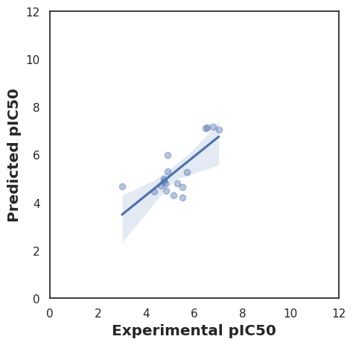
13
Model Fitting:
The dataset is split into train and test(80-20 split).
K-fold Cross Validation is used(with 5 splits).
Randomized search CV is used to select number of neighbors, weights and the distance measure.
The best parameters are found to be:
A 4-NN model is fitted to the data and Manhattan distance is used as the distance metric. The weights used are the distances themselves.
MAE on the test set is found to be 0.55.

Slide 8
Thank You!

