Slide 1

Data Science
Masters degree SS26
Presented by:
Ishant Ishant

Slide 2
Project Description
Exploratory data analysis
Feature engineering
Unsupervised learning
Supervised learning
Model evaluation metrics

Slide 3
- Frame the requirement
- Data interpretation
- Identify issues(nan,outliers)
-Drop labels
-Train Raw vs engineered feature
-Evaluate(ARI,Silhouette)
Final detailed evaluation covering all metrics as acc.score,F1,Precision,Recall,confusion matrix…etc
EDA
Feature eng.
Clustering ,GMM
ML models
Detailed evaluation
-Clean data
-Log numerical outliers
-Combine features
-encode categorical features
- Labeled data
-7 models on 80% Training
-20% Testing
-Evaluate

Slide 4
EDA First insights
Data consists of 32561 rows and 15 columns
15 columns (14 features + 1 Label target)
6 numerical features + 9 categorical features
Missing values in 3 specific columns and outliers in mostly all numerical columns

Slide 5
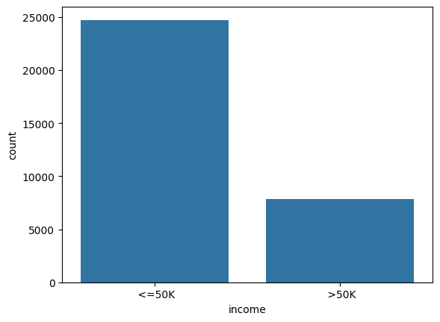
EDA-Target distribution
Use countplot to explore the target income column
Imbalance is clearly shown with large amount of people earning less than or equal 50 k

Slide 6
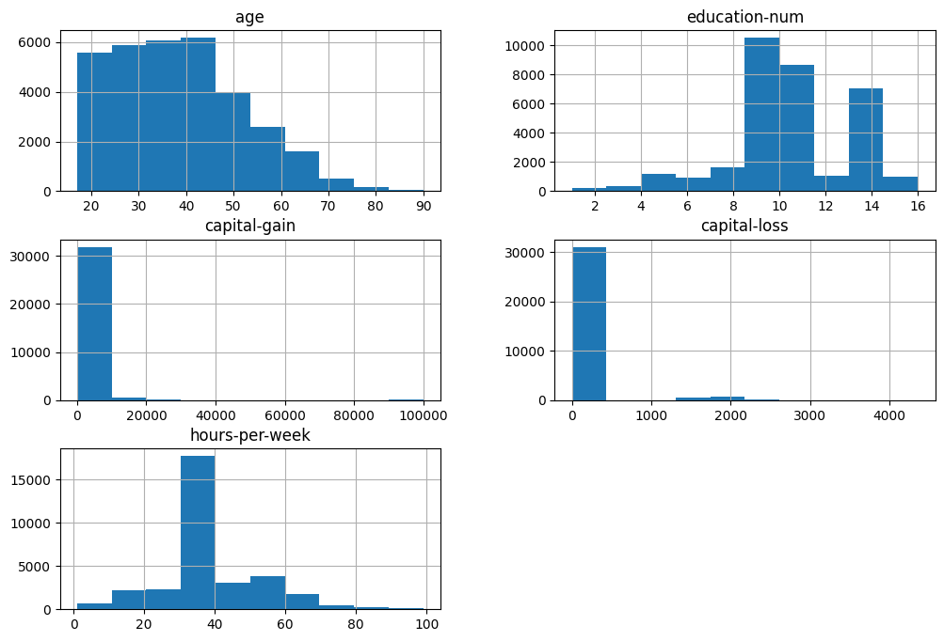
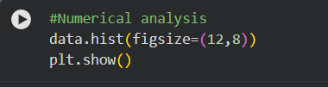
EDA-Numerical features

Slide 7
EDA-Numerical features interpretation
The dataset is dominated by working-age teenagerds between 20 and 45 years,as distribution is slightly right-skewed, meaning fewer older individuals.
Capital gain and loss extremely right skewed indicating outliers
Work Habits: There is a massive concentration at 40 hours per week, indicating that the majority of the population works a standard full-time schedule

Slide 8
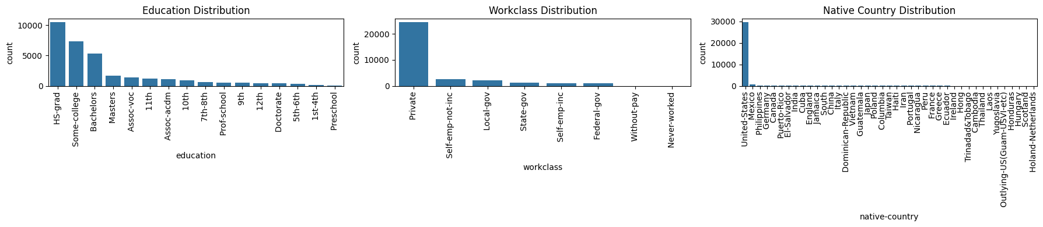
EDA-Categorical features

Slide 9
EDA-Categorical features interpretation
The "Private" sector overwhelmingly dominates the dataset, accounting for roughly 75 % of all entries
The dataset is heavily biased toward the United States
"HS-grad" is the most frequent category, followed by "Some-college" and "Bachelors

Slide 10
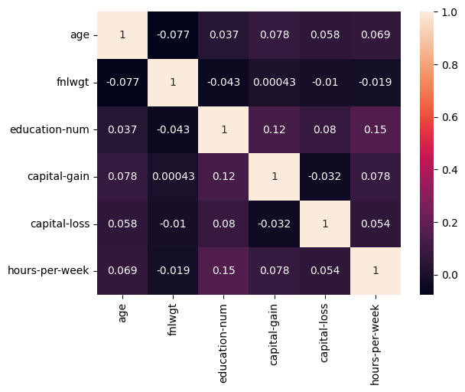
EDA-Correlation analysis
Very weak strength relationship between numerical features ,which is logically due to skewness showed in previous analysis and also high variance spreading data in wide range

Slide 11
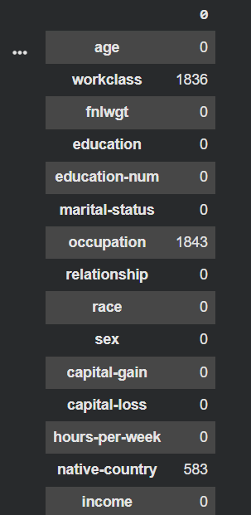

Missing values detection

Slide 12
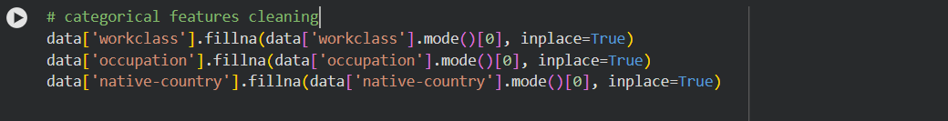
Missing values techniques
Use mode if the missing values are in categorical
Use median if the missing values are in numerical
Get the first most frequent scalar value (0)+ Inplace set to true to avoid adding new columns
Overall missing data ratio is now 0%

Slide 13
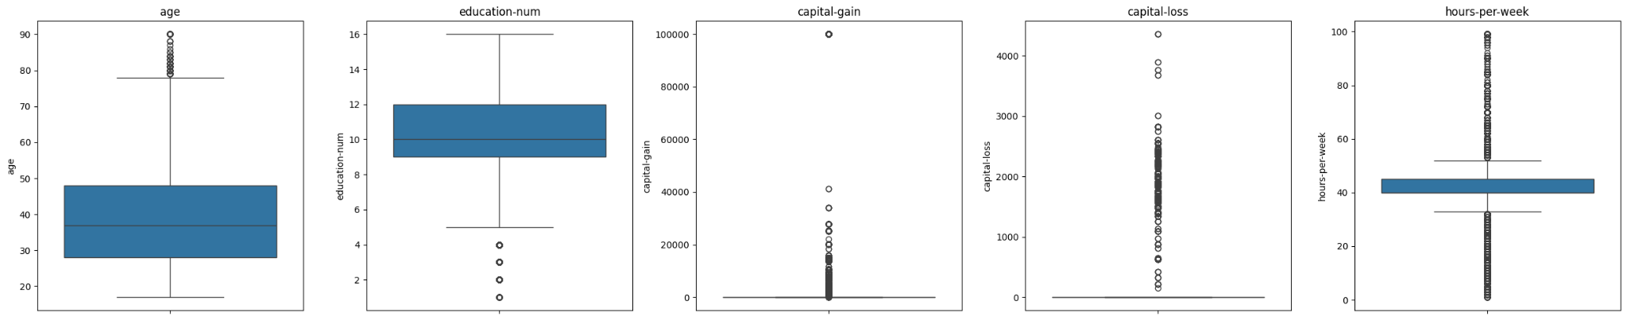
Numerical features outliers
Capital gain and loss have the biggest number of outliers which should be fixed
Hours per week also has outliers on both sides up and down
Age and education num have very few outliers which will not affect our data significantly so no need to engineer both features

Slide 14
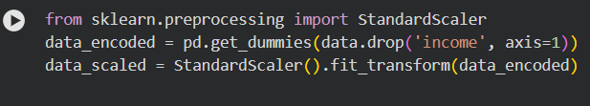
Engineered features techniques
Encoding is necessary at the beginning to convert all categorical data to numerical so machine learning can process them
Scaling also ensures all features are on a similar range so that large-valued variables don’t dominate smaller ones in distance models ( KNN or K-means).
Dropping income is only required for clustering as it works on unlabeled data

Slide 15
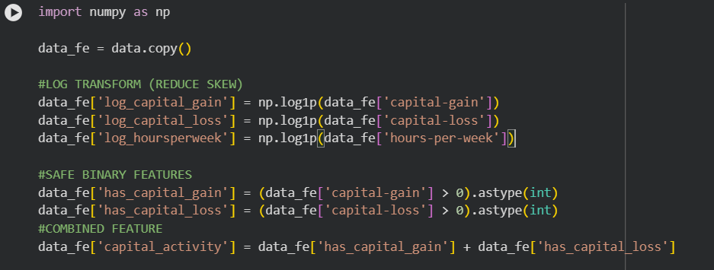
Engineered features techniques
Logging all features with extreme outliers
Merges gain/loss capital into one feature to capture overall capital-related financial behavior after converting it into binary yes or no feature

Slide 16
Unsupervised learning-Clustering task
Trained using K-means model and regarding evaluation here are many metrics for evaluating machine learning models but according requirement we select the correct metric
Required: Do unsupervised clusters align with the supervised labels?
Adjusted Rand Index (ARI) — The Gold Standard
The Adjusted Rand Index (ARI) takes your true supervised labels (the target) and your unsupervised cluster assignments, and looks at them side-by-side to see how well they agree.

Slide 17
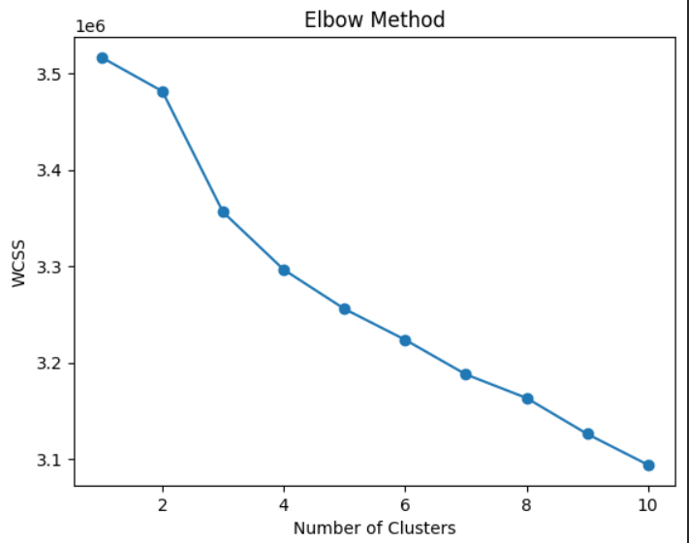
Clustering model
Elbow method is used firstly to check the optimal number of clusters
From K = 1 → 3, the WCSS decreases sharply.
After K = 3, the curve starts flattening and improvements become smaller.
This bend in the curve is the “elbow point.”

Slide 18
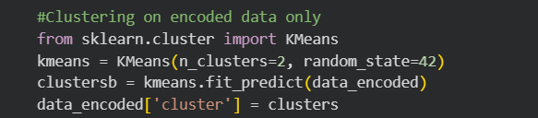
Clustering raw
Firstly clustering is done on raw data only with just encoding the features to check the difference between with and without feature engineering
ARI approximately equals 0.007 which means random guessing

Slide 19
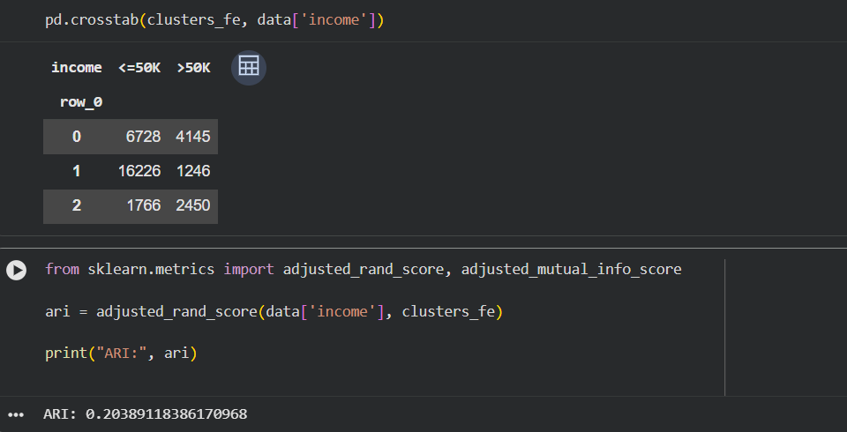
Clustering featured
-Great enhance in ARI due to scaling and logging outliers + combining features
-Crosstab also shows logic values due to the high amount of less than or equal 50 K label

Slide 20
Compare 3 models with different K
Number of Clusters | K=2 | K=3 | K=5
ARI | 0.16 | 0.20 | 0.20
Silhouette | 0.53 | 0.55 | 0.5
-Silhouette good values indicate good separation of clusters into different groups but does not guarantee that this groups are the same labeled groups
-Enhance in ARI after feature eng,however values is still low due to the unlabeled target so lets transfer now to second phase of supervised learning

Slide 21
Supervised Learning Introduction
Supervised learning uses labelled data: Each training example contains input features and a known target label. The algorithm learns patterns that connect the feature values to the correct output class.
Testing measures performance on unseen data: After training, predictions are made on separate test data. This checks whether the model generalizes beyond the examples it already saw.
The model learns from training data: During training, the model estimates decision rules or mathematical relationships using examples where the correct answer is already available.
This project focuses on classification accuracy: The goal is to compare supervised classification models and observe how cleaning, feature engineering, and model tuning change prediction accuracy.

Slide 22
Supervised Learning in this Project
The dataset was treated as a labelled classification task: Input columns were used as predictors, while the target column represented the class the model needed to learn and predict.
Seven supervised models were compared: The same project workflow tested KNN, Logistic Regression, Decision Tree, Random Forest, Bagging, AdaBoost, and Gradient Boosting.
Training and testing followed an 90/10 split: Eighty percent of the data was used for model training, and the remaining twenty percent was kept separate for testing model performance.
Accuracy was tracked across dataset versions: Each model was evaluated after raw analysis, impurity removal, feature selection, feature engineering, and final combined improvements.

Slide 23
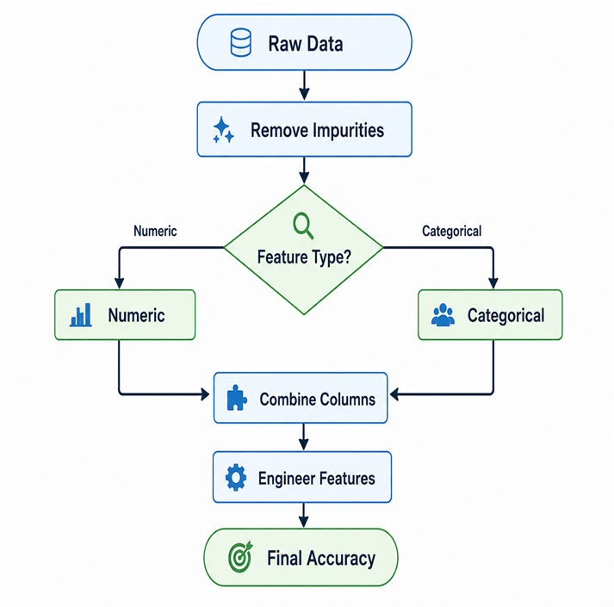
Machine Learning Workflow
Start with raw data analysis: The first experiment trained all seven models on the raw dataset to establish a starting baseline before cleaning or feature engineering.
Remove impurities and separate feature types: Impurities such as question marks and dots were removed, then numeric-only and categorical-only datasets were tested separately to understand their individual predictive value.
Combine numeric and categorical columns: After separate analysis, cleaned numeric and categorical features were combined to create the main baseline dataset for later improvement comparisons.
Engineer features and compare accuracy changes: Later experiments removed noisy columns and added transformed features such as capital activity, log hours, age groups, and occupation groups before comparing final accuracy.

Slide 24
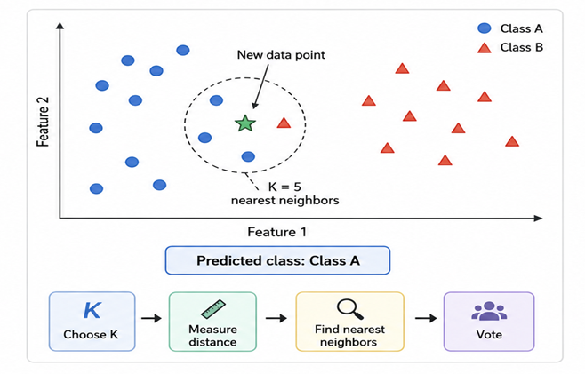
Brief Introduction to ML Models
KNN Method
  KNN is a supervised learning method that does not build a complex training model. It stores the training data and compares a new data point with the existing examples.
  For prediction, KNN finds the K nearest neighbors using a distance measure such as Euclidean distance. The new data point is classified based on the majority class of those nearest neighbors.
  KNN is sensitive to feature scaling and the value of K. A small K can be affected by noise, while a larger K gives smoother predictions but may miss small patterns. So scaling and tuning K are important.

Slide 25
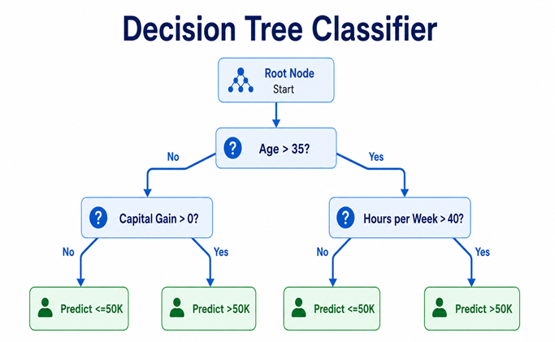
Decision Tree Method
  Decision Tree is a supervised learning model that makes predictions by asking a sequence of yes/no questions about the data features.
  It splits the data step by step based on important conditions, for example: capital-gain > 0, age > 35, or hours-per-week > 40. Each split tries to separate the income classes better.
  The final prediction is made at the leaf node. For classification, the model chooses the majority class in that final group, such as <=50K or >50K.

Slide 26
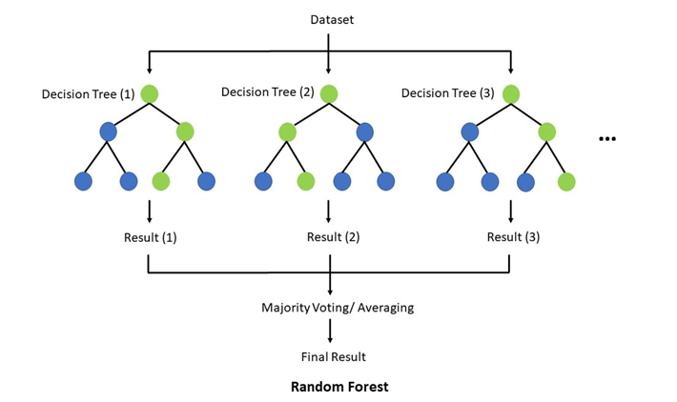
Random Forest
  Random Forest is an ensemble model that builds many decision trees instead of using only one tree. Each tree learns from a different random sample of the training data.
  Each tree gives a prediction, and the final class is selected by majority voting. For example, if most trees predict >50K, the Random Forest predicts >50K.
  It is more stable than a single Decision Tree because combining many trees reduces overfitting and improves prediction reliability.

Slide 27
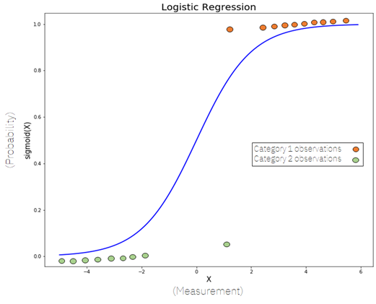
Logistic Regression
  Logistic Regression is a supervised classification model used to predict categories, not continuous values. In our project, it predicts whether income is <=50K or >50K.
  It calculates the probability of a class using input features like age, education, occupation, working hours, and capital gain/loss. If the probability is above a threshold, it predicts one class; otherwise, it predicts the other class.
  It is useful as a baseline model because it is simple, fast, and easy to interpret. However, it may not capture complex nonlinear relationships as well as tree-based models like Random Forest or Gradient Boosting.

Slide 28
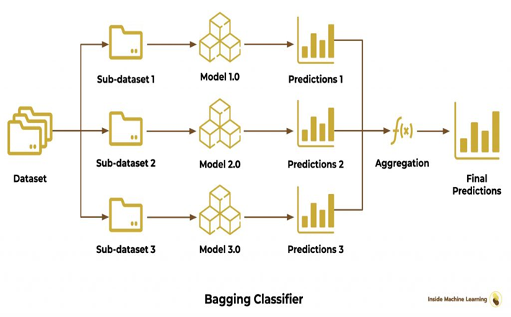
Bagging Method
  Bagging is an ensemble learning method that trains many models, usually decision trees, on different random samples of the training data.
  Each model gives its own prediction, and the final result is decided by majority voting for classification. For example, if most trees predict >50K, the bagging model predicts >50K.
  Bagging helps reduce overfitting and improves stability, because it does not depend on only one decision tree. Instead, it combines many trees to get a more reliable prediction.

Slide 29
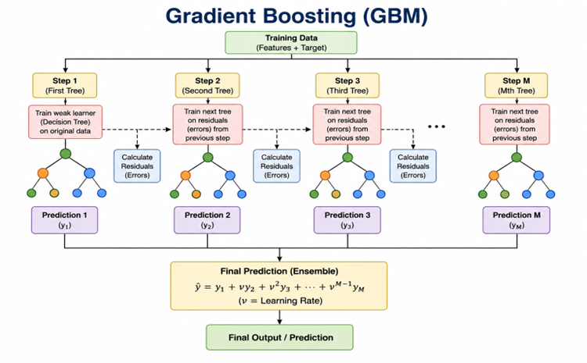
Gradient Boosting
  Gradient Boosting is a supervised ensemble model that builds many small decision trees step by step. Each new tree tries to correct the mistakes made by the previous trees.
  It improves prediction gradually, because the model focuses more on the records that were predicted wrongly before. In this way, weak learners are combined to create a stronger final model.
  In our project, Gradient Boosting performed best because it can capture complex patterns between features like age, occupation, working hours, and capital gain/loss.

Slide 30
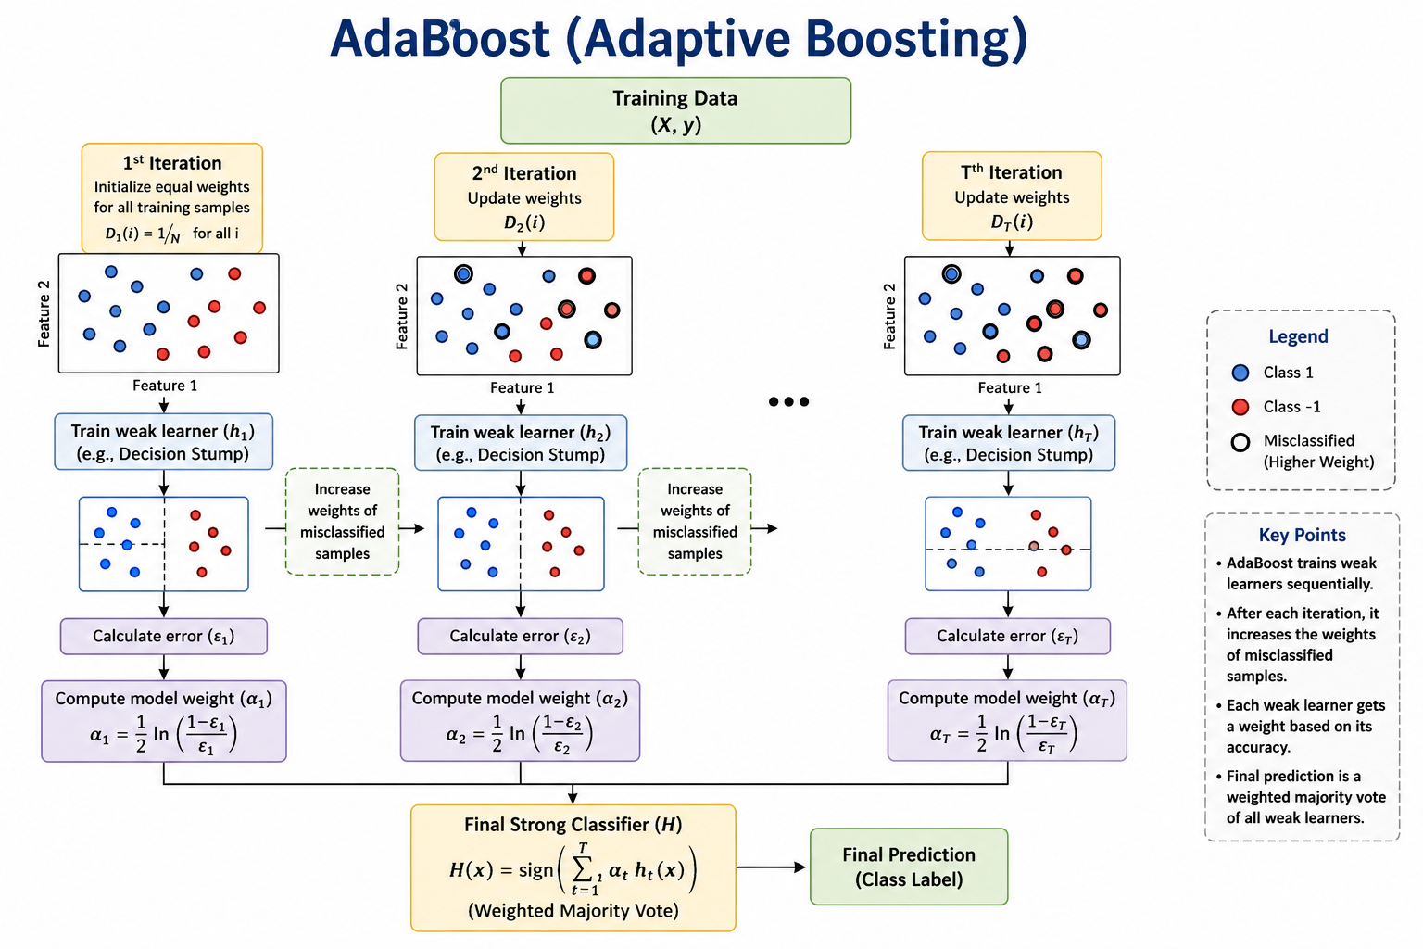
Adaboost
  AdaBoost is an ensemble learning method that combines many weak learners, usually small decision trees, to create one stronger model.
  It trains models step by step. After each model, AdaBoost gives more importance to the incorrectly predicted records, so the next model focuses more on those difficult cases.
  Final prediction is made by weighted voting. Models that perform better get more influence in the final decision.

Slide 31
Raw Data Accuracy Results
Raw dataset baseline: First experiment used the original raw dataset. No impurity removal or feature engineering was applied yet. The goal was to create a starting baseline for later comparison.
Best model: Gradient Boosting gave the best raw-data result. Best raw-data accuracy: 0.6082. It performed slightly better than Random Forest and Bagging in this stage.
Main takeaway: Raw data produced weak model performance. Accuracy stayed close to the 60% range. This proved that cleaning and feature engineering were needed to improve the model.
Method | KNN | Logistic Regression | Decision Tree | Random Forest | Bagging | Gradient Boosting | AdaBoost
Accuracy | 0.5818 | 0.5953 | 0.5947 | 0.6018 | 0.6063 | 0.6082 | 0.5998

Slide 32
Removing Impurities: Numeric Columns Only
Cleaned numeric dataset: Impurity values such as '?' and '.' were removed. Only numeric columns were used in this experiment. The goal was to check how much prediction power came from numerical features.
Best model: Gradient Boosting gave the best result. Best numeric-only accuracy: 0.8463. It performed slightly better than Bagging and Random Forest in this stage.
Main takeaway: Numeric features were highly useful after cleaning. Accuracy improved strongly compared with raw data. This proved that impurity removal had a major effect on model performance.
Method | KNN | Logistic Regression | Decision Tree | Random Forest | Bagging | Gradient Boosting | AdaBoost
Accuracy | 0.8254 | 0.8162 | 0.8334 | 0.8364 | 0.8385 | 0.8463 | 0.8373

Slide 33
Removing Impurities: Categorical Columns Only
Cleaned categorical dataset: Impurity values such as '?' and '.' were removed. Only categorical columns were used in this experiment. The goal was to check how much prediction power came from category-based features.
Best model: Logistic Regression gave the best result. Best categorical-only accuracy: 0.8383. It performed slightly better than Gradient Boosting and Random Forest in this stage.
Main takeaway: Categorical features were highly useful. Their performance was close to numeric-only features. This proved that combining numeric and categorical columns should improve the model further.
Method | KNN | Logistic Regression | Decision Tree | Random Forest | Bagging | Gradient Boosting | AdaBoost
Accuracy | 0.8352 | 0.8385 | 0.8346 | 0.8350 | 0.8313 | 0.8377 | 0.8295

Slide 34
Combined Numeric and Categorical Columns
Combined cleaned dataset: Numeric and categorical columns were combined after impurity removal. This version used more complete information than numeric-only or categorical-only data. It became the main baseline for later improvement slides.
Best model: Gradient Boosting gave the best combined-dataset result. Best combined accuracy: 0.8800. Bagging and Random Forest were also strong ensemble performers.
Main takeaway: Combining numeric and categorical columns produced the strongest baseline. Accuracy improved far beyond the raw-data result. Later feature-engineering experiments are compared against this slide.
Method | KNN | Logistic Regression | Decision Tree | Random Forest | Bagging | Gradient Boosting | AdaBoost
Combined Numeric and cat. Accuracy | 0.8542 | 0.8528 | 0.8659 | 0.8690 | 0.8745 | 0.8819 | 0.8729
Raw Data | 0.5818 | 0.5953 | 0.5947 | 0.6018 | 0.6063 | 0.6082 | 0.5998

Slide 35
Removing Noisy Column: Gender
Feature selection experiment: After combining numeric and categorical columns, the sex/gender column was removed. This column was treated as a possible noisy or weak predictor. The goal was to check whether removing it improved model accuracy.
Best model: Gradient Boosting still gave the best result. Accuracy after removing sex/gender: 0.8786. This was slightly lower than the combined baseline accuracy of 0.8800.
Main takeaway: Removing sex/gender had only a small effect. KNN and Logistic Regression improved slightly. The best overall model did not improve, so this feature was not a major source of accuracy gain.
Method | KNN | Logistic Regression | Decision Tree | Random Forest | Bagging | Gradient Boosting | AdaBoost
After removing noisy Column | 0.8532 | 0.8551 | 0.8657 | 0.8676 | 0.8733 | 0.8813 | 0.8741
Combined Accuracy | 0.8542 | 0.8528 | 0.8659 | 0.8690 | 0.8745 | 0.8819 | 0.8729

Slide 36
Capital Gain/Loss Feature Engineering
Capital feature engineering experiment: Capital-gain and capital-loss columns were improved using transformations. Log features were created to reduce the effect of very large values. Has-capital indicators and a capital-activity feature were added
Best model: Gradient Boosting gave the best result again. Accuracy with capital features: 0.8800. Random Forest improved to 0.8753, and KNN improved to 0.8563 compared with the combined baseline.
Main takeaway: Capital feature engineering improved several models. The best model stayed equal to the combined baseline at 0.8800. These features helped smaller models more than Gradient Boosting.
Method | KNN | Logistic Regression | Decision Tree | Random Forest | Bagging | Gradient Boosting | AdaBoost
Capital gain/ loss feature Engg. | 0.8585 | 0.8577 | 0.8661 | 0.8723 | 0.8774 | 0.8813 | 0.8629
Combined Accuracy | 0.8542 | 0.8528 | 0.8659 | 0.8690 | 0.8745 | 0.8819 | 0.8729

Slide 37
Occupation Group Feature Engineering
Occupation-group experiment: The original occupation column was kept in the dataset. A new occupation income group feature was added. The goal was to test whether grouped occupation categories improved model accuracy.
Best model: Gradient Boosting gave the best result. Accuracy with occupation grouping: 0.8802. This was slightly higher than the combined baseline accuracy of 0.8800.
Main takeaway: Occupation grouping helped some tree-based and boosting models. AdaBoost improved from 0.8678 to 0.8708. The overall gain was small, but it added useful structure to the feature set.
Method | KNN | Logistic Regression | Decision Tree | Random Forest | Bagging | Gradient Boosting | AdaBoost
Occupation Accuracy | 0.8506 | 0.8530 | 0.8639 | 0.8671 | 0.8757 | 0.8837 | 0.8745
Combined Accuracy | 0.8542 | 0.8528 | 0.8659 | 0.8690 | 0.8745 | 0.8819 | 0.8729

Slide 38
Age Group Feature Engineering
Age-group experiment: The original age column was kept in the dataset. A new age group feature was added by dividing age into different age ranges. The goal was to test whether grouped age categories improved model accuracy.
Best model: Gradient Boosting gave the best result. Accuracy with age grouping: 0.8821. This was slightly higher than the combined baseline accuracy of 0.8819.
Main takeaway: Age grouping gave a very small improvement for Gradient Boosting and KNN. However, some models such as Random Forest and AdaBoost slightly decreased. Overall, the gain was small, but the age group feature added useful structure to the dataset.
Method | KNN | Logistic Regression | Decision Tree | Random Forest | Bagging | Gradient Boosting | AdaBoost
Occupation Accuracy | 0.8545 | 0.8585 | 0.8655 | 0.8673 | 0.8745 | 0.8821 | 0.8723
Combined Accuracy | 0.8542 | 0.8528 | 0.8659 | 0.8690 | 0.8745 | 0.8819 | 0.8729

Slide 39
Education Group Feature Engineering
Education-group experiment: The original education column was kept in the dataset. A new education group feature was added by grouping education levels into broader categories. The goal was to test whether grouped education categories improved model accuracy.
Best model: Gradient Boosting gave the best result. Accuracy with education grouping: 0.8802. This was slightly lower than the combined baseline accuracy of 0.8819.
Main takeaway: Education grouping helped some models slightly, such as Decision Tree and Random Forest. However, the best overall model, Gradient Boosting, decreased slightly. Therefore, education grouping did not improve the final best accuracy, but it still provided useful feature-structure information.
Method | KNN | Logistic Regression | Decision Tree | Random Forest | Bagging | Gradient Boosting | AdaBoost
Occupation Accuracy | 0.8536 | 0.8528 | 0.8661 | 0.8704 | 0.8743 | 0.8802 | 0.8729
Combined Accuracy | 0.8542 | 0.8528 | 0.8659 | 0.8690 | 0.8745 | 0.8819 | 0.8729

Slide 40
Final Combined Improved Dataset
Final improved dataset: The cleaned combined dataset was further improved by removing the sex/gender column and adding new engineered features. Capital gain/loss was transformed using log features, binary has-capital features, and a capital activity feature. In addition, age group and occupation income group features were added to give the model more structured information.
Best model: Gradient Boosting gave the best final result. Final best accuracy: 0.8831. This was higher than the combined numeric and categorical baseline accuracy of 0.8819.
Main takeaway: The final combined feature set gave the highest overall accuracy. Accuracy improved from 0.8819 baseline to 0.8831 final for Gradient Boosting. The gain is small but valuable because the baseline was already strong after cleaning and combining numeric and categorical features.

Slide 41
Method | KNN | Logistic Regression | Decision Tree | Random Forest | Bagging | Gradient Boosting | AdaBoost
All Combined Accuracy | 0.8610 | 0.8622 | 0.8628 | 0.8764 | 0.8764 | 0.8831 | 0.8704
Combined numeric and cat. Accuracy | 0.8542 | 0.8528 | 0.8659 | 0.8690 | 0.8745 | 0.8819 | 0.8729
Raw Data | 0.5818 | 0.5953 | 0.5947 | 0.6018 | 0.6063 | 0.6082 | 0.5998

Slide 42
Conclusion: Supervised Learning Results
Data cleaning created the biggest improvement: Raw-data best accuracy was 0.6082. After impurity removal and proper preprocessing, model performance increased strongly because the models received cleaner learning signals.
Combined features gave the strongest baseline: Numeric-only and categorical-only experiments both performed well. Combining both feature types increased the best baseline accuracy to 0.8819 with Gradient Boosting. This became the reference point for later feature engineering.
Feature engineering gave final refinement: The final version removed the sex/gender column and added capital gain/loss log features, has-capital indicators, capital activity, age group, and occupation income group. These features added extra structure to the dataset.
Best final model: Gradient Boosting was the strongest final model. Final best accuracy improved from 0.8819 baseline to 0.8831 final. The improvement is small but valuable because it came after an already strong cleaned baseline.

Slide 43

Thankyou for Your attention

