Slide 1
Lending Club Case Study SUBMISSION
Name:
Amit Agarwal
Ishant Wankhede

Slide 2
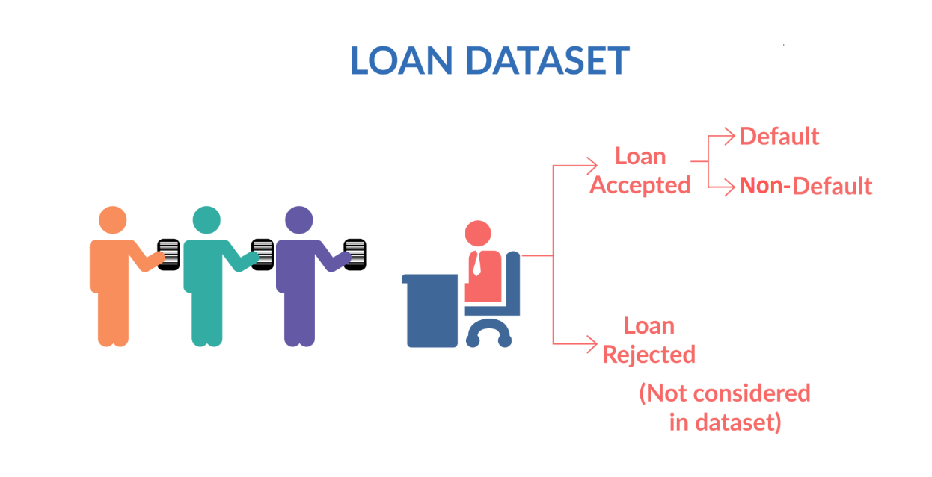
Lending Club: Loan Risk Analysis
Business Domain:
Largest online loan marketplace, facilitating personal loans, business loans, and financing of medical procedures
Lends various types of loans to urban customers.
Loan applications are categorized based on
Customer Attributes
Loan Attributes
Business Requirement :
Identify driving factors for Loan Defaults.
Identify indicators for Loan Default
Decrease loan defaults to reduce business loss

Slide 3
Analysis Approach
Clean Data
Null Values Handling
Univariate Analysis
Check Distribution of Numerical Values
Check Distribution of Categorical Values
Derived Metrics
Create Business Oriented Metrics
Create Data & Type Metrics
Segmented Univariate Analysis
Bivariate Analysis
Observations/ Recommendation
Converting & Formatting Data-types
Correlation Analysis
Analyze Patterns b/w variables
Explore joint Distribution
Check Distribution over various Segments
Suggestions based on Case-Study

Slide 4
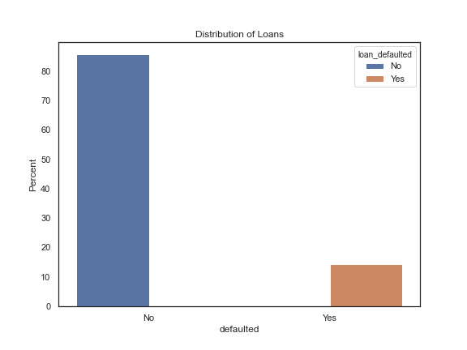
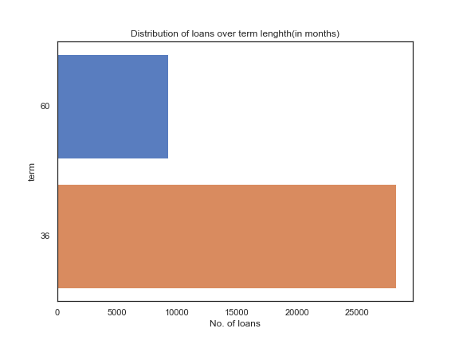
Understanding Loan Status
Default Rate in issued Loans
Term of Issued Loans
Observations :
Lending Club(LC) as an organization sees ~14% Default over all the loan it issues.
Lending Club(LC) seems to prefer short term(3 years) loan as they are less risky.

Slide 5
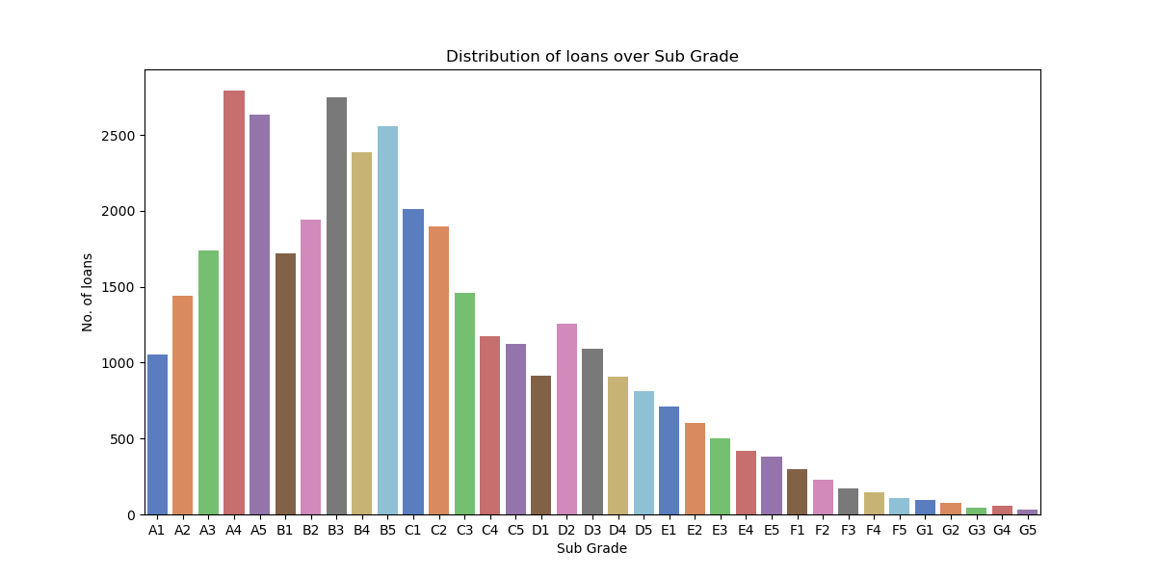
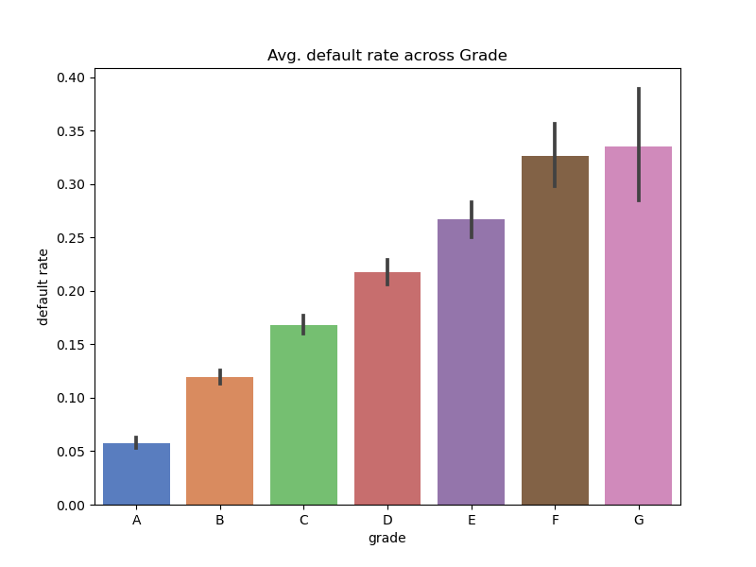
Understanding Loan Status
Loans issued over various Grades
Default Rate against Grade of Loan
Observations :
As the grade diminishes the number of loans also decreases.
But we should pay attention to, grade A and grade B, where the loans peak as we move from A to B, conveying that huge, majority get B loans and A grade loans are less.
Default Rate increases sharply as the Grade diminishes.

Slide 6
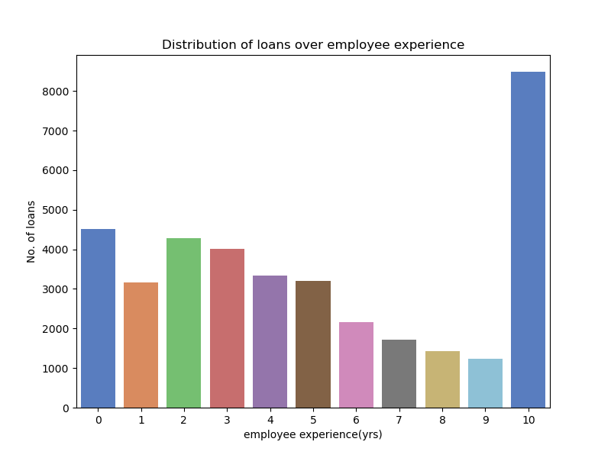
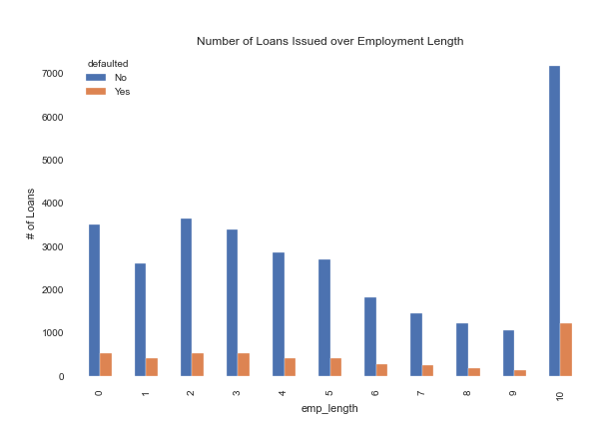
Understanding Applicant Attribute
Number of Loans over Employment Length
Employment Length Against Default Rate
Observations :
Most loans belong to employees with more than 10+ years of work experience, the reason is capping of work experience to 10
A diminishing trend can be seen for number of loans against employment length (0-9 years).
This may be indicative of growth in savings with long term employment.
It’s interesting to see that Default rate also decrease with increase in employment length(0-9 years). Given 10+ years is a huge bucket .

Slide 7
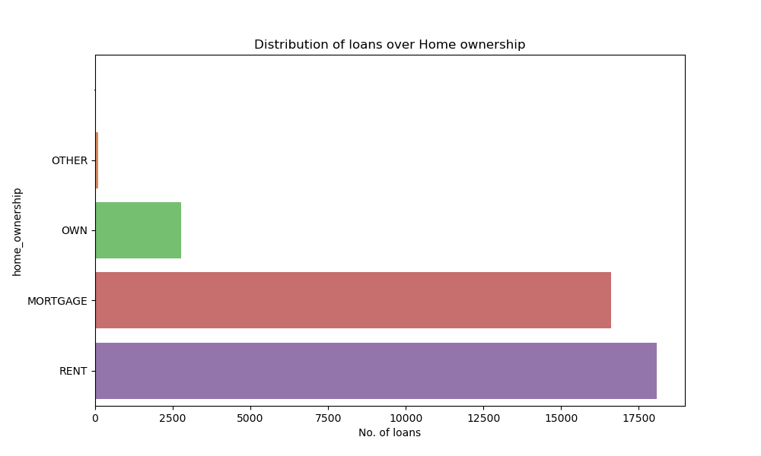
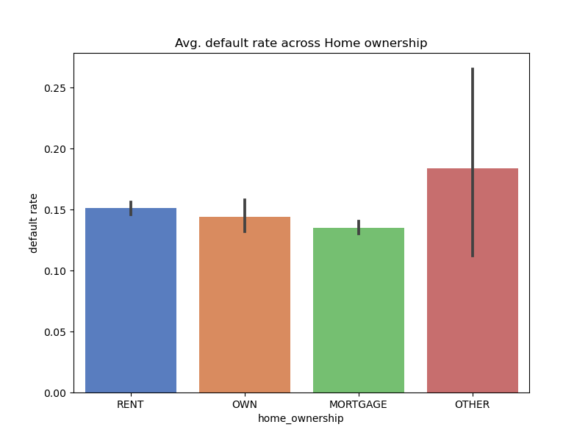
Understanding Applicant Attribute
Type of Home Ownership
Default Rate against Home Ownership
Observations :
Applicants applying to Lending Club(LC) generally have a Home on Rent or Mortgage.
Applicants with OTHER type of Home ownership have the Highest default rate, making these loans risky.
Rest all are pretty close to each other, with Mortgage having the least risk in the group.

Slide 8
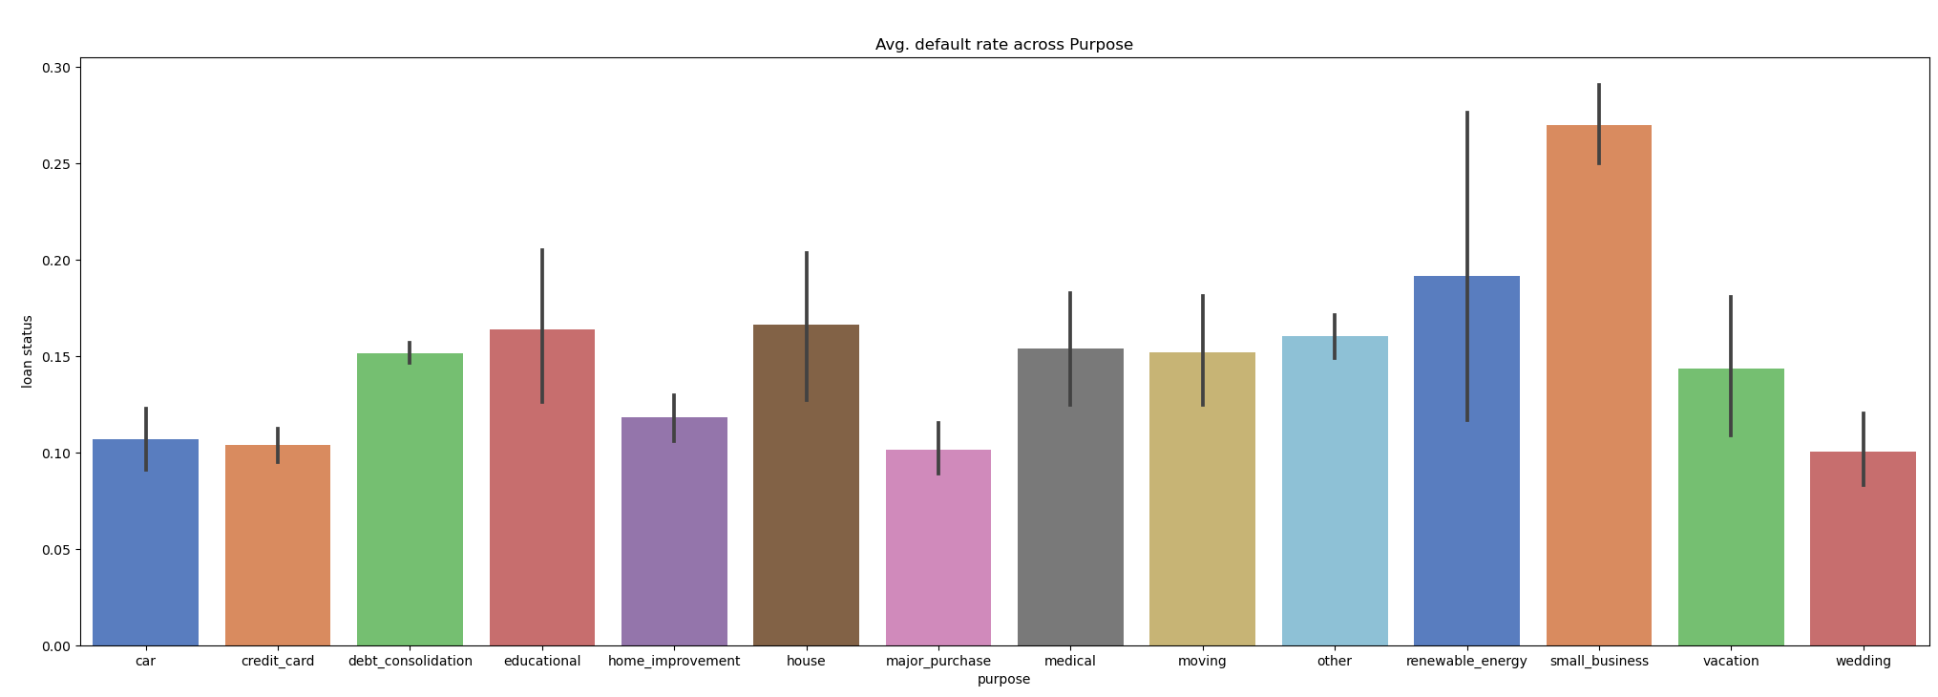
Loan Purpose
Observations :
Small Businesses have the highest Default Rate, which has a natural intuition of the business failing.
Renewable Energy as a sector is growing globally but is still subject to high risk. This is evident from the Default Rate & high variance
Loans taken for Wedding have the least Default Rate.
Debt Consolidation though is the most popular reason for loan, has a comparatively medium risk level.

Slide 9
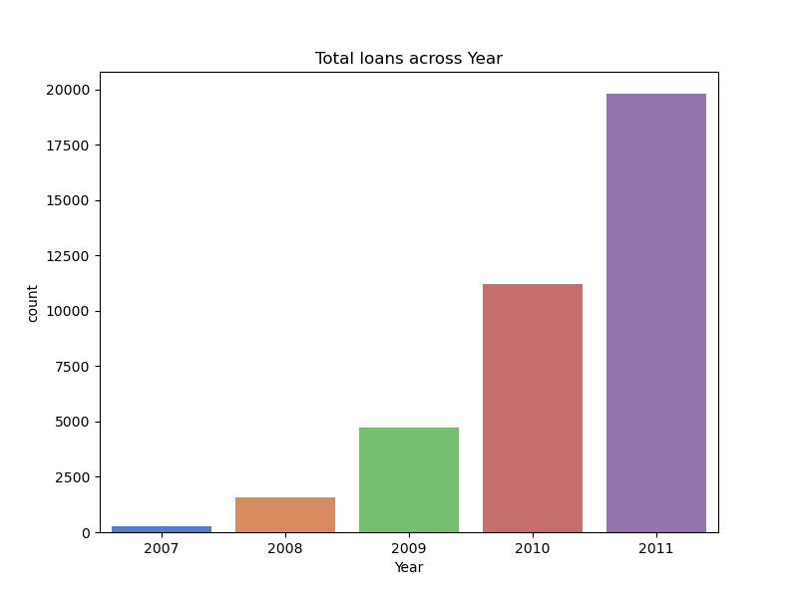
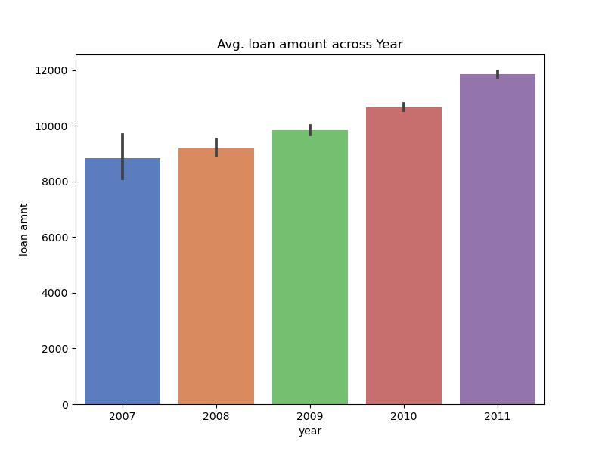
Loan Pattern over Time
Year application
Year Loan amount
Observations :
The number of Loans issued exponentially increases over time.
Strikingly, the average Loan Amount issued increased very gradually.

Slide 10
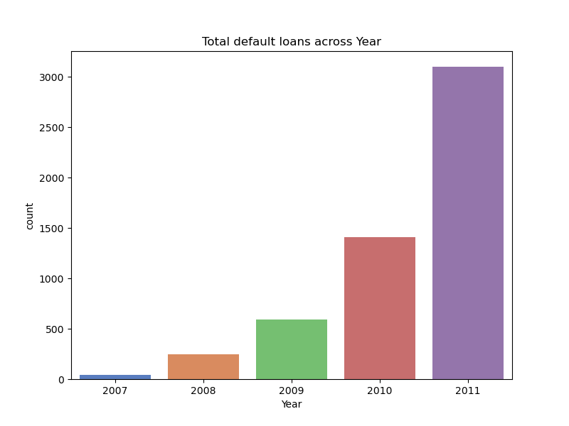
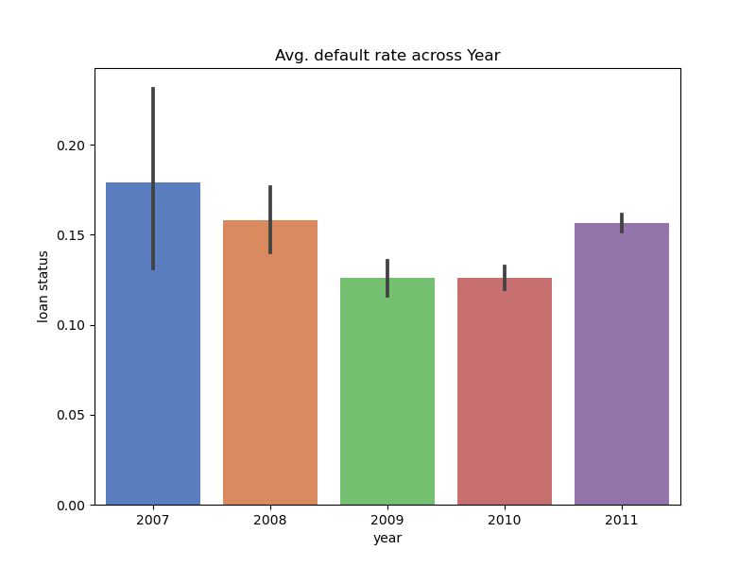
Loan Pattern over Time
Year application
Year Default
Observations :
As the total number of Loans increased, similar pattern in Default is visible
Strikingly, average default rate came down from 2007-2009 which can be attributed to the Economic Crisis.
Post the crisis, it seems the default rate is on the rise again, which needs to taken care of.

Slide 11
Understanding Relationships
In the next section we explore how Loan Amount is related to other parameters for Defaulted & Non-Defaulted Loans.

Slide 12
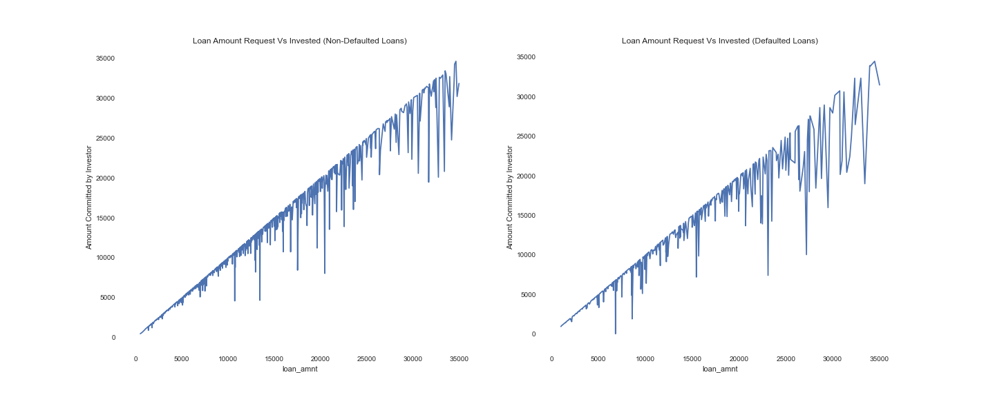
Loan Amount with Funded Amount Investor
Observations :
Intuition holds true, as Loan Amount requested increases, Funded Amount by investor increases.
Notice the noise(dropping lines) showing that certain loans grants differ massively from the requested amount.
NO loan was funded more than the requested amount. This proves the correctness of the data.
Non-Defaulted Loans have a higher positive slope than Defaulted Loans.
Defaulted Loans see a wider gap between approved amount and the requested amount.

Slide 13
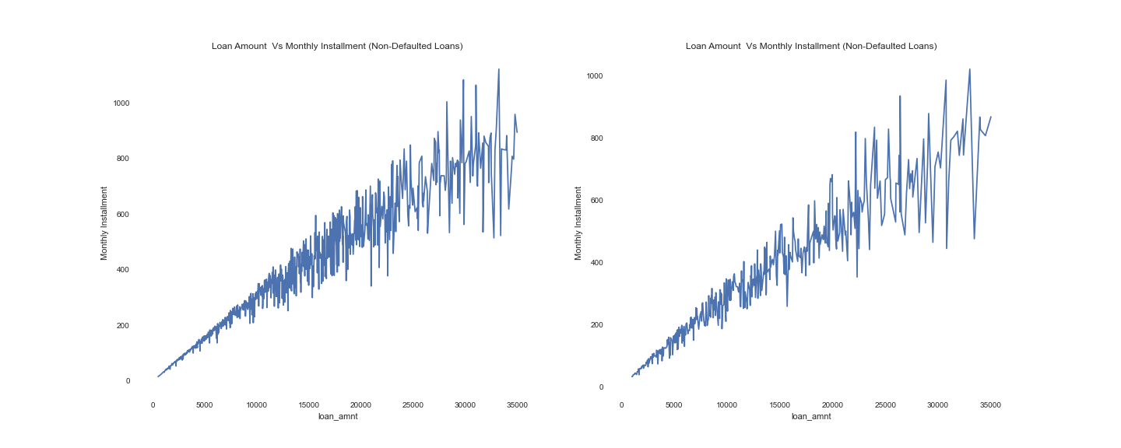
Loan Amount with Monthly Instalment
Observations :
A near linear relation between Loan Amount & Monthly Installment.
The deviation from the general trend diverges more as the Loan Amount increases.
The slope of the linear trend is lower for Defaulted Loans as compared to Non-Defaulted loans.
The magnitude of diversion from the linear trend is more for Defaulted Loans.
This makes a strong point on dependence of Loan amount on interest rate & period of loan. This dependence is seen more for high amount & defaulted loans.

Slide 14
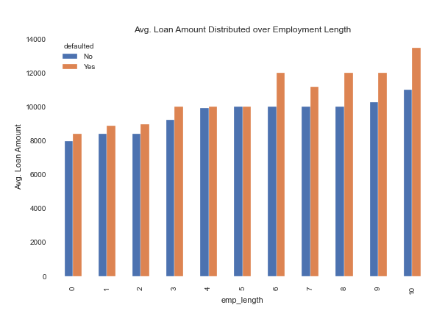
Employment Length v/s Loan Amount
Loans issued over Employment Length
Loan Amount Defaulted over Employment Length
Observations :
Applicants with mid-range employment have low default rate & high average loan amount.
Average Loan amount gradually increases with increase in employment years.
Amount of Defaulted Loan(in orange) is generally higher in most of the cases compared to the Non-Defaulted Loan Amount.

Slide 15
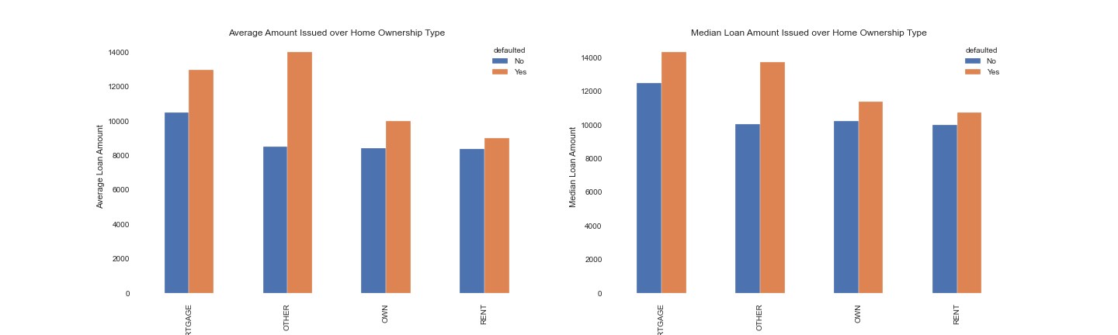
Home Ownership v/s Loan Amount
Observations :
The avg./median for applicant's with Home Ownership as Mortgage & Other is the highest in the 4 categories.
The difference between the Defaulted & Non-Defaulted Loan Amount is also maximum for Other & Mortgage home owner applicant's

Slide 16
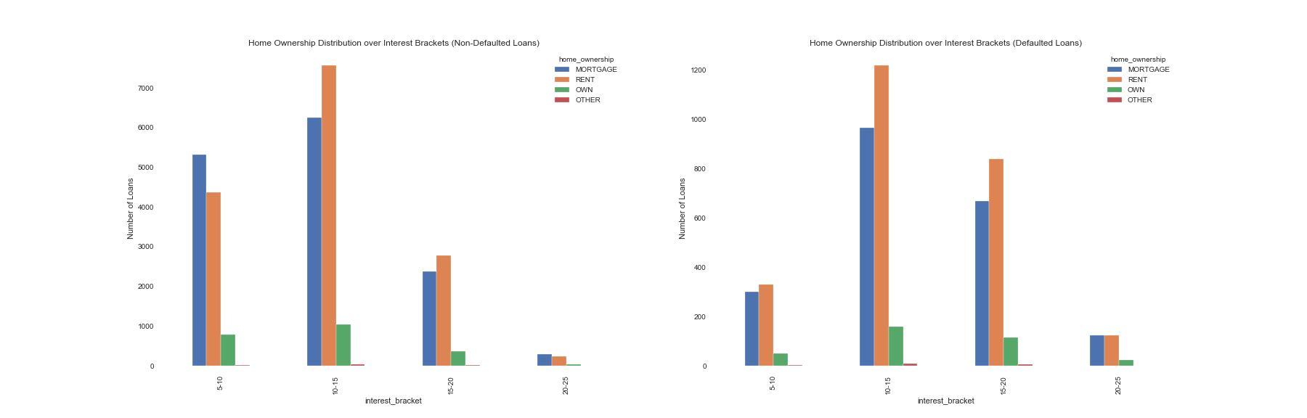
Interest Rate v/s Home Ownership
Observations :
For Non-defaulted Loans, we can see majorly loans in 5-10 & 10-15 percent interest bracket.
For Defaulted Loans, we can see majorly loans in 10-15 & 15-20 percent interest bracket.
The striking fact is that for Defaulted loans, 5-10 percent interest bracket has less number of loans. This can be attributed to these being more risky loans.

Slide 17
Recommendations
Action : Stop issuing Loans below E grade.
Action : Stop issuing Loans to applicant whose Home Ownership is OTHER type.
Precaution : Loans for the purpose of Small Business is highly risky.
Suggestion : Applicants with mid-term employment(5-9) years should be given preference.
Insight : Based on Employment Length of an applicant,we can suggest thresholds above which loans have high chance of defaulting.
Insight : Based on the Home Ownership of an applicant, we suggest thresholds above which loans have high chance of defaulting.
Suggestion : We suggest increasing interest rate for loans(>10) to maximize profit for applicants with Rented house.
Suggestion : For Loan Amount > 25000$ , investors need to reduce loan sanctions or amount.

