Slide 1
MATCH EACH PIECE OF CIPHERTEXT WITH ITS CORRESPONDING PIECE OF PLAINTEXT
Present By:
Mohammed Ishaq
40AIML306-21/1
Under the Guidance of:
University of Hyderabad &
Applied Roots

Slide 2
CONTENTS
Introduction
Encryption
Decryption
Importance of Encryption
Dataset
Cipher Levels
References

Slide 3
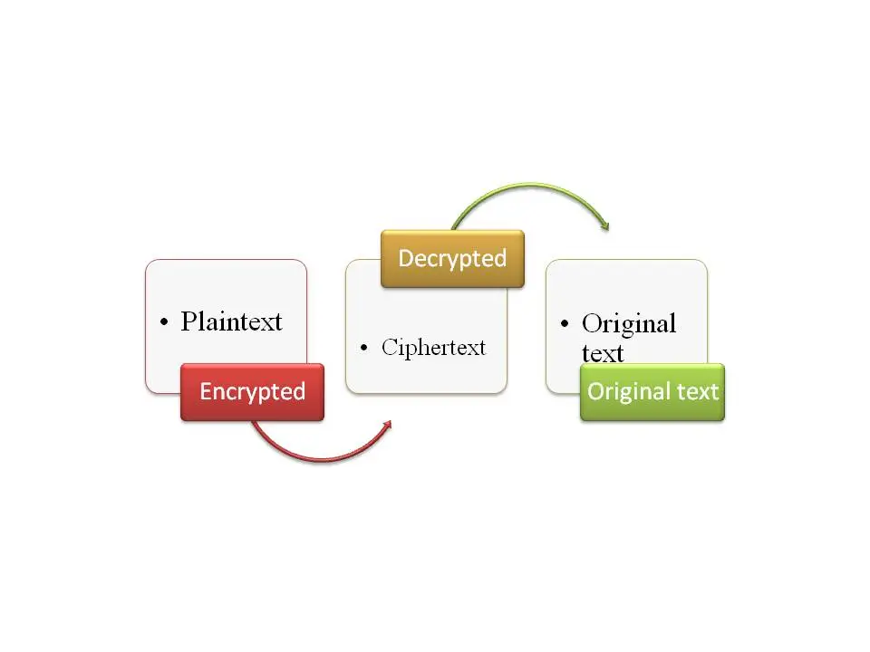
INTRODUCTION

Slide 4
INTRODUCTION
Plain Text
Anything that humans can understand and relate to. It could be as simple as English sentences.
Cipher Text
Is a series of randomized alphabet letters that humans are unable to comprehend. Usually referred as encrypted text.

Slide 5

ENCRYPTION

Slide 6

DECRYPTION

Slide 7
IMPORTANCE OF ENCRYPTION
Encryption Provides Privacy
Providing Security at all Times
Encryption Ensures Integrity of Data
Provides Authentication
Beneficial in Protecting Data across Devices

Slide 8
DATASET
https://www.kaggle.com/competitions/ciphertext-challenge-iii/data
sample_submission.csv
test.csv
train.csv

Slide 9
CIPHER LEVELS
The difficulty level denotes exactly which cipher were applied, and in what order.
Difficulty 1
Difficulty 2
Difficulty 3
Difficulty 4

Slide 10
REFERENCES
https://www.kaggle.com/competitions/ciphertext-challenge-iii/data
https://www.kaggle.com/code/pednt9/something-to-begin-with-a-first-hint/notebook
https://www.kaggle.com/code/tenffe/ciphertext-eda-and-baseline/notebook
https://www.kaggle.com/code/tarobxl/cipher-level-1-2-simple-eda-on-level-3-4

Slide 11
THANK YOU

