Slide 1
Analyzing Regional Differences in Fertility Rates
Using WHO Global Health Indicators
Angela R. • Dat D. • Ishaq A. • Oluwateniola T.
DATA4381 Data Capstone Project 1 | 10/7/2026

Slide 2
Problem Overview and Motivation
Why regional fertility differences matter
Problem we are solving
Why it matters
• Fertility rates vary widely across world regions and income levels.
• Health and socioeconomic factors may explain why some regions have higher or lower fertility.
• A data science model can identify patterns that are hard to see from single indicators alone.
• Fertility shapes future population size, health-system demand, education planning, and workforce needs.
• Life expectancy is a key health feature because it summarizes overall population health and living conditions.
• Results can support public-health researchers, planners, and policy analysts with regional evidence.

Slide 3
Background and Previous Work
What prior studies do — and how our project extends them
Global fertility trends
Shows large-scale fertility changes and regional differences over time.
Predictive fertility models
Uses statistical / machine-learning methods to predict fertility outcomes.
Birth-rate forecasting in Scotland
Focuses on a specific country context and short-term forecasting.
Fertility classification in Ethiopia
Uses classification methods for one-country fertility patterns.
Connection to our project: prior work studies fertility trends or prediction, but none of these exactly combines global 2000–2024 country-year data, regional comparisons, fertility prediction, life-expectancy prediction, feature importance, and simulation planning in one pipeline.
Sources: PMCID links provided by team: PMC11122687; PMC3367999; PMC11276648; PMC11756417.

Slide 4
Research Gap / Project Opportunity
The opportunity is not just prediction — it is regional interpretation
What is still missing?
Our project addresses
• Many studies focus on global totals or one country rather than comparing regions side-by-side.
• Some work predicts fertility, but often without clear regional error analysis or feature interpretation.
• Fewer projects connect fertility with life expectancy as a main health feature over 2000–2024.
• Regional fertility and life-expectancy trends across 211 countries.
• Predictive models with a clear baseline and validation strategy.
• Feature-importance analysis to identify the strongest health and socioeconomic indicators.
• A future simulation framework for country-level scenario analysis.

Slide 5
Research Questions and Project Objectives
Specific and achievable across Capstone I and II
Predict fertility rate
Build baseline and advanced regression models using health + socioeconomic features.
Predict life expectancy
Create a second prediction target to compare health-system patterns.
Find important features
Use correlations, coefficients, and feature importance to identify key drivers.
Simulation model
Estimate how changes in key predictors may shift predicted fertility.
Country-level planning
Group countries by fertility pattern and regional context for decision support.
Capstone I focus: data cleaning, EDA, baseline models, initial feature analysis. Capstone II focus: tuning, validation, simulation, country profiles, dashboard/report.

Slide 6
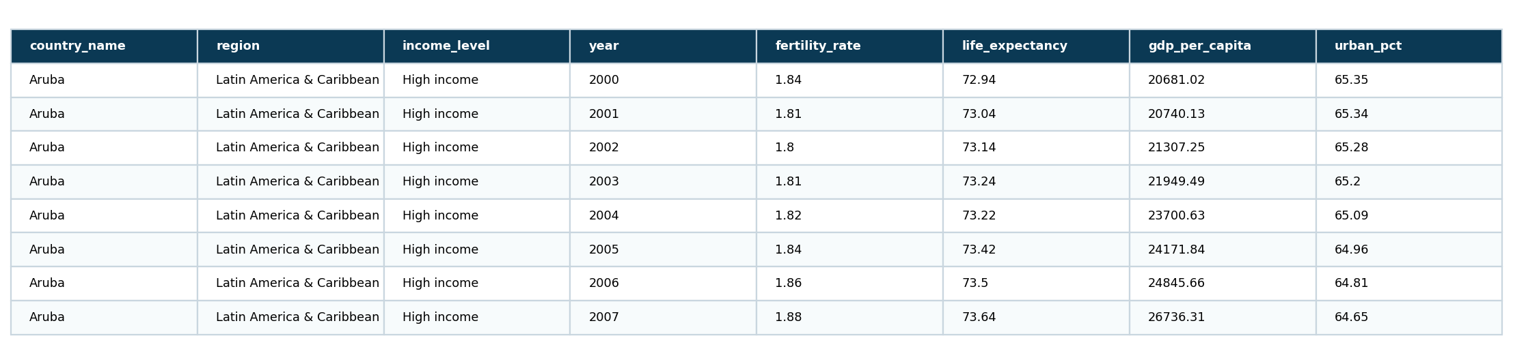
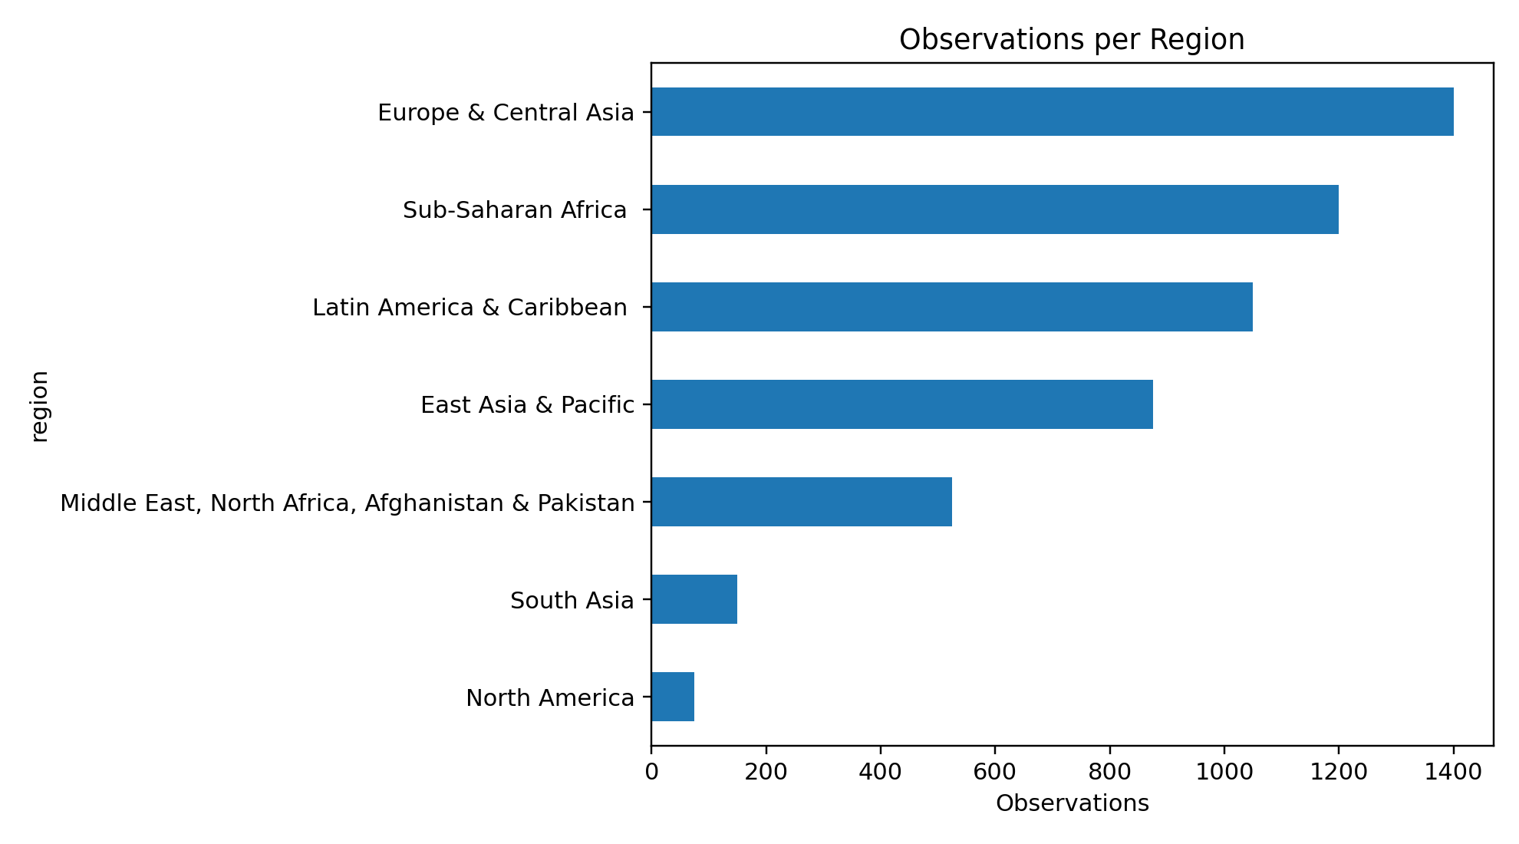
Dataset Overview
Global Health Indicators, 2000–2024
5,275
211
25
48
country-year observations
countries
years
columns
Unit of observation: one country in one year
Target variables: fertility_rate and life_expectancy
Feature types: health, demographics, income level, region, healthcare resources, mortality, sanitation, immunization, GDP, poverty, and urbanization
Dataset source: Health Indicators Dataset for Forecasting (WHO) on Kaggle; file used: health_indicators.csv.

Slide 7
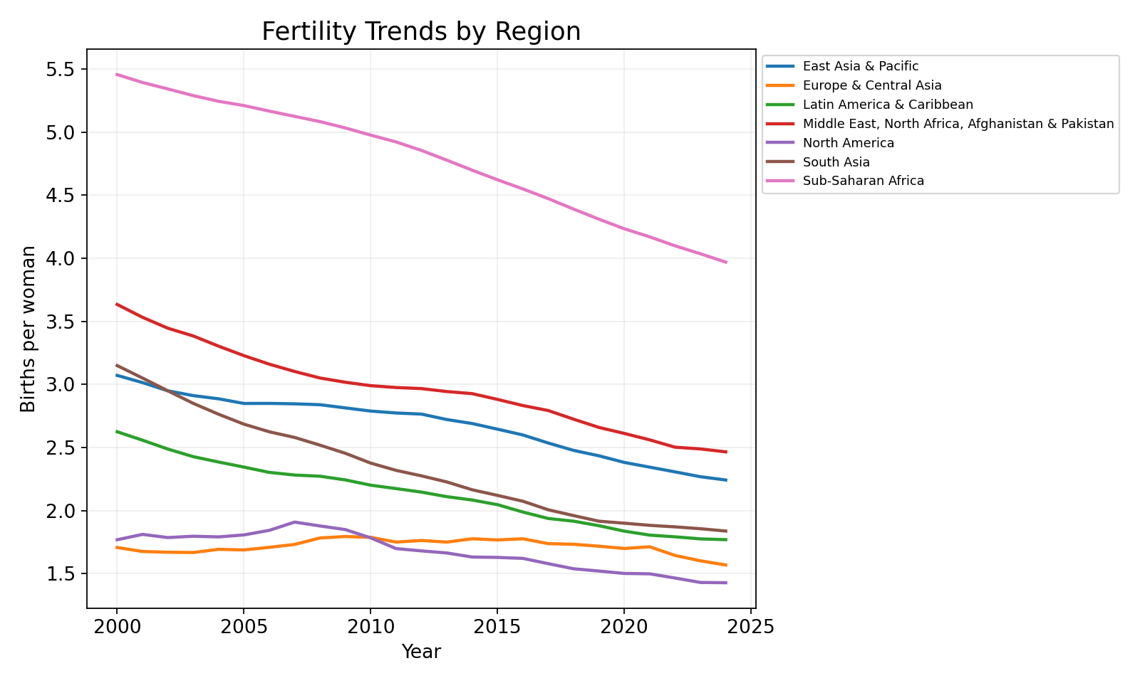
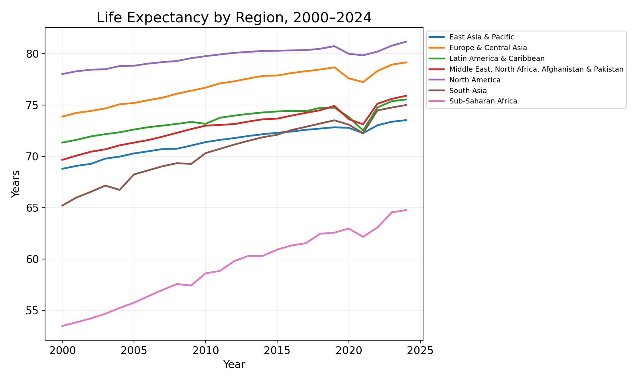
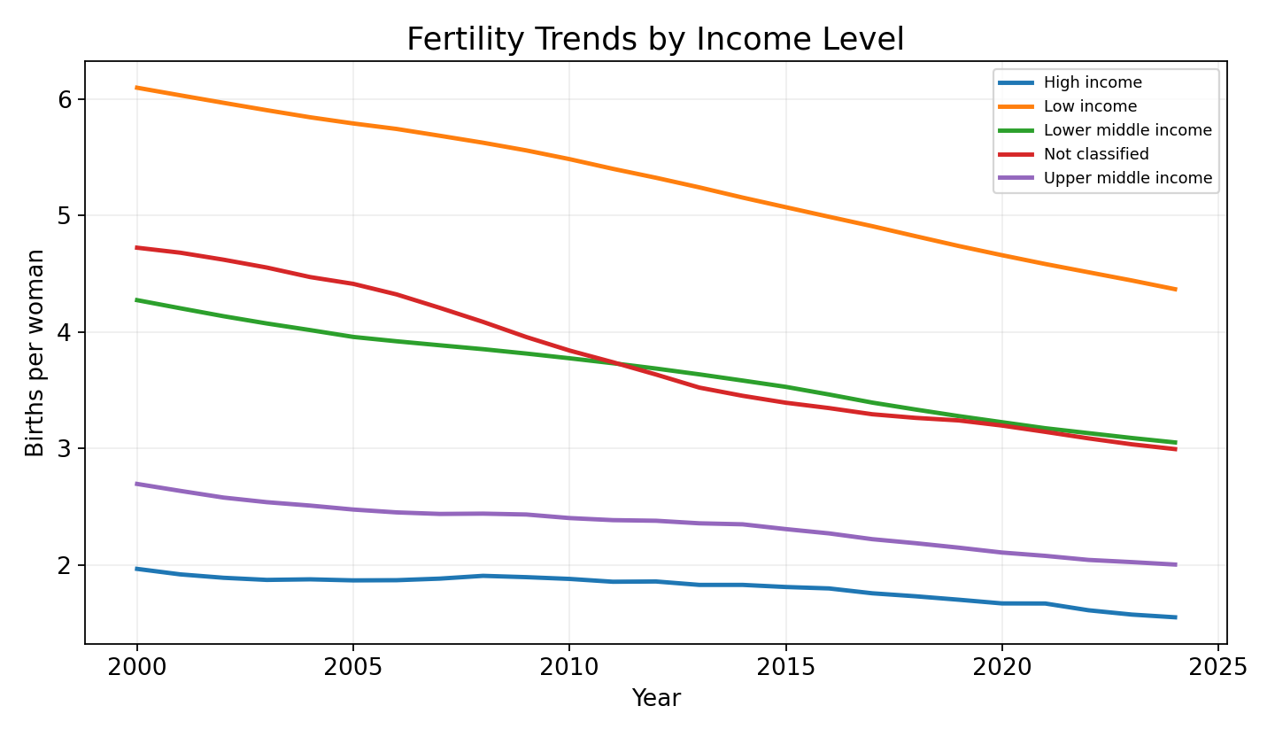
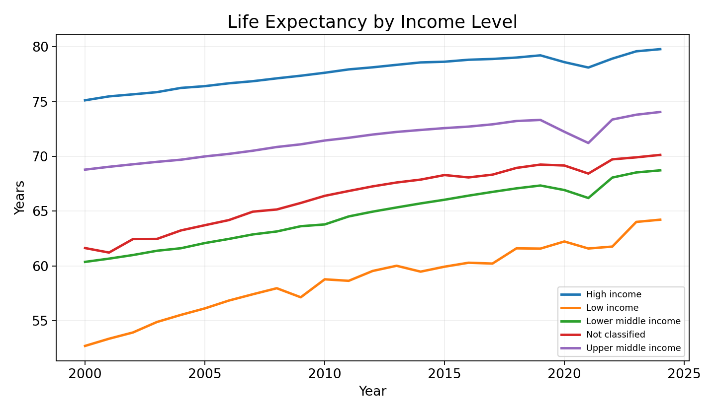
Data Understanding and Initial Exploration
Initial patterns: fertility and life expectancy differ by region and income

Slide 8
Proposed Methodology
From raw data to validated models and interpretation
1
Clean + validate
2
EDA
3
Preprocess
Check columns, years, countries, duplicates, missingness
Fertility and life expectancy trends by region/income
Impute missing data, encode categories, scale linear models
4
Model
5
Validate
6
Interpret
Mean baseline, Linear/Ridge, Random Forest, Gradient Boosting
Time holdout and GroupKFold by country
Feature importance, regional error, simulation planning
Reasoning: because the same countries repeat across years, evaluation must avoid leakage and test whether the model generalizes across time and countries.

Slide 9
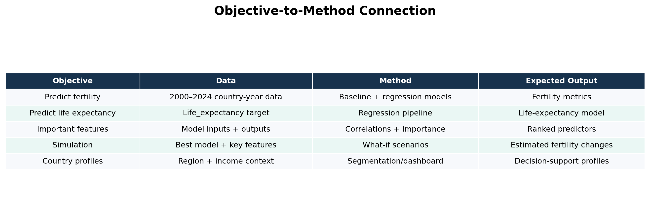
Objective-to-Method Connection
Every objective has a dataset, method, and output
Note: model outputs are preliminary for Capstone I; simulation and dashboard are Capstone II deliverables.

Slide 10
Baseline
The simplest benchmark and why we need it
Baseline model
Comparison models
• Mean Baseline predicts the average training-set fertility rate for every future observation.
• It gives the minimum benchmark that all useful models should beat.
• Linear Regression is added as an interpretable baseline.
• Ridge Regression reduces instability from correlated predictors.
• Random Forest captures nonlinear patterns and interactions.
• Gradient Boosting tests another nonlinear ensemble approach.
Training/testing plan: train on 2000–2019 → test on 2020–2024.

Slide 11
Evaluation and Definition of Success
Metrics match the regression problem
MAE
Average error in births per woman; easiest to explain.
RMSE
Penalizes large prediction errors more strongly.
R²
How much variation in fertility the model explains.
GroupKFold
Tests performance when entire countries are held out.
Definition of success: the final model should clearly outperform the mean baseline on MAE/RMSE, maintain positive R², and remain stable under time-based and country-level validation.

Slide 12
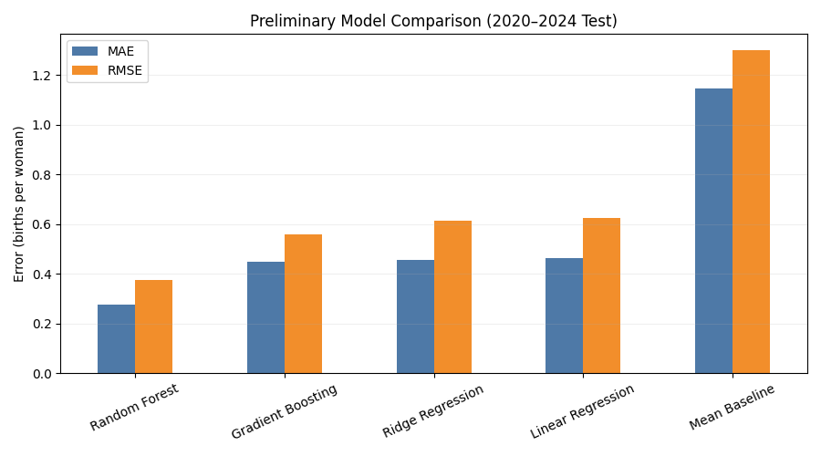
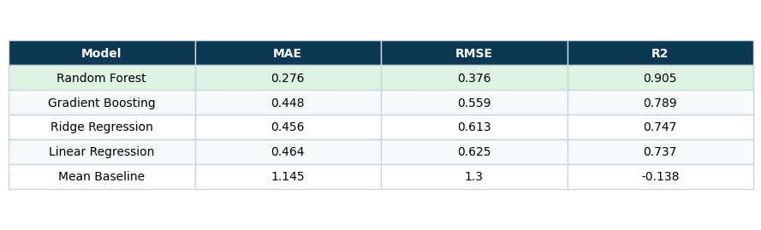
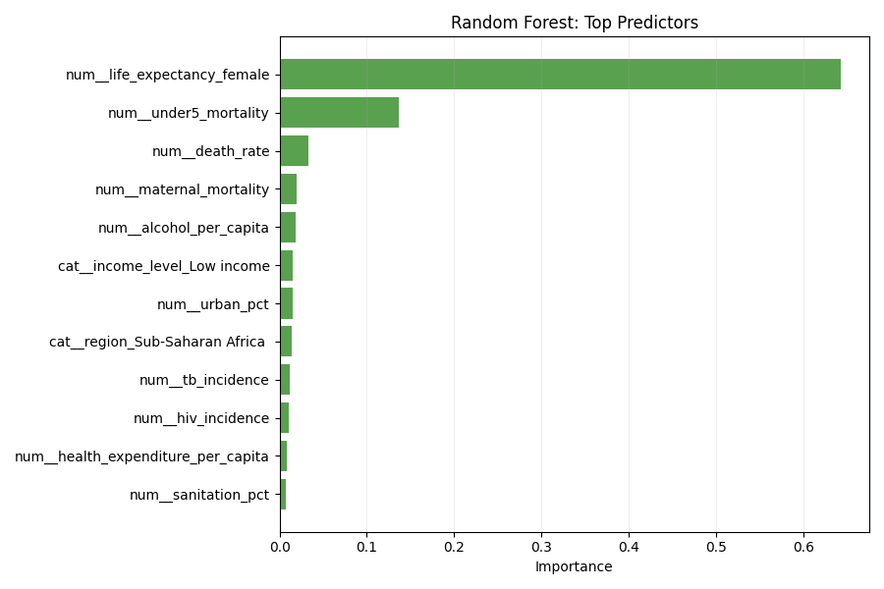
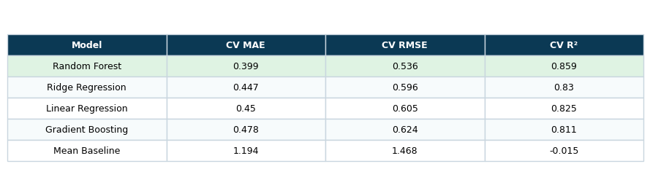
Preliminary / Baseline Results
Current model outputs from the correct 2000–2024 dataset
Preliminary conclusion: Random Forest produced the strongest fertility-rate prediction in the current test, but results will be refined in Capstone II with additional validation and interpretation.

Slide 13
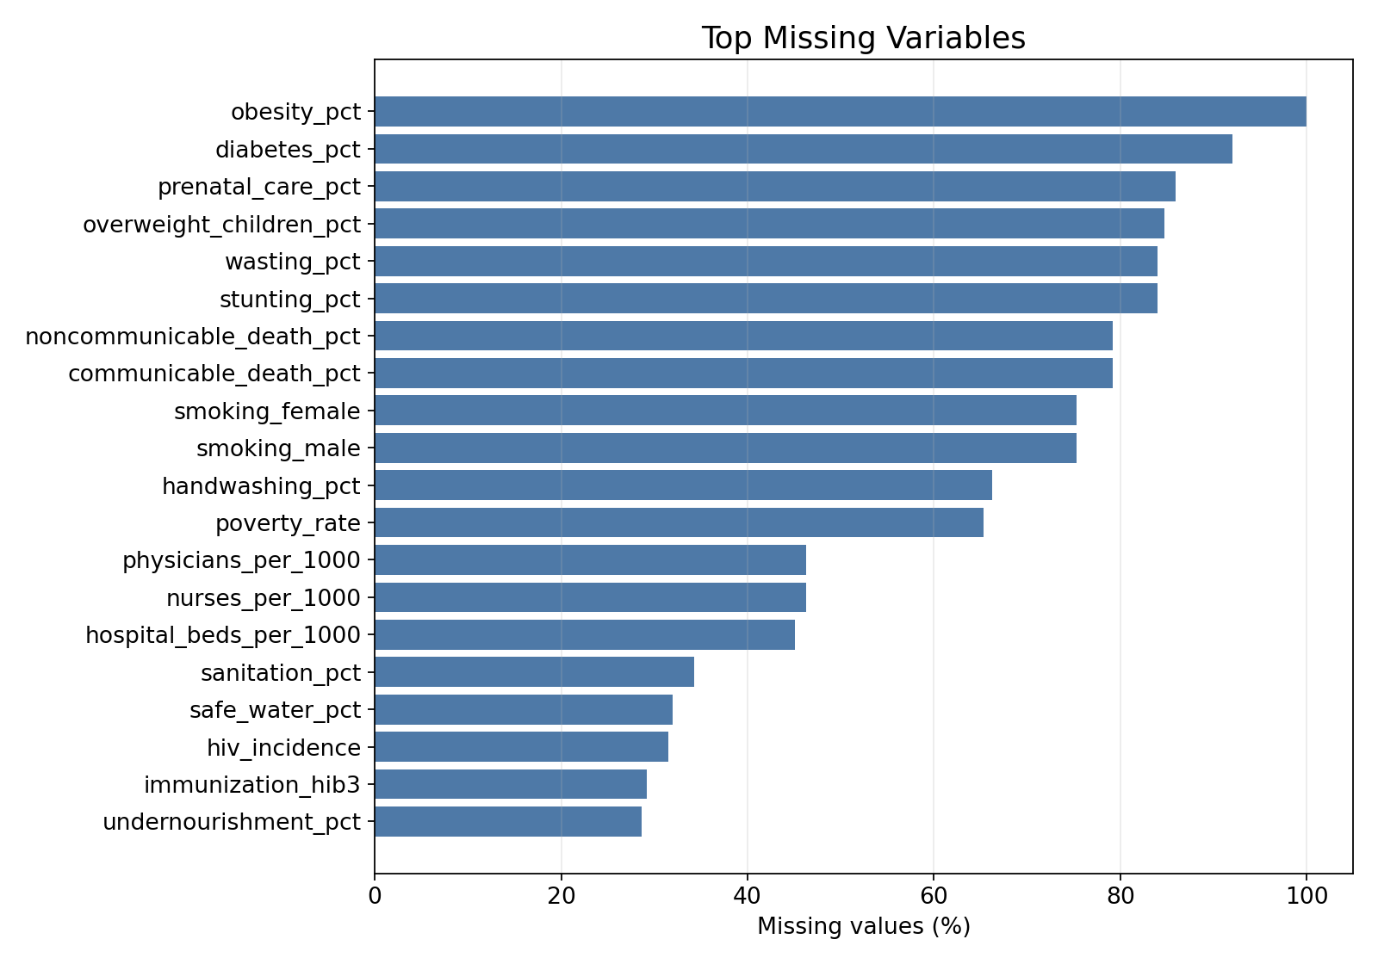
Expected Challenges and Proposed Solutions
Known risks and how we will address them
Missing values
Region-aware imputation, removal rules, sensitivity checks
Regional differences
Analyze regions separately and compare model errors
Multicollinearity
Correlation heatmap, VIF, Ridge/Lasso-style regularization
Data leakage
Feature screening; exclude direct fertility proxies; time-based split
Limited social variables
Add external data if feasible; state limitations clearly

Slide 14
Complete Project Workflow
From question to final product
Problem
Data
EDA
Models
Validation
Interpret
Capstone II
Define fertility & life expectancy questions
Load 2000–2024 country-year dataset
Regional trends + life expectancy patterns
Baseline → Ridge/RF/GB models
Time holdout + country GroupKFold
Feature importance + regional error
Simulation + dashboard + final report
This workflow shows the complete two-semester data science pipeline: data collection, cleaning, preprocessing, modeling, evaluation, interpretation, and final deliverable.

Slide 15
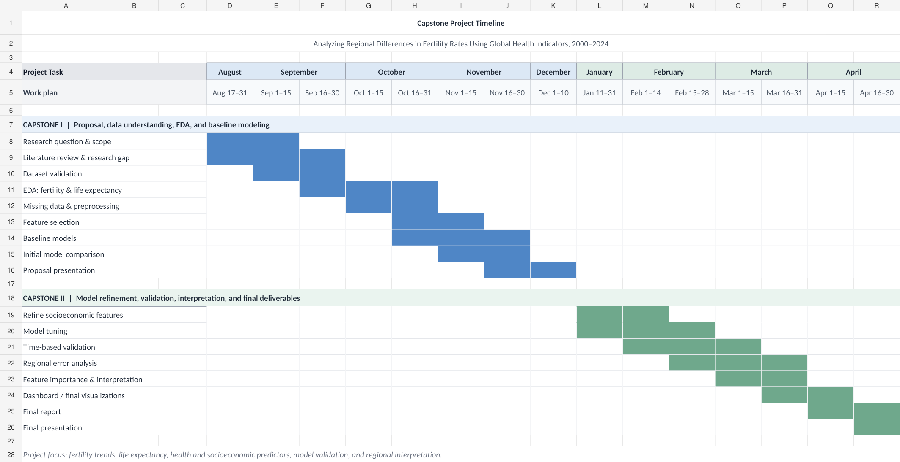
Capstone I and II Plans
Calendar-style timeline and deliverables
Timeline separates Capstone I proposal work from Capstone II modeling, validation, simulation, and final deliverables.

Slide 16
Expected Final Product / Contribution
What the project will produce by the end of Capstone II
Final products
Contribution
• Validated fertility-rate prediction model.
• Life-expectancy prediction model for comparison.
• Feature-importance and regional error analysis.
• Simulation tool for fertility-related scenarios.
• Dashboard or visualization report.
• Combines global country-year data with regional interpretation.
• Moves beyond simple trends by comparing models and validation strategies.
• Gives planners a clear way to compare countries, regions, and scenarios.
• Useful for public-health researchers, policymakers, NGOs, and students.

Slide 17
Questions?
Thank you

