Slide 1
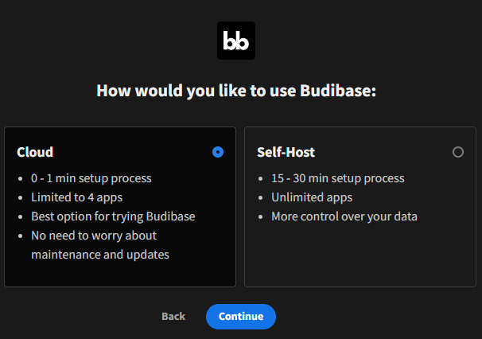
Budibase
Go to https://account.budibase.app/register to register, and complete the registration.
Select whether to go with “Cloud” or “Self-Host”:
Cloud: Use Budibase’s website to host our form/survey.
Self-Host: Use our own website to host our form/survey. Requires connection of Digital Ocean, or Docker, or Kubernetes between Budibase and our own website.
3. Easiest way is to use Cloud.

Slide 2
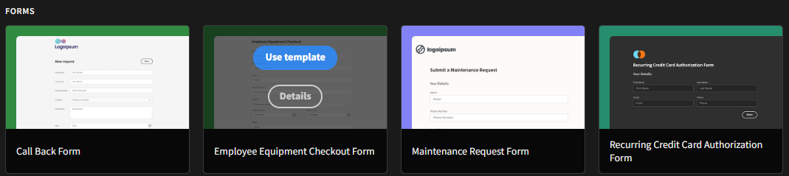
Budibase
There are a lot of preset template ready to use and editable. All template and scratch form have their own database readily setted up.
After satisfied with the form, we need to “Publish” the form in order to make it (the form’s link) accessible to use.

Slide 3
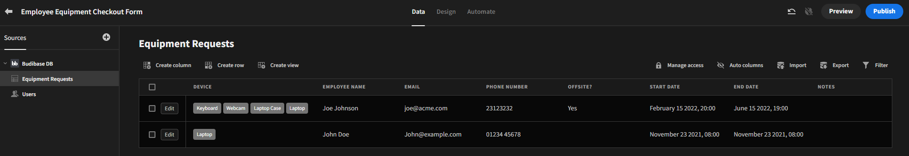
Budibase
Example used: https://acedigital.budibase.app/app/employee-equipment-checkout-form
Following is the example of admin’s POV of a form that has been setted up.
4
1
2
3
5
6
After satisfied with the form, we need to “Publish” the form in order to make it (the form’s link) accessible to use.
The database of the survey form. Comes with CRUD functionalities.
Design is where we manage the interface of the form, add question, add action, and it uses drag-and-drop.
Automate is where we create an automated action in which an action will be triggered if the answer of the form meets the condition we set.
To publish the survey form so that it’s accessible by the user.
To download the data from the database; whether in CSV or JSON.
Data that has been filled by users.

