Slide 1








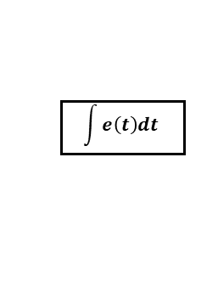

RNN
$$d(t)$$
$$e(t)$$
$$plant$$
$$y(t)$$
$$+$$
$$e$$
$$r (t)$$
$$\int{e\left(t\right)dt}$$
$$−$$
$$\frac{de\left(t\right)}{dt}$$

Slide 2
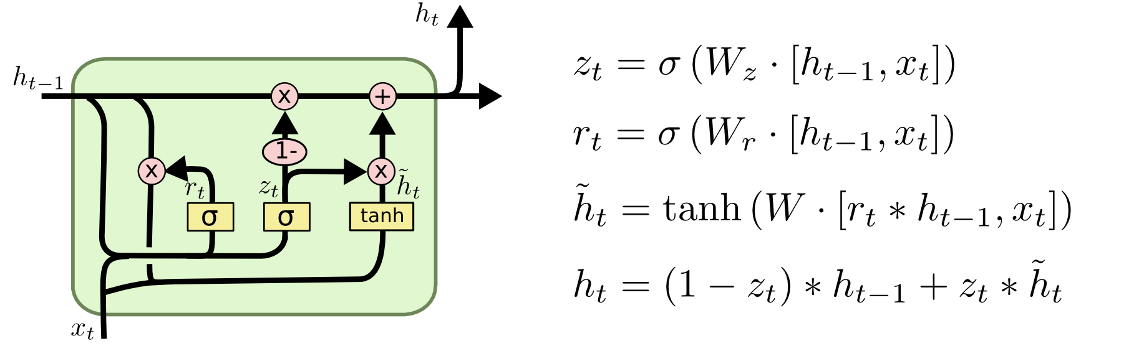

Slide 4



$$×$$
$$1−$$
$$1−$$

Slide 5
















$$h_{k−1}$$
$$⨀$$
$$+$$
$$h_{k}$$
$$⨀$$
$$r_{k}$$
$$1−g_{k}$$
$$⨀$$
$$g_{k}$$
$$σ$$
$$σ$$
$${\tilde{h}}_{k}$$
$$tanh$$
$$+$$
$$+$$
$$s_{k}$$
Notes:
Finalized!

Slide 6















$$h_{k−1}$$
$$⨀$$
$$+$$
$$h_{k}$$
$$⨀$$
$$r_{k}$$
$$g_{k}$$
$$1−g_{k}$$
$$⨀$$
$${\tilde{h}}_{k}$$
$$σ$$
$$σ$$
$$tanh$$
$$+$$
$$+$$
$$s_{k}$$
Notes:
Finalized!

Slide 7
$$h_{k−1}$$
$$⨀$$
$$+$$
$$h_{k}$$
$$⨀$$
$$r_{k}$$
$$g_{k}$$
$$1−g_{k}$$
$$⨀$$
$${\tilde{h}}_{k}$$
$$σ$$
$$σ$$
$$tanh$$
$$+$$
$$+$$
$$s_{k}$$
Notes:
Finalized!

Slide 8
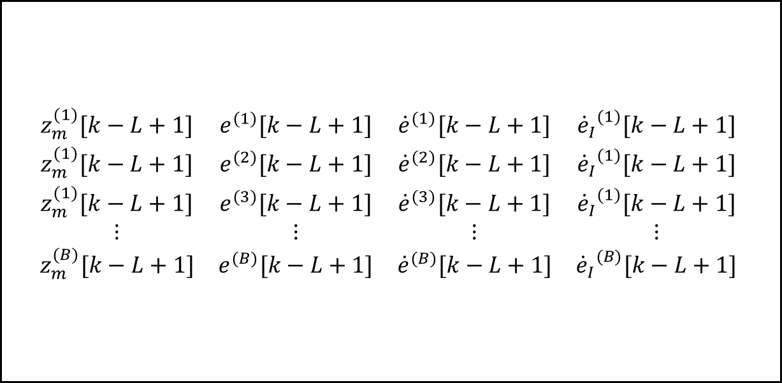
$$\begin{matrix}z_{m}^{(1)}[k−L+1] & e^{(1)}[k−L+1] & {\dot{e}}^{(1)}[k−L+1] & {{\dot{e}}_{I}}^{(1)}[k−L+1] \\ z_{m}^{(1)}[k−L+1] & e^{(2)}[k−L+1] & {\dot{e}}^{(2)}[k−L+1] & {{\dot{e}}_{I}}^{(1)}[k−L+1] \\ z_{m}^{(1)}[k−L+1] & e^{(3)}[k−L+1] & {\dot{e}}^{(3)}[k−L+1] & {{\dot{e}}_{I}}^{(1)}[k−L+1] \\ ⋮ & ⋮ & ⋮ & ⋮ \\ z_{m}^{(B)}[k−L+1] & e^{(B)}[k−L+1] & {\dot{e}}^{(B)}[k−L+1] & {{\dot{e}}_{I}}^{(B)}[k−L+1]\end{matrix}$$

Slide 9
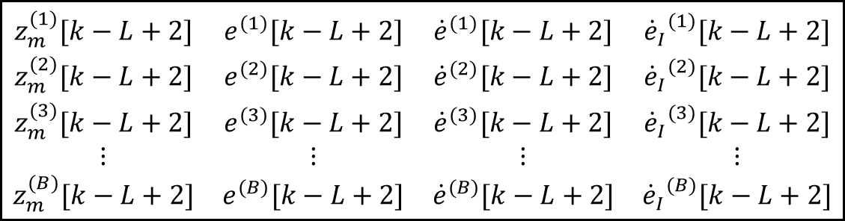
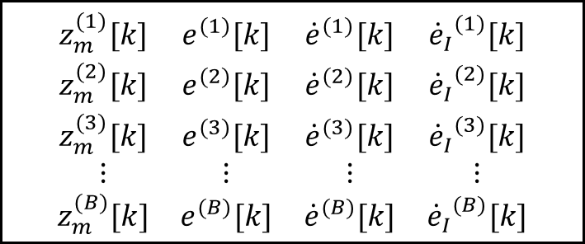

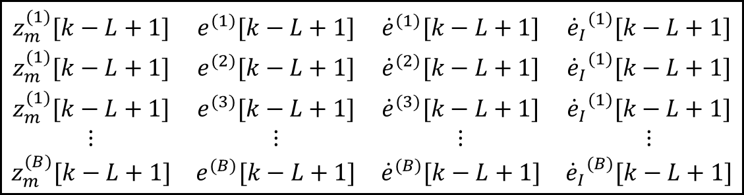
$$z^{\left(−\left(L−1\right)\right)}$$
$$\begin{matrix}z_{m}^{(1)}[k] & e^{(1)}[k] & {\dot{e}}^{(1)}[k] & {{\dot{e}}_{I}}^{(1)}[k] \\ z_{m}^{(2)}[k] & e^{(2)}[k] & {\dot{e}}^{(2)}[k] & {{\dot{e}}_{I}}^{(2)}[k] \\ z_{m}^{(3)}[k] & e^{(3)}[k] & {\dot{e}}^{(3)}[k] & {{\dot{e}}_{I}}^{(3)}[k] \\ ⋮ & ⋮ & ⋮ & ⋮ \\ z_{m}^{(B)}[k] & e^{(B)}[k] & {\dot{e}}^{(B)}[k] & {{\dot{e}}_{I}}^{(B)}[k]\end{matrix}$$
$$\begin{matrix}z_{m}^{(1)}[k−L+2] & e^{(1)}[k−L+2] & {\dot{e}}^{(1)}[k−L+2] & {{\dot{e}}_{I}}^{(1)}[k−L+2] \\ z_{m}^{(2)}[k−L+2] & e^{(2)}[k−L+2] & {\dot{e}}^{(2)}[k−L+2] & {{\dot{e}}_{I}}^{(2)}[k−L+2] \\ z_{m}^{(3)}[k−L+2] & e^{(3)}[k−L+2] & {\dot{e}}^{(3)}[k−L+2] & {{\dot{e}}_{I}}^{(3)}[k−L+2] \\ ⋮ & ⋮ & ⋮ & ⋮ \\ z_{m}^{(B)}[k−L+2] & e^{(B)}[k−L+2] & {\dot{e}}^{(B)}[k−L+2] & {{\dot{e}}_{I}}^{(B)}[k−L+2]\end{matrix}$$
$$\begin{matrix}z_{m}^{(1)}[k−L+1] & e^{(1)}[k−L+1] & {\dot{e}}^{(1)}[k−L+1] & {{\dot{e}}_{I}}^{(1)}[k−L+1] \\ z_{m}^{(1)}[k−L+1] & e^{(2)}[k−L+1] & {\dot{e}}^{(2)}[k−L+1] & {{\dot{e}}_{I}}^{(1)}[k−L+1] \\ z_{m}^{(1)}[k−L+1] & e^{(3)}[k−L+1] & {\dot{e}}^{(3)}[k−L+1] & {{\dot{e}}_{I}}^{(1)}[k−L+1] \\ ⋮ & ⋮ & ⋮ & ⋮ \\ z_{m}^{(B)}[k−L+1] & e^{(B)}[k−L+1] & {\dot{e}}^{(B)}[k−L+1] & {{\dot{e}}_{I}}^{(B)}[k−L+1]\end{matrix}$$

Slide 10
GRU cell
GRU cell
GRU cell
GRU cell

Slide 11
GRU cell
GRU cell
GRU cell
GRU cell
GRU cell
GRU cell
GRU cell
GRU cell

Slide 12


GRU cell
GRU cell
GRU cell
GRU cell
GRU cell
GRU cell
$$⋮$$
$$⋮$$
GRU cell
GRU cell

Slide 13
GRU cell
GRU cell
GRU cell
GRU cell
GRU cell
GRU cell
$$⋮$$
$$⋮$$
GRU cell
GRU cell

Slide 14







Layer 1
Layer 2
GRU
GRU
$$q_{z}[k]$$
GRU
GRU
$$e_{z}[k]$$
$${\hat{u}}_{1}[k]$$
$$d_{z}[k]$$
GRU
GRU
$$η_{z}[k]$$
$$⋮$$
$$⋮$$
GRU
GRU

Slide 15




Layer 1
Layer 2
GRU
GRU
$$q_{z}[k]$$
GRU
GRU
$$e_{z}[k]$$
$${\hat{u}}_{1}[k]$$
$$d_{z}[k]$$
GRU
GRU
$$η_{z}[k]$$
$$⋮$$
$$⋮$$
GRU
GRU

Slide 16
Layer 1
Layer 2
GRU
GRU
$$q_{z}[k]$$
GRU
GRU
$$e_{z}[k]$$
$${\hat{u}}_{1}[k]$$
$$d_{z}[k]$$
GRU
GRU
$$η_{z}[k]$$
$$⋮$$
$$⋮$$
GRU
GRU

Slide 17
















Motor Mixing Algorithm
Motor Speed
Commands
$φ_{cmd}$
Roll input
Roll MRAC
$$u_{2}$$
$θ_{cmd}$
Pitch input
Pitch MRAC
$$u_{3}$$
$$ω_{1}$$
$$ω_{2}$$
Output
MMA
$$ω_{3}$$
Quadrotor
$ψcmd$
Yaw input
Yaw MRAC
$$u_{4}$$
$$ω_{4}$$
$$u_{1}$$
$$z_{cmd}$$
Altitude input
Altitude MRAC
$$\left[\begin{matrix}φ \\ \begin{matrix}\dot{φ} \\ \dot{θ} \\ \dot{ψ}\end{matrix}\end{matrix}\right]$$
$$\left[\begin{matrix}θ \\ \begin{matrix}\dot{φ} \\ \dot{θ} \\ \dot{ψ}\end{matrix}\end{matrix}\right]$$
$$\left[\begin{matrix}ψ \\ \begin{matrix}\dot{φ} \\ \dot{θ} \\ \dot{ψ}\end{matrix}\end{matrix}\right]$$
$$\left[\begin{matrix}z \\ \dot{z}\end{matrix}\right]$$
Sensing
&
Estimation
System States

Slide 18
Motor Mixing Algorithm
Motor Speed
Commands
$φ_{cmd}$
Roll input
Roll MRAC
$$u_{2}$$
$θ_{cmd}$
Pitch input
Pitch MRAC
$$u_{3}$$
$$ω_{1}$$
$$ω_{2}$$
Output
MMA
$$ω_{3}$$
Quadrotor
$ψcmd$
Yaw input
Yaw MRAC
$$u_{4}$$
$$ω_{4}$$
$$u_{1}$$
$$z_{cmd}$$
Altitude input
Altitude MRAC
$$\left[\begin{matrix}φ \\ \begin{matrix}\dot{φ} \\ \dot{θ} \\ \dot{ψ}\end{matrix}\end{matrix}\right]$$
$$\left[\begin{matrix}θ \\ \begin{matrix}\dot{φ} \\ \dot{θ} \\ \dot{ψ}\end{matrix}\end{matrix}\right]$$
$$\left[\begin{matrix}ψ \\ \begin{matrix}\dot{φ} \\ \dot{θ} \\ \dot{ψ}\end{matrix}\end{matrix}\right]$$
$$\left[\begin{matrix}z \\ \dot{z}\end{matrix}\right]$$
Sensing
&
Estimation
System States

Slide 19
$φ_{cmd}$
Roll input
Roll MRAC
$$u_{2}$$
$θ_{cmd}$
Pitch input
Pitch MRAC
$$u_{3}$$
$$ω_{1}$$
$$ω_{2}$$
Output
MMA
$$ω_{3}$$
Quadrotor
$ψcmd$
Yaw input
Yaw MRAC
$$u_{4}$$
$$ω_{4}$$
$$u_{1}$$
$$z_{cmd}$$
Altitude input
Altitude MRAC
$$\left[\begin{matrix}φ \\ \begin{matrix}\dot{φ} \\ \dot{θ} \\ \dot{ψ}\end{matrix}\end{matrix}\right]$$
$$\left[\begin{matrix}θ \\ \begin{matrix}\dot{φ} \\ \dot{θ} \\ \dot{ψ}\end{matrix}\end{matrix}\right]$$
$$\left[\begin{matrix}ψ \\ \begin{matrix}\dot{φ} \\ \dot{θ} \\ \dot{ψ}\end{matrix}\end{matrix}\right]$$
$$\left[\begin{matrix}z \\ \dot{z}\end{matrix}\right]$$
Sensing
&
Estimation
System States

Slide 20
















$q_{r, φ}[k]$
Roll PID
$$τ_{φ}[k]$$
$q_{r, θ}[k]$
$$q_{φ}[k]$$
$$τ_{θ}[k]$$
Pitch PID
$$q_{θ}[k]$$
$$τ_{ψ}[k]$$
Quadrotor
Dynamics
$q_{r, ψ}[k]$
Yaw PID
$$q_{ψ}[k]$$
$$+$$
$$e_{z}[k]$$
$$u_{1}[k]$$
$q_{r, z}[k]$
Altitude GRU
$$−$$
$$q_{z}[k]$$
$$χ[k]$$

Slide 21


$q_{r, φ}[k]$
Roll PID
$$τ_{φ}[k]$$
$q_{r, θ}[k]$
$$q_{φ}[k]$$
$$τ_{θ}[k]$$
Pitch PID
$$q_{θ}[k]$$
$$τ_{ψ}[k]$$
Quadrotor
Dynamics
$q_{r, ψ}[k]$
Yaw PID
$$q_{ψ}[k]$$
$$+$$
$$χ\left[k\right]$$
$$u_{1}[k]$$
$q_{r, z}[k]$
Altitude GRU
$$−$$
$$q_{z}[k]$$
$$χ\left[k\right]={\left[ \begin{matrix}q_{z}\left[k\right] & e_{z}\left[k\right] & d_{z}\left[k\right] & η_{z}\end{matrix}\left[k\right]\right]}^{T}$$

Slide 22


$q_{r, φ}[k]$
Roll PID
$$τ_{φ}[k]$$
$q_{r, θ}[k]$
$$q_{φ}[k]$$
$$τ_{θ}[k]$$
Pitch PID
$$q_{θ}[k]$$
$$τ_{ψ}[k]$$
Quadrotor
Dynamics
$q_{r, ψ}[k]$
Yaw PID
$$q_{ψ}[k]$$
$$+$$
$$e_{z}\left[k\right]$$
$$u_{1}[k]$$
$q_{r, z}[k]$
Altitude GRU
$$−$$
$$q_{z}[k]$$
$$χ\left[k\right]={\left[ \begin{matrix}q_{z}\left[k\right] & e_{z}\left[k\right] & d_{z}\left[k\right] & η_{z}\end{matrix}\left[k\right]\right]}^{T}$$

Slide 23

$q_{r, φ}[k]$
Roll PID
$$τ_{φ}[k]$$
$q_{r, θ}[k]$
$$q_{φ}[k]$$
$$τ_{θ}[k]$$
Pitch PID
$$q_{θ}[k]$$
$$τ_{ψ}[k]$$
Quadrotor
Dynamics
$q_{r, ψ}[k]$
Yaw PID
$$q_{ψ}[k]$$
$$+$$
$$e_{z}\left[k\right]$$
$$u_{1}[k]$$
$q_{r, z}[k]$
Altitude GRU
$$−$$
$$q_{z}[k]$$
$$χ\left[k\right]$$

Slide 24




$q_{r, φ}[k]$
Roll GRU
$$τ_{φ}[k]$$
$q_{r, θ}[k]$
$$χ_{φ}[k]$$
$$τ_{θ}[k]$$
Pitch GRU
$$χ_{θ}[k]$$
$$τ_{ψ}[k]$$
Quadrotor
Dynamics
$q_{r, ψ}[k]$
Yaw GRU
$$χ_{ψ}[k]$$
$$+$$
$$e_{z}\left[k\right]$$
$$u_{1}[k]$$
$q_{r, z}[k]$
Altitude GRU
$$−$$
$$q_{z}[k]$$
$$χ_{z}\left[k\right]$$

Slide 25








$q_{r, φ}[k]$
$$e_{φ}\left[k\right]$$
Fully Coupled GRU
$$τ_{φ}[k]$$
$q_{r, θ}[k]$
$$q_{φ}[k]$$
$$e_{θ}\left[k\right]$$
$$τ_{θ}[k]$$
$$q_{θ}[k]$$
$$e_{ψ}\left[k\right]$$
$$τ_{ψ}[k]$$
Quadrotor
Dynamics
$q_{r, ψ}[k]$
$$q_{ψ}[k]$$
$$+$$
$$e_{z}\left[k\right]$$
$$u_{1}[k]$$
$q_{r, z}[k]$
$$−$$
$$q_{z}[k]$$
$$χ^{c}\left[k\right]$$

