Slide 1

BLUESTOCK FINTECH
MUTUAL FUND
ANALYTICS PLATFORM
End-to-End Data Engineering • ETL • SQL • EDA • Performance Analytics • BI
Capstone Project I

Slide 2
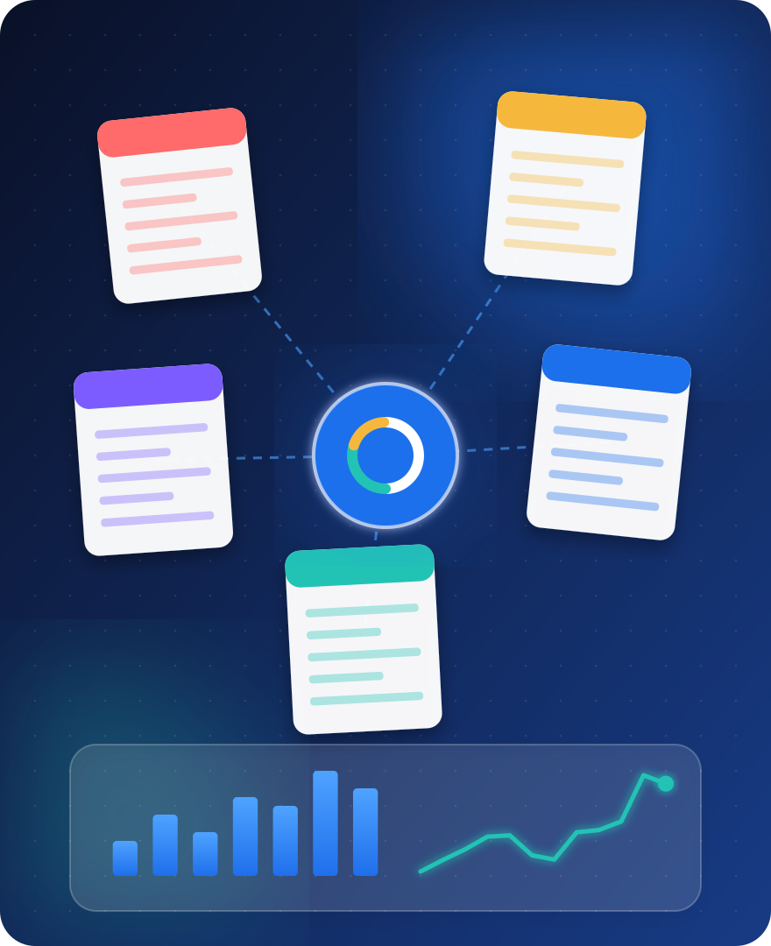




2. Problem & Objective
Mutual-fund information is distributed across multiple datasets and reporting frequencies.
Build a unified workflow to clean, store, analyse and visualise fund and industry data.
Support comparison of NAV, AUM, SIP flows, risk-adjusted returns and investor transaction patterns.
Deliver reproducible code, a relational database, analytical notebooks, dashboard and documentation.

Slide 3
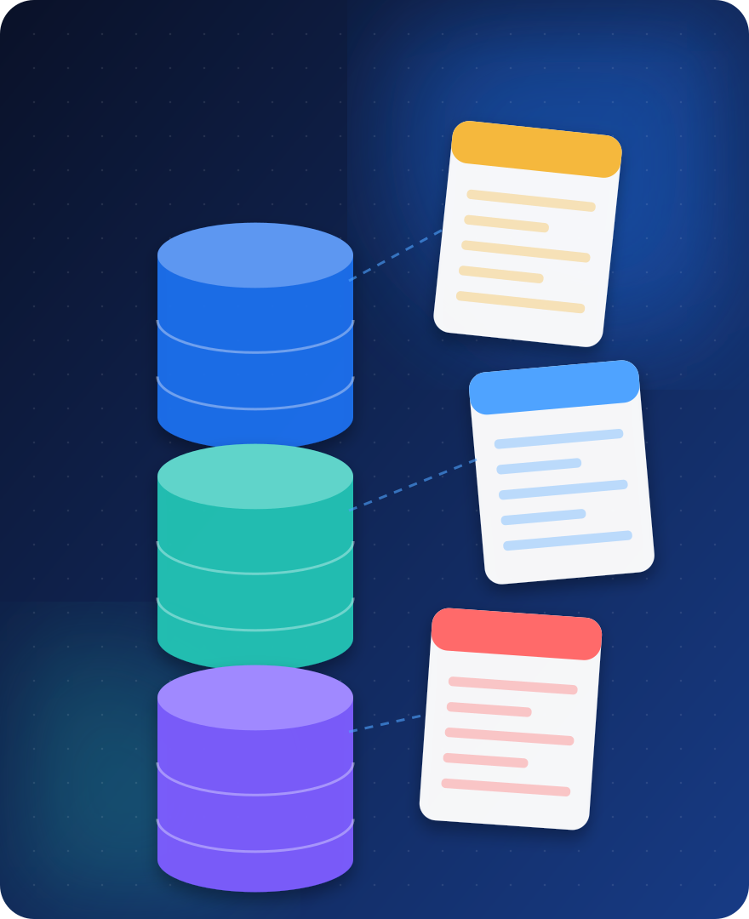





3. Data Sources & Coverage
10 supplied CSV datasets covering 40 schemes and 10 fund houses.
46,000 daily NAV observations: 03 Jan 2022 – 29 May 2026.
90 AUM observations across nine reporting dates: Mar 2022 – Dec 2025.
48 monthly SIP observations: Jan 2022 – Dec 2025; 21 folio observations.
32,778 project-provided investor transactions: Jan 2024 – May 2025; treat as synthetic.

Slide 4







4. Solution Architecture & ETL
Extract:
Transform:
Load:
Analyse:
Present:
source CSVs and selected mfapi.in NAV API extracts.
parse dates, standardise transaction types, validate numeric domains and remove duplicates.
processed CSVs and SQLite fact/dimension tables using SQLAlchemy and pandas.
SQL queries, EDA, fund performance, risk metrics and benchmark comparisons.
Power BI pages for industry, performance, investor and SIP/market analysis.

Slide 5
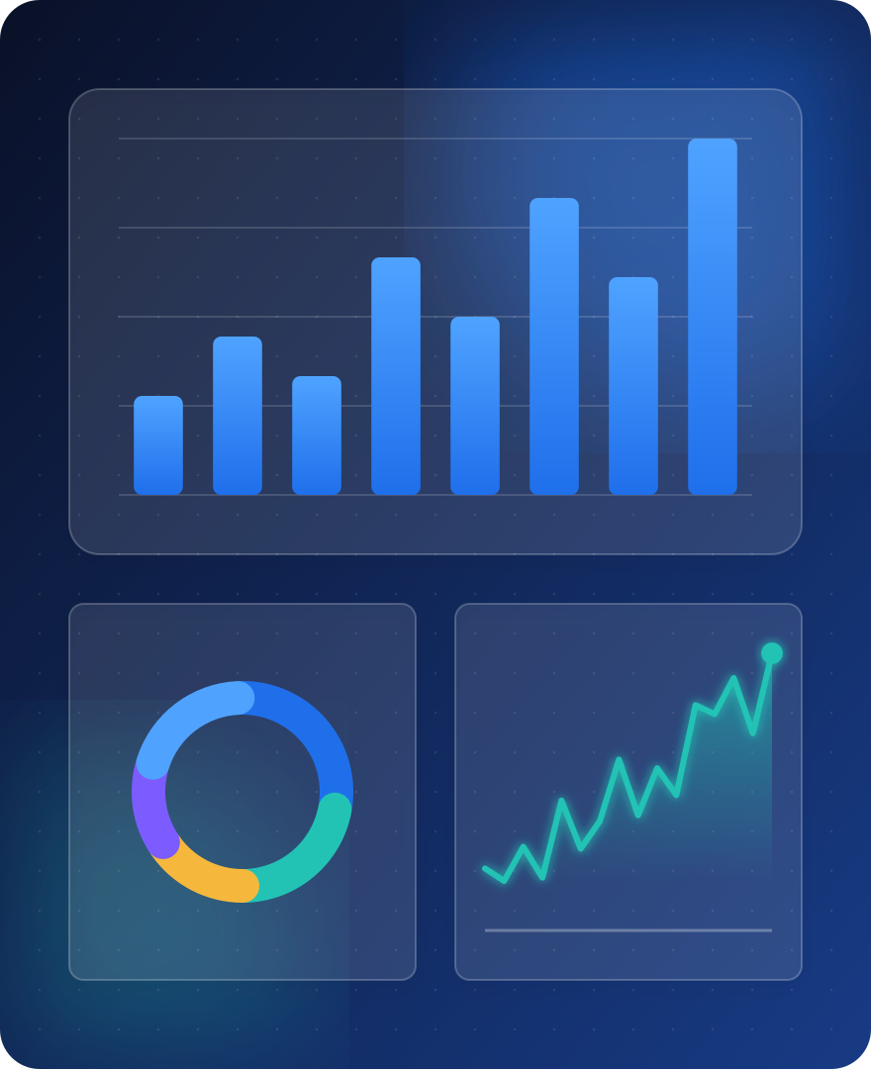




5. EDA Highlights — NAV & AUM
40 schemes each have 1,150 NAV observations in the supplied history.
No duplicate scheme/date NAV keys were found in the documented audit.
Latest AUM snapshot is 31 Dec 2025; supplied ten-fund-house sample totals ₹62.74 lakh crore.
SBI Mutual Fund is the largest supplied fund-house record at ₹12.50 lakh crore in that snapshot.

Slide 6
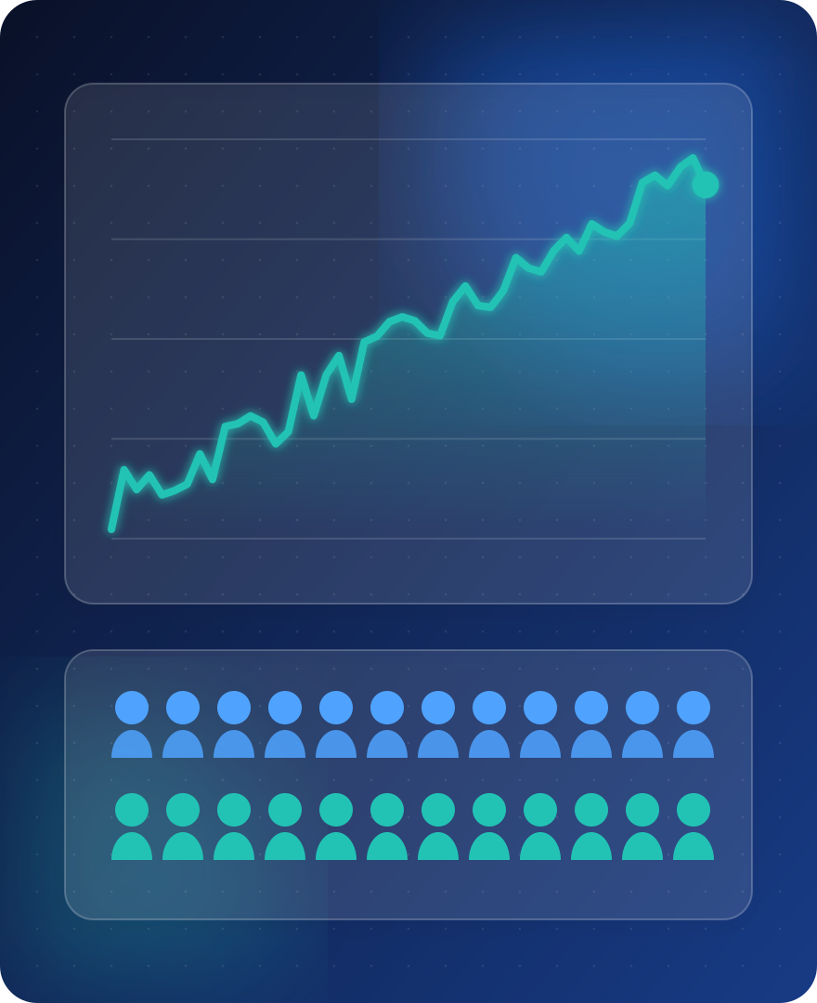



6. EDA Highlights — SIP & Folios
Monthly SIP series covers Jan 2022 – Dec 2025 (48 months).
Highest supplied monthly SIP inflow: ₹31,002 crore in Dec 2025.
Industry folios increase from 13.26 crore in Jan 2022 to 26.12 crore in Dec 2025.
2022 YoY SIP growth is missing because 2021 comparison months are not included.

Slide 7
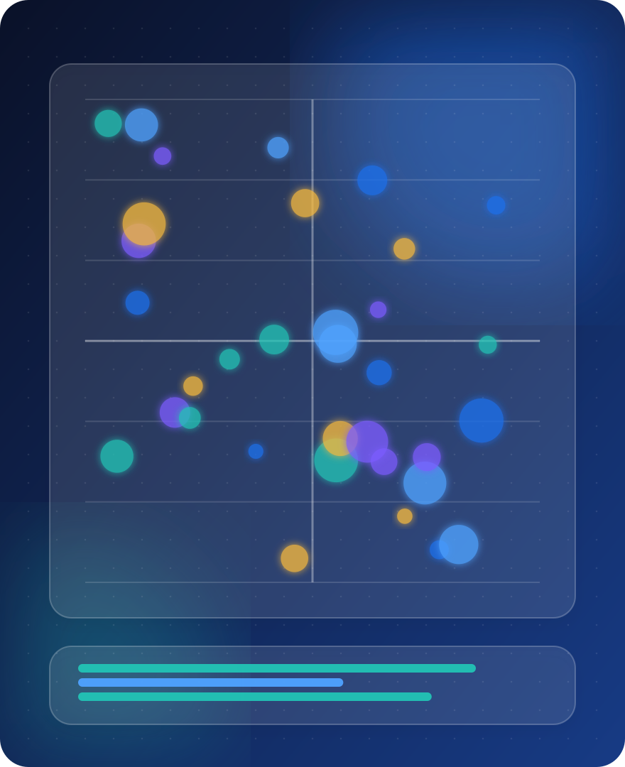


7. Performance Analytics — Risk & Return
Performance table covers 40 schemes with 1Y, 3Y and 5Y reported returns.
Metrics include Sharpe, Sortino, alpha, beta, annualised volatility and maximum drawdown.
Top reported 5Y returns are concentrated among several small-cap schemes in this sample.
Risk metrics are method-dependent; document annualisation, risk-free rate and downside deviation assumptions.

Slide 8
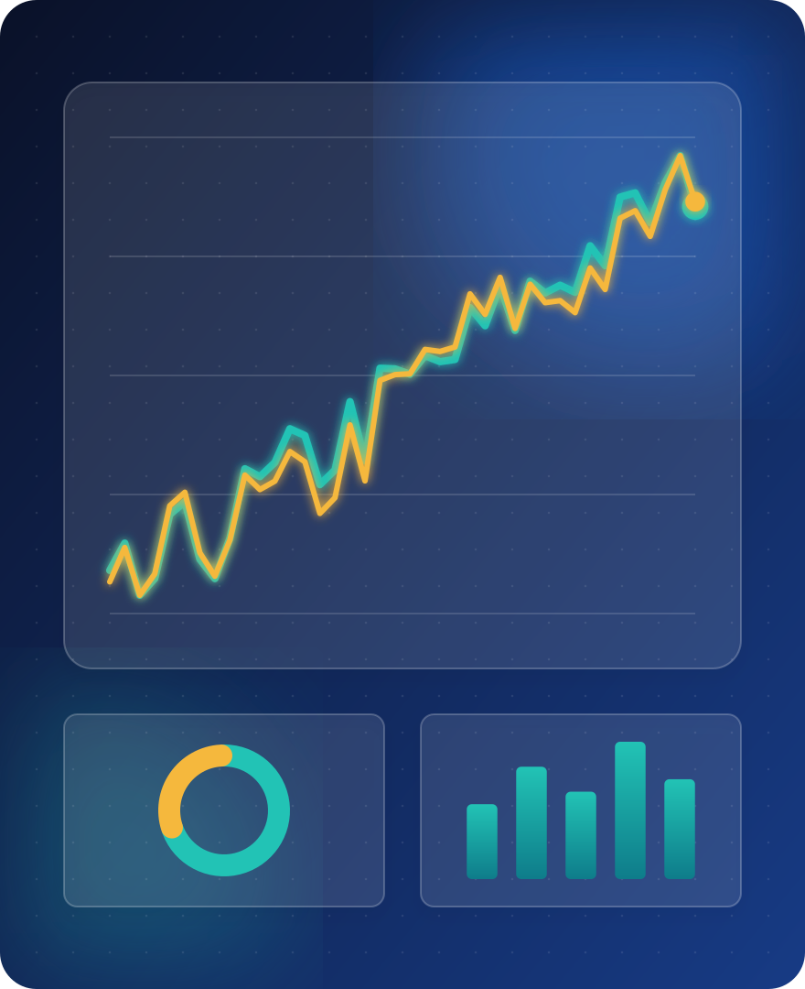




8. Performance Analytics — Benchmarking
Benchmark dataset contains seven indices with 1,150 observations each.
Fund and benchmark returns must be aligned on matching dates before regression.
Tracking error = standard deviation of daily active returns × √252.
Use scheme-specific stated benchmarks where available; identify any proxy benchmark clearly.

Slide 9
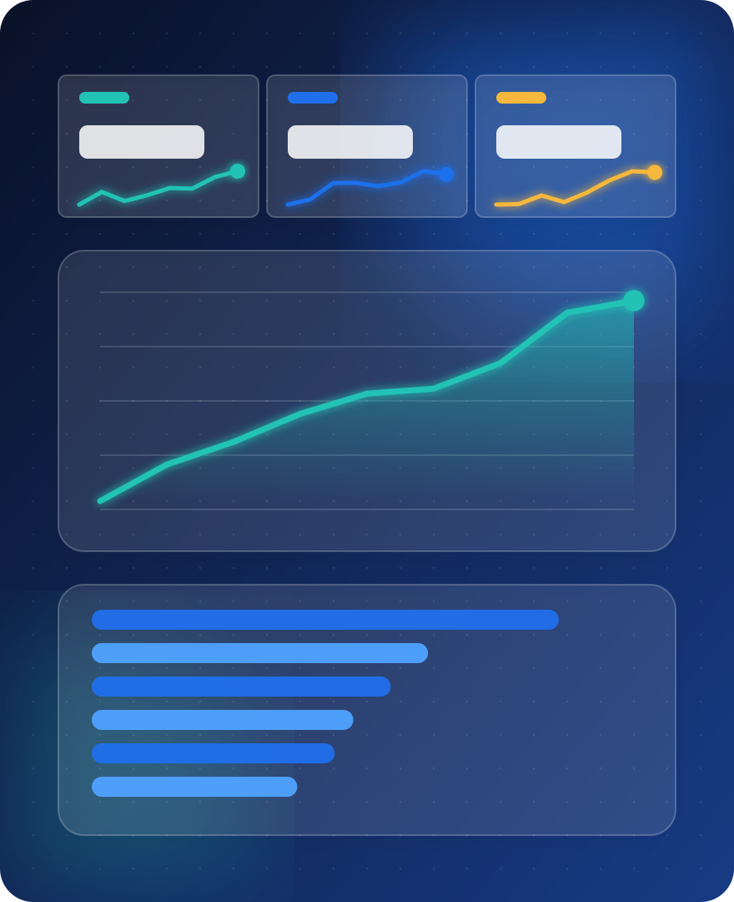



9. Dashboard — Industry Overview
KPIs: latest AUM, latest monthly SIP inflow, latest folio count and scheme coverage.
Charts: AUM trend by reporting date and latest AUM by fund house.
Filters: date and fund house.
Display source coverage and units on the page; do not sum AUM across historical dates.

Slide 10
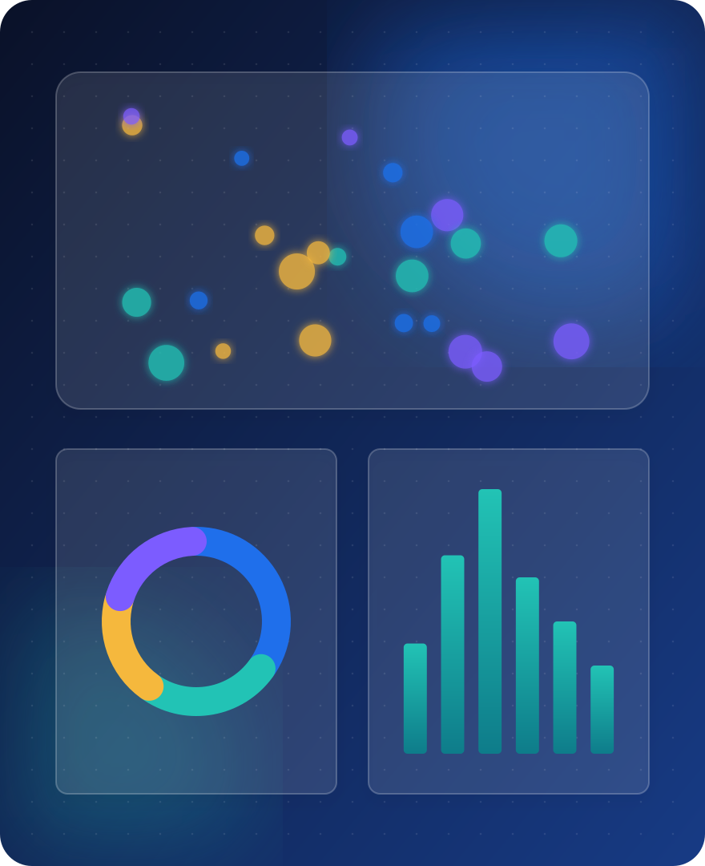



10. Dashboard — Performance & Investor Pages
Fund performance: risk-return scatter, sortable scorecard and NAV-versus-benchmark detail.
Investor analytics: transaction amount by state, transaction-type mix and age-group analysis.
Slicers: fund house, category, plan, state, age group and city tier.
Investor transactions are synthetic/project-provided and are not evidence of actual customer behaviour.

Slide 11
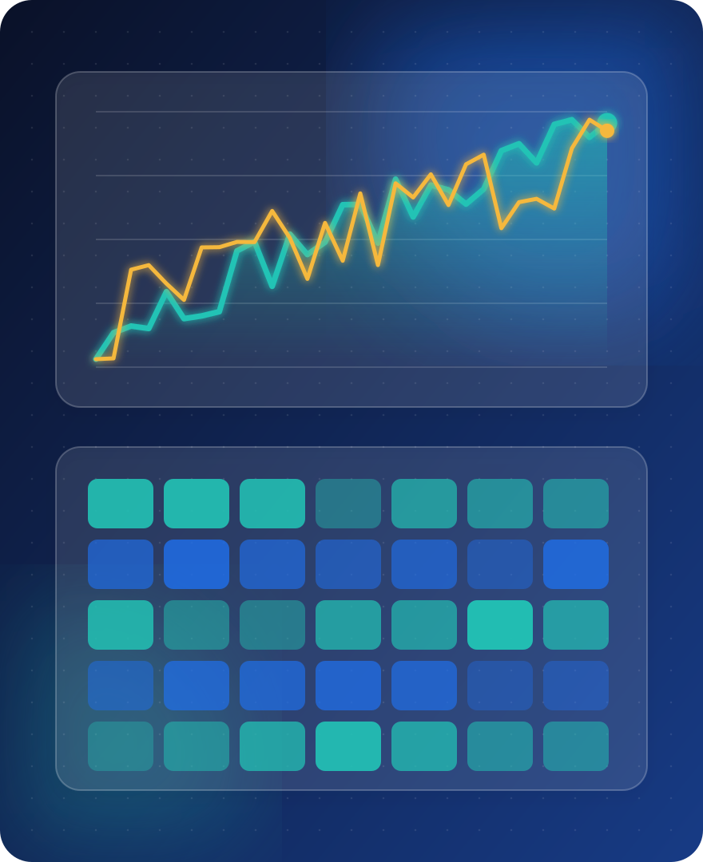



11. Dashboard — SIP, Findings & Recommendations
SIP trend: monthly inflow series and NIFTY50 market context.
Category inflow matrix covers Apr 2024 – Mar 2025 only.
Preserve missing SIP YoY values for 2022; do not replace with zero.
Improve data lineage, date dimensions, automated validation and refresh logging.

Slide 12





12. Conclusion & Deliverables
Completed core data ingestion, cleaning, SQLite loading, SQL analysis and analytical notebooks.
Final delivery package: source code, processed datasets, schema, queries, data dictionary, report and slides.
Power BI .pbix, PDF and four PNG exports must be confirmed from Power BI Desktop before final submission.
Educational analytics only; not investment advice.

