Slide 1
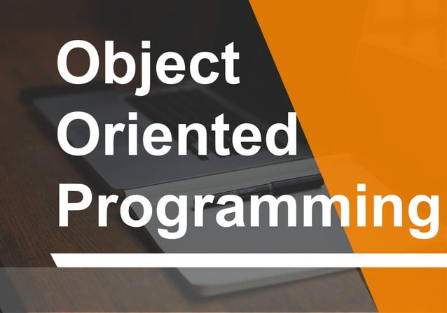

Slide 2
Agenda
What is Object-Oriented Programming?
Basic OOP Concepts
Classes and Objects
Encapsulation
Inheritance
Polymorphism
Abstraction
Example: Creating a Class in Python
Example: Inheritance in Java
Benefits of Object-Oriented Programming
Conclusion

Slide 3
What is Object-Oriented Programming?
Object-Oriented Programming (OOP) is a programming paradigm based on the concept of "objects".
It allows developers to structure their code by creating reusable and modular components.
It organizes software design around data, or objects, rather than functions and logic.
Lets discuss: Procedural vs Object Oriented approach

Slide 4
Basic OOP Concepts
OOP revolves around four main principles:
Encapsulation
That is bilding together similar data members and functions.
Inheritance
That is taking properties of parent class and modifying it.
Polymorphism
It means many forms, e.g. a function can take many forms depending on parameters.
Abstraction
Means hiding unnecessary details, e.g lets discuss about an example of car.

Slide 5
Classes and Objects
A Class is a blueprint for creating objects.
It defines the properties (attributes) and behaviors (methods) that objects of the class will have.
An Object is an instance of a class.
Objects can store data (attributes) and perform actions (methods) associated with the class.
Classes and objects form the basis of OOP.

Slide 6
Encapsulation
Encapsulation is the bundling of data and methods that operate on the data into a single unit (class).
It hides the internal state of an object and only exposes the necessary functionalities.
Encapsulation provides data security by preventing direct access to data from outside the class, and it prevents accidental modification of data.

Slide 7
Inheritance
Inheritance is a mechanism wherein a new class is derived from an existing class.
The new class inherits properties and behaviors (methods) of the existing class.
It promotes code reusability and saves time by allowing the creation of new classes built upon existing ones.

Slide 8
Polymorphism
Polymorphism allows objects of different classes to be treated as objects of a common superclass.
It enables one interface to be used for a general class of actions, making it possible to use a single entity in multiple forms.
Polymorphism is often achieved through method overriding and method overloading.

Slide 9
Abstraction
Abstraction refers to the concept of hiding complex implementation details and showing only the essential features of the object.
It helps in reducing programming complexity and efforts by providing a simplified view of the objects.
Abstraction allows us to focus on what an object does instead of how it does it.

Slide 10
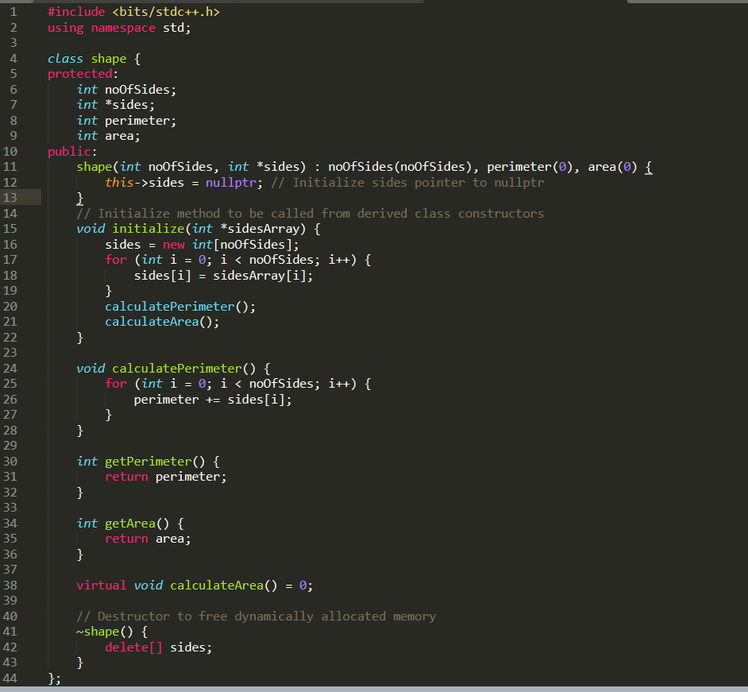
Example: Creating a Class in C++

Slide 11
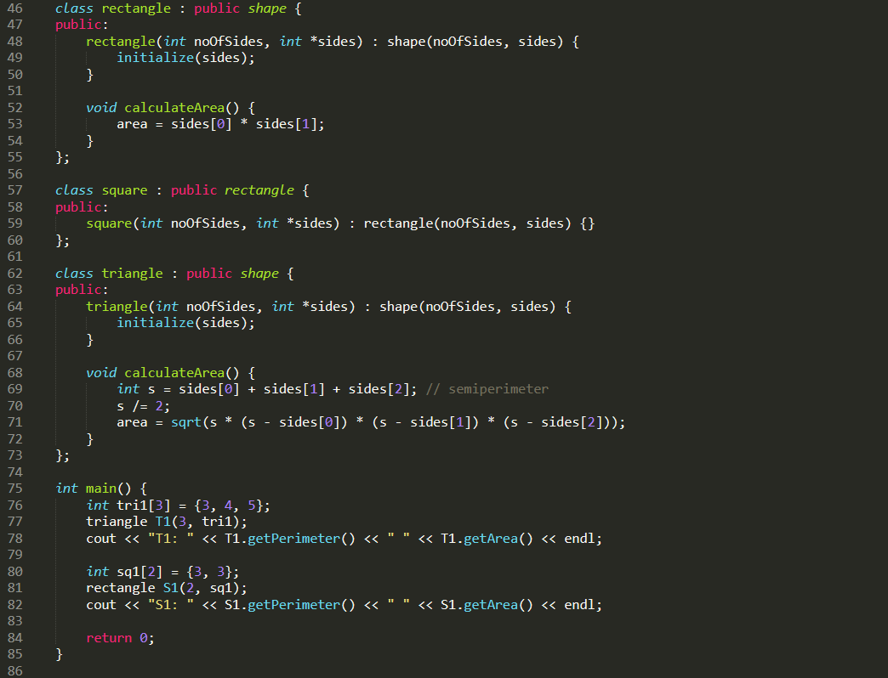

Slide 12
Example: Inheritance in Java
Example demonstrates inheritance in Java.
Shows how a subclass (Dog) inherits properties and methods from a superclass (Animal).
Example on the next Slide:

Slide 13
class Animal {
void sound() {
System.out.println("Animal makes a sound");
}
}
class Dog extends Animal {
void sound() {
System.out.println("Dog barks");
}
}
public class Main {
public static void main(String[] args) {
Dog dog = new Dog();
dog.sound();
}
}

Slide 14
Benefits of Object-Oriented Programming
Modularity: Code is divided into objects, making it easier to manage and update.
Reusability: Objects can be reused in different parts of the program.
Flexibility: Changes can be made easily without affecting the entire program.
Maintainability: Code is organized and easier to maintain, reducing the chances of errors and bugs.

Slide 15
Conclusion
Object-Oriented Programming (OOP) is a powerful programming paradigm that provides a systematic approach for designing software.
Understanding OOP concepts, such as encapsulation, inheritance, polymorphism, and abstraction, is crucial for every programmer.
OOP promotes code reusability, modularity, and maintainability, leading to the development of scalable and efficient software solutions.
By adopting OOP principles, developers can write cleaner, more organized, and easier-to-maintain code.
Whether you're working on small projects or large-scale applications, mastering OOP concepts will significantly enhance your programming skills and productivity.

Slide 16
THANK YOU !
By: Ishav Gupta

