Slide 1
06-05-2024(compilation and execution)
By
Ishav Gupta

Slide 2
Interfaces
Interface Segregation Principle and supports Dependency Inversion
Interface Segregation Principle (ISP):
Design small, cohesive interfaces that contain only the methods that a client requires.
Avoid Fat interfaces.
Dependency Inversion Principle (DIP):
Use abstractions (interfaces or abstract classes) to define dependencies.
Depend upon abstractions rather than concrete implementations.
High-level modules should depend on abstractions, not on the concrete implementations.
This means, don’t care about how to implements stuffs, just have a method in interface or abstract class. Method toh baad mein bhi ban jayega.

Slide 3
Framework vs library
Framework – set of library, tools, functions, classes that provide a foundation to a software.
Library - set of library, tools, functions, classes designed for a specific task or grp of tasks.
Inversion of Control (IoC):
In a framework, the control flow is inverted. The framework calls the developer's code.
In a library, the control flow is not inverted. The developer calls the library's code.
Extent of Control:
In a framework, the developer provides implementations for specific functions or methods. The framework controls the overall structure of the application.
In a library, the developer calls specific functions or methods from the library as needed. The developer controls the overall structure of the application.

Slide 4
CTS
CTS (Common Type System):
Definition: CTS is a standard that specifies how types are defined and used in the Common Language Runtime (CLR) of the .NET Framework. It ensures that objects written in different .NET languages can interact with each other

Slide 5
CLI (Common Language Infrastructure):
Definition: CLI is an open specification developed by Microsoft that describes the executable code and runtime environment that form the core of the Microsoft .NET Framework.

Slide 6
Common Language Specification (CLS)
It's a subset of the CTS that defines a set of rules that .NET languages must follow in order to ensure interoperability between languages.
CLS VS CTS
CTS defines data types, inheritance, method signatures, and other aspects of types.
CLS Specifies a common set of features that .NET languages should support to ensure interoperability.

Slide 7
CLR
CLR is the execution engine of the .NET Framework. It provides various services, such as memory management, exception handling, and security, that are required for the execution of .NET programs.
Just-In-Time (JIT) Compilation: CLR converts Intermediate Language (IL) code into native machine code during execution.

Slide 8
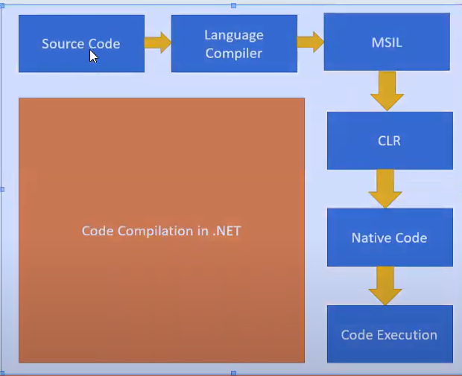
Source code is convrtd to MSIL OR IL using language specific compilr (specific to lang).
Now using CLR (specific to os), this is convrtd to machine code (0s and 1s) that machine understands.

