Slide 1
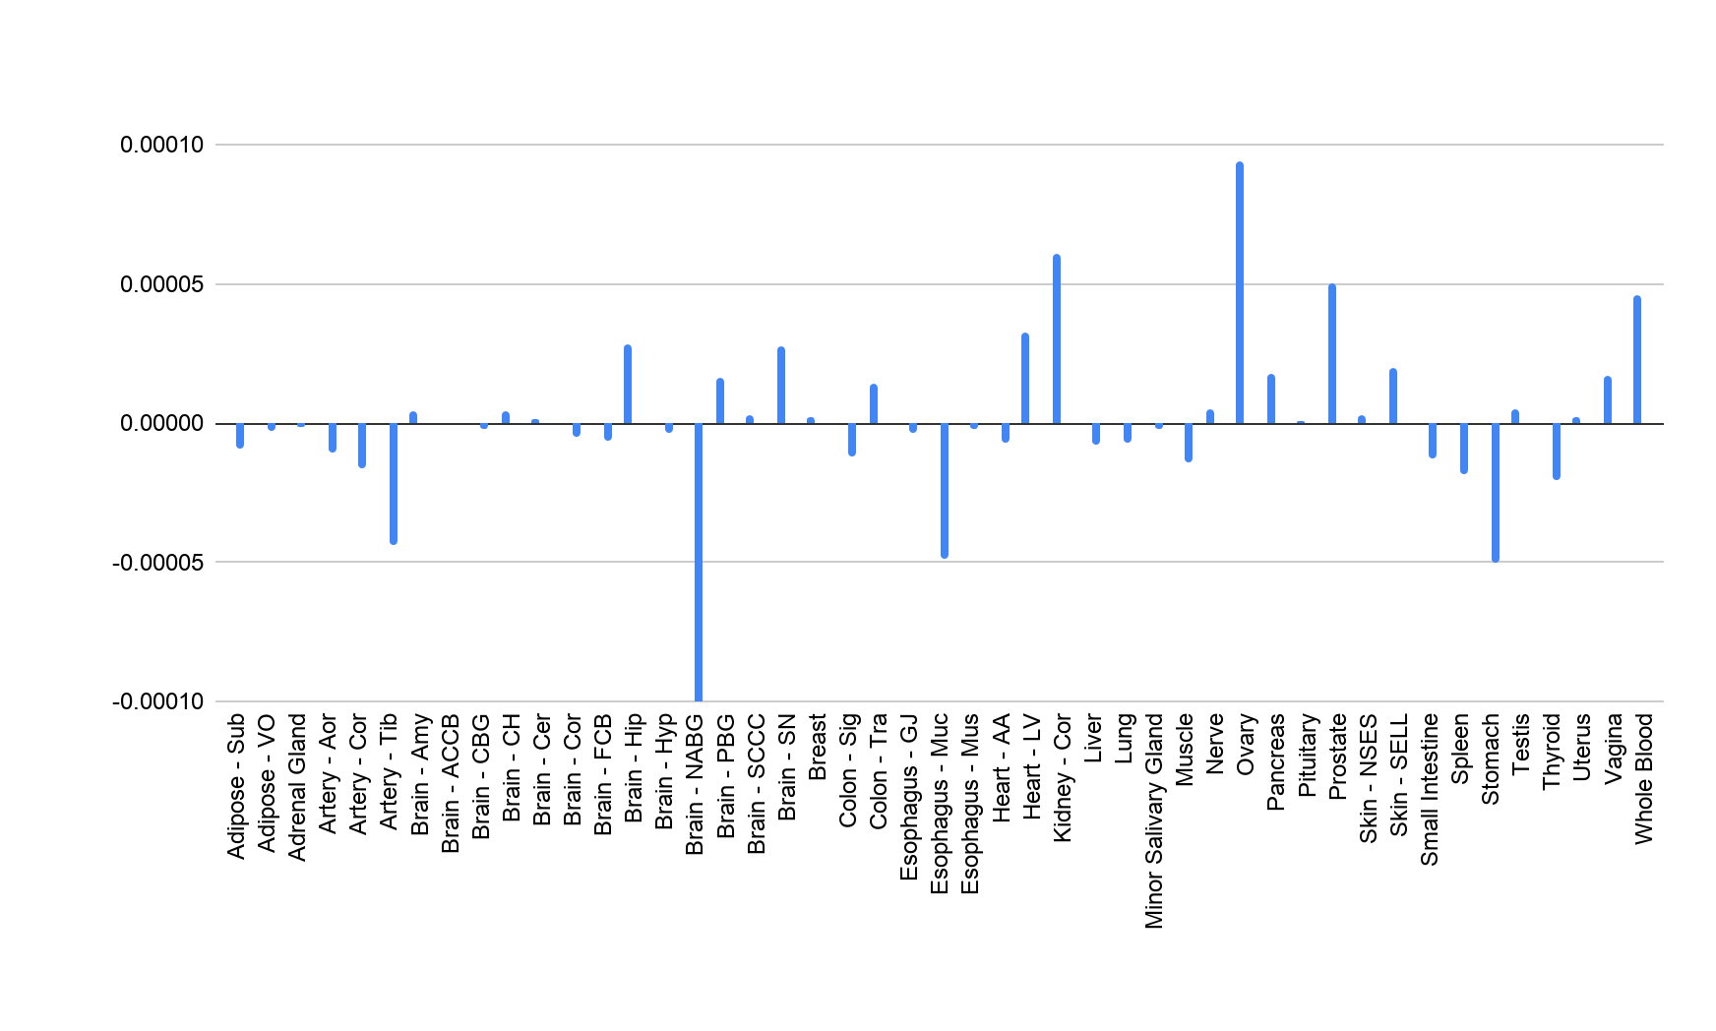
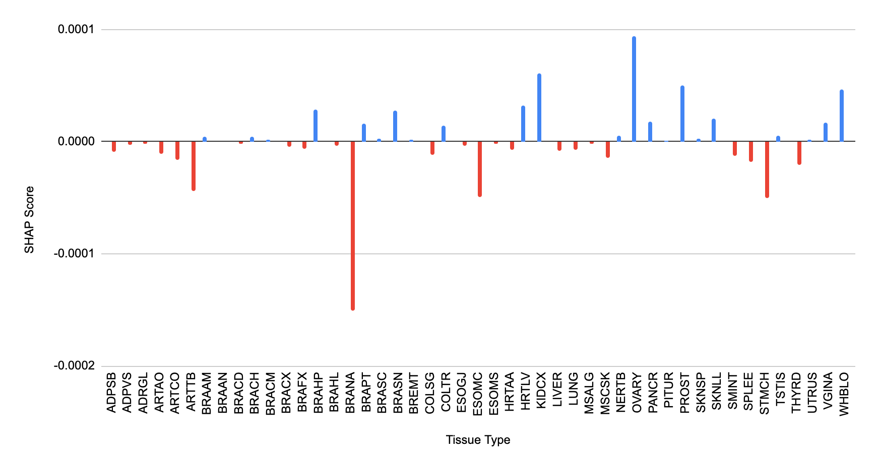
18884 genes
One gene
2350 samples
SHAP Scores
47 tissue types

