Slide 1

TO-DO LIST
Isha Yadav
2110992064
G-19

Slide 2
1
IDEA OF PROJECT
A MERN stack to-do list uses MongoDB for task storage, Express.js for server-side logic, React.js for the frontend interface, and Node.js to run the server. Users interact with the React frontend, which communicates with Express to perform CRUD operations on tasks stored in MongoDB, creating a seamless full-stack application.

Slide 3
2
APPROACH USED
MongoDB (Database): Stores task data in a flexible, JSON-like format
Express.js (Backend): Handles HTTP requests, interacts with MongoDB, and manages server-side logic.
React.js (Frontend): Manages client-side rendering and user interactions.
Node.js (Runtime): Executes the Express server for backend operations.

Slide 4
3
TECH USED
HTML
CSS
JavaScript
MongoDB
ExpressJS
React
NodeJS

Slide 5
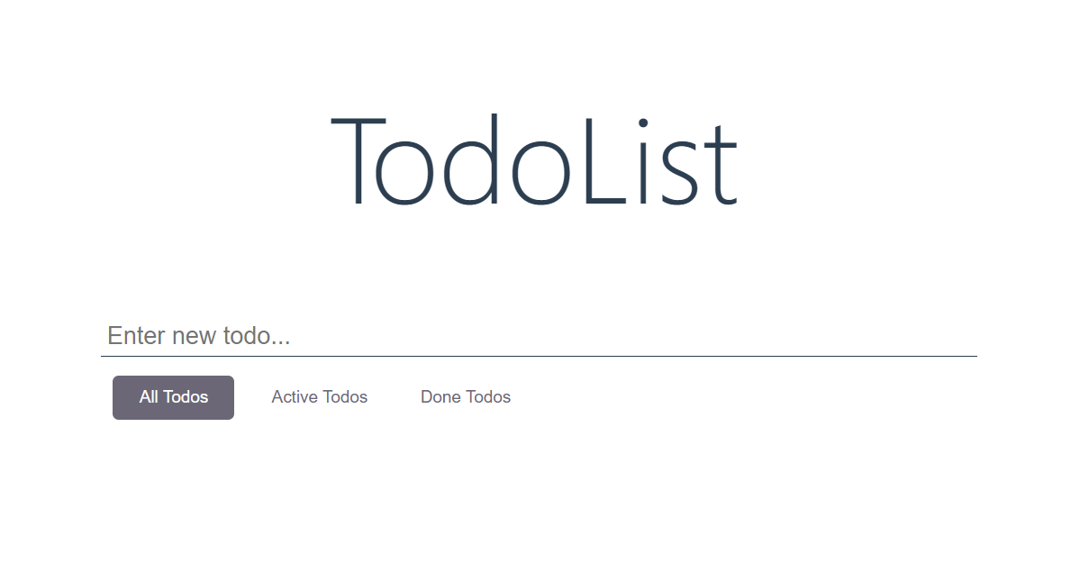
4
PROJECT OVERVIEW

Slide 6
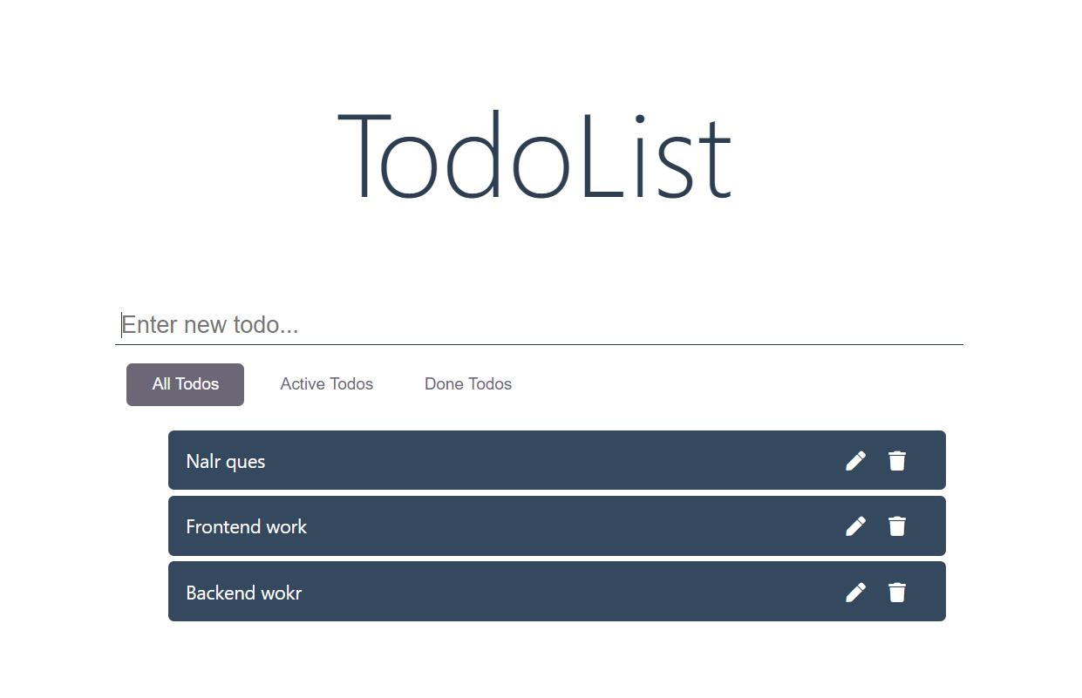
5
ADD TODO

Slide 7
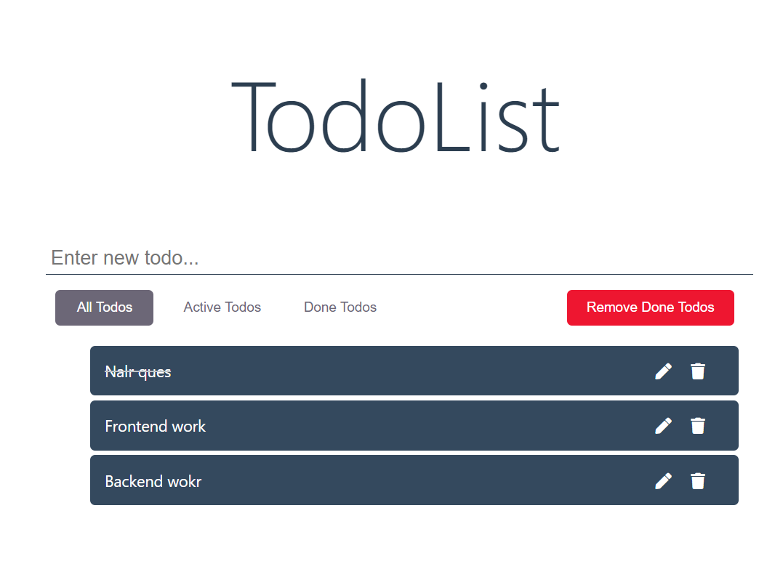
6
If we click on any todo then it moves to done todo and removed from active todo and when we again click on that todo i.e. 2nd click then it is again active todo

Slide 8
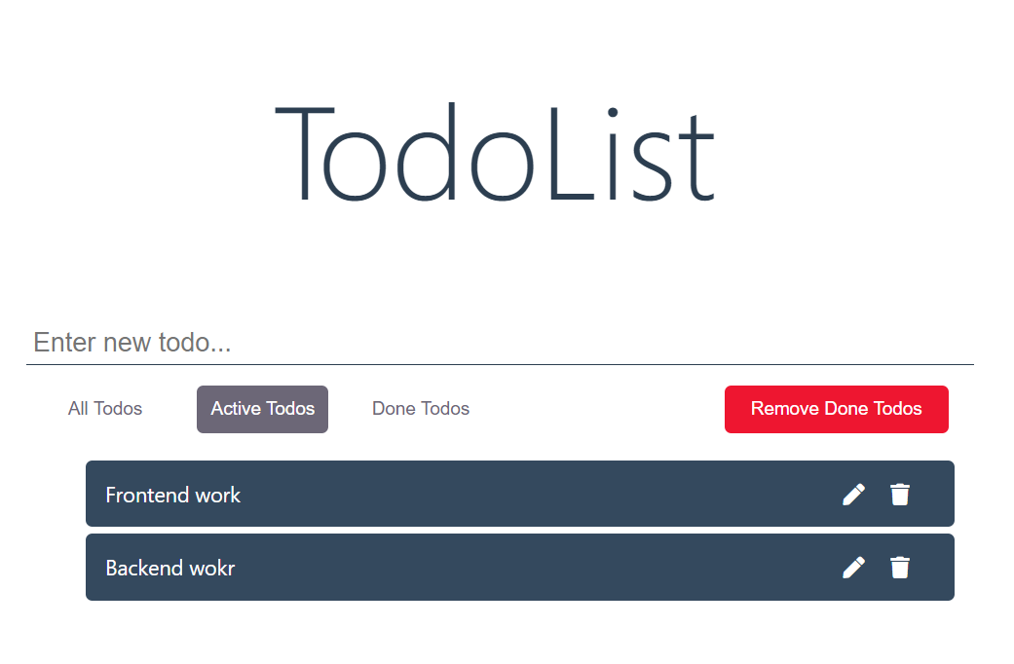
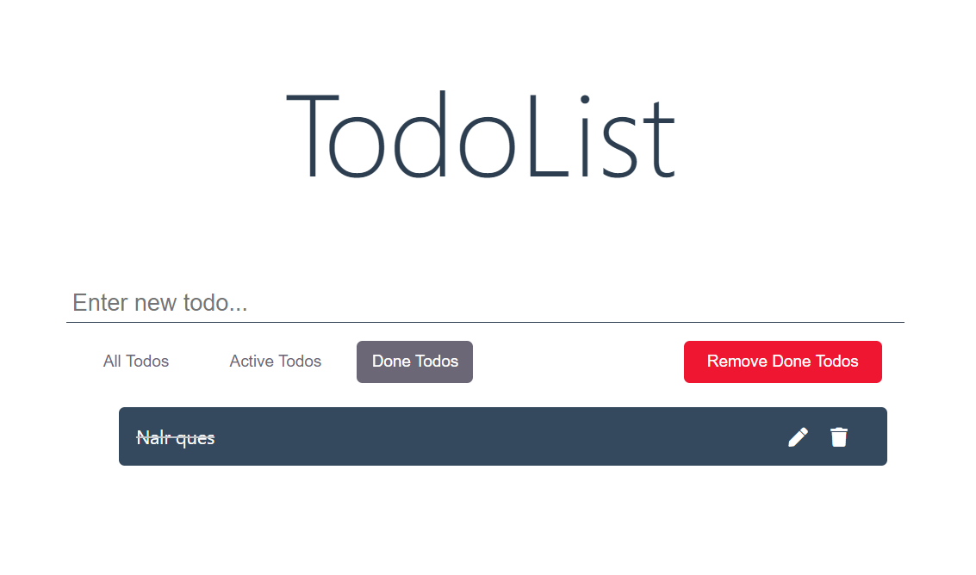
7

Slide 9
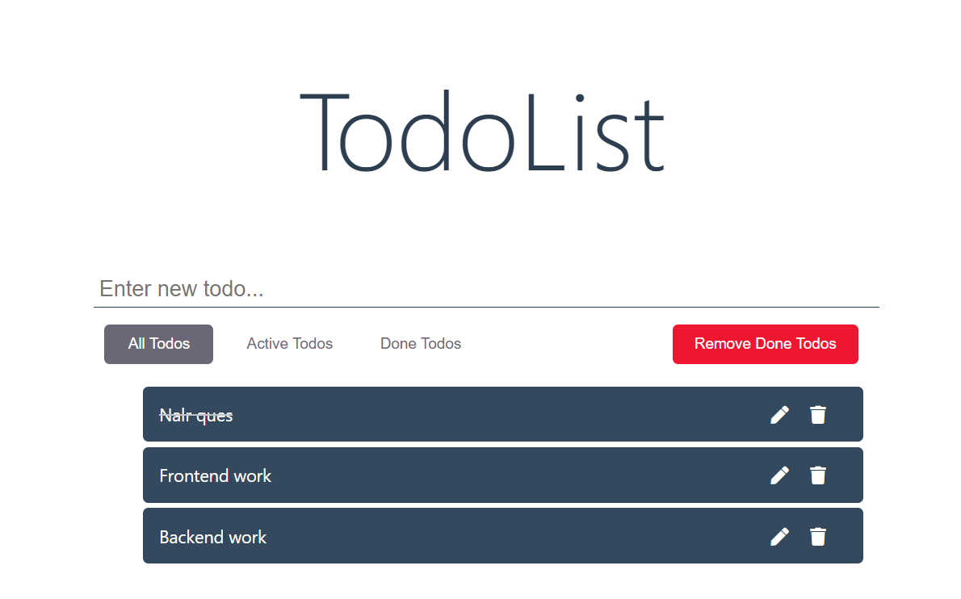
8
UPDATE TODO

Slide 10
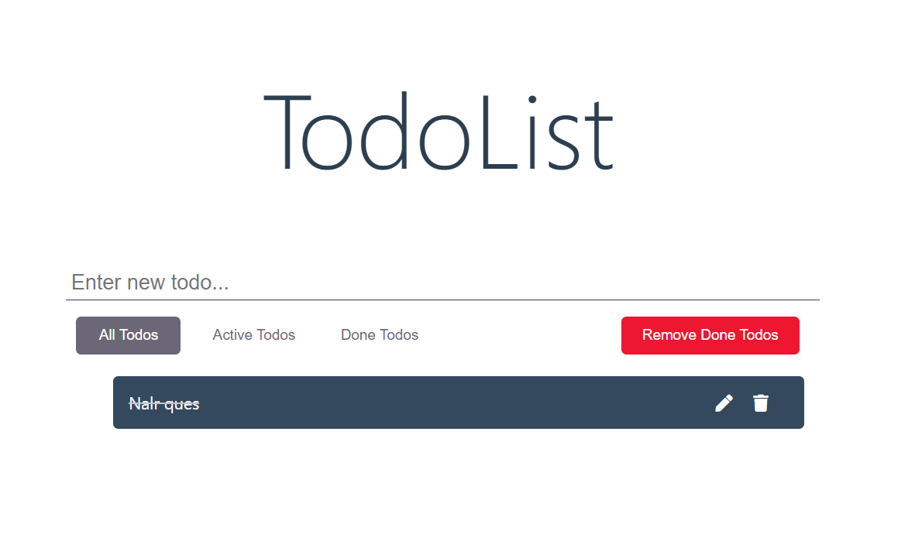
9
DELETE TODO

Slide 11
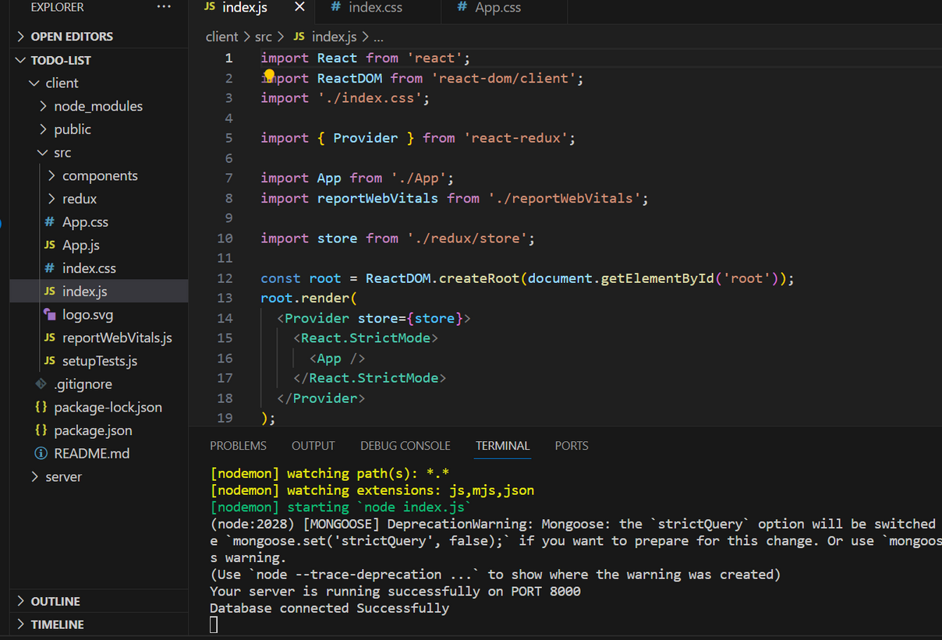
10
CLIENT AND SERVER SIDE FILES

Slide 12
11
CONCLUSION
The backend-driven to-do list project successfully leverages a robust technology stack, seamlessly integrating database, server-side logic, and efficient API handling. This approach ensures a scalable and responsive task management system.

Slide 13
THANK YOU

