Slide 1

Website Development

Slide 2

Website Development Overview
Components: Front-end (what users see) and back-end (server, database).
Website development is the process of creating and maintaining websites.
Essential for online presence and interaction.

Slide 3

HTML Fundamentals
Definition: HTML (Hypertext Markup Language) structures web content.
Tags: Elements like <html>, <head>, <body>.
Example: Simple HTML structure for a webpage.

Slide 4
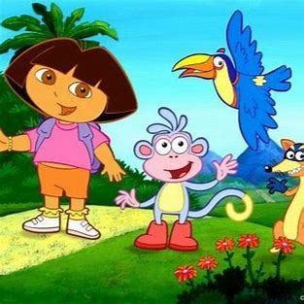
CSS for Styling
Definition: CSS (Cascading Style Sheets) enhances the visual presentation of HTML.
Selectors: Target HTML elements for styling.
Example: <style =”color=: red”;

Slide 5
Types of Websites
Static Website
Responsive Website
Dynamic Website

Slide 6

Adding Interactivity with JavaScript
Definition: JavaScript makes websites dynamic and interactive.
Functions: Enables actions like user input validation.
Example: document.getelementbyid.innerhtml= “hello”;

Slide 7

Bringing It All Together
Integration: HTML, CSS, and JavaScript work together for a cohesive website.
Best Practices: Responsive design, code organization, and optimization.
Resources: Recommend online tutorials and documentation.

Slide 8
Real Life Examples:
www.fiverr.com
www.joinpakarmy.gov pk
www.teenycoders.com

Slide 9
Thank You!

