Slide 1

Realtime Blood Management System
Phase 1
Supervisor name: Divya Verma(E13867)

Slide 2
Team Members
Aayush Kumar Singh UID: 21BCS7008
Anoop Kumar UID: 21BCS7055
Dhuriya Ankit Subhash UID: 21BCS6952
Ishica UID: 21BCS7050
Sakshi Bajpai UID: 21BCS6938
Branch: Computer Science & Engineering

Slide 3
Client Identification & Recognition of Need
In this technical era, most of the blood banks are still working on manual blood bank system due to which many of the patient who need blood urgently are unable to survive because of time factor.
At this time as we know every second is important, but lack of awareness can lead to the loss of life, to prevent that a person must have a way to find the blood donor at a right moment time to cure their love ones.
Our client are the one who suffer from above given scenarios. And, our object is provide them a platform where they can easily find solution to their problems.

Slide 4
Problem Identification
Availability of blood nearby.
Compatibility issues in blood.
No online medium to check nearby availability.
No direct interact with donor provided.

Slide 5
Recognition & Knowledge of relevant contemporary issues
Blood shortages at critical moments
Lack of information related to nearby donors.
Nearly 12,000 individuals die in India each day, due to non-availability of quality blood.
Every year our nation requires about 5 Crore units of blood, out of which only a meager 2.5 Crore units of blood are available.

Slide 6
Project Scope
To provide better facility to the client.
This project will help to find the specific needed blood as fast as possible.
This project can further be modified using google map.
Threw this site we can encourage people to donate blood by applying for donor and donate blood when needed.
“
Every second is important when a person fights for his life in hospital.
”

Slide 7
Task Identification
Real-time Blood management system is a way to facilitate a person by providing them a way to make the arrangement of the needed blood type required. This is a website which provide an interface to the user through which they can do the

Slide 8
Project Overview
The title of this project is “Real Time blood management system”. In this we are providing a way to the person to become a donor or to be recipient by using our website and finding their need in a very easy way.
We have database of people who urgently wants a blood transfer or transfusion as per required blood group and provide them the details of their required type near them so they can save their time in fatal situation. Also, provide same for donor who wants to donate their blood for needy one. It contains the database of blood bank and hospitals with all necessary requirements for blood donation

Slide 9
Results
A fully developed website, which provide a easier method to find a blood donor nearby location.
It will help a person if they wants a active donor who can donate a blood for a good purpose.

Slide 10
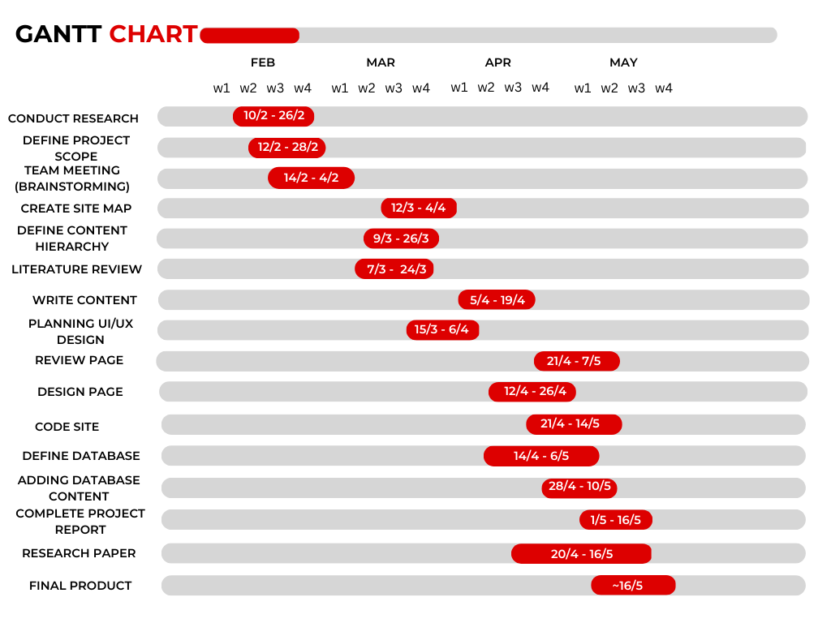
Gantt Chart

