Slide 1

Realtime Blood Management System
Supervisor name: Divya Verma(E13867)

Slide 2

Team Members
Aayush Kumar Singh UID: 21BCS7008
Anoop Kumar UID: 21BCS7055
Dhuriya Ankit Subhash UID: 21BCS6952
Ishica UID: 21BCS7050
Sakshi Bajpai UID: 21BCS6938
Branch: Computer Science & Engineering

Slide 3
Introduction
Everything is online for efficient service delivery in today's world but only medical lags behind in online development, failing to reach those in need efficiently.
Manual blood searches are time-consuming and can be life-threatening when urgent blood is needed.
Our website offers an efficient way to search for required blood, providing instant and location-based results.

Slide 4
Abstract
It connects blood donors and recipients in real-time, streamlining the donation process and improving access to blood supplies.
It enhances blood donation networks by eliminating delays, ensuring timely assistance, and offering advanced search capabilities.
It enables blood donors to register their details and allows recipients to request blood based on type and urgency, facilitating real-time matching.

Slide 5
Need of System
The need for the Realtime Blood Management System arises from the limitations of traditional manual blood search methods.
Time-Sensitive Situations.
Accessibility to different locations.
Reduced Wastage.
Real-Time Updates.
Convenience in searching donor.

Slide 6
Language Used
Building of such system requires many markup, programming languages and query language knowledge.
Languages used in this website development:
HTML
CSS
JAVASCRIPT
JavaScript’s library ReactJS
NodeJS’s framework ExpressJS
MYSQL

Slide 7
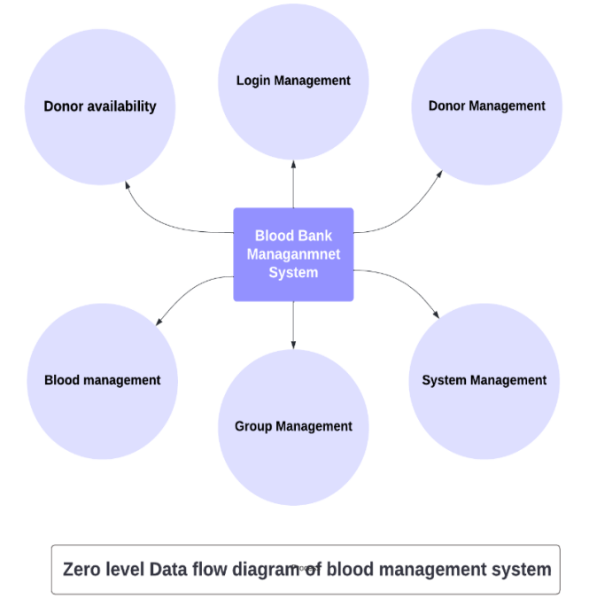
DFD
Data flow diagram showing the main feature and modules of our system

Slide 8
Function
Some features of the Realtime Blood Management System are as follows:
User Authentication
Donor Registration Form validation
Blood Requirement Form validation
Donor Searching
Realtime matchmaking
User-friendly Interface
Responsive Design/Mobile-Friendly Interface

Slide 9
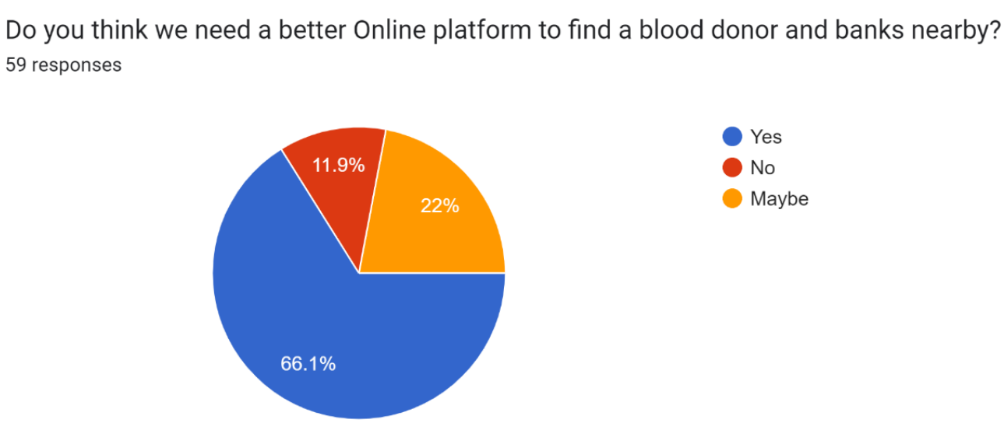
Survey 1

Slide 10
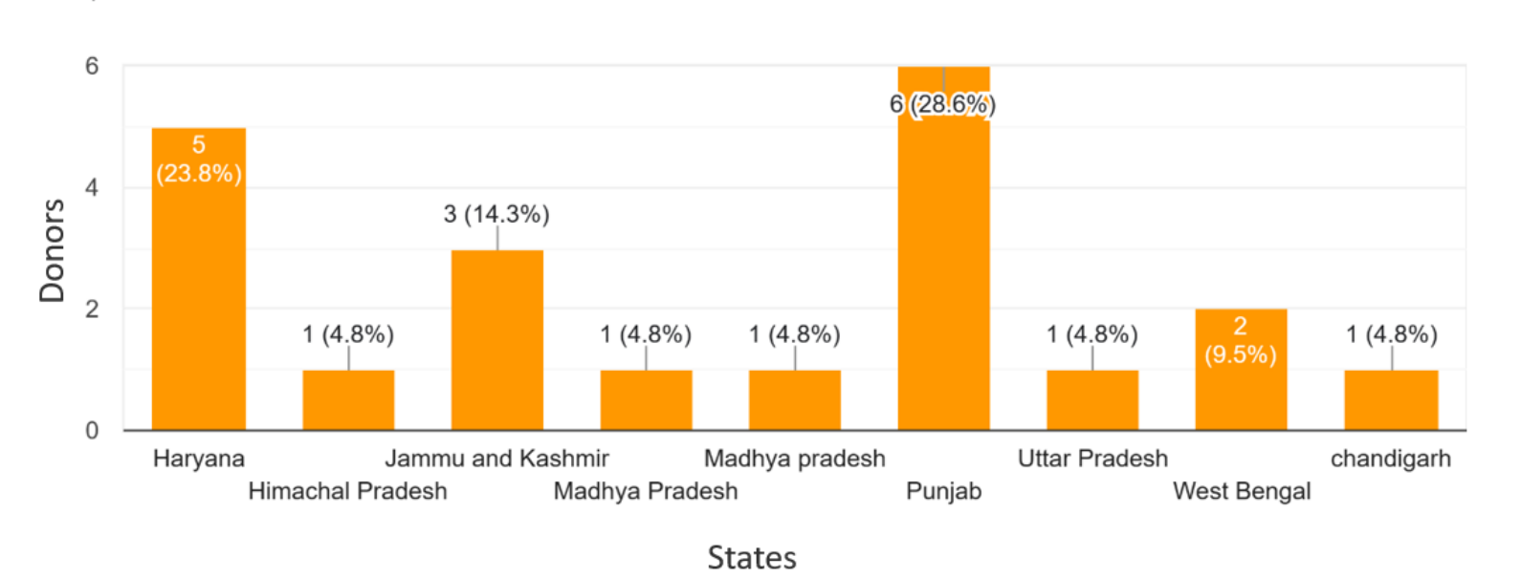
Survey 2

Slide 11
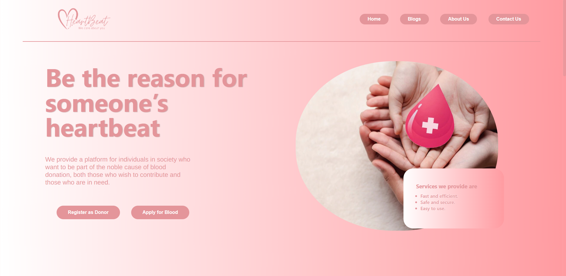
Our Website

Slide 12
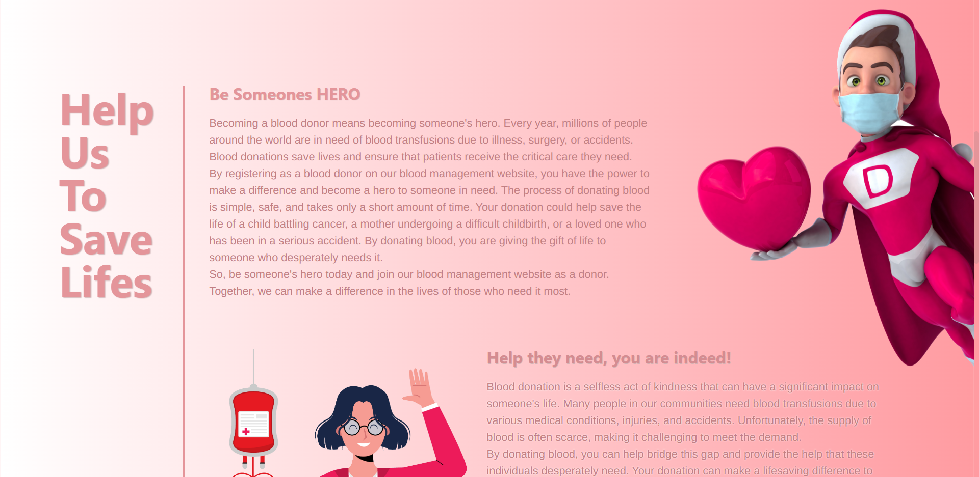
Inspiring others to become a donor

Slide 13
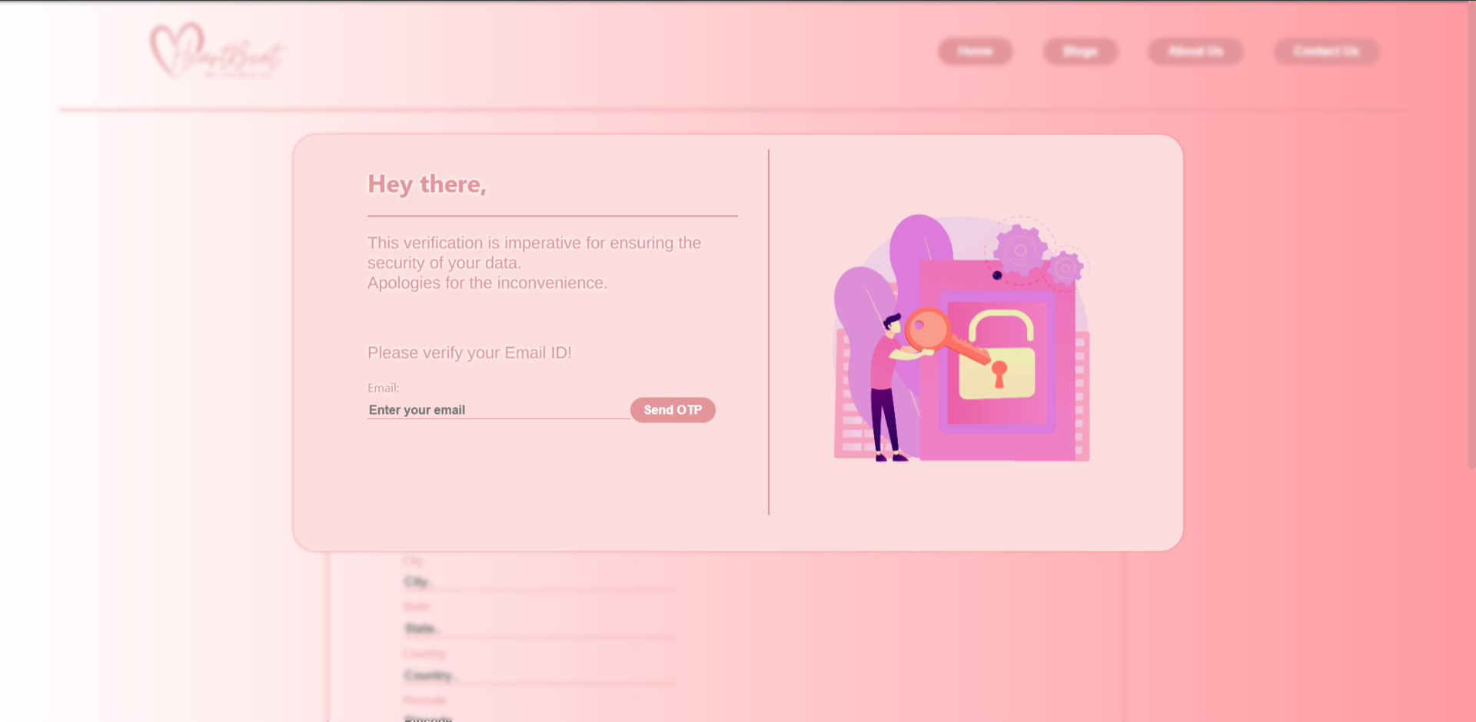
User Authentication

Slide 14
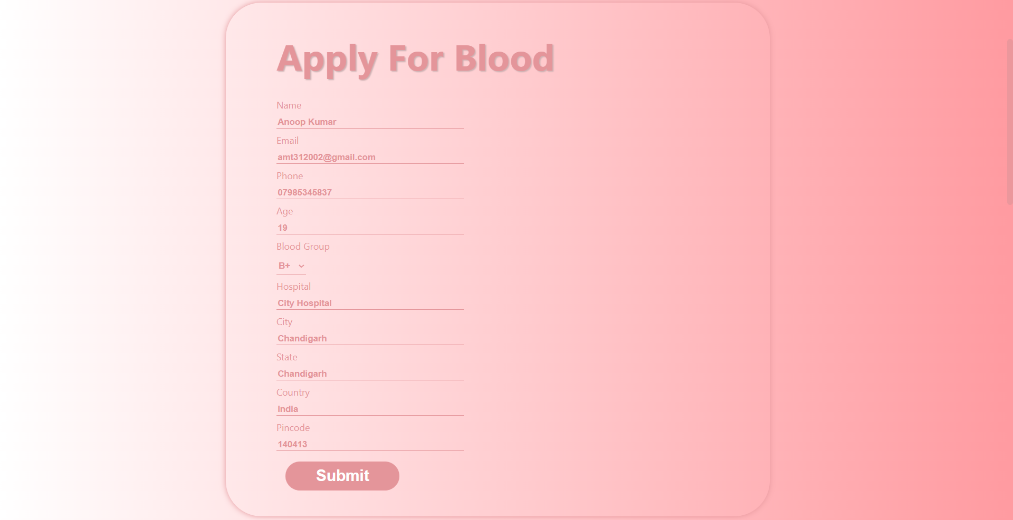
Blood Request Form

Slide 15
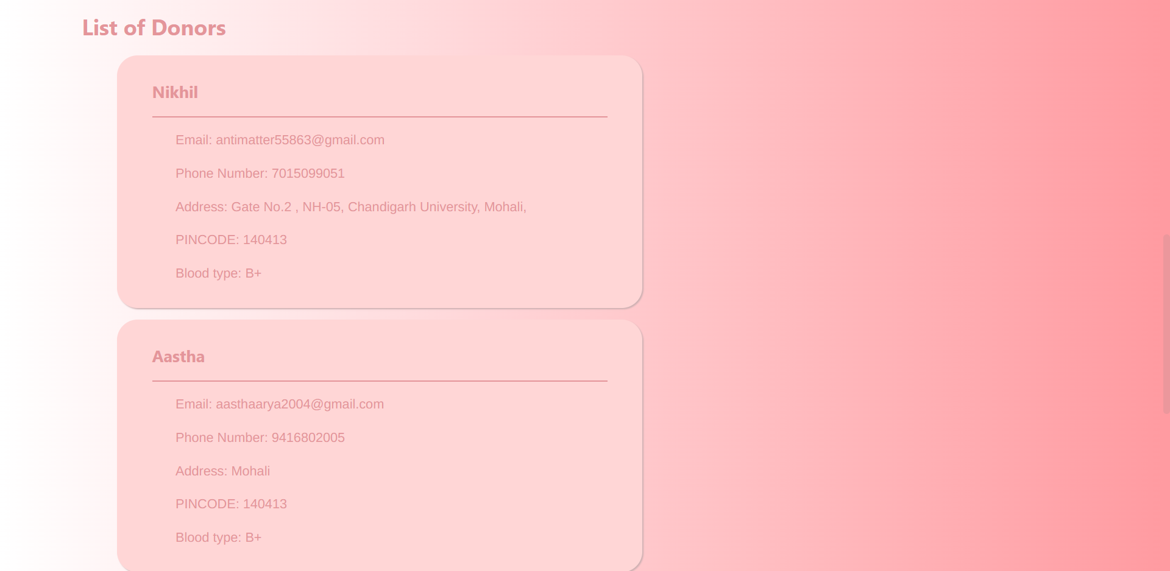
Donor List below form

Slide 16
Conclusion and Future Scope
The Realtime Blood Management System streamlines the blood donation process, ensuring timely access to blood supplies and saving lives.
Future work includes improving matching algorithms, integrating with external systems, developing mobile applications, and implementing analytics for better system optimization.
Collaboration with blood banks and healthcare institutions can expand the system's reach and enhance the pool of donors.
Continuous development and innovation will further enhance the system's functionality, usability, and impact on efficient blood management.
Thank You

Slide 17
Conclusion and Future Scope
Thank You
The Realtime Blood Management System streamlines the blood donation process, ensuring timely access to blood supplies and saving lives.
Future work includes improving matching algorithms, integrating with external systems, developing mobile applications, and implementing analytics for better system optimization.
Collaboration with blood banks and healthcare institutions can expand the system's reach and enhance the pool of donors.
Continuous development and innovation will further enhance the system's functionality, usability, and impact on efficient blood management.

