Slide 1
Realtime blood management system
Supervisor name: Divya Verma(E13867)

Slide 2
Team Members
Aayush Kumar Singh UID: 21BCS7008
Anoop Kumar UID: 21BCS7055
Dhuriya Ankit Subhash UID: 21BCS6952
Ishica UID: 21BCS7050
Sakshi Bajpai UID: 21BCS6938
Branch: Computer Science & Engineering

Slide 3
Introduction
Everything is online for efficient service delivery in today's world but only medical lags behind in online development, failing to reach those in need efficiently.
Manual blood searches are time-consuming and can be life-threatening when urgent blood is needed.
Our website offers an efficient way to search for required blood, providing instant and location-based results.

Slide 4
Abstract
It connects blood donors and recipients in real-time, streamlining the donation process and improving access to blood supplies.
It enhances blood donation networks by eliminating delays, ensuring timely assistance, and offering advanced search capabilities.
It enables blood donors to register their details and allows recipients to request blood based on type and urgency, facilitating real-time matching.

Slide 5
Need of System
The need for the RealTime Blood Management System arises from the limitations of traditional manual blood search methods.
Time-Sensitive Situations.
Accessibility to different locations.
Reduced Wastage.
Real-Time Updates.
Convenience in searching donor.

Slide 6
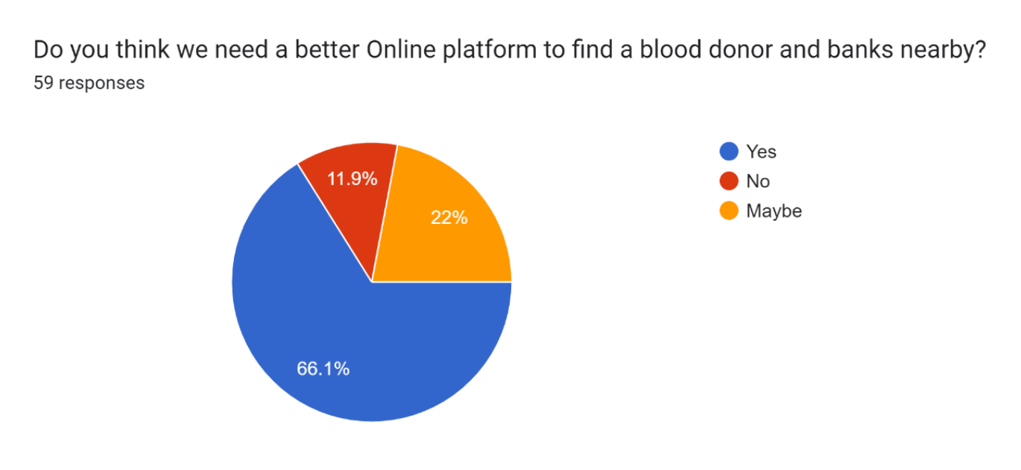
Survey

Slide 7
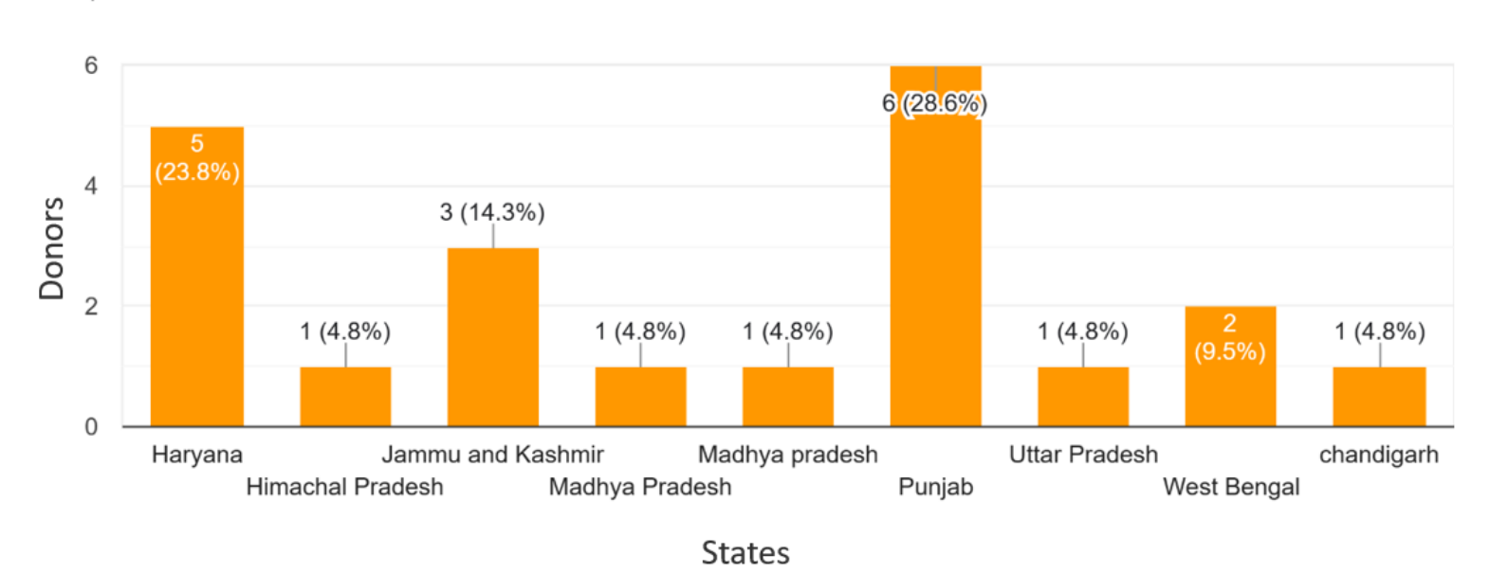
Survey (continued..)

