Slide 1
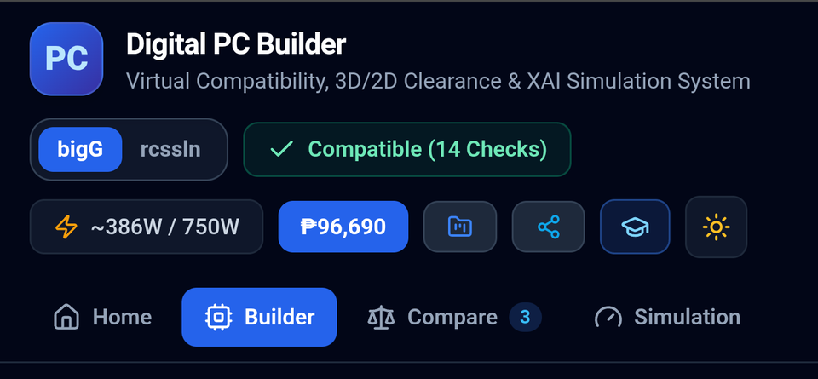

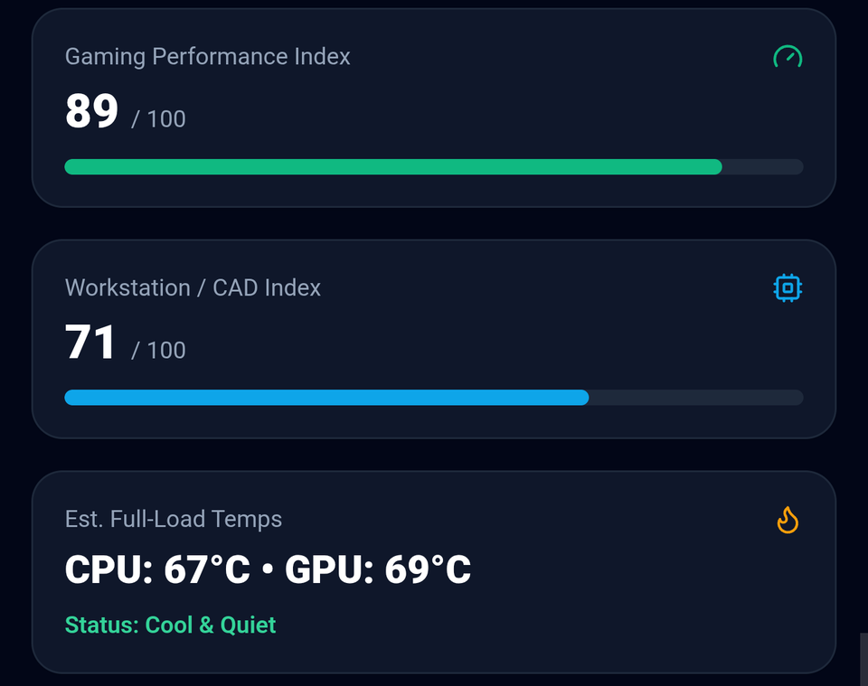
Digital PC Builder
From Empathy to Testing: A Virtual Compatibility & Simulation System
Live at bigg-one.vercel.app
Justine Dwight Acoba
John Benedict Alberto
Arom Sylon Apostle Alcausin
Nythan Bagasani
Karl Vincent Balcita
Jonas Nathaniel Bonifacio
Luis Bullanday
Zeus Bumagat
Mark Lorenz Datuin
Micko Gabriel Permison
Stephen Jay Polendey
Rhed Luis Ratuita
Mariano Marcos State University | College of Computing and Information Sciences
Presenter: Luis Bullanday
Notes:
[0:00–0:30 | Luis] Good morning. We are the Digital PC Builder team from MMSU CCIS. Our project helps first-time PC builders choose parts that fit and work together, priced in pesos. (Everyone: camera on, full name in profile.)

Slide 2
Our Design Thinking Journey
OVERVIEW • HOW EACH STAGE FEEDS THE NEXT
1
Empathize
2
Define
3
Ideate
4
Prototype
5
Test
WHAT WE DID
WHAT WE DID
WHAT WE DID
WHAT WE DID
WHAT WE DID
Listened to first-time builders around MMSU and reviewed existing tools
Turned the pain points into one user, need and insight
Compared 4 solution ideas against the user needs
Built and deployed the React + TypeScript web app
Automated rule tests now; usability sessions with real users next
OUTPUT
OUTPUT
OUTPUT
OUTPUT
OUTPUT
6 user pain points + 4 gaps in current tools
“How might we…” problem statement
Web-based visual builder with 6 features, each traced to a need
Live site: bigg-one.vercel.app
19 / 19 tests passed + usability test plan
Slides 3–4
Slide 5
Slides 6–8
Slides 9–17 (live demo)
Slide 18
Iteration loop: what we learn in Test goes back into Define and Prototype — wording, rules and layouts get fixed in the next version.
Presenter: Luis Bullanday
Notes:
[0:30–1:15 | Luis] This is our design thinking journey. Each stage's output became the next stage's input: pain points became our problem statement, which shaped the features, which became the prototype, which we test. Justine will start with the community concern.

Slide 3




First-Time PC Builders Lose Money to Mistakes They Can't See
EMPATHIZE & DEFINE
Students, gamers and small offices around MMSU build their own PCs to save money.
RAM / COOLER
GPU / CASE
RAM can be too tall for the CPU cooler
Graphics card can be too long for the case
POWER SUPPLY
BOTTLENECK
PSU may be too weak or lack the right cable
CPU and GPU can hold each other back
Result: returns, wasted pesos and failed first builds
Presenter: Justine Dwight Acoba
Notes:
[1:15–1:55 | Justine] COMMUNITY CONCERN. Students, gamers and small offices near MMSU build PCs to save money, but hidden traps cost them: RAM too tall for the cooler, GPU too long for the case, weak PSU, CPU/GPU bottleneck. Result: returns and wasted pesos. John will share what we found.

Slide 4
What We Found
EMPATHIZE & DEFINE
What users told us
What existing tools miss
1. Don't understand bottlenecks
2. Don't know which parts are needed
3. Think expensive = better
4. Afraid to buy, no descriptions
5. Want to compare parts
6. Want to know it runs smoothly
• PCPartPicker checks sockets and GPU length, but not RAM height against the cooler
• Bottleneck calculators give a percentage with no explanation of why
• Most tools price in USD, not Philippine pesos
• Brand builders (e.g. NZXT BLD) only allow their own fixed templates
Presenter: John Benedict Alberto
Notes:
[1:55–2:40 | John] USER RESEARCH INSIGHTS. On the left, the six things users told us. On the right, what current tools miss: no RAM-vs-cooler check, bottleneck percentages with no explanation, USD prices, fixed brand templates. Arom will turn this into our problem statement.

Slide 5
Problem Statement
EMPATHIZE & DEFINE
“How might we help first-time PC builders choose parts that actually fit, work together and stay within their budget in pesos, before they buy?”
USER
NEED
INSIGHT
MMSU students and other first-time builders
Confidence that every part fits and works, not just the socket
Existing tools catch some mistakes but never explain why, so beginners can't learn from them
Presenter: Arom Sylon Apostle Alcausin
Notes:
[2:40–3:15 | Arom] PROBLEM STATEMENT. Read the How-Might-We question. User: MMSU students and first-time builders. Need: confidence every part fits and works. Insight: tools catch mistakes but never explain why.

Slide 6


Ideate: Ideas We Considered
IDEATE & SYSTEM DESIGN
PRINTABLE CHECKLIST / SPREADSHEET
CHATBOT ADVISOR
Cheap, but can't check sizes or power automatically
Friendly, but answers aren't consistent or explainable
USE PCPARTPICKER AS-IS
CHOSEN: WEB-BASED VISUAL BUILDER
Misses clearance traps, USD prices and explanations
Rule-based compatibility engine, peso prices and plain-language explanations
Presenter: Arom Sylon Apostle Alcausin
Notes:
[3:15–3:50 | Arom] IDEATE. We brainstormed four ideas: a printable checklist, a chatbot, using PCPartPicker as-is, and a web-based visual builder. We chose the builder because only it can check sizes and power automatically, price in pesos and explain each warning. Nythan will present the features.

Slide 7





Key Features & Value Proposition
IDEATE & SYSTEM DESIGN
Beginner-friendly, priced in pesos, and it explains WHY a part doesn't fit.
Interactive Builder
Compatibility Engine
Build Summarizer
Eight hardware slots: CPU, motherboard, cooler, RAM, GPU, storage, PSU and case.
14 live checks. A header badge shows whether the build is compatible.
Running total price and power estimate stay in view while you build.
Comparison Tool
Performance Simulation
Explainable Insights
Compare up to 4 parts per category on price-to-performance.
Gaming and workstation indexes, temperatures, noise and FPS estimates.
Plain-language CPU vs GPU bottleneck analysis and PSU headroom guidance.
Presenter: Nythan Bagasani
Notes:
[3:50–4:35 | Nythan] KEY FEATURES & VALUE PROPOSITION. Read the value line at the top: beginner-friendly, priced in pesos, and it explains WHY. Then go through the six features. Karl will show how each feature connects to a user need.

Slide 8
From User Needs to Features
IDEATE & SYSTEM DESIGN • TRACEABILITY
User need
Feature
Where to see it
Don't understand bottlenecks
Explainable bottleneck analysis
Simulation
Don't know which parts are needed
8-slot builder listing every component
Builder
Hard to judge value for money
Price-to-performance score
Compare
Afraid to buy, no descriptions
Part descriptions + plain-language warnings
Builder (click a slot to see part details)
Want to compare parts
Side-by-side comparison (up to 4)
Compare
Want to know it runs smoothly
FPS estimates, temps, compatibility badge
Simulation
Presenter: Karl Vincent Balcita
Notes:
[4:35–5:20 | Karl] TRACEABILITY. Every feature comes from one of the six user needs. Read two or three rows, e.g. 'don't understand bottlenecks' leads to explainable bottleneck analysis in the Simulation tab. Luis will now open the live system.

Slide 9
System Prototype & Live Demo
PROTOTYPE • LIVE AT BIGG-ONE.VERCEL.APP
We switch to the live website. Each presenter drives one step; the next 8 slides are our backup if the connection drops.
1
Header & build status
2
Builder slots
3
Part browser
4
Build summary
Show the green Compatible (14 Checks) badge, wattage and ₱ total
Walk the 8 slots and open one to see part details
Pick an Intel CPU on an AM5 board to trigger the red socket warning
Itemized parts adding up to ₱96,690 and 386W of 750W
Jonas
Zeus
Mark
Micko
5
Compare
6
Simulation
7
Bottleneck analysis
8
FPS & PSU curve
Put 3 GPUs side by side and read the value score
Gaming 89 / 100, workstation 71 / 100, temps and noise
Plain-language reason why the CPU and GPU are balanced
Frame rates at 1080p / 1440p / 4K and PSU efficiency
Stephen
Rhed
Justine
John
Presenter: Luis Bullanday (opens the site and hands over)
Notes:
[5:20–5:40 | Luis] Open bigg-one.vercel.app in the shared screen (have it pre-loaded in a tab). Hand off to Jonas. If the site or connection fails, stay on the slides: the next 8 slides show the same steps.

Slide 10
Build Status Is Always Visible
  Compatibility badge: turns green with "Compatible (14 Checks)" when every rule passes.
  Power estimate: ~386W of a 750W supply, updated as parts change.
  Total price: live running cost of the build in pesos (₱96,690 here).
  Four tabs: Home, Builder, Compare (with a count of saved parts) and Simulation.
  Toolbar icons: shortcuts for files, sharing, learning and a light/dark theme toggle.
Mobile-first layout: the screenshots were captured on a phone.
Presenter: Jonas Nathaniel Bonifacio
Notes:
[5:40–6:05 | Jonas] LIVE: point at the header. Green badge = all 14 checks pass; power ~386W of 750W; running total ₱96,690.

Slide 11
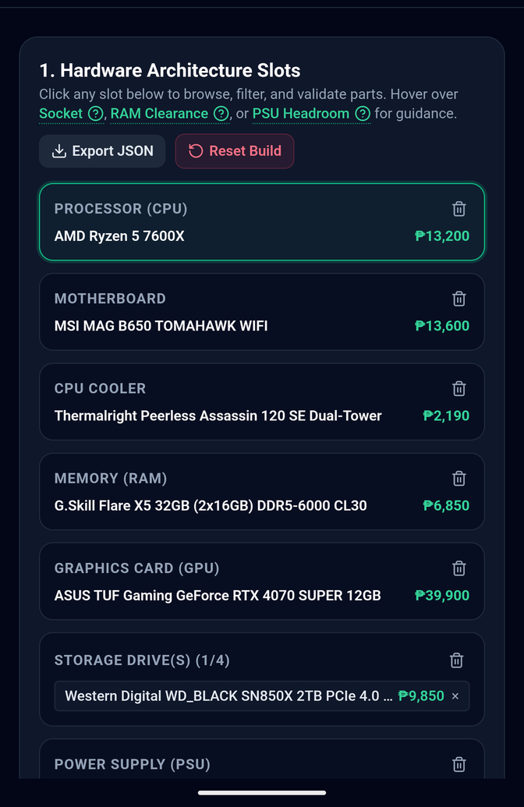
Interactive Builder: Hardware Slots
  One card per component: processor, motherboard, CPU cooler, memory, graphics card, storage (up to 4 drives), PSU and case.
  Each slot shows the chosen part and its price in pesos.
  Tap a slot to browse, filter and validate parts for it.
  Hover hints for Socket, RAM Clearance and PSU Headroom explain the rule behind each check.
  Export JSON and Reset Build save a build or start over in one tap.
Presenter: Zeus Bumagat
Notes:
[6:05–6:30 | Zeus] LIVE: Builder tab. Walk the eight slots; hover a hint like RAM Clearance to show the rule behind it.

Slide 12
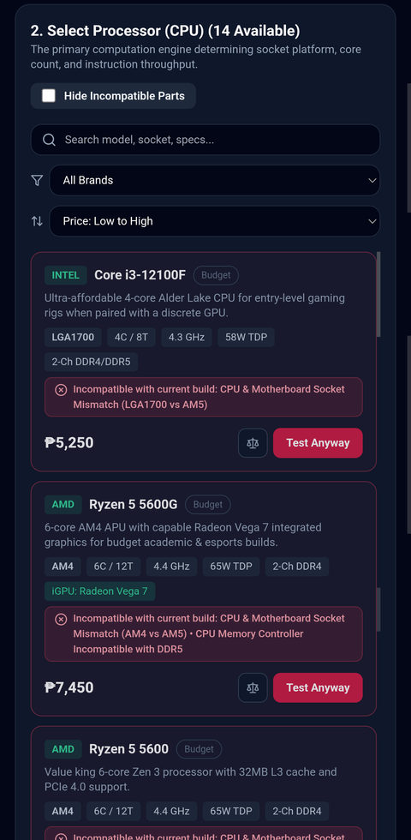
Part Browser: Filter, Validate, Test Anyway
  Search and sort: find parts by model, socket or specs, filter by brand, sort by price.
  Hide Incompatible Parts toggle keeps the list clean for beginners.
  Spec chips: socket, cores/threads, clock speed, TDP and memory type on every card.
  Red warnings explain why: for example "CPU & Motherboard Socket Mismatch (LGA1700 vs AM5)" or "Incompatible with DDR5".
  Test Anyway lets users see the effect of a risky pick without losing the build.
Presenter: Mark Lorenz Datuin
Notes:
[6:30–6:55 | Mark] LIVE: open the CPU slot, pick an Intel CPU to show the red 'Socket Mismatch (LGA1700 vs AM5)' warning, then show Hide Incompatible Parts.

Slide 13
Build Summary: Itemized Cost and Power
Slot | Selected part | Price
Processor | AMD Ryzen 5 7600X | ₱13,200
Motherboard | MSI MAG B650 TOMAHAWK WIFI | ₱13,600
CPU cooler | Thermalright Peerless Assassin 120 SE | ₱2,190
Memory | G.Skill Flare X5 32GB (2x16GB) DDR5-6000 CL30 | ₱6,850
Graphics card | ASUS TUF Gaming GeForce RTX 4070 SUPER 12GB | ₱39,900
Storage | WD_BLACK SN850X 2TB PCIe 4.0 | ₱9,850
Power supply | MSI MAG A750GL PCIE5 750W 80+ Gold ATX 3.0 | ₱5,850
Case | Corsair 4000D Airflow ATX Mid Tower | ₱5,250
Total |  | ₱96,690
₱96,690
Total estimated cost
386W / 750W
Estimated draw vs PSU
14 / 14
Compatibility checks passed
Presenter: Micko Gabriel Permison
Notes:
[6:55–7:20 | Micko] LIVE: build summary. Each part's price adds up to ₱96,690; 386W draw on a 750W PSU; 14 of 14 checks passed.

Slide 14
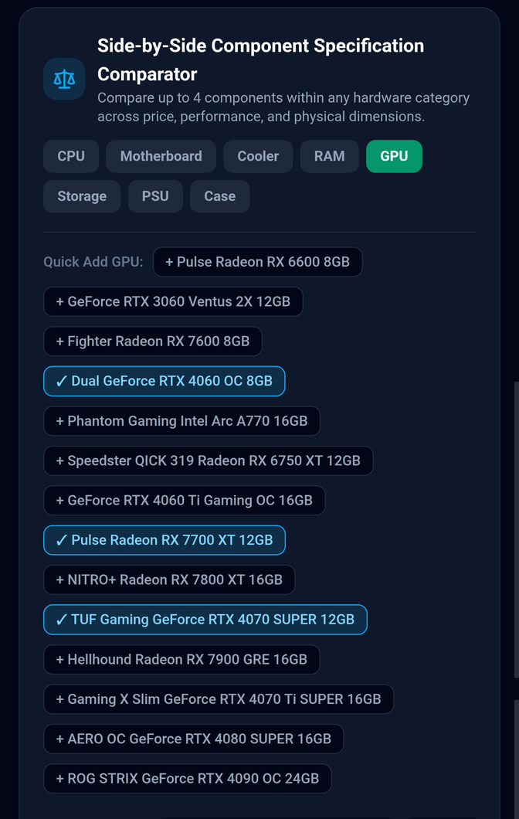
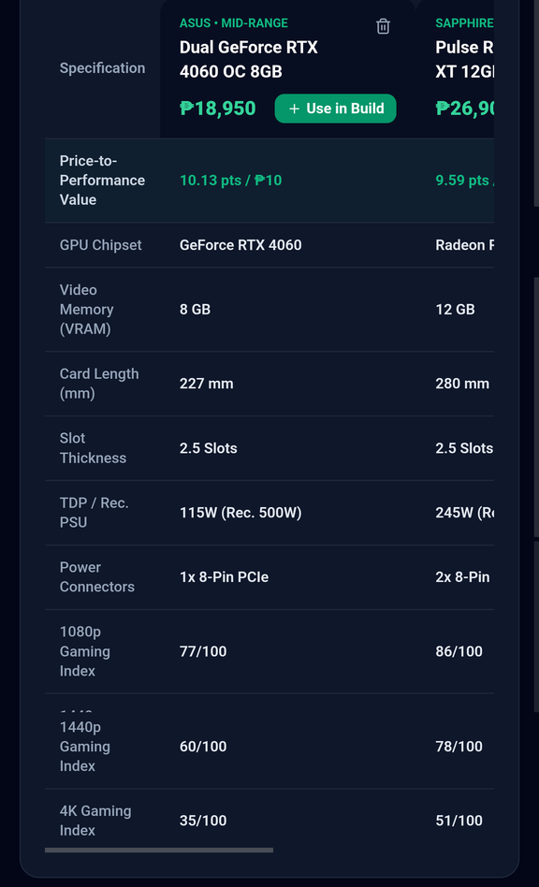
Side-by-Side Component Comparator
  Category tabs: CPU, Motherboard, Cooler, RAM, GPU, Storage, PSU, Case.
  Quick Add chips put up to 4 parts into the table.
  Value score: RTX 4060 8GB scores 10.13 pts per ₱10 vs 9.59 for the RX 7700 XT 12GB.
  Physical specs: card length, slot thickness, TDP, power connectors.
  Gaming indexes: 1080p, 1440p and 4K scores. Use in Build sends the winner to the builder.
Presenter: Stephen Jay Polendey
Notes:
[7:20–7:45 | Stephen] LIVE: Compare tab. Three GPUs side by side; RTX 4060 has the best value score (10.13 points per ₱10). Use in Build sends it to the builder.

Slide 15
Simulation: Performance Before You Buy
89 / 100
71 / 100
Gaming performance index
Workstation / CAD index
67°C
69°C
CPU full-load temp
GPU full-load temp
Cool & quiet: about 26 dBA at 386W load. Peak transient draw is 441W, and the site recommends a 650W supply.
Presenter: Rhed Luis Ratuita
Notes:
[7:45–8:10 | Rhed] LIVE: Simulation tab. Gaming index 89/100, workstation 71/100, CPU 67°C and GPU 69°C, about 26 dBA.

Slide 16
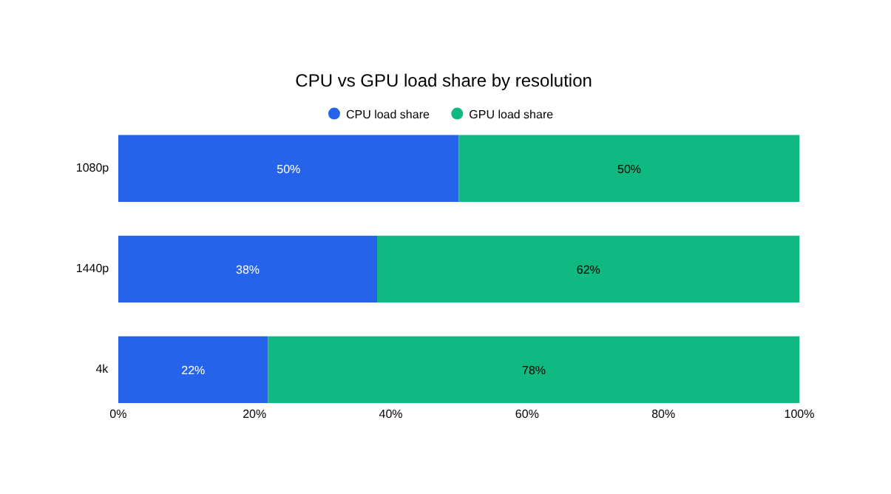
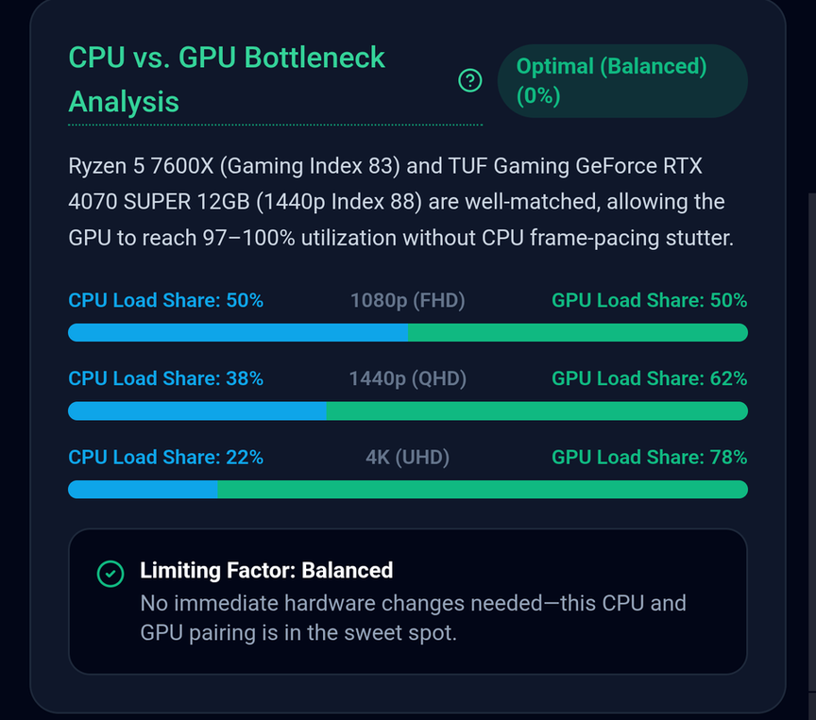
Explainable Bottleneck Analysis
Balanced (0%). Ryzen 5 7600X and RTX 4070 SUPER are well matched, so the GPU reaches 97-100% utilization without CPU stutter.
Presenter: Justine Dwight Acoba
Notes:
[8:10–8:35 | Justine] LIVE: bottleneck card. Balanced 0%: the GPU reaches 97–100% use without CPU stutter. At 4K the load shifts to the GPU.

Slide 17
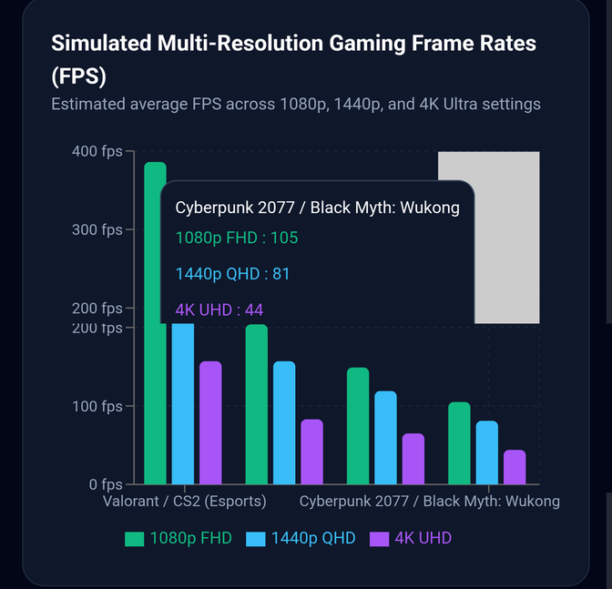
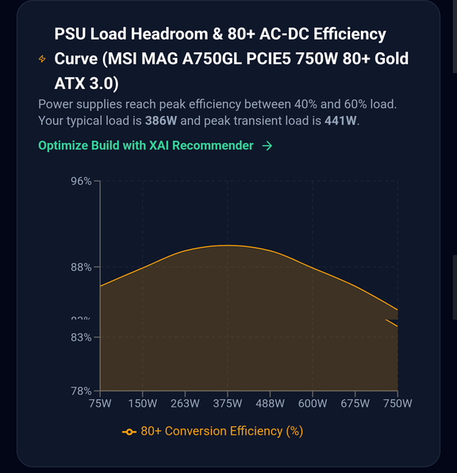
Frame Rates and PSU Efficiency
  Multi-resolution FPS for esports and heavy titles.
  Cyberpunk 2077 / Black Myth: Wukong: 105 FPS at 1080p, 81 at 1440p, 44 at 4K.
  PSU curve: 80+ efficiency across load; this 750W Gold unit peaks near 40-60% load.
  Typical load 386W, peak 441W.
Frame rates and efficiency curves come from curated sample data in this academic demo, not live benchmarks.
Presenter: John Benedict Alberto
Notes:
[8:35–9:00 | John] LIVE: FPS chart and PSU curve. Cyberpunk: 105 FPS at 1080p, 81 at 1440p, 44 at 4K. Mention this is curated sample data for an academic demo. Then switch back to slides for Karl.

Slide 18
Test: Checking That It Works for Users
TEST • CLOSING THE LOOP
AUTOMATED RULE TESTS (DONE)
USABILITY TESTING (NEXT)
WHAT RESULTS FEED BACK INTO
19 / 19
Who: MMSU students, gamers, hardware store staff and IT faculty
1
Define
Check that the problem we solve is the one users feel
unit tests passed (Vitest)
TASKS THEY WILL DO
1. Load the “Hidden Traps” build and find 3 conflicts
2. Fix the RAM-vs-cooler clash
3. Get a recommended build for ₱55,000
4. Read the FPS chart and share the build
2
Prototype
EACH ONE IS A TRAP USERS TOLD US ABOUT
Fix confusing wording, rules and layouts testers report
Socket mismatch: AM5 CPU on an LGA1700 board
56 mm RAM under a cooler with 32 mm clearance
358 mm GPU in a 315 mm case
550 W PSU with no 16-pin cable for an RTX 4090
Core i3 + RTX 4090 flagged as a CPU bottleneck
3
Data
Refresh prices and specs to current retail
4
Features
Rated on a 12-item System Usability Scale (SUS) form
Turn the share button into community build sharing
Presenter: Karl Vincent Balcita
Notes:
[9:00–9:50 | Karl] TEST. All 19 automated tests pass, covering the exact traps from our empathy stage. Next is usability testing with students, gamers, store staff and faculty using four tasks and a SUS form. Results feed back into Define and Prototype, which closes the design thinking loop.

Slide 19
Thank You!
Questions & Answers
Try it yourself: bigg-one.vercel.app
Source code: github.com/IshiguroTaiga/bigG
Presenter: Luis Bullanday (moderates Q&A)
Notes:
[9:50–10:05 | Luis] Thank the panel and open Q&A (3–5 minutes). Assign who answers: technical/engine questions to the developers, research questions to Justine/John, design questions to Arom/Nythan.

