Slide 1
Intro to Programming Part 4: Modeling and simulations
Luisa Escobar-Robledo, Chris Morii-Sciolla

Slide 2
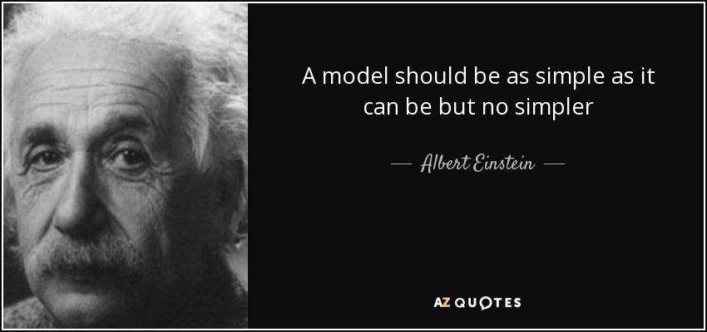
What is a model?
"Our simplified yet useful representation of reality."
Predict the future.
Predict different outcomes.
“Modeling”: To build, analyze, test, and critique models (of biology).
Gunawardena, J. Models in biology: ‘accurate descriptions of our pathetic thinking’. BMC Biol 12, 29 (2014). https://doi.org/10.1186/1741-7007-12-29

Slide 3
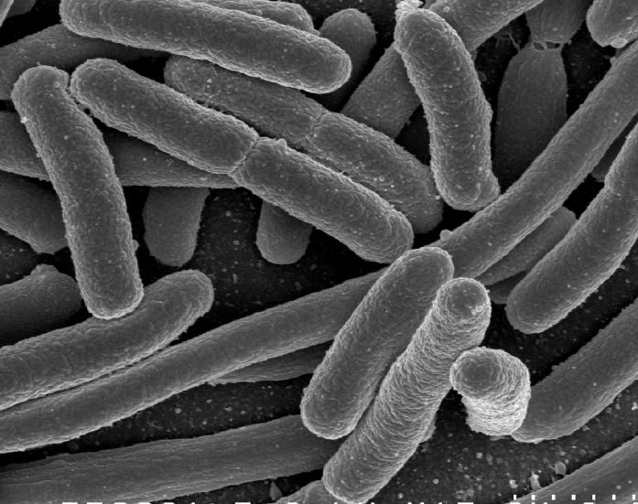
A simple growth model: Bacterial cells divide every 20 min Starting from one cell, how many cells in 4 hours?

Slide 4
Doubling every 20 minutes is a “chain reaction”
Time [min] | Generation | Nr. of cells N
0 | 1 | 1
20 | 2 | 2
40 | 3 | 4
60 | 4 | 8
Cell number in
next generation
= $2C$
$C:$ current cell number

Slide 5
How would you predict the # of cells vs. time?

Slide 6
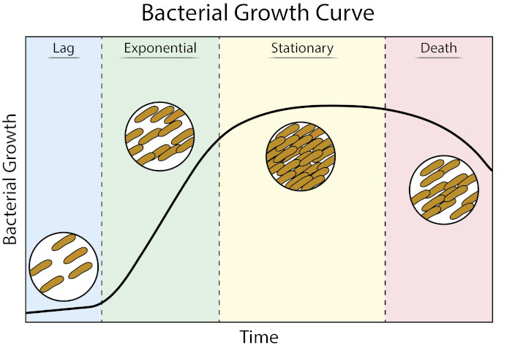
Bacterial division leads to exponential growth
Until resources are consumed…
Bonus Q:
How can you model resource consumption?
Log(Cell number)
JoVE Science Education Database. Microbiology. Growth Curves: Generating Growth Curves Using Colony Forming Units and Optical Density Measurements. JoVE, Cambridge, MA, (2023).

Slide 7
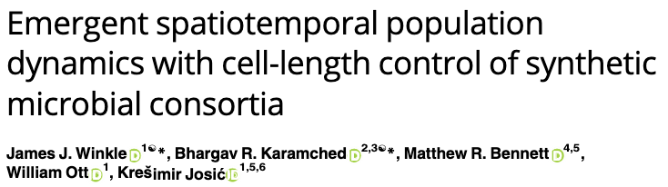
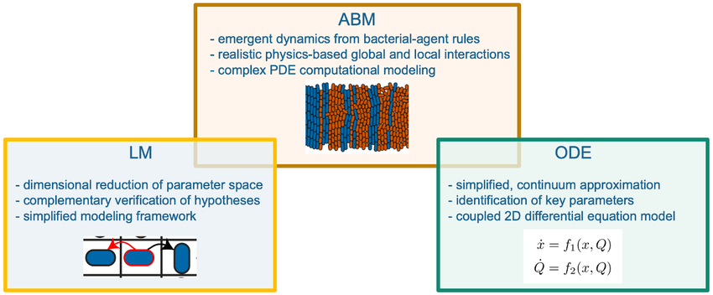
Different Model Types

Slide 8
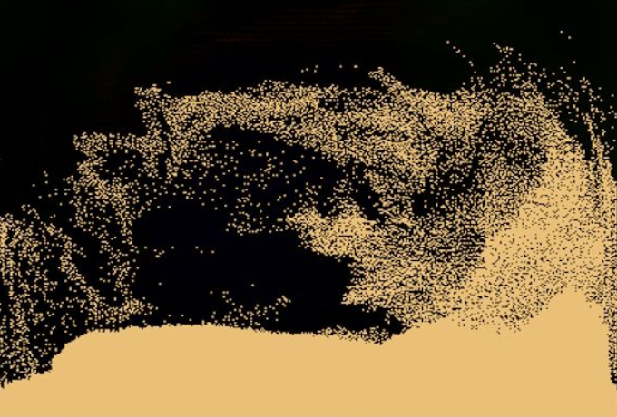
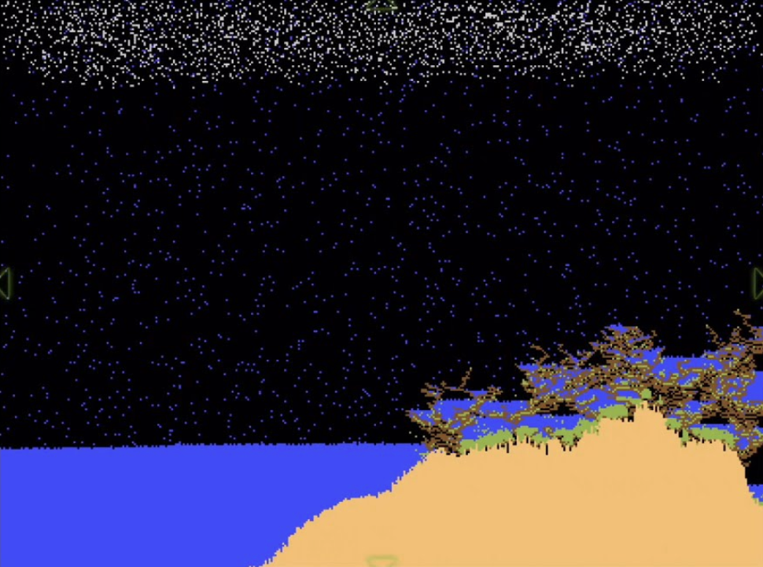
Agent based models can simulate spatial dynamics
https://dan-ball.jp/en/javagame/dust/

Slide 9
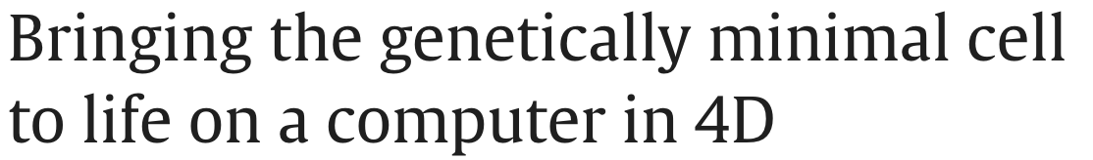
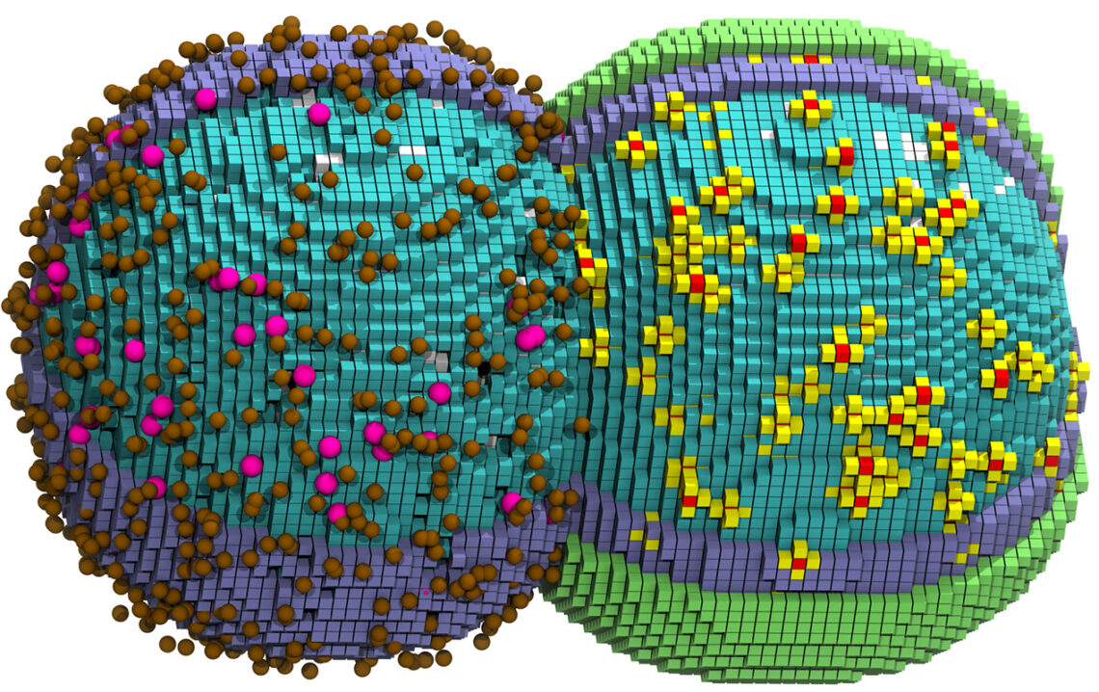
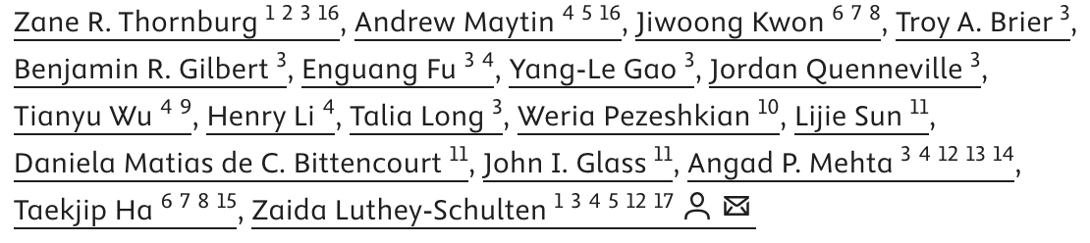
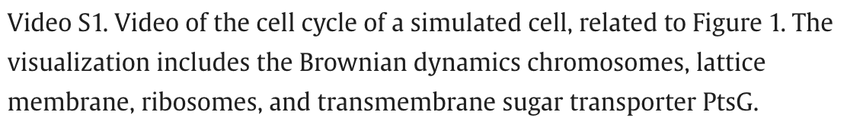
How can we model everything?
https://www.youtube.com/watch?v=EQ2ywYhYs5Y
https://www.youtube.com/watch?v=9JhVKu4GEA8

Slide 10
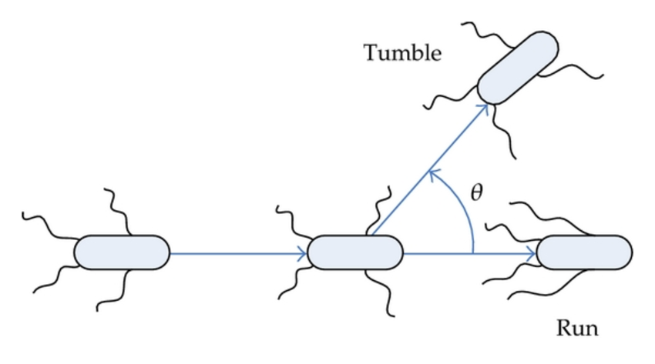
Let’s build a model! (Chemotaxis)

