Slide 1
Intro to Programming Part 3: Numpy arrays and image analysis
Keisuke Ishihara, Chris Morii-Sciolla

Slide 2
Tracking bacterial growth (and death)
We want to know:
How fast cells grow
When they divide
When they die
https://media.giphy.com/media/Lr3rWruv5qmWpCOXDQ/giphy.gif

Slide 3
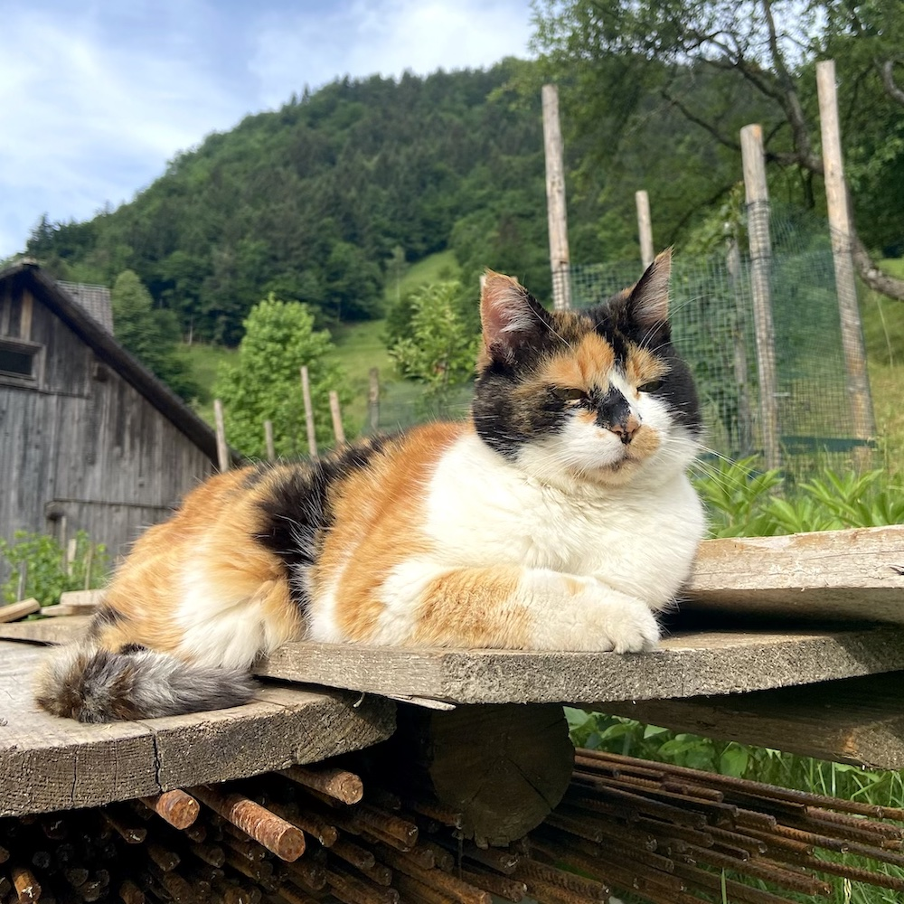
Digital image
of Klea taken on my phone

Slide 4
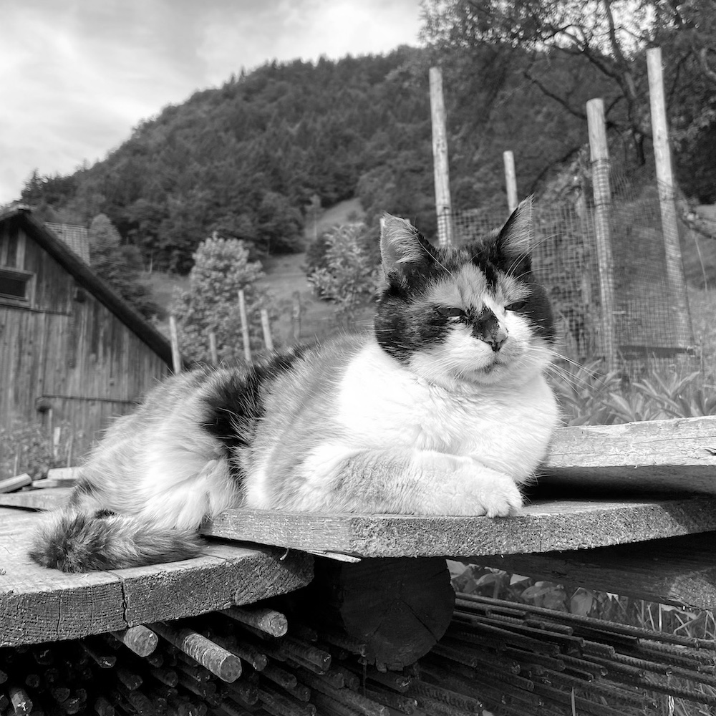
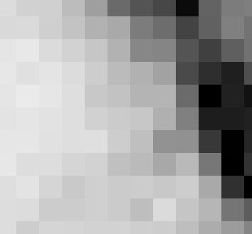
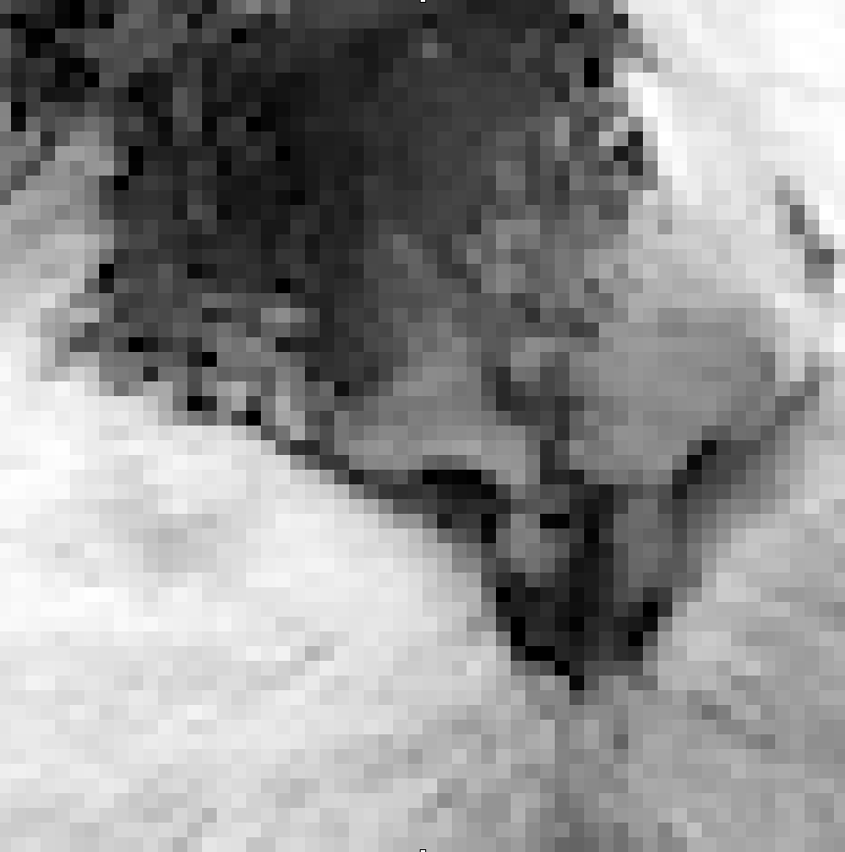

A digital image is composed of pixels
64
237
0
190
219
gray scale image
pixel

Slide 5

50 columns
50x50 pixel
8 bit
gray scale image
50 rows
matrix
8 bit contains
2^8 possible values:
0-255

Slide 6
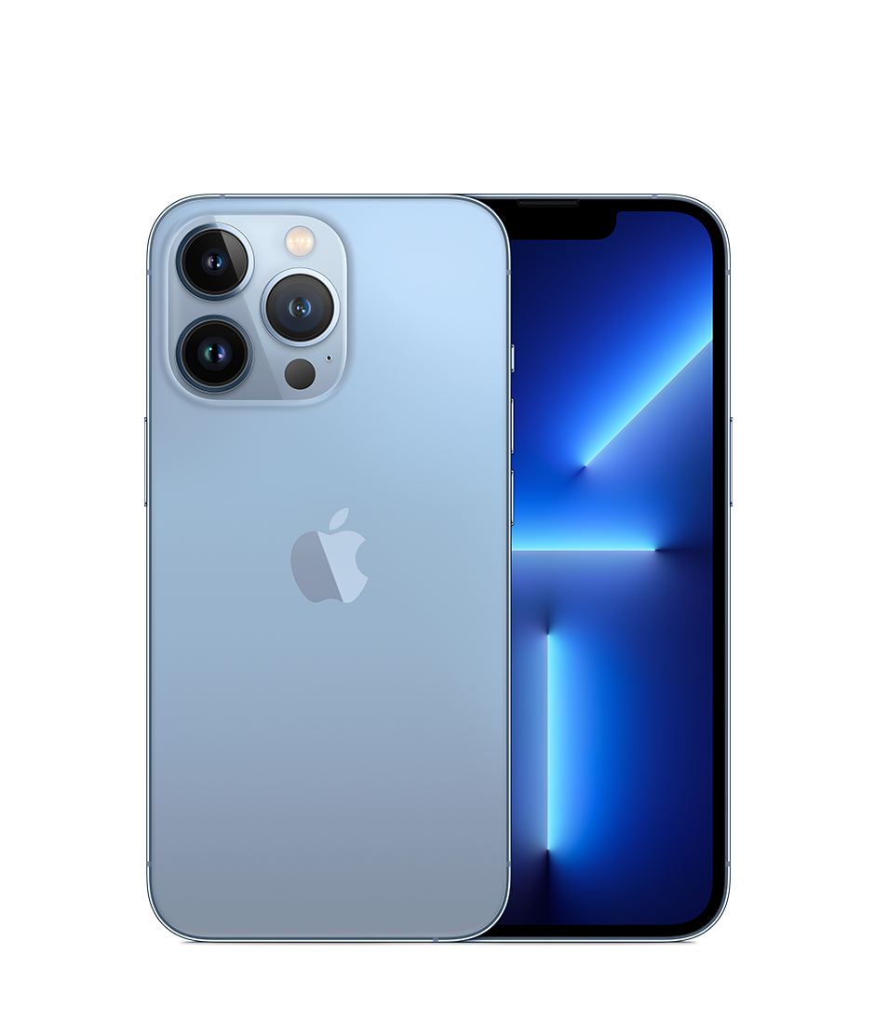
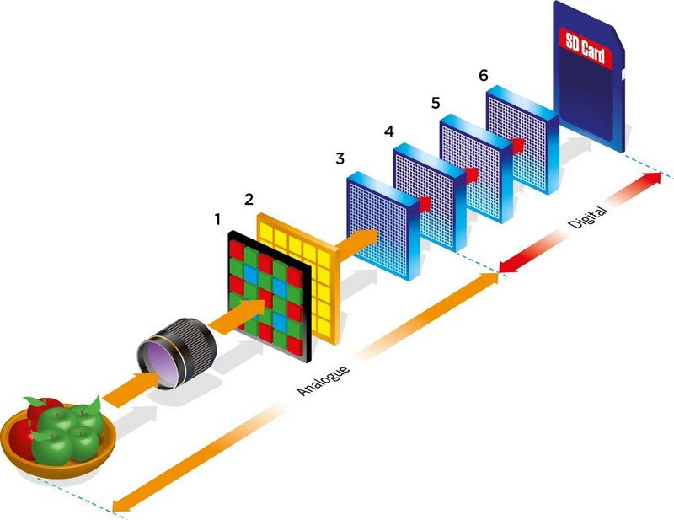
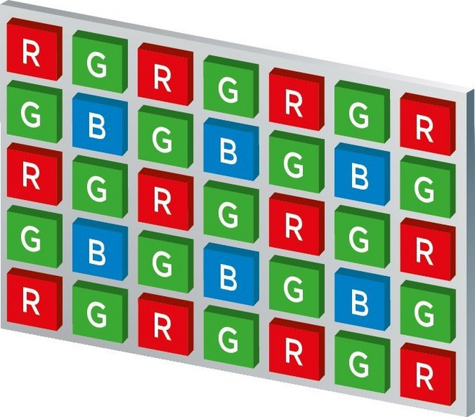
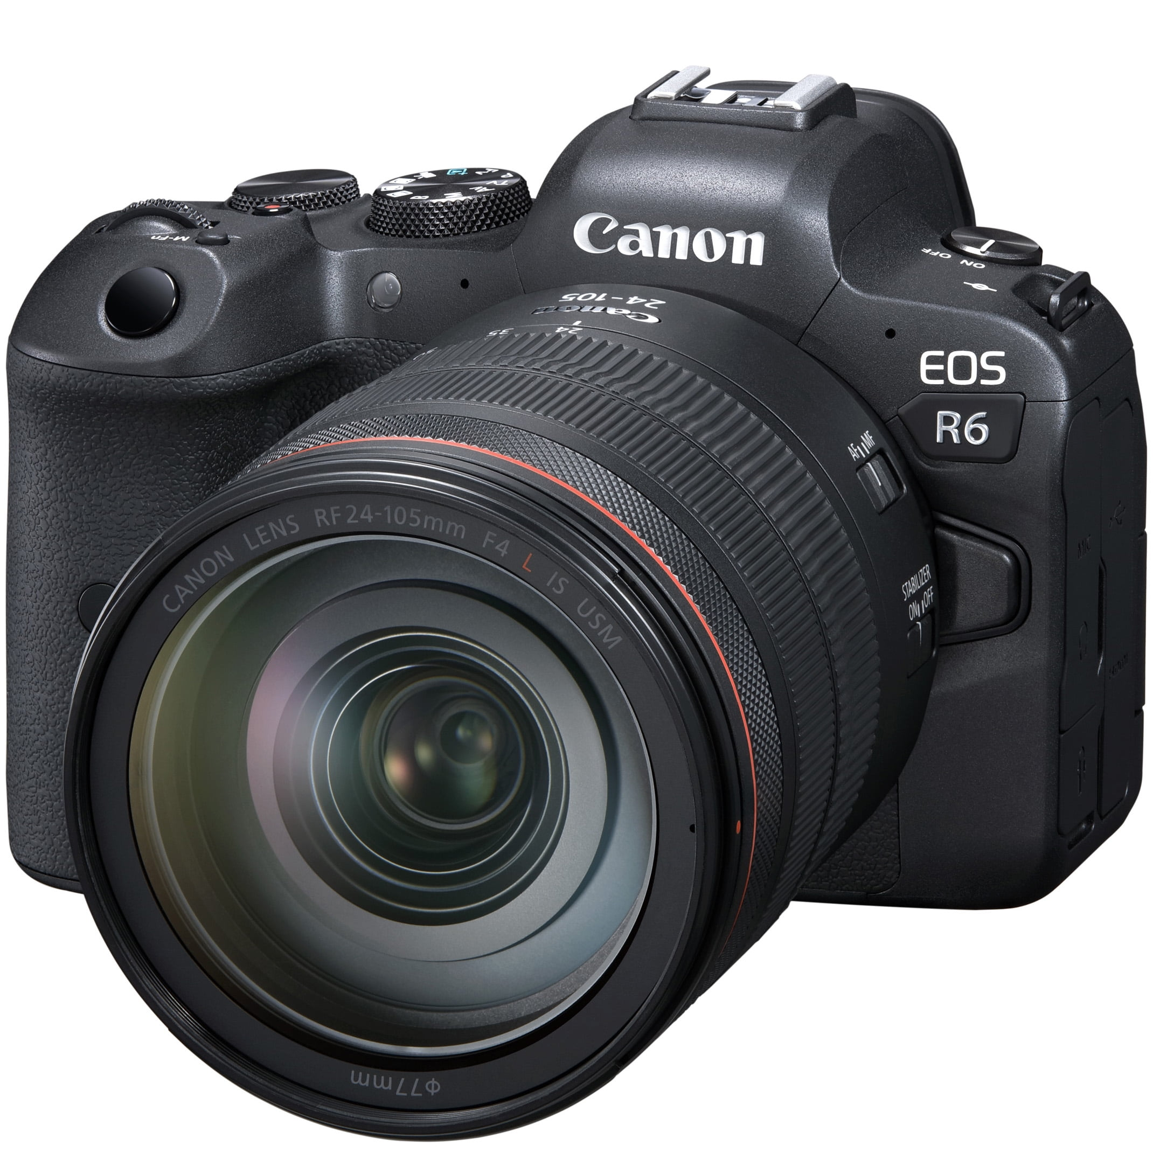
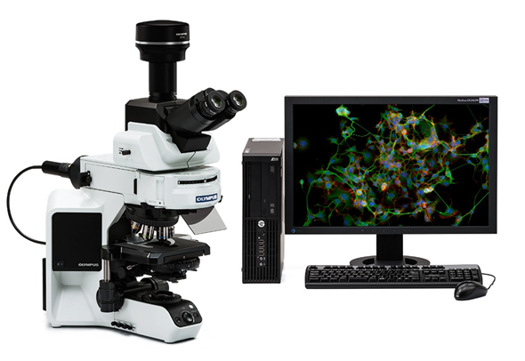
How do digital cameras work?
Red/Green/Blue color-aware sensor array converts photons to electric signals
Analog signals are digitized.
Information is stored as image files.
Today, practically all research microscopes are controlled by a computer!
https://www.canon.com.cy/pro/infobank/image-sensors-explained/

Slide 7
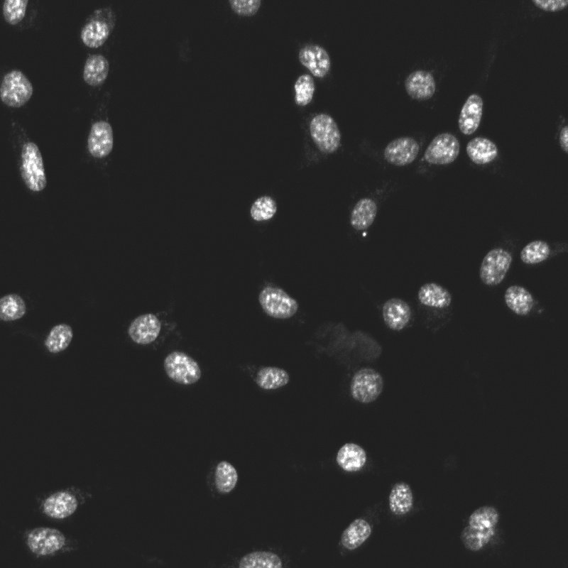
Let’s use Python to interact with digital images!
Today’s goal:
Write a program that
counts cells
measures nuclear area
Tracks bacteria growth and death

