Slide 1
MINOR PROJECT | AIML451
Ekatra
Adaptive multi-agent orchestration for autonomous software development
Tejas Bhalla and team | B.Tech, Artificial Intelligence & Machine Learning
VIPS – Technical Campus | Academic year 2026-27

Slide 2



THE PROBLEM
A fixed AI team cannot follow the work
Multi-agent systems give each role one agent for the whole run, however the project changes.
Uneven workload
Changing risk
Wasted resources
Many backend tasks, few frontend tasks: one backend agent becomes the bottleneck while others sit idle.
A security finding late in a build cannot attract more security capacity.
Extra agents on a light role burn tokens and time for no gain.
Ekatra | Minor Project AIML451
2

Slide 3
THE APPROACH
Our idea: let a controller resize the team
The LLM writes.
The controller scales.
1
Observe
2
Analyse
Six roles: PM, Architect, Frontend, Backend, QA, Security
Deterministic scores choose SPAWN, TERMINATE, REASSIGN, PRIORITIZE or CONTINUE
Every decision is logged with its reason
A fixed baseline uses the same tasks, so only orchestration differs
3
Decide
4
Allocate
5
Execute
6
Evaluate
Ekatra | Minor Project AIML451
3

Slide 4
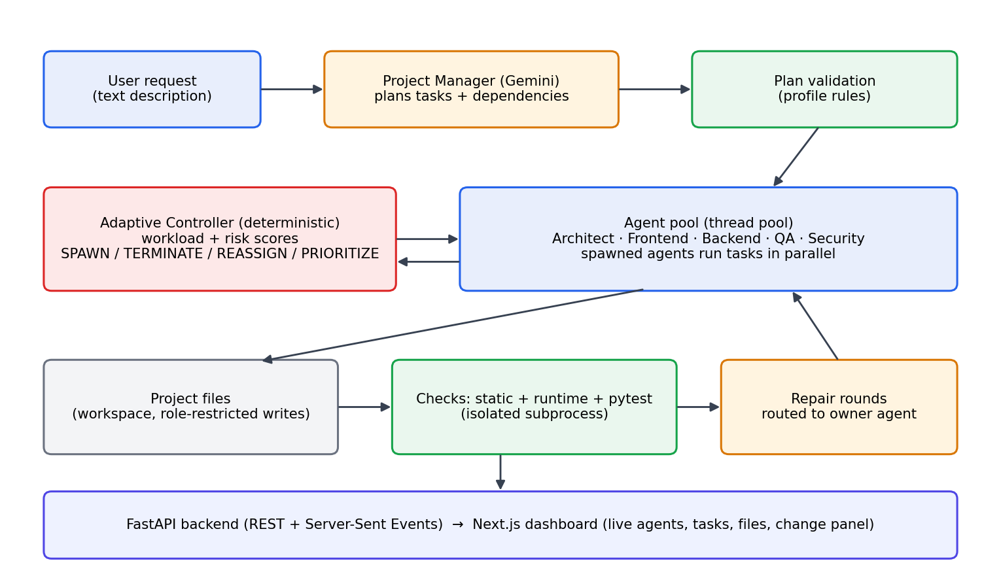




ARCHITECTURE
How the system fits together
FastAPI streams live state to a Next.js dashboard
Spawned agents run tasks in parallel
One Gemini wrapper: retries, key scrubbed
Generated code runs in an isolated subprocess
Ekatra | Minor Project AIML451
4

Slide 5





THE RESEARCH CORE
The adaptive controller
Workload = 0.40·Queue + 0.30·Complexity + 0.20·Delay + 0.10·Failures
Score 0–100: below 40 continue | 40–70 monitor | above 70 consider a spawn (configurable)
SPAWN
Add an agent when a role is overloaded or risk is high
TERMINATE
Release an idle spawned agent when work drains
REASSIGN
Move a waiting task to an idle agent
PRIORITIZE
Raise the priority of risky or blocking tasks
CONTINUE
No change; the reason is still logged
Ekatra | Minor Project AIML451
5

Slide 6





REAL BUILD MODE
From a sentence to working software
Plan
Write
Check
Repair
Ship
PM drafts tasks and dependencies
Agents write files in parallel
Static, runtime and pytest checks
Failures go to the owning agent
README and run record saved
Eight project types, not only websites
Web app
REST API
CLI tool
Library
Data script
Database app
Text game
Automation
Ekatra | Minor Project AIML451
6

Slide 7
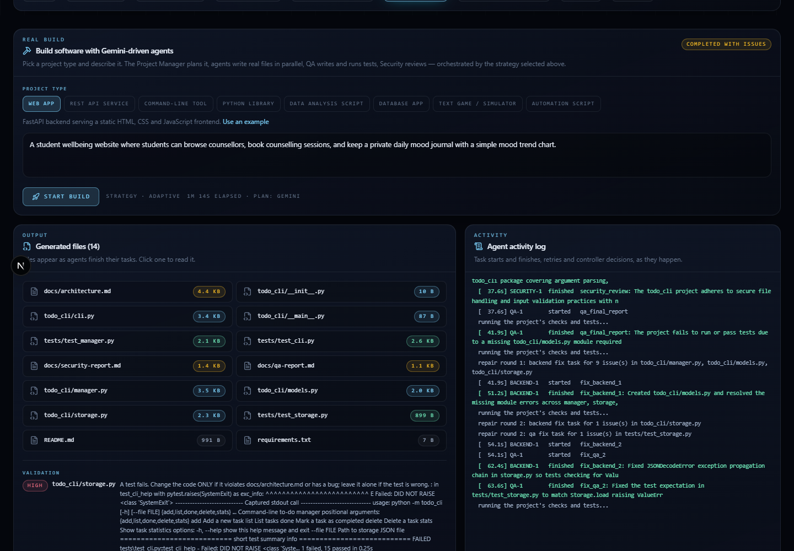




USER INTERFACE
Watch it work: the live dashboard
Agents, tasks and files appear live
Run tests or the site in one click
Change or fix a finished project with text
Every decision shown with its reason
Ekatra | Minor Project AIML451
7

Slide 8
RESULTS
Completion time: fixed vs adaptive
9 scenarios x 5 seeded repetitions on a simulated clock. Both strategies see identical durations and failures.
Ekatra | Minor Project AIML451
8

Slide 9
FINDINGS
What the data says
52%
21%
0%
faster on a parallel backlog
faster under security risk
gain on chained work
Spawned agents ran independent tasks at once
Extra security capacity was actually used
Agents spawned but had nothing ready to run
Adaptation helps only where work can run in parallel. We also report where it does not.
Ekatra | Minor Project AIML451
9

Slide 10


WRAP-UP
Conclusion and future scope
Built and tested
Next
Deterministic controller and fixed baseline
475 automated tests
Real Gemini builds, 8 project types
Change requests and live dashboard
Spawn only when ready tasks exist
Larger study with real latency and cost
Mobile apps and a container sandbox
Human review before changes apply
Thank you | Questions?

