Slide 1
Vault - Centralized Website for Placement Documents

Slide 2
Project team members
Ishika Jain - 1DS20CS089
Janvi Kumari - 1DS20CS088
Dheeraj Gajula - 1DS20CS072

Slide 3
Abstract
The Vault project aims to develop a centralized website where students can securely store their placement-related documents such as resumes and project details. This presentation highlights the objectives, system architecture, literature survey, expected outcomes, and conclusions of the Vault project

Slide 4
Problem Statements and Objectives
Problem 1
Lack of a centralized platform for students to store and manage their placement documents.
Problem 2
Difficulty in accessing and updating placement-related information efficiently.
Objective 1
Develop a user-friendly website for students to securely store their placement documents.
Objective 2
Allow students to update and manage their documents conveniently.

Slide 5
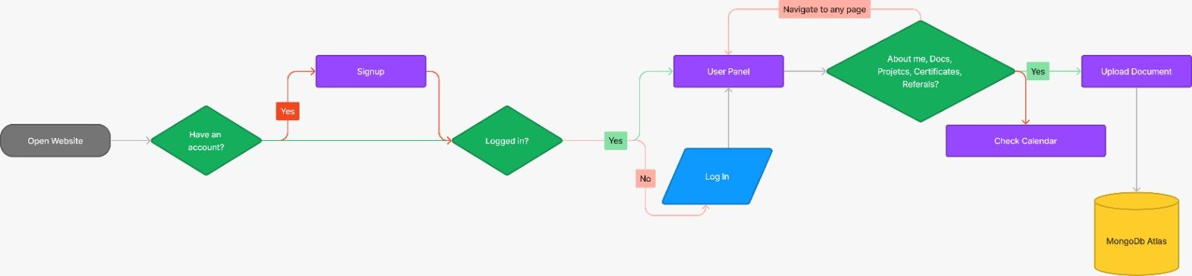
Architecture

Slide 6
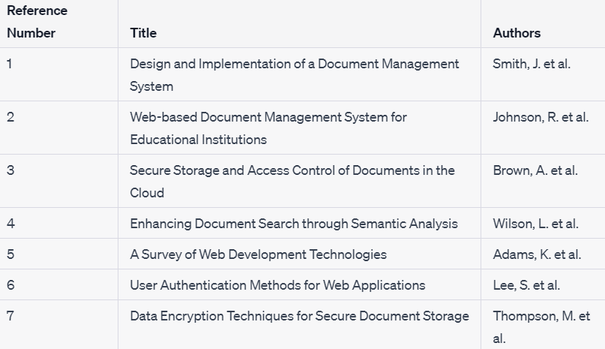

Slide 7
Hypothesis
By providing students with a centralized platform for storing their placement-related documents, we expect an increase in efficiency and convenience during the placement process.

Slide 8
Expected Outcome
The Vault project will enable students to easily manage and access their placement documents, resulting in improved organization and better preparation for placement opportunities.

Slide 9
Each Members Contribution
Ishika Jain
Janvi Kumari
Front-end using React
Database Management using Firebase
Dheeraj Gajula
Backend using python and flask

Slide 10
Conclusion
The Vault project aims to revolutionize the way students handle their placement documents by providing a user-friendly and centralized platform for document management. By utilizing the Vault system, students will experience enhanced organization and seamless access to their placement-related documents, leading to improved preparation for placement opportunities.
With the Vault project, students will no longer have to deal with the hassle of manually organizing and tracking their placement documents. The system offers a streamlined and intuitive interface that allows users to upload, store, and categorize their resumes, project details, and other relevant documents. This centralized approach eliminates the need to search through various folders or email attachments, saving valuable time and effort.
One of the key benefits of the Vault project is its accessibility. Students can conveniently access their documents from anywhere, anytime, using any device with an internet connection. This flexibility ensures that crucial placement materials are readily available, whether students are attending interviews, networking events, or preparing for their dream job applications.

