Slide 1
Project Presentation of Industry Oriented Hands on Experience (22CS422)
On
Role of Communication Skills in Educational
Counselling and Student Guidance
Supervised By
Dr.Anshu Singla
Ishika Bedi (2210990422) Shubham(2210992372)
Bhawna(2210994775) Mimansa(2210991925)
Department of Computer Science and Engineering, Chitkara University, Punjab

Slide 2
Introduction
The education sector has rapidly expanded with the rise of EdTech platforms and diverse academic programs.
Students often face confusion while choosing suitable courses and career paths.
Effective communication is a key element in successful counseling.
Educational counseling helps students make informed academic and career decisions.
Skills like clarity, active listening, empathy, and feedback play a crucial role in guiding students.

Slide 3
Objective
Examine the role of communication skills in educational counseling
Analyze how effective communication influences:
Student trust
Engagement
Satisfaction
Understand the impact of communication on students’ decision-making
Explore how students choose academic programs and career paths

Slide 4
Problem Statement
Students often struggle to express:
Concerns
Goals
Expectations during counseling sessions
Ineffective communication by counselors leads to:
Misunderstandings
Lack of trust
Poor decision-making
Communication gap results in:
Students choosing unsuitable academic paths
Need to improve communication skills for:
Better guidance
Improved outcomes

Slide 5
Methodology
This study is based on both primary and secondary data.
Primary data was collected through structured questionnaires distributed to students and educational counselors.
Secondary data was gathered from research papers, journals.
A descriptive research approach was used to analyze the relationship between communication skills and the effectiveness of educational counseling.

Slide 6
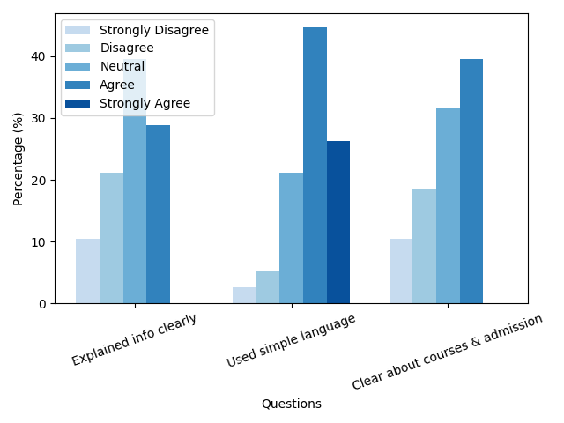
Student Satisfaction Levels

Slide 7
Results & Discussion
The findings of the study indicate that effective communication significantly improves the counseling process.
Counselors who demonstrate active listening, empathy, and clarity are able to build trust with students. This trust encourages students to openly share their concerns and aspirations, leading to better decision-making.
Moreover, strong communication skills increase student satisfaction and confidence, ultimately enhancing the overall effectiveness of counseling services.

Slide 8
Conclusion
In conclusion, communication skills are a fundamental component of successful educational counseling.
They help in building trust, improving understanding, and guiding students toward the right academic and career choices. Institutions should focus on training counselors in communication techniques to ensure better student engagement and outcomes.
Strengthening communication in counseling will not only benefit students but also improve the quality of educational services.

Slide 9
Thank You
3

