Slide 1
Physical Factors
Development of Overall Reactor Model
Mass balance on pellets
Enthalpy Balance on pellets
Effectiveness of rate equation by neglecting diffusive resistance
External mass and heat transfer effects
Effective diffusion coefficient
Viscosity
Thermal Conductivity

Slide 2
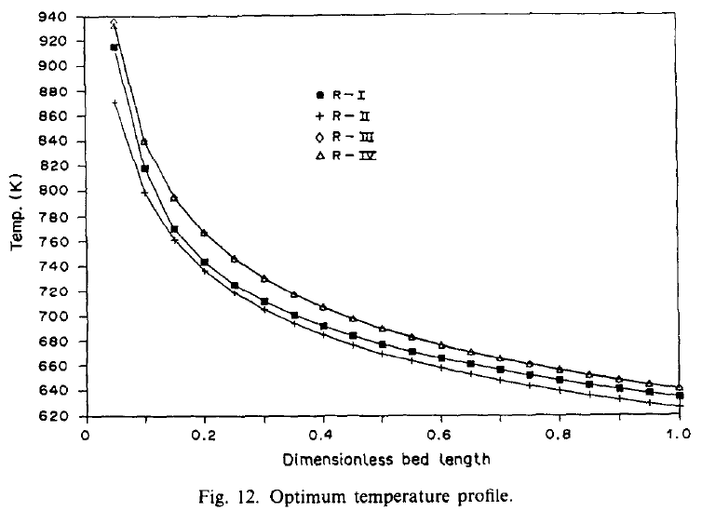
Temperature Profile for Adiabatic Conditions

Slide 3
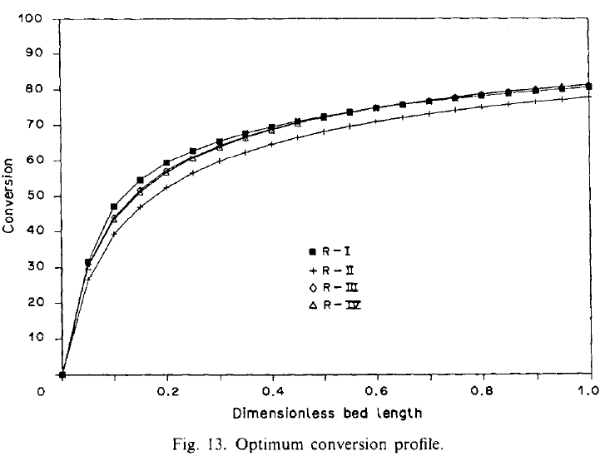
Conversion Profile

Slide 4
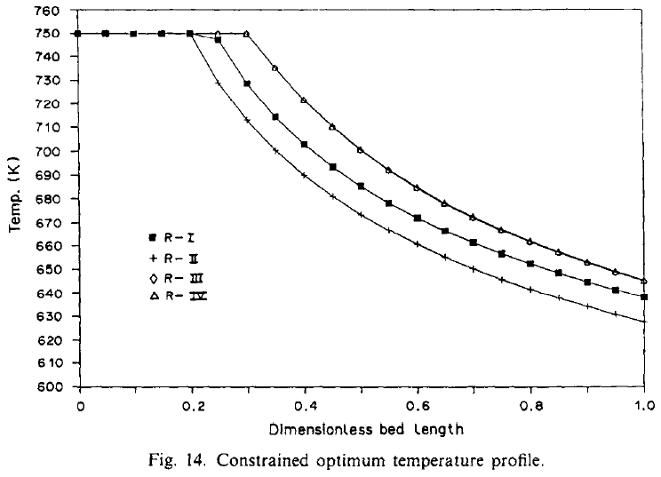
Constraints- T=<750K

Slide 5
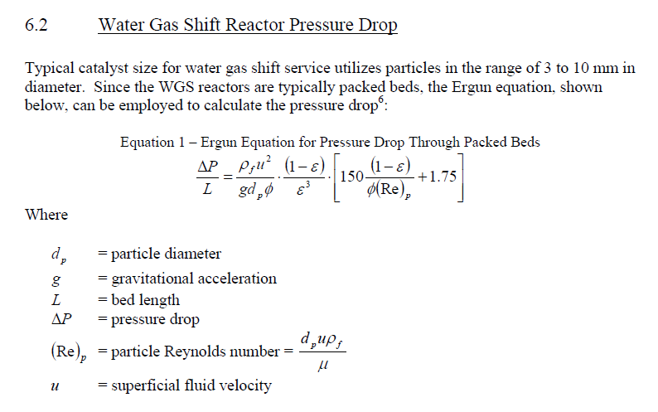

Slide 6
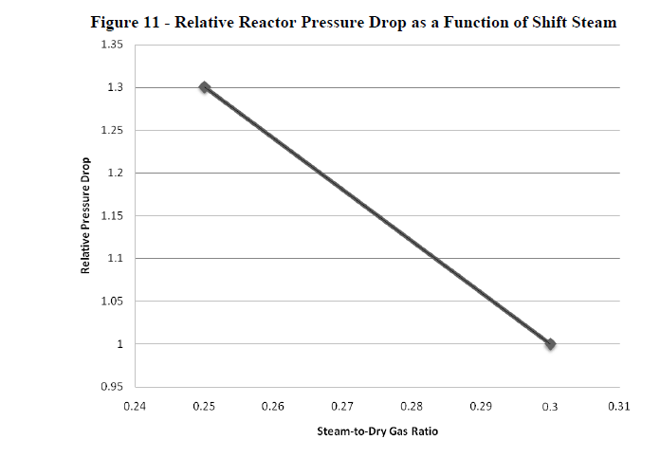

Slide 7
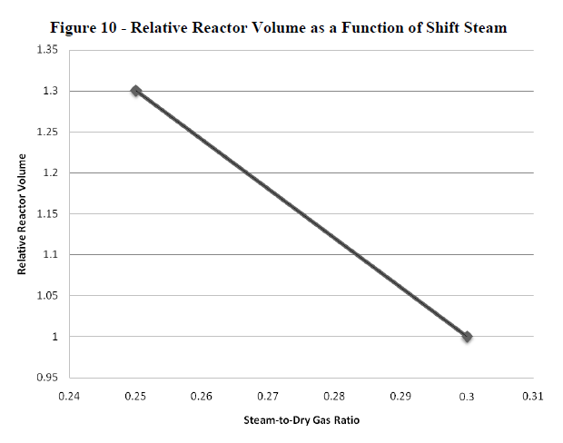

Slide 8
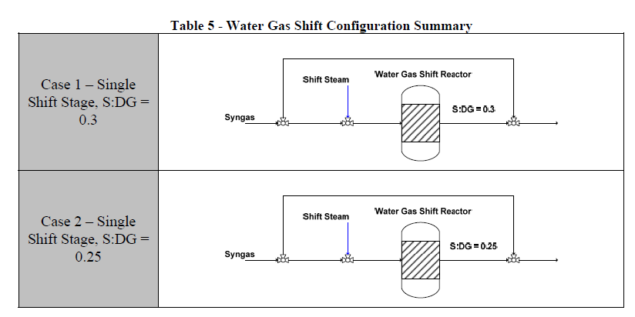

Slide 9
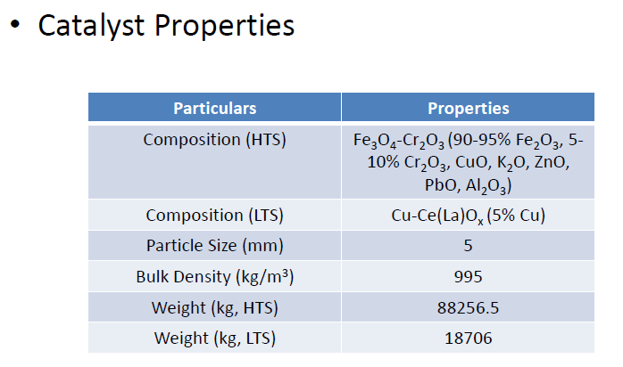

Slide 10
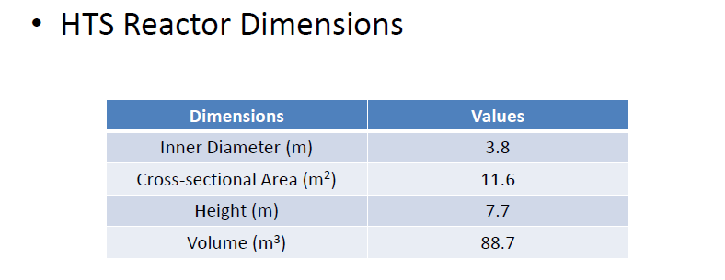
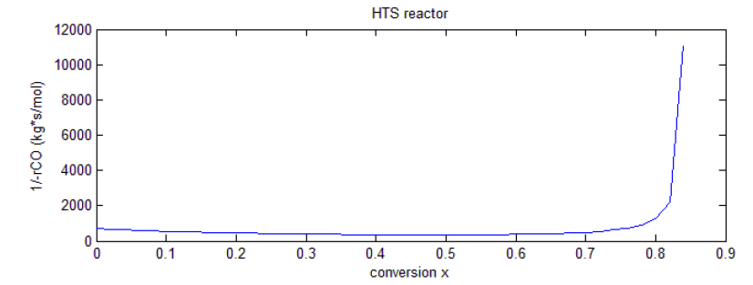

Slide 11
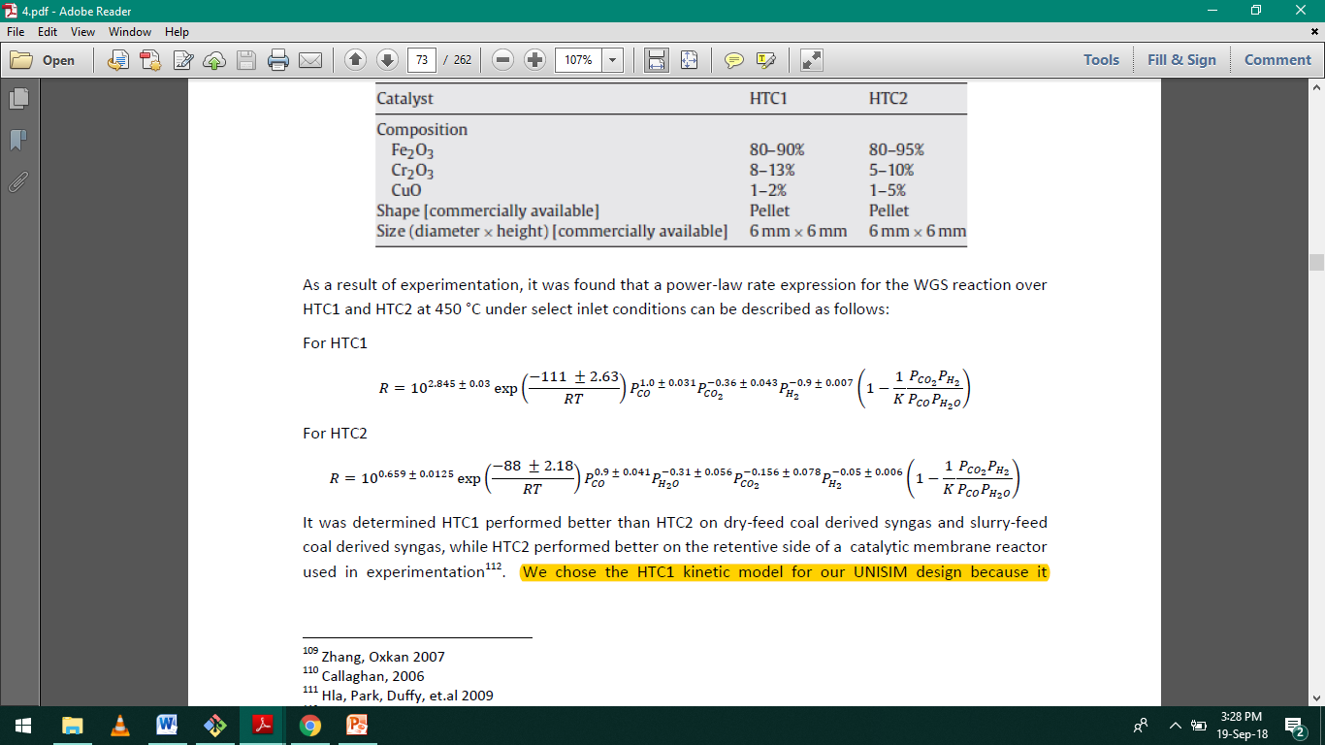

Slide 12
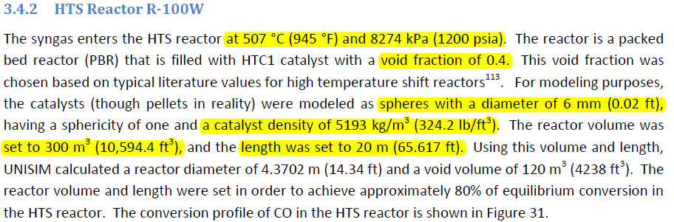

Slide 13
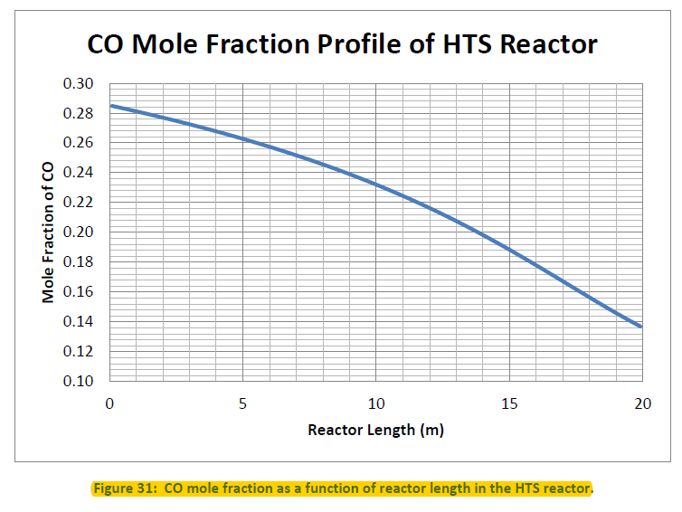

Slide 14
