Slide 1
DATA STRUCTURES AND ALGORITHMS
Name: Ishika Aggarwal
Registration No.:11904047
Course Code: CSE443
Course Name: Seminar On Summer Training

Slide 2
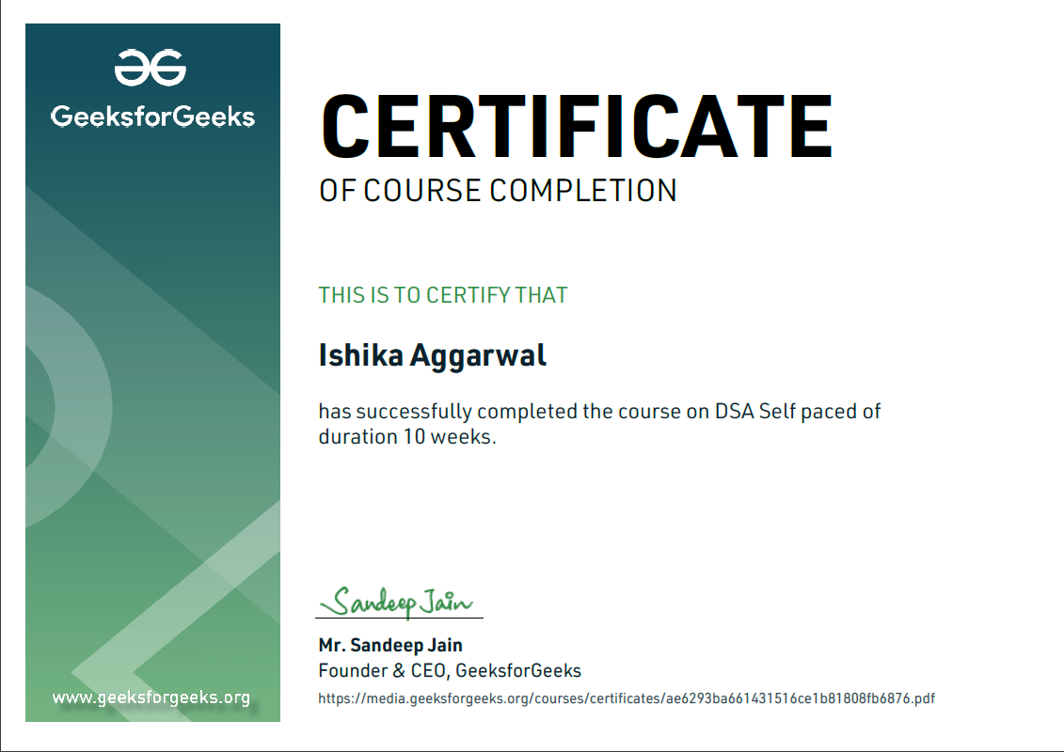
Certificate

Slide 3
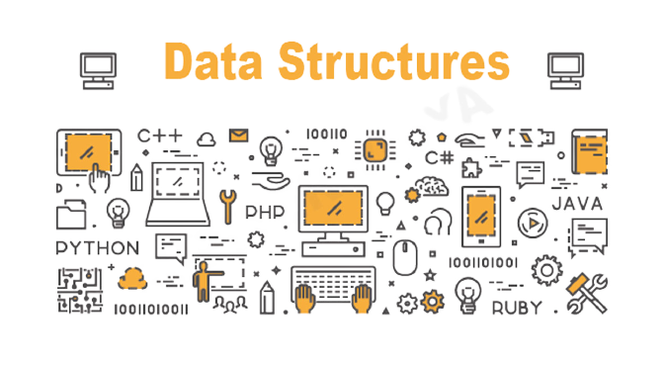
introduction
Data structures- A data structure is a particular way of organizing data in a computer so that it can be used effectively.
Algorithm- Algorithm refers to a set of rules/instructions that step-by-step define how a work is to be executed upon in order to get the expected results.

Slide 4
Data Structure Asymptotic Notation
Asymptotic notations are mathematical tools to represent the time complexity of algorithms for asymptotic analysis. They are of three types
Big-O Notation (Ο) – Big O notation specifically describes worst case scenario.
Omega Notation (Ω) – Omega notation specifically describes best case scenario.
Theta Notation (θ) – This notation represents the average complexity of an algorithm.

Slide 5
Types of data structures
1. Linear data structure- In this data elements are arranged sequentially or linearly where the elements are attached to its previous and next adjacent in what is called a linear data.
It contain array, stack, queue, linked list, etc.
2.Non-Linear data structure- In this data elements are not arranged sequentially or linearly are called non-linear data structures.
It contain graphs, trees etc.

Slide 6
Linear data structures
Array- Array is the collection of data element with same data type.
Linked list- Linked list is the collection of data element which are connected through pointer
Stacks- Stacks are based on the LIFO principle, i.e., the element inserted at the last, is the first element to come out of the list.
Queues- Queues are based on the FIFO principle, i.e., the element inserted at the first, is the first element to come out of the list.

Slide 7
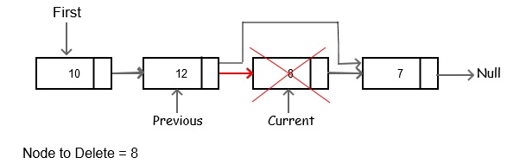

Slide 8
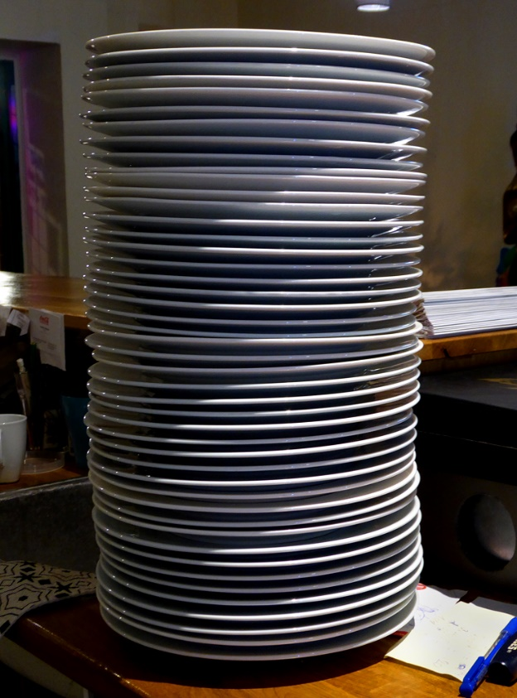
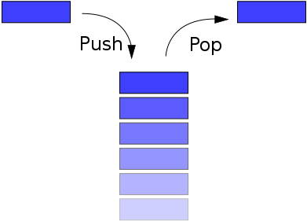

Slide 9
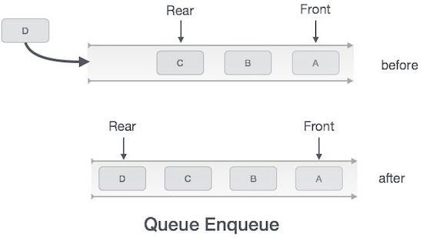


Slide 10
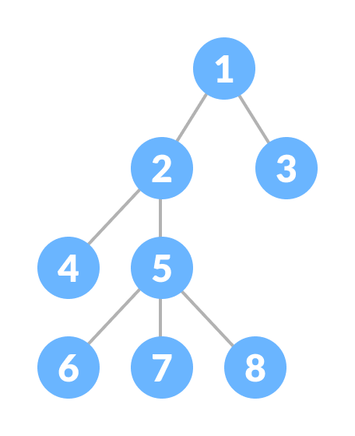
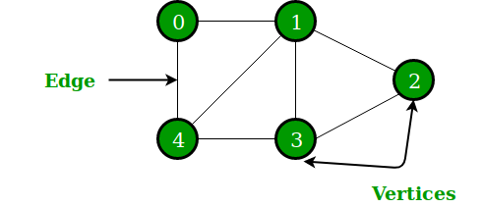
Non linear data structures
Graph- A graph is collection of two sets V and E where V is a finite non-empty set of vertices and E is a finite non-empty set of edges.
Trees- A tree is a finite set of one or more nodes such that there is a specially designated node called root.

Slide 11
Project Overview
Shopping Management System
Objective: The central concept of the application is to allow the owner of the departmental stores to manage the database of both the customers as well as products as well as allow customers to shop directly.
Data Structures Used: Arrays, linked list, stack and queue.
Module 1:
Administrator
Portal
Module 2:
Customer Portal
Module 3:
Exit

Slide 12
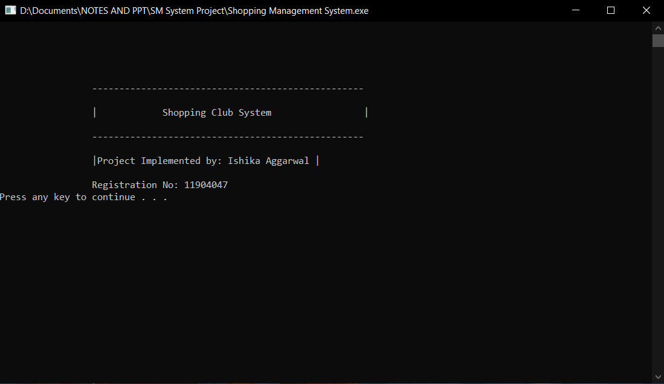
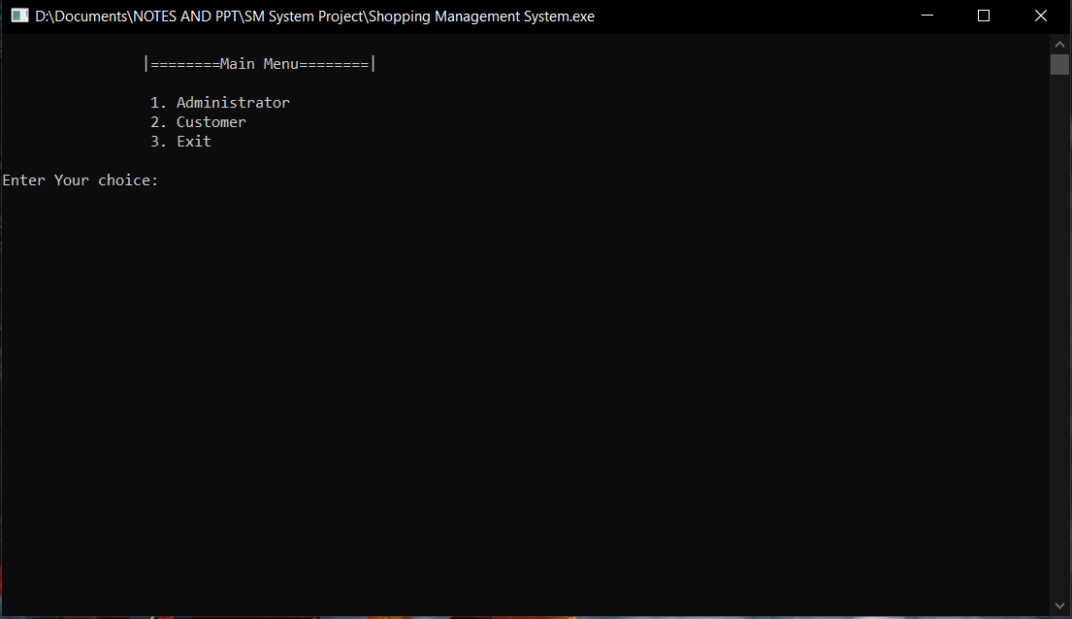

EXECUTION
1. WELCOME PAGE
2. MAIN MENU

Slide 13
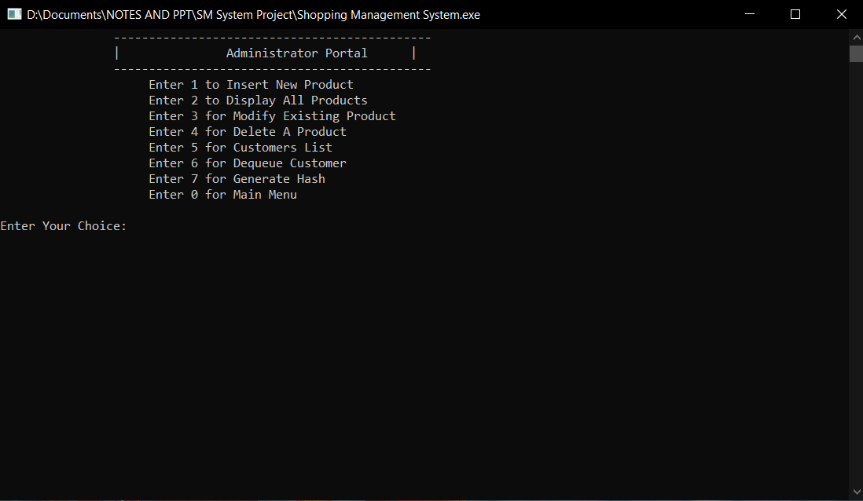
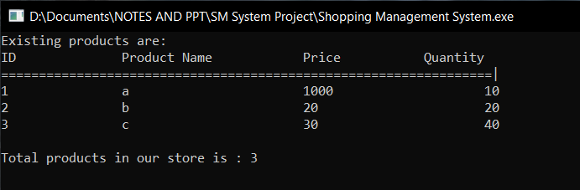
3. ADMINISTRATOR PORTAL
3.1. Insertion & Display Of The Products

Slide 14
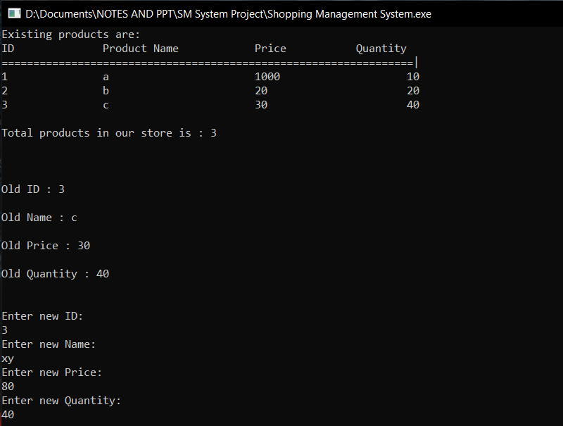
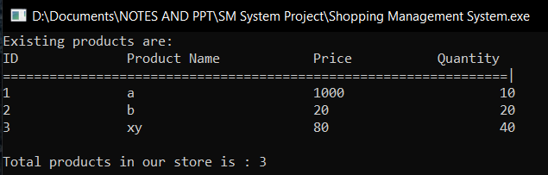
3.2. Modification Of The Existing Product

Slide 15
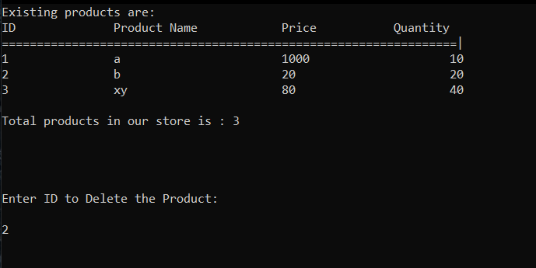
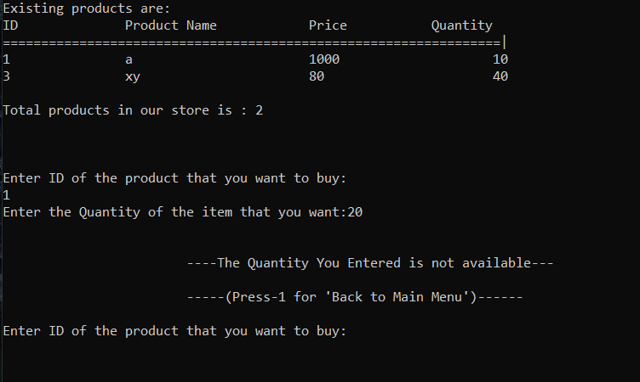
3.3. Deletion Of The Product

Slide 16
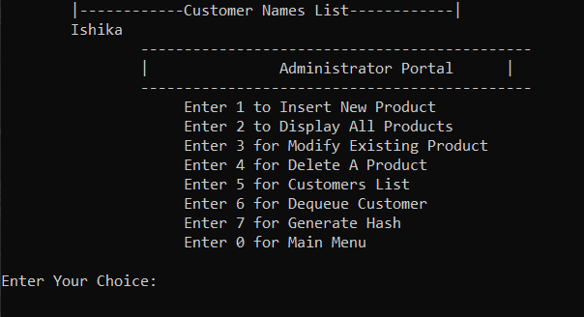
3.4. Displaying & Deleting Customer Names

Slide 17
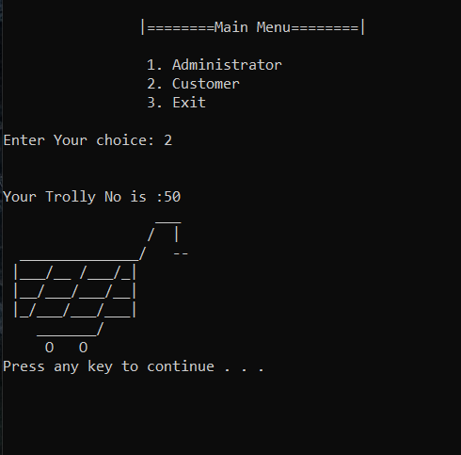
4. CUSTOMER PORTAL

Slide 18
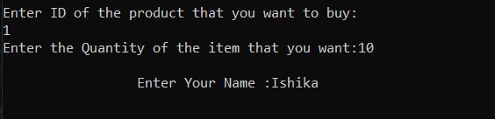
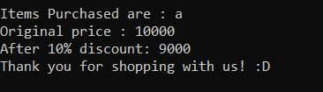
4.1. Purchasing Of The Item
Scenario 1: When the quantity entered is larger than the available quantity of the item.
Scenario 2: When the quantity entered is smaller or equal to the available quantity of the item.

Slide 19
Implementation:
Shopping Management System
Administrator
Portal
Customer
Portal
Exit
Through Linked List
Insert
Display
Modify
Delete
Display Customer Names
Delete Customer Name
Stack
Take Trolly
Purchase an Item
Add the name in the queue.
Program Terminates here
Array
Queue

Slide 20
Conclusion
Data Structures are the most basic yet an integral part of writing a code as it helps to maintain our data into various formats according to the requirement.

