Slide 1
Simple Study Group Finder Web Application
[Name]
[Date]
Notes:
Greetings. Today my presentation is referred as the Simple Study Group Finder Web Application. It is a complete web platform that facilitates the work of students through academics. The system also enables the users to enroll, follow their courses, find study groups and communicate. It illustrates the frontend development, backend implementation and organised software engineering.

Slide 2
Project Goal & Problem Statement
Problem
Students struggle to:
Find study partners in their courses (de Bie (2022)
Organize collaborative learning
Track academic study groups
Goal
Develop a web-based platform that:
Allows students to register
Track enrolled courses
Discover and join study groups
Communicate within groups
Notes:
Numerous students are unable to find study partners in their courses. There is disjointed communication that is not structured. The aim of the project was to create a central web platform, where students can interact due to their shared academic courses, create study groups, and enhance teamwork in a well-organised digital platform.

Slide 3
System Architecture
User
Frontend
HTML (Structure)
CSS (UI Styling)
Vanilla JavaScript (State Management & UI Rendering)
Backend
Node.js
Express Framework
REST API Endpoints (Herdiyatmoko, 2022)
In-memory database (users & groups arrays)
Browser (Frontend JS)
Express Server
In-Memory Data
Notes:
The architecture of the system is the client-server. Front end is developed with HTML, CSS and JavaScript and the backend is developed with node.js and Express. The front end is connected to REST API endpoints. The information is stored in memory temporarily. This segregation provides scalability and serviceability of the system architecture.

Slide 4
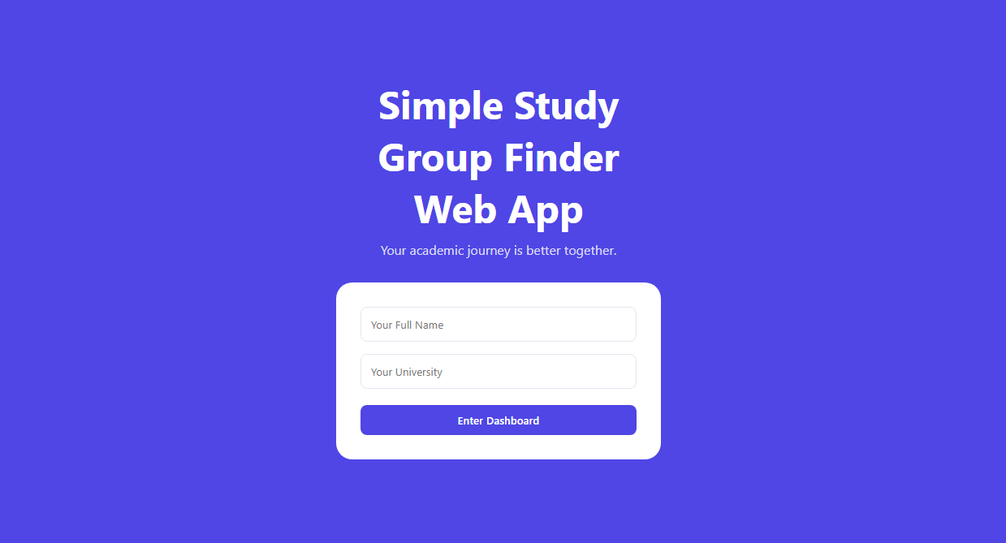
Modules / Building Blocks
Implemented Components
Module | Responsibility
Authentication | User login & profile initialization
Course Management | Add/remove enrolled courses
Group Marketplace | Discover & filter study groups
Group Creation | Publish new study groups
Join System | Join groups with validation
Messaging UI | Basic chat interface
Notes:
The application was categorised into distinct functional modules. These are authentication, course management, group discovery, group creation, the ability to join and messaging. The modules were implemented on their own and then combined. This non-integrity design enhances maintainability, easier debugging, and compliance with the principles of the structured software architecture.

Slide 5
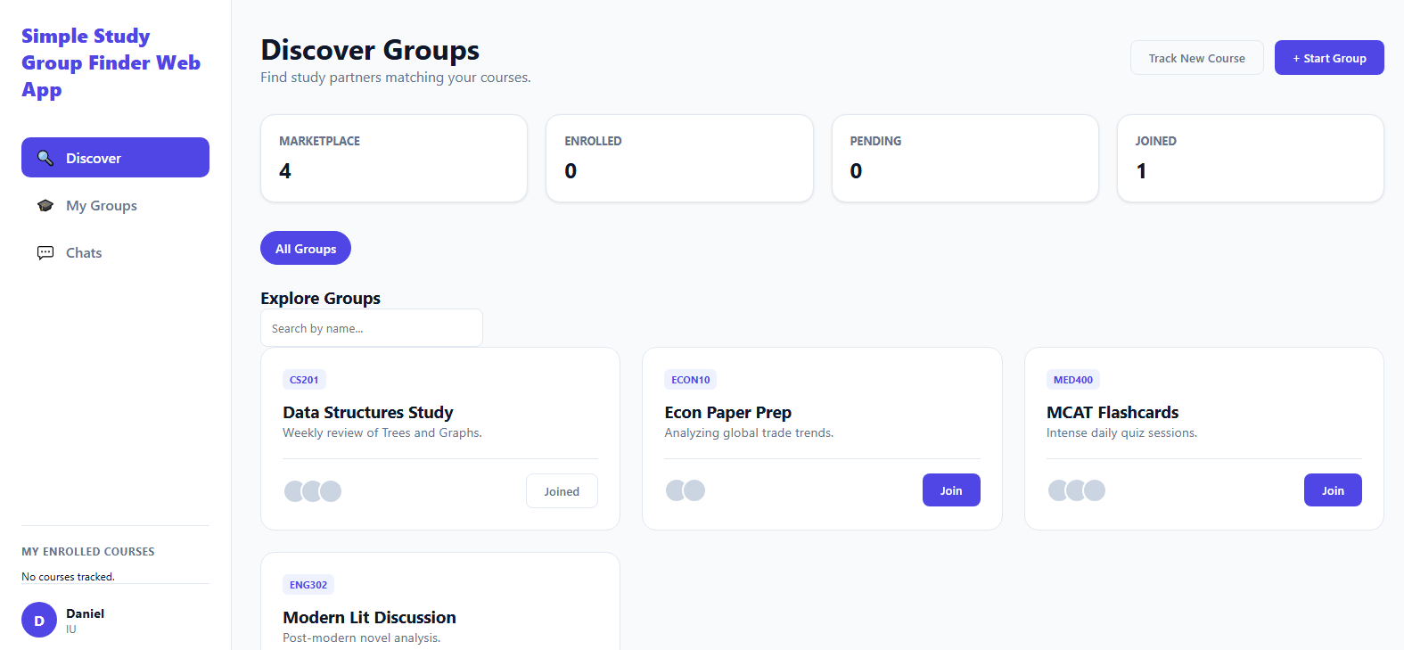
Frontend Design & UI
UI Structure
Sidebar Navigation (Discover / My Groups / Chats)
Dashboard Statistics Cards
Course Filter Ribbon
Group Card Grid Layout
Modal Windows (Create Group / Add Course)
Notes:
The user interface was put into a dashboard format with a sidebar. It contains statistics, filters, and card groups which are dynamic. Groups and course additions are made with the help of modals. Its design is centred on usability, clarity and responsiveness. JavaScript is dynamically loaded into the interface; it does not reload the page each time.

Slide 6
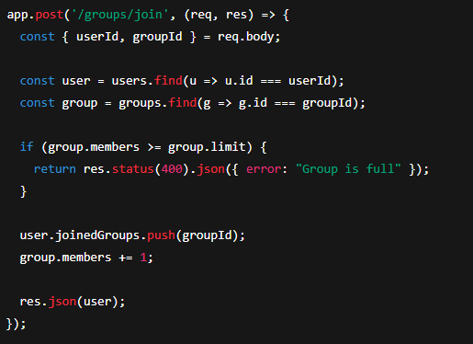
Backend Implementation
Key API Endpoints
Method | Endpoint | Purpose
POST | /login | User authentication
GET | /groups | Fetch all groups
POST | /groups | Create new group
POST | /groups/join | Join study group
POST | /course | Add course
POST | /course/remove | Remove course
This demonstrates:
  Validation logic
  Capacity check
  State update
Notes:
Express and organised REST endpoints were used to implement the backend. These terminals handle the logic of login, group retrieval, group creation and group joining. The validation will not allow users to be in full groups. The server stores users and groups in arrays, emulating a cheap database to development and test.

Slide 7
Development Phase (Reflection)
Framework & Tool Setup
Node.js runtime environment
Express.js for routing
Visual Studio Code
Git (Version control recommended) (Ponuthorai & Loeliger 2022)
Browser DevTools for debugging
Third-Party Libraries
Express
Body-parser
CORS
Rationale:
Lightweight
Easy REST implementation
Fast development cycle
Notes:
In the development stage, Node.js and express were set as the back end framework. The development environment was the Visual Studio Code. Third-party libraries were also chosen to facilitate the use of the JSON communication: CORS and body-parser. The reasons technology stack was selected is because it was simple, fast to implement and scale.

Slide 8
Design Decisions & Rationale
Important Decisions
Single Page Application structure
Faster user experience
No page reloads
In-memory database
Simplifies testing
Suitable for prototype
REST API structure
Clear separation of frontend & backend
Scalable for future database integration (Gowda & Gowda 2024)
Optimistic UI updates
Immediate feedback for join actions
Improved user experience
Notes:
Some major design choices were arrived at. One page design enhances ease of use. A database stored in memory makes prototyping easier. Good API design guarantees the clear separation of the frontend and backend. Optimistic UI is a feedback that gives the user immediate feedback. All the decisions were recorded and explained with references to the usability, scalability, and the scope of the project.

Slide 9
Testing & Risk Analysis
Performed Tests
Login validation (empty fields)
Course addition & removal
Group join validation
Group capacity restriction
UI state updates
Risks Identified
No persistent database
No authentication security
Chat is client-side only
Test Data
Predefined groups:
Group Name | Course | Members | Limit
Data Structures Study | CS201 | 4 | 6
Econ Paper Prep | ECON10 | 2 | 5
MCAT Flashcards | MED400 | 9 | 10
Notes:
The testing involved checking of the login, course management, joining of groups and testing of capacities. Simulated realistic scenarios were done with predefined test data. Lack of persistent storage, insufficient authentication security and non-real-time messaging are types of risks that have been identified. They were recognised and listed as points of future enhancement and expansion.

Slide 10
Reflection & Future Improvements
Reflection on Development Phase
Project goals achieved successfully
Core features implemented and tested
REST architecture working reliably
UI responsive and interactive
Improvement Opportunities
MongoDB database integration
Real-time chat with WebSockets (NANDAMURU, 2025)
Authentication with JWT
Image upload for group cards
Deployment to cloud server
Notes:
The development stage was able to convert the idea into a prototype. The application can meet the fundamental functional requirements. In the future, the database will be integrated, authenticated, made message-in-real-time, and published in a cloud server. The project has well organised implementation, documentation and reflection according to the principles of software engineering.

Slide 11
References
de Bie, A. (2022). Respectfully distrusting ‘Students as Partners’ practice in higher education: Applying a Mad politics of partnership. Teaching in Higher Education, 27(6), 717-737.
Gowda, P., & Gowda, A. N. (2024). Best Practices in REST API Design for Enhanced Scalability and Security. Journal of Artificial Intelligence, Machine Learning and Data Science, 2(1), 827-830.
Herdiyatmoko, H. F. (2022). Back-End System Design Based on Rest Api. Jurnal Tekinkom (Teknik Informasi dan Komputer), 5(1), 123-129.
NANDAMURU, A. P. (2025). REAL TIME WEB CHAT APPLICATION USING WEBSOCKETS IN DJANGO. Journal of Nonlinear Analysis and Optimization, 16(1).
Ponuthorai, P. K., & Loeliger, J. (2022). Version Control with Git. " O'Reilly Media, Inc.".

