Slide 1




Simple Study Group Finder Web Application
Ishika Bhuva
18.04.2026

Slide 2
Project Goal & Problem Statement
Problem
Students struggle to:
Find study partners in their courses (de Bie (2022)
Organize collaborative learning
Track academic study groups
Goal
Develop a web-based platform that:
Allows students to register
Track enrolled courses
Discover and join study groups
Communicate within groups

Slide 3

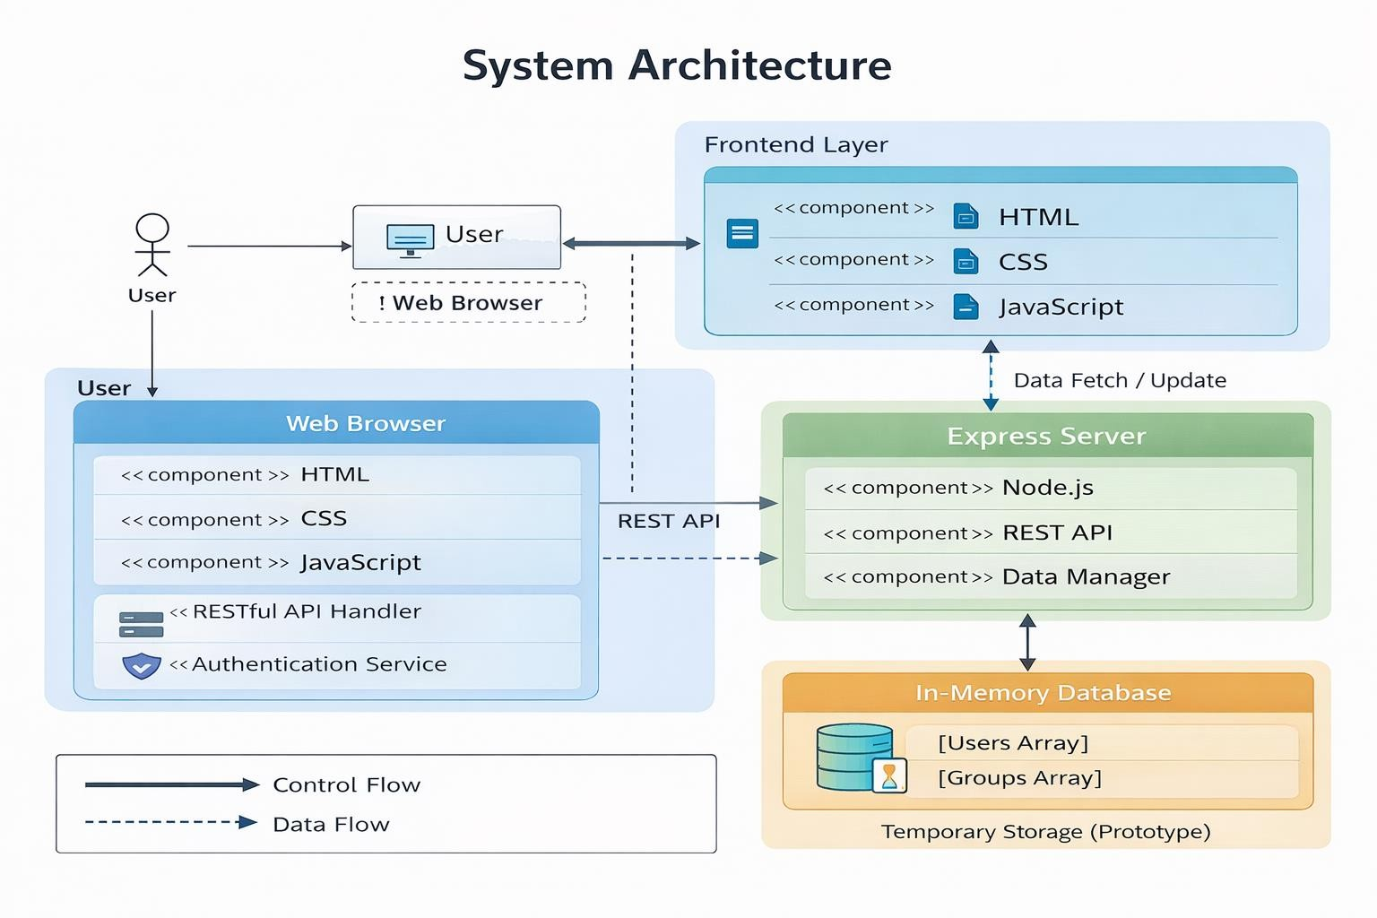
System Architecture
Fronten d
HTML (Structure)
CSS (UI Styling)
Vanilla JavaScript (State Management & UI Rendering)
Node.js
Express Framework
REST API Endpoints (Herdiyatmoko, 2022)
In-memory database (users & groups
arrays)
Backend

Slide 4
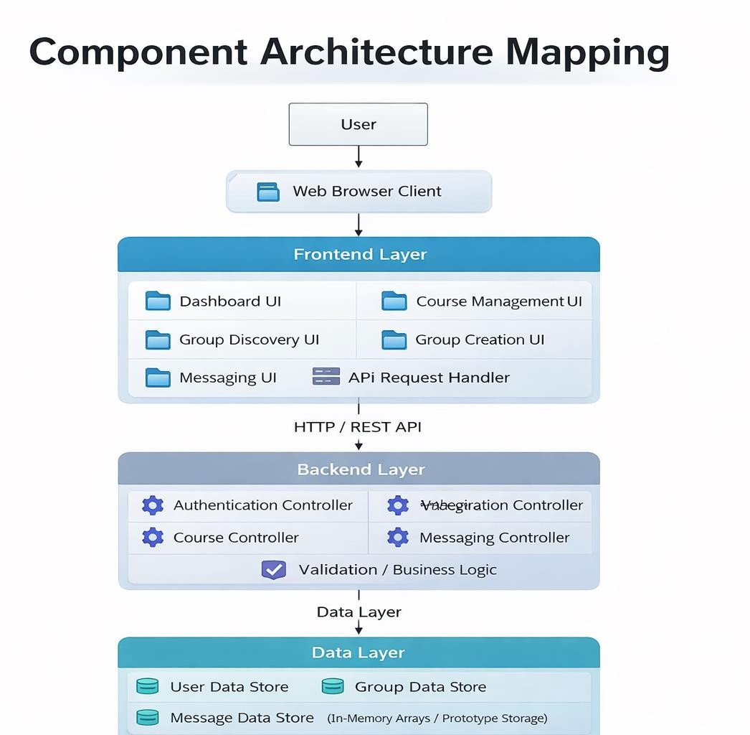
Modules / Building Blocks
Architecture Layer | Component | Responsibility
Frontend | UI Renderer | Displays dashboard, groups, and updates interface dynamically
Frontend | State Manager | Handles user input, course selection, and UI state updates
Frontend | API Handler | Sends HTTP requests to backend endpoints and processes responses
Backend | Express Server | Handles routing, processes requests, and manages application logic
Backend | Authentication Service | Validates user login and manages session-like behaviour
Backend | Group Service | Creates, retrieves, and manages study groups
Backend | Course Service | Handles course addition and removal operations
Data Layer | In-Memory Store | Temporarily stores users and groups using arrays
Data Layer | Data Access Logic | Performs read/write operations on in-memory data

Slide 5
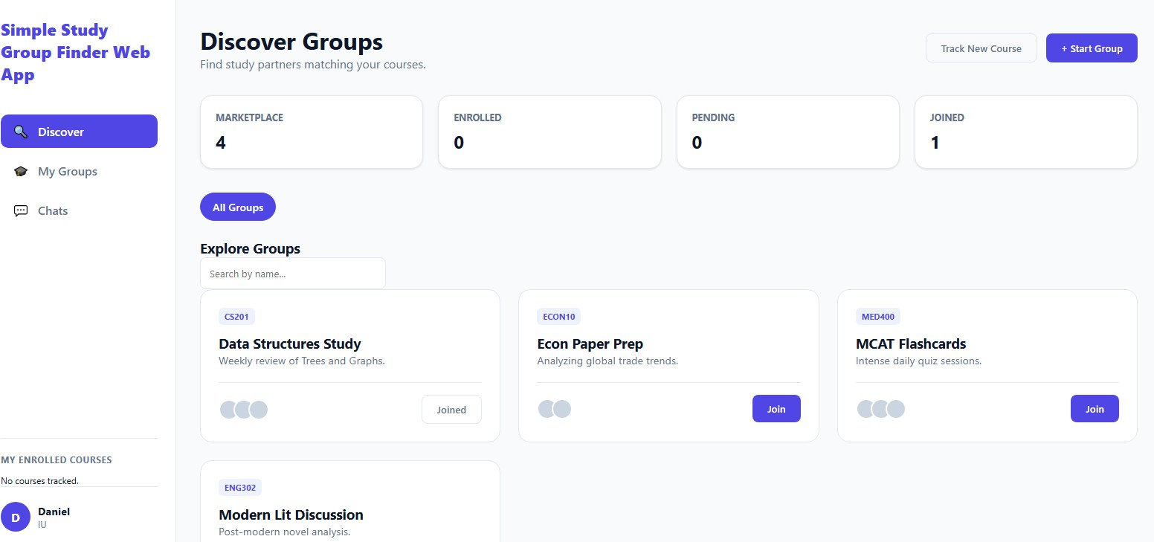
Frontend Design & UI
UI Structure
Sidebar Navigation (Discover / My Groups / Chats)
Dashboard Statistics Cards
Course Filter Ribbon
Group Card Grid Layout
Modal Windows (Create Group / Add Course)

Slide 6
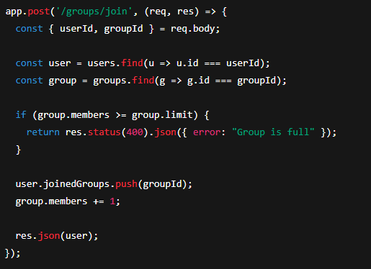
Backend Implementation
Key API Endpoints
Method | Endpoint | Purpose
POST | /login | User authentication
GET | /groups | Fetch all groups
POST | /groups | Create new group
POST | /groups/join | Join study group
POST | /course | Add course
POST | /course/remove | Remove course
This demonstrates:
Validation logic
Capacity check
State update

Slide 7
Development Phase (Reflection)
Node.js runtime environment
Express.js for routing
Framework & Tool Setup
Visual Studio Code
Git (Version control recommended) (Ponuthorai & Loeliger 2022)
Browser DevTools for debugging
Third-Party
Libraries
Express
Body-parser
CORS
Rationale:
Lightweight
Easy REST implementation
Fast development cycle

Slide 8
Design Decisions & Rationale
Important Decisions
Single Page Application structure
Faster user experience
No page reloads
In-memory database
Simplifies testing
Suitable for prototype
REST API structure
Clear separation of frontend & backend
Scalable for future database integration (Gowda & Gowda 2024)
Optimistic UI updates
Immediate feedback for join actions
Improved user experience

Slide 9
Testing & Risk Analysis
Test Data
Predefined groups:
Group Name | Course | Members | Limit
Data Structures Study | CS201 | 4 | 6
Econ Paper Prep | ECON10 | 2 | 5
MCAT Flashcards | MED400 | 9 | 10
Login validation (empty fields)
Course addition & removal
Group join validation
Group capacity restriction
UI state updates
Performed
Tests
No persistent database
No authentication security
Chat is client-side only
Risks
Identified

Slide 10
Project Risks & Mitigation
Risk Category | Description | Impact | Mitigation Strategy
Data Loss Risk | No database; all data stored temporarily in memory | High | Integrate MongoDB or SQL database for persistent and reliable data storage
Security Risk | No secure authentication or encryption implemented | High | Implement JWT authentication, password hashing, and HTTPS protocols
Scalability Risk | System cannot handle increased users or large datasets | Medium–High | Deploy scalable cloud infrastructure and replace in-memory storage with database
Performance Risk | API response time may degrade with increased load | Medium | Optimize backend logic and introduce caching mechanisms
Usability Risk | Lack of real-time chat reduces user engagement | Medium | Implement WebSockets for real-time communication functionality
Data Loss Risk
Lack of persistent storage may result in permanent loss of user data and groups Security
Vulnerability Risk
Weak authentication mechanisms can expose user accounts and sensitive platform interactions Scalability
Performance Risk
In-memory data storage limits system performance when handling large numbers of users

Slide 11
System Requirements Specification
Requirement Type | Requirement | Description
Functional | User Registration | Users must be able to create accounts and log into the platform securely
Functional | Course Management | Users can add or remove enrolled courses for personalised group discovery
Functional | Group Discovery | System should display available study groups based on selected courses
Functional | Group Creation | Users must be able to create new study groups with defined capacity limits
Functional | Group Joining | Users can join groups with validation checks such as maximum capacity
Functional | Messaging | Users should communicate within groups through a basic chat interface
Non-Functional | Performance | System should respond to user requests within acceptable time under normal load
Non-Functional | Scalability | Architecture should support future integration with databases and increased users
Non-Functional | Security | User data must be protected using authentication and secure communication protocols
Non-Functional | Usability | Interface should be simple, intuitive, and easy to navigate for all users
Non-Functional | Reliability | System should operate consistently without crashes during standard operations
Constraint | Storage Limitation | Data is stored temporarily in memory, not persisted across sessions
Constraint | Authentication Limitation | Basic login implemented without advanced security mechanisms like JWT
Constraint | Communication Limitation | Messaging is not real-time and lacks WebSocket-based implementation
Functional Requirements
System must support user registration, course tracking, group creation, joining, and messaging features
Non-Functional Requirements
System should ensure performance, scalability, security, usability, and reliability under normal usage conditions
System Constraints
Prototype limitations include in- memory storage, no real-time communication, and basic authentication mechanisms

Slide 12
Reflection & Future Improvements
Project goals achieved successfully
Core features implemented and tested
REST architecture working reliably
UI responsive and interactive
Reflection on Development Phase
MongoDB database integration
Real-time chat with WebSockets (NANDAMURU, 2025)
Authentication with JWT
Image upload for group cards
Deployment to cloud server
Improvement Opportunities

Slide 13

References
de Bie, A. (2022). Respectfully distrusting ‘Students as Partners’ practice in higher education: Applying a Mad politics of partnership. Teaching in Higher Education, 27(6), 717-737.
Gowda, P., & Gowda, A. N. (2024). Best Practices in REST API Design for Enhanced Scalability and Security. Journal of Artificial Intelligence, Machine Learning and Data Science, 2(1), 827-830.
Herdiyatmoko, H. F. (2022). Back-End System Design Based on Rest Api. Jurnal Tekinkom (Teknik Informasi dan Komputer), 5(1), 123-129.
NANDAMURU, A. P. (2025). REAL TIME WEB CHAT APPLICATION USING
WEBSOCKETS IN DJANGO. Journal of Nonlinear Analysis and Optimization, 16(1).
Ponuthorai, P. K., & Loeliger, J. (2022). Version Control with Git. " O'Reilly Media, Inc.".

