Slide 1

Bin packing problem
CSE462 - ALGORITHM ENGINEERING SESSIONAL
Presented By
1805071
1805081
1805092
1805114
1805118

Slide 2
Problem definition

Slide 3
The bin packing problem is an optimization problem that aims to efficiently pack a set of items with varying weights (sizes) into a minimum number of identical bins with a fixed capacity.
Given:
A set of items (N) with their respective weights (w_i)
A set of bins (B) with a fixed capacity (c)
Goal:
Assign each item to one bin, ensuring the total weight of all items in a bin never exceeds its capacity. The objective is to minimize the total number of used bins.

Slide 4
Problem formulation

Slide 5
Sets:
N: Set of items (1, 2, ..., n)
B: Set of bins (1, 2, ..., b)
Parameters:
c: Capacity of each bin
w_i: Weight (size) of item i (where i ∈ N)
Decision Variables:
x_ij: Binary variable that takes a value of 1 if item i is assigned to bin j, and 0 otherwise (i ∈ N, j ∈ B)

Slide 6
Objective Function:
Minimize: ∑_(j ∈ B) 1 (Minimize the number of used bins)
Constraints:
Capacity constraint: The total weight of items assigned to any bin cannot exceed its capacity.
∑_(i ∈ N) w_i * x_ij ≤ c (for all j ∈ B)
Each item is assigned to one bin:
∑_(j ∈ B) x_ij = 1 (for all i ∈ N)
Item assignment: x_ij can only be 0 or 1.
x_ij ∈ {0, 1} (for all i ∈ N, j ∈ B)

Slide 7
Types of Bin Packing Algorithms

Slide 8
1. First Fit (FF):
Iterates through items in arbitrary order.
Places each item in the first available bin that has enough space.
Simple and efficient, but can lead to internal fragmentation (wasted space in partially filled bins) towards the end of the process.
2. Next Fit (NF):
Similar to First Fit, but starts searching from the last utilized bin instead of the beginning.
Helps avoid internal fragmentation to some extent compared to FF.
Can still lead to suboptimal solutions in some cases.

Slide 9
3. Best Fit (BF):
Scans through all remaining bins and chooses the one with the tightest fit (smallest remaining capacity) for the current item.
Aims to minimize wasted space within bins.
Can be computationally more expensive than FF and NF due to searching all remaining bins.
4. First Fit Decreasing (FFD):
Sorts items in descending order of size before applying the First Fit algorithm.
This prioritizes placing larger items first, potentially leading to better utilization of bin space and fewer overall bins used.
Adds a sorting step, increasing the overall time complexity.

Slide 10
5. Best Fit Decreasing (BFD):
Similar to Best Fit, but also sorts items in descending order of size beforehand.
Combines the advantages of best fit (minimizing wasted space) with the benefit of prioritizing larger items, potentially leading to more efficient packing than regular Best Fit.
Like FFD, introduces an additional sorting step increasing complexity.

Slide 11
Real-Life Bin Packing Algorithm Applications
CSE462 - ALGORITHM ENGINEERING SESSIONAL

Slide 12
Application: Logistics and Transportation
Bin Packing Problem (BPP): In cargo loading, the BPP involves fitting items into containers or pallets efficiently. The goal is to minimize the number of containers used while maximizing space utilization.

Slide 13
Application: Logistics and Transportation(contd.)
Some real-world examples from logistics companies that use bin packing for cargo loading:
FedEx
DHL
UPS

Slide 14
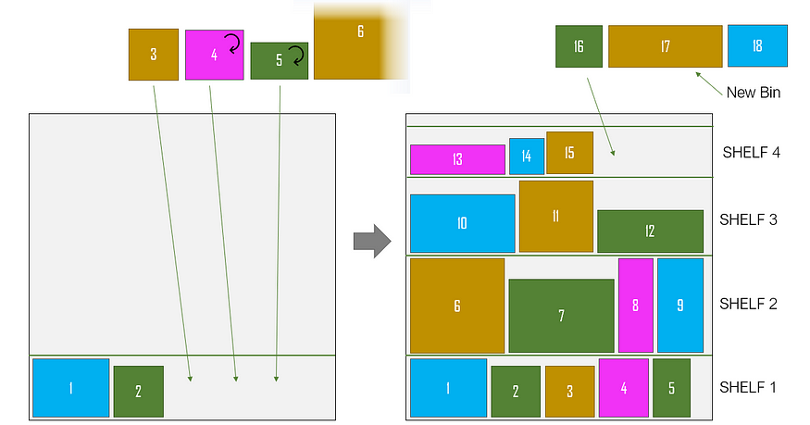
Application: Logistics and Transportation(contd.)

Slide 15
Application in Cloud Computing
Utilization of bin packing for resource allocation
Fit virtual machines (VMs) into physical machines (PMs) with fixed capacities.
Goal: Minimize the number of PMs used while maximizing PM utilization.

Slide 16

Application in Cloud Computing
Infrastructure Available → Bins
Client Requests → Objects

Slide 17
Application in Memory Management in Operating Systems
Memory management involves allocating resources to processes efficiently.
Goal: Meet the diverse demands of different processes while minimizing overhead

Slide 18
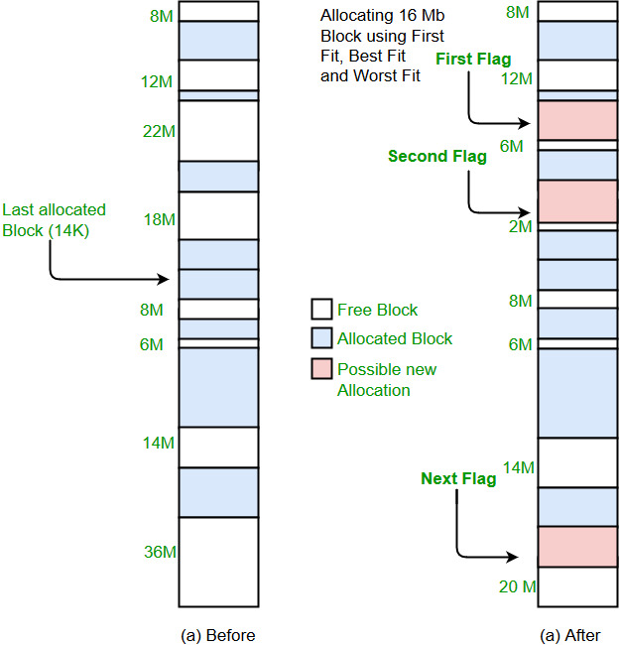
Using Best Fit Algorithm in Memory Management

Slide 19
Application in Time Scheduling and Task Assignment
Imagine a puzzle where we need to allocate tasks to resources over a specified time horizon.
The challenge: Finding the best way to do this efficiently.

Slide 20
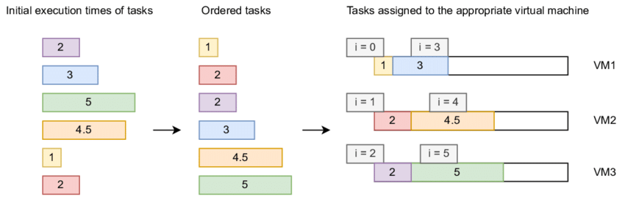
Application in Time Scheduling and Task Assignment

Slide 21
Hardness of the problem

Slide 22
NP- hard
The bin packing problem is known to be NP-hard because of its inherit computational complexity.
Here are the reasons why bin packing problem falls under NP hard :

Slide 23
The difficulty of bin packing arises from the vast number of possible configurations to consider when assigning items to bins. Here's why it's challenging:
Multiple solutions: There can be many valid ways to pack the items into a minimum number of bins. Finding the absolute optimal solution becomes increasingly difficult as the number of items grows.
Exponential growth: The number of potential configurations grows exponentially with the number of items. Checking all possibilities becomes computationally infeasible for larger datasets.
Greedy vs. Optimal: Greedy algorithms like First-Fit or Best-Fit can often find good (but not necessarily optimal) solutions quickly. However, guaranteeing the optimal solution requires exploring a massive search space, leading to NP-hardness.
However Approximation algorithms and heuristics offer practical solutions for real-world scenarios, achieving near-optimal results with reasonable efficiency.

Slide 24
First fit Algorithm

Slide 25
First Fit Algorithm
The items are placed in the order they are given, without any sorting.
It places the items in the first available bin sequentially until it can no longer accommodate any more items.
If there is not enough space for an item in the current bin, it starts a new bin and continues the process.

Slide 26
First Fit Algorithm - Example
0.5, 0.7, 0.5 , 0.2 , 0.4, 0.2, 0.5, 0.1 , 0.6
M=1
0.5

Slide 27
First Fit Algorithm - Example
0.5, 0.7, 0.5 , 0.2 , 0.4, 0.2, 0.5, 0.1 , 0.6
M=1
0.7
0.5

Slide 28
First Fit Algorithm - Example
0.5, 0.7, 0.5 , 0.2 , 0.4, 0.2, 0.5, 0.1 , 0.6
0.5
M=1
0.7
0.5

Slide 29
First Fit Algorithm - Example
0.5, 0.7, 0.5 , 0.2 , 0.4, 0.2, 0.5, 0.1 , 0.6
0.5
M=1
0.2
0.7
0.5

Slide 30
First Fit Algorithm - Example
0.5, 0.7, 0.5 , 0.2 , 0.4, 0.2, 0.5, 0.1 , 0.6
1
0.5
0.2
0.7
0.5
0.4

Slide 31
First Fit Algorithm - Example
0.5, 0.7, 0.5 , 0.2 , 0.4, 0.2, 0.5, 0.1 , 0.6
1
0.5
0.2
0.7
0.5
0.2
0.4

Slide 32
First Fit Algorithm - Example
0.5, 0.7, 0.5 , 0.2 , 0.4, 0.2, 0.5, 0.1 , 0.6
1
0.5
0.2
0.7
0.5
0.2
0.5
0.4

Slide 33
First Fit Algorithm - Example
0.5, 0.7, 0.5 , 0.2 , 0.4, 0.2, 0.5, 0.1 , 0.6
1
0.5
0.1
0.2
0.7
0.5
0.2
0.5
0.4

Slide 34
First Fit Algorithm - Example
0.5, 0.7, 0.5 , 0.2 , 0.4, 0.2, 0.5, 0.1 , 0.6
1
0.5
0.1
0.2
0.7
0.5
0.2
0.5
0.6
0.4
Total Bin Number = 5

Slide 35
def firstFit(weight, n, c):
# Initialize result (Count of bins)
res = 0
# Create an array to store remaining space in bins
# there can be at most n bins
bin_rem = [0]*n
# Place items one by one
for i in range(n):
# Find the first bin that can accommodate
# weight[i]
j = 0
while( j < res):
if (bin_rem[j] >= weight[i]):
bin_rem[j] = bin_rem[j] - weight[i]
break
j+=1
# If no bin could accommodate weight[i]
if (j == res):
bin_rem[res] = c - weight[i]
res= res+1
return res

Slide 36
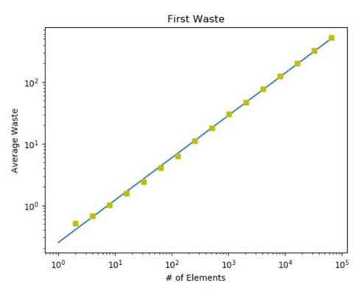
complexity
This greedy algorithm attempts to pack values in the first available bin, restarting its search at the beginning of the bin sequence for each value to be packed.
The running time is O(n*n) because worst case there will be no room for any values and will either be placed in the final bin or create a new one.
While this algorithm is much slower, it generates much less waste. The slope of the regression line for this algorithm is 0.008, with a y-intercept of 0.0041, resulting in the function W(A) = 0.008*n + 0.0041 for this algorithm.
The space needed to store the input items and bins is O(n + m), where n is the number of items, and m is the number of bins. This is because we need space to store the sizes of n items and the capacities of m bins.

Slide 37
It is important to note that the number of bins used by the algorithm will never use more than twice the optimal number of bins.
It is not possible for more than two bins to at most half full at any point in time, because those values would be packed together. This means that out of B bins, at least B-1 are more than half full, providing us with our optimal bounds for the algorithm.

Slide 38
First-Fit finds a 2OPT solution
OPT: # bins used in the optimal solution.
Proof:
- Suppose that First-Fit uses m bins
- Then, at least ( m-1) bins are more than half full.
-• We never have two bins less than half full.
-If there are two bins less than half full, items in the second bin can be substituted into the first bin by First-Fit.

Slide 39
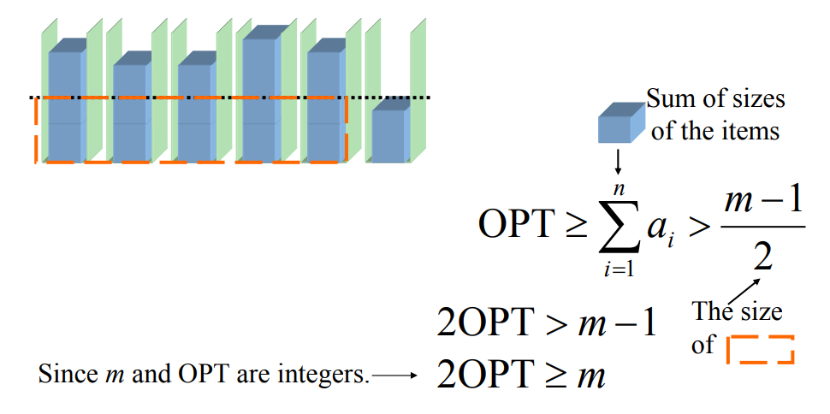
And so the approximation factor of first-fit is 2.

Slide 40
Best Fit Decreasing

Slide 41
The Best Fit Decreasing (BFD) algorithm is a heuristic algorithm used in the bin packing problem, which aims to efficiently allocate a set of items into a fixed number of bins with minimal wasted space.
The "decreasing" aspect comes from sorting the items in non-increasing order of size before applying the Best Fit algorithm.
By combining the benefits of both approaches, it typically achieves even better results in terms of the number of bins used.

Slide 42
Here's a step-by-step explanation of the Best Fit Decreasing algorithm:
Sort Items: Sort the items in non-increasing order of size. This step is crucial for the "decreasing" variant.
Initialize Bins: Start with an given set of bins.
Iterate Through Items: For each item in the sorted list:
Find the bin with the smallest remaining capacity that can accommodate the current item. If multiple bins have the same smallest capacity, choose the one that was created first.
If there is no such bin, create a new bin and place the item in it.
Repeat: Continue this process until all items are placed.

Slide 43
Best Fit Decreasing Algorithm - Example
The waste size randomly: 0.5, 0.7, 0.5, 0.2, 0.4, 0.2, 0.5, 0.1, 0.6
After sorting the waste size: 0.7,0.6,0.5,0.5,0.5,0.4,0.2,0.2,0.1
M=1
0.7

Slide 44
Best Fit Decreasing Algorithm - Example
0.7,0.6,0.5,0.5,0.5,0.4,0.2,0.2,0.1
M=1
0.7
0.6

Slide 45
Best Fit Decreasing Algorithm - Example
0.7, 0.6,0.5,0.5,0.5,0.4,0.2,0.2,0.1
M=1
0.7
0.6
0.5

Slide 46
Best Fit Decreasing Algorithm - Example
0.7, 0.6, 0.5, 0.5,0.5,0.4,0.2,0.2,0.1
0.5
M=1
0.7
0.6
0.5

Slide 47
Best Fit Decreasing Algorithm - Example
0.7, 0.6, 0.5, 0.5,0.5,0.4,0.2,0.2,0.1
0.5
M=1
0.7
0.6
0.5
0.5

Slide 48
Best Fit Decreasing Algorithm - Example
0.7, 0.6, 0.5, 0.5, 0.5,0.4,0.2,0.2,0.1
0.4
0.5
M=1
0.7
0.6
0.5
0.5

Slide 49
Best Fit Decreasing Algorithm - Example
0.7, 0.6, 0.5, 0.5, 0.5, 0.4,0.2,0.2,0.1
0.2
0.4
0.5
M=1
0.7
0.6
0.5
0.5

Slide 50
Best Fit Decreasing Algorithm - Example
0.7, 0.6, 0.5, 0.5, 0.5, 0.5, 0.2,0.2,0.1
0.4
0.5
0.5
M=1
0.2
0.6
0.2
0.7
0.5
0.5

Slide 51
Best Fit Decreasing Algorithm - Example
0.7, 0.6, 0.5, 0.5, 0.5, 0.5, 0.2, 0.2,0.1
0.1
0.4
0.5
0.5
M=1
0.2
0.6
0.2
0.7
0.5
0.5
Total Bin Number = 4

Slide 52
def best_fit_decreasing(items, bin_capacity):
# Sort items in decreasing order
items.sort(reverse=True)
# Initialize empty bins
bins = []
# Loop through each item
for item in items:
found_bin = False
# Iterate through existing bins
for bin in bins:
# Check if item fits in the current bin
if item <= bin_capacity - sum(bin):
bin.append(item)
found_bin = True
break
# If no existing bin fits the item, create a new bin
if not found_bin:
bins.append([item])
return bins

Slide 53
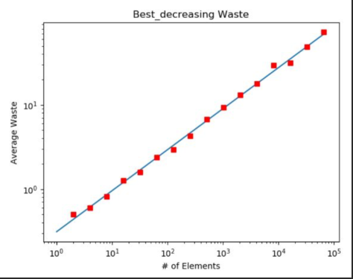
Complexity
Sorting the items in non-increasing order of size is typically done using efficient sorting algorithms like quicksort or merge sort. The time complexity for sorting a list of n items is O(n log n).
After sorting, the algorithm iterates through the sorted list once, attempting to place each item into the bins. In the worst case, each iteration may involve checking each bin, resulting in a time complexity of O(n) for the iteration. Therefore, the overall time complexity of the First Fit Decreasing algorithm is dominated by the sorting step, making it O(n log n), where n is the number of items.
This version of the algorithm performs much better with a waste function of W(A) = 0.0011*n + 0.5. This is because the algorithm deals with all of the largest values first and then can more efficiently pack in the smaller values that will follow. Once the algorithm reaches values of half the bin capacity size, it can start packing those values into already created bins. This “order of operations” makes the packing much less wasteful
. The space needed to store the input items and bins is O(n + m), where n is the number of items, and m is the number of bins. This is because we need space to store the sizes of n items and the capacities of m bins.

Slide 54
Comparison of the two algorithms
CSE462 - ALGORITHM ENGINEERING SESSIONAL

Slide 55
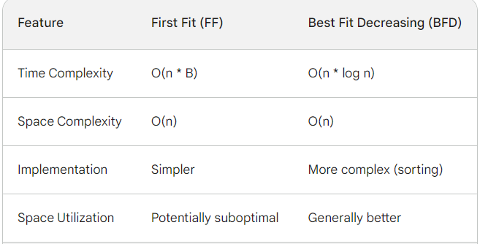

Slide 56
Time Complexity:
FF iterates through items one by one, placing each item in the first bin that can accommodate it. This worst-case complexity is O(n * B), where n is the number of items and B is the number of bins used.
BFD sorts the items in descending order first, then iterates through them, placing each item in the bin with the least remaining capacity that can hold it. This sorting step adds a log n term, resulting in a total complexity of O(n * log n), which is generally lower than FF's for larger datasets.
Space Complexity:
Both algorithms use similar space complexity, O(n), to store information about the items and potentially the bins used.

Slide 57
Implementation:
FF is generally simpler to implement due to its straightforward iteration process.
BFD requires additional complexity for sorting the items before bin packing.
Space Utilization:
FF might not always utilize the available bin capacity optimally.
BFD generally leads to better space utilization by placing items in bins with less remaining capacity, potentially reducing the total number of bins needed.

Slide 58
Choice Between FF and BFD:
The choice between FF and BFD depends on the specific requirements of your application:
For large datasets or applications where performance is critical, BFD is generally the better choice due to its lower time complexity.
For simple implementations or situations where space utilization is not a major concern, FF might be sufficient.

Slide 59
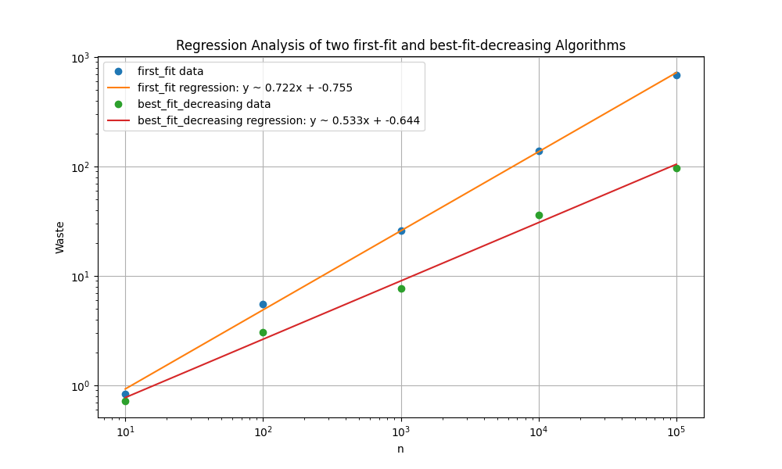
Best Fit Decreasing and First Fit Decreasing both perform at the nearly same level with identical regression slopes.
First Fit performs fairly well and put a good attempt towards keeping up with its decreasing counterpart.

Slide 60
THANK YOU

