Slide 1
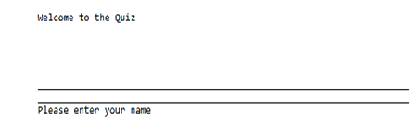
Quiz
Submitted to :-
Department:- Training and Placement
Faculty :- Ram Babu Lovewanshi
Submitted By :-
Name :- Ishika Srivastava
Enrollment No :- 0176EC181009
Branch :- EC
Semster :- V

Slide 2
DECLARATION
We hereby declare that this project of “Quick Accounting ” has not been copied from anywhere but designed & developed by us through the help of our college faculties for which we are very thankful of them.
Student Name: Ishika Srivastava
Enrollment No: 0176EC181009

Slide 3
INDEX
History
In Present system
My system
Introduction of the Project
Objective
Requirement
Code::Blocks 20.03
Introduction Page
Report
Limitations
Future Enhancement
Conclusion

Slide 4
HISTORY
Earlier if we had to check somebody’s knowledge on anything may it be general knowledge or any particular subject knowledge what we had to do is we had to prepare questions then get them written on the blackboard for the students to read and write down their answers after this the faculty had to calculate the total marks obtained which was both time consuming ad error prone as the results were calculated by normal humans which can make mistakes

Slide 5
IN PRESENT
In present with the help of this Quiz Application we are trying to reduce the manual work, trying to make the task of faculties simple and making it error free. In this application we just have to upload the questions then it does the entire process of asking the questions and calculating the total marks within seconds and displays you the final result.
It also stores the questions which were being asked what were the wrong answers given by the student and which were the right ones.

Slide 6
MY SYSTEM
In the existing system user just has to upload questions in the file along with its options and the right answer. The pattern in which the questions is asked will be taken care of by the application jotting down the right answers and wrong answers and the final marks obtained will be taken care of by the system.

Slide 7
INTRODUCTION OF THE PROJECT
In this quiz game, questions are chosen in such a way that they cover all fields of a typical quiz contest . Here we have used two files, one file contains the questions asked in the quiz along with their correct answers while the second file contains the questions asked the answer entered by the user and it also shows whether the entered answer is correct or not and if wrong then what is the correct answer. Here, in this quiz I have allotted 4 marks for each question and the total number of questions asked will be 10. There will be no negative marking for the wrong answers. We cannot leave any question unanswered and if in case we input any other option other than the available ones then while displaying the options entered it shows blank on the wrong options.

Slide 8
OBJECTIVE
The main objective of this Quiz is to test one’s basic general knowledge about different things in the world. We can also change the questions if we want to make a programming language quiz or subject wise quiz which covers questions from all corners of the subject. It has no limited number of attempts user can attempt any number of times he / she wants. Here we are using another file for keeping the track of questions which were asked during the quiz and the answers given to those questions. We have a separate file for the quiz questions and we have used it in our main program by using File Handling.

Slide 9
REQUIREMENT
SOFTWARE REQUIREMENTS SPECIFICATION
Operating System : Windows 10 Pro
Programming Language : C
Database : Another File
HARDWARE REQUIREMENTS SPECIFICATION
Processor : Intel® Core™ i3
RAM : Minimum of 1GB RAM
Memory : 200 MB or higher

Slide 10
Code::Blocks 20.03
Code::Blocks is a free C, C++ and Fortran IDE built to meet the most demanding needs of its users. It is designed to be very extensible and fully configurable.
Finally, an IDE with all the features you need, having a consistent look, feel and operation across platforms.
Features
Open Source! GPLv3, no hidden costs.
Cross-platform. Runs on Linux, Mac, Windows (uses wxWidgets).
Written in C++. No interpreted languages or proprietary libs needed.
Extensible through plugins

Slide 11
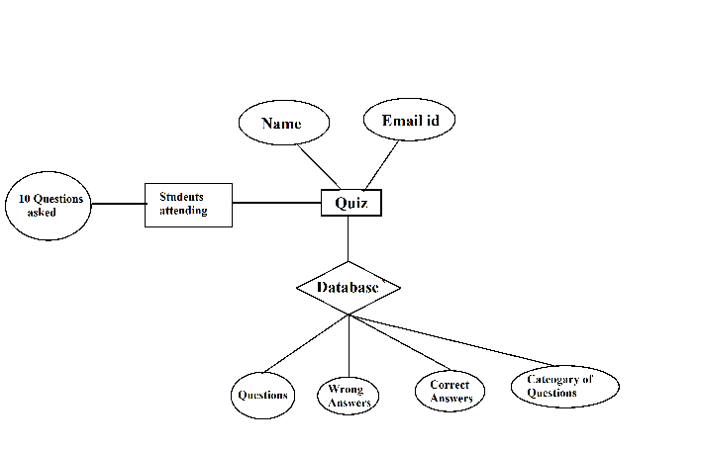
ER - Diagram

Slide 12
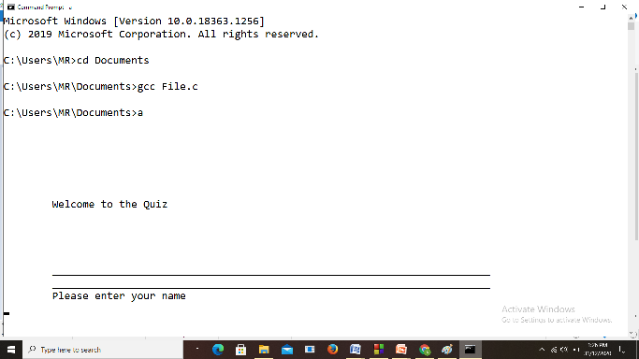
Introduction page

Slide 13
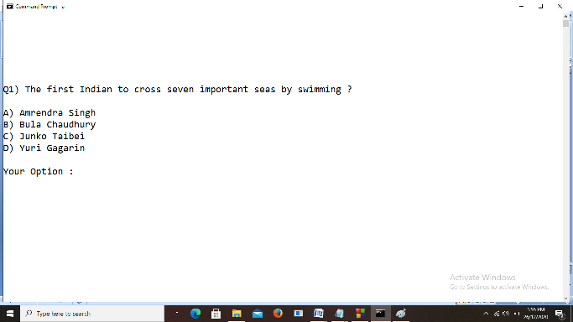
Questions

Slide 14

Answering Format

Slide 15
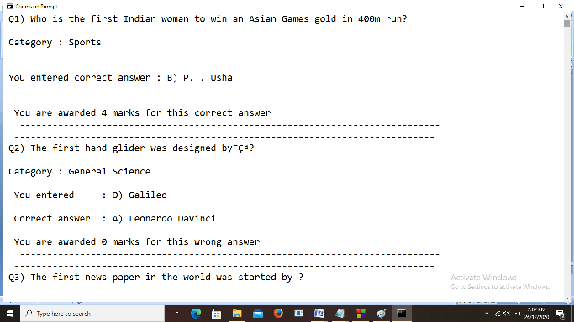
Result Format

Slide 16
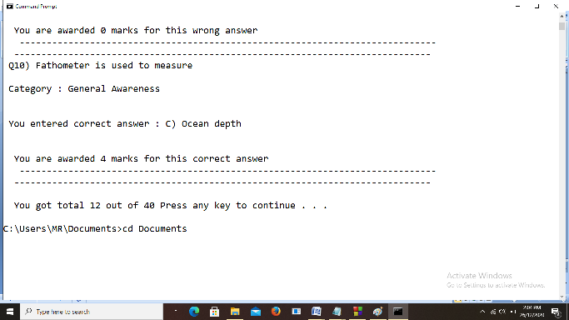
Total Marks Format

Slide 17
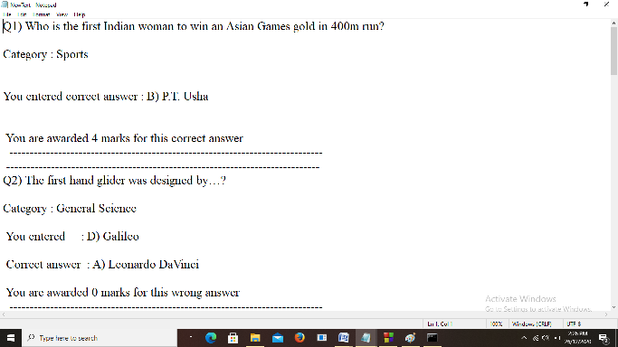
Database of Questions

Slide 18
Limitations
In this project the questions stored in the database file changes as soon as a new quiz starts.
A user can attempt the quiz any number of times which is a big disadvantage while using this system in institutions.

Slide 19
FUTURE ENHANCEMENT
The Quiz Application can be enhanced in the future in different kinds of ways such as:
By changing the language we can make this quiz an online application and store its entries in database using My Sql and other platforms.

Slide 20
Conclusion
This project is made to test user’s general knowledge on basis of different questions asked from various subjects. This makes it easy for both the examiner and the examine as it avoids the pen paper mode and reduces manual work.

