Slide 1
Problem Statement
Expense and Income Management System
Many individuals and businesses struggle with financial management due to inefficient tracking of income and expenses. Manual processes often result in errors, loss of data, and poor financial decision-making. This project aims to develop an automated PL/SQL-based Oracle database solution to improve financial tracking and reporting.
HABIMANA ISHIMWE Diane

Slide 2
Context & Users:
Individuals managing personal finances
Small businesses & startups tracking cash flow
Financial managers & accountants ensuring accurate reporting.
Project Goals:
Automate financial record-keeping with PL/SQL
Enhance data integrity & security using exception handling
Provide real-time reports for financial insights
Expected Benefits:
Efficiency: Reduces manual tracking & errors
Security: Ensures data protection & validation
Insights: Provides meaningful financial analytics
Scalability: Can be expanded for advanced financial applications.
Outcome:
A fully functional PL/SQL-based Oracle database system that helps users efficiently track, manage, and analyze their income and expenses.
Database Entities:
Users – Stores user information (Admin, Accountant, Manager, Financer)
Transactions – Records income and expense details
Categories – Classifies transactions (e.g., rent, salary, groceries)
Budgets – Helps set spending limits
Reports – Generates financial summaries

Slide 3
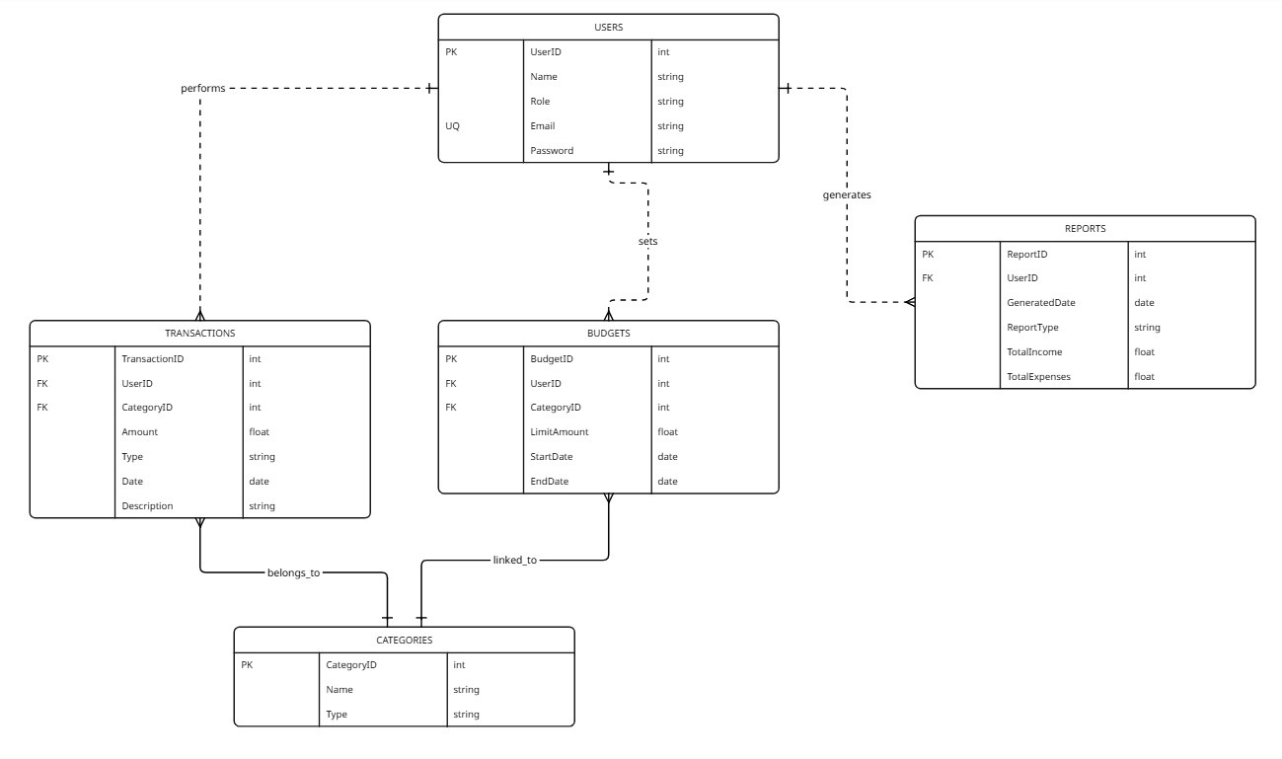
Database Design & Entity Relationships

