Slide 1
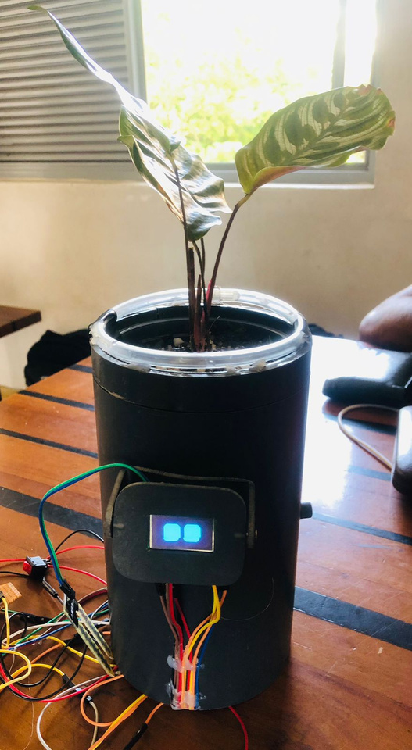
Smart Flower Pot
Name : P.I.D.De Silva
Index No : AS2021914

Slide 2
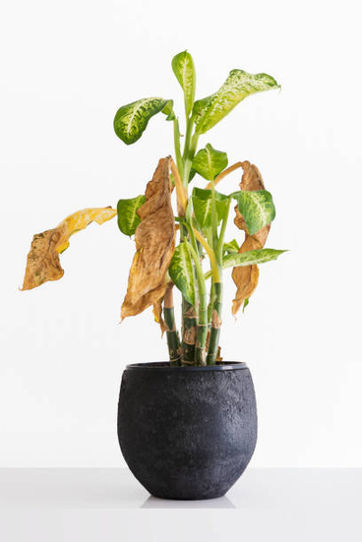
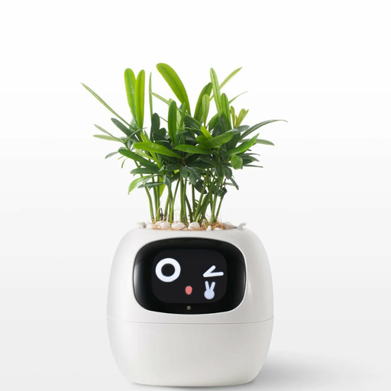
Why choose a Smart Flower Pot
Imagine a world where your plants thrive effortlessly , cared for by a smart companion that not only nurtures them but also brings you peace and joy !!

Slide 3
Project Overview
Hardware Components.
2.Using Software.
3.Functions
Functional Requirements
Non-functional Requirements

Slide 4
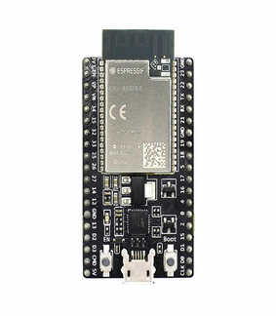
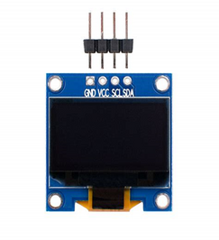
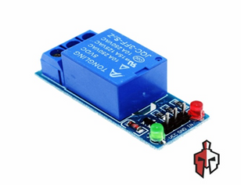
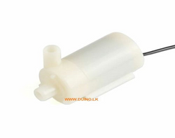
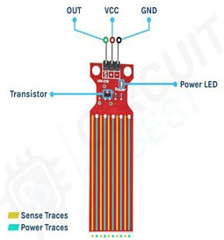
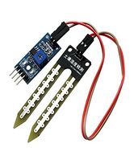
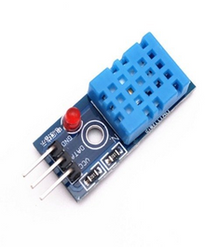
hardware components
Microcontroller.
OLED Screen.
Relay Module.
Water Pump.
Soil Moisture Sensor.
DHT11 Sensor.
Water Level Sensor.

Slide 5

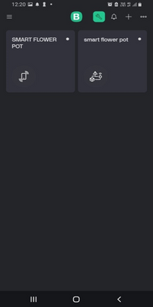
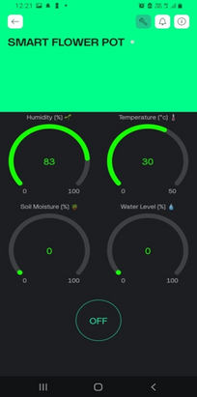
Using Software
Arduino IDE
BLYNK IOT Platform

Slide 6
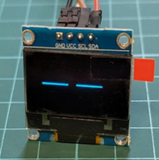
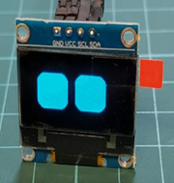
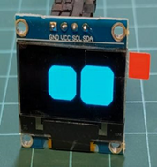
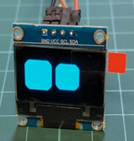
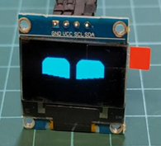
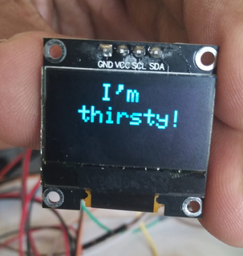
Unique Features
What makes this project unique is its focus not just on functionality but also on user engagement. The OLED display provides real-time updates and animations that make the experience more personal, offering mental relaxation and companionship..

Slide 7
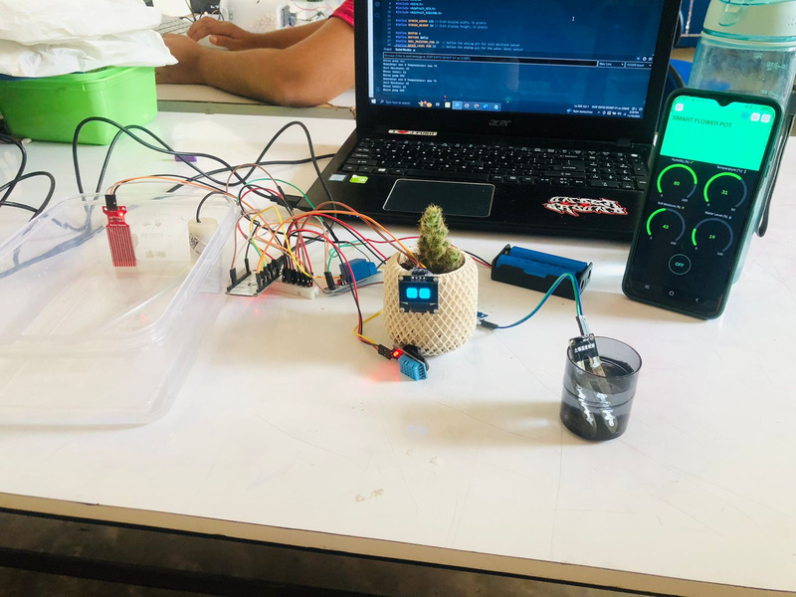
Functions
Functional Requirements
Soil Moisture Monitoring
Automated Watering
Real-Time Data Monitoring
OLED Display for User Interaction
Non-functional Requirements
Water Level Monitoring

Slide 8

Code Explanation

Slide 9
Purpose and Impact
The purpose of this project is to showcase how technology can seamlessly integrate into daily life to make it more convenient and fulfilling. The Smart Flower Pot is designed to ensure consistent plant care, even when the owner is unavailable, and to foster an emotional connection with the user. By transforming plant care into an engaging and enjoyable experience, this project highlights the potential of smart solutions to enrich both functionality and user satisfaction.

Slide 10
Thank You !

