Slide 1

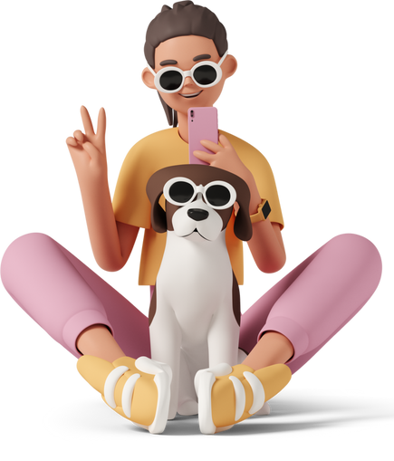
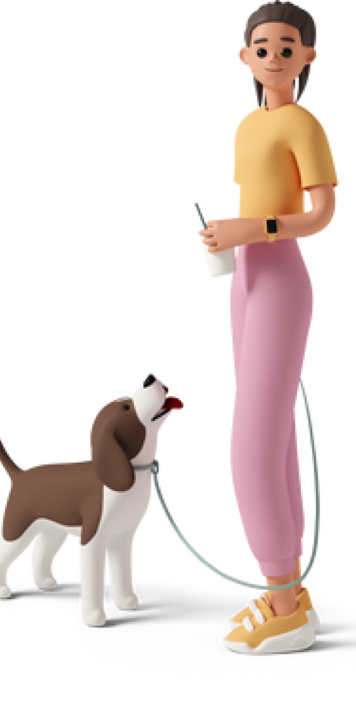

Pet Assure
Final Presentation
An application for pet care
Group No:-IS 06

Slide 2


Pet Assure
Team Members
M. Sangeerthan -20020937
T.N.Wickramasinghe - 20021161
R.S.P. N. Krishnajina - 20020589
E.M.Ishini Ekanayake - 20020341

Slide 3
Pet Assure
Line Up
1. Introduction.
2. Actors and functionalities.
3. Updates and Upgrades.
4.Test Cases.
5.Technologies.
6. Project Progress.
7. Work Load Distribution.
8. Demonstration.

Slide 4
Pet Assure
1.Introduction
Pet Assure
Is a platform for the pet lovers to get the services from multiple service providers for their lovely pets.
Pet Assure
Is a platform for the pet based service providers to get their clients easily

Slide 5
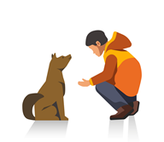






Pet Assure
User Identifications
Admin
Customers
Veterinarian
Pet Boarding
Pet sitters
Groomers

Slide 6
Pet Assure
Project Description
Veterinarian, petsitter , pet boarding services, groomers can Register proving their valid identifications and documents.
A platform to get and give pet based services.
Online service booking system
Platform to findout the pets for buy, adoption and crossing

Slide 7
Pet Assure
Project Goals
Introducing one web-based platform for create a connection between pet owners and pet care services.
All the parties can benefit from each other and provide their services through our website.

Slide 8









Pet Assure
4.Technologies
Versioning Control
Git-hub
Designing tools
Draw.io
Programming languages
PHP
Javascript
Web Server
Apache Web Server
Markup languages
HTML5
Payment Gateway Sandbox
Stripe
Style sheet languages
CSS3
Database Management System
MySQL

Slide 9
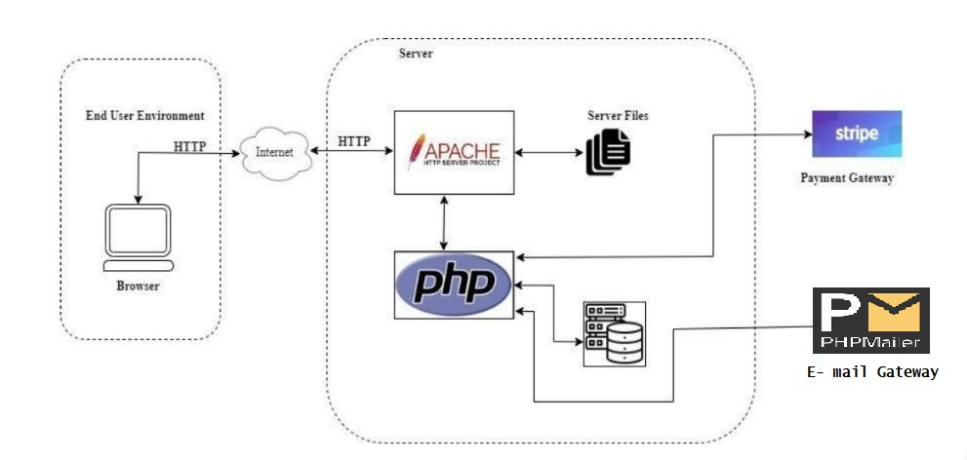
Pet Assure
High-Level Architecture

Slide 10
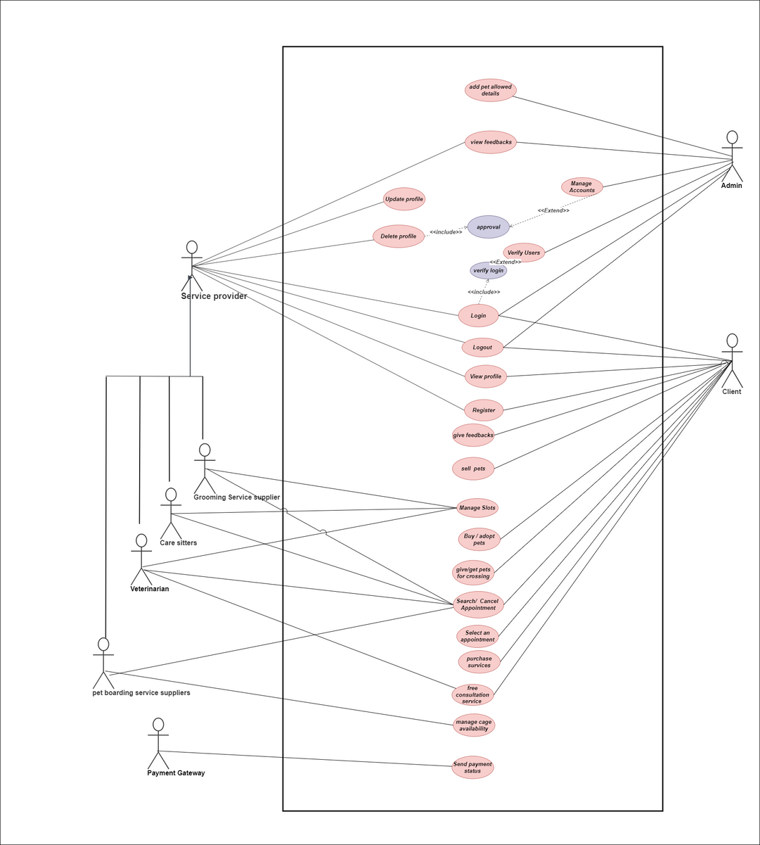
Pet Assure
Usecase diagram

Slide 11
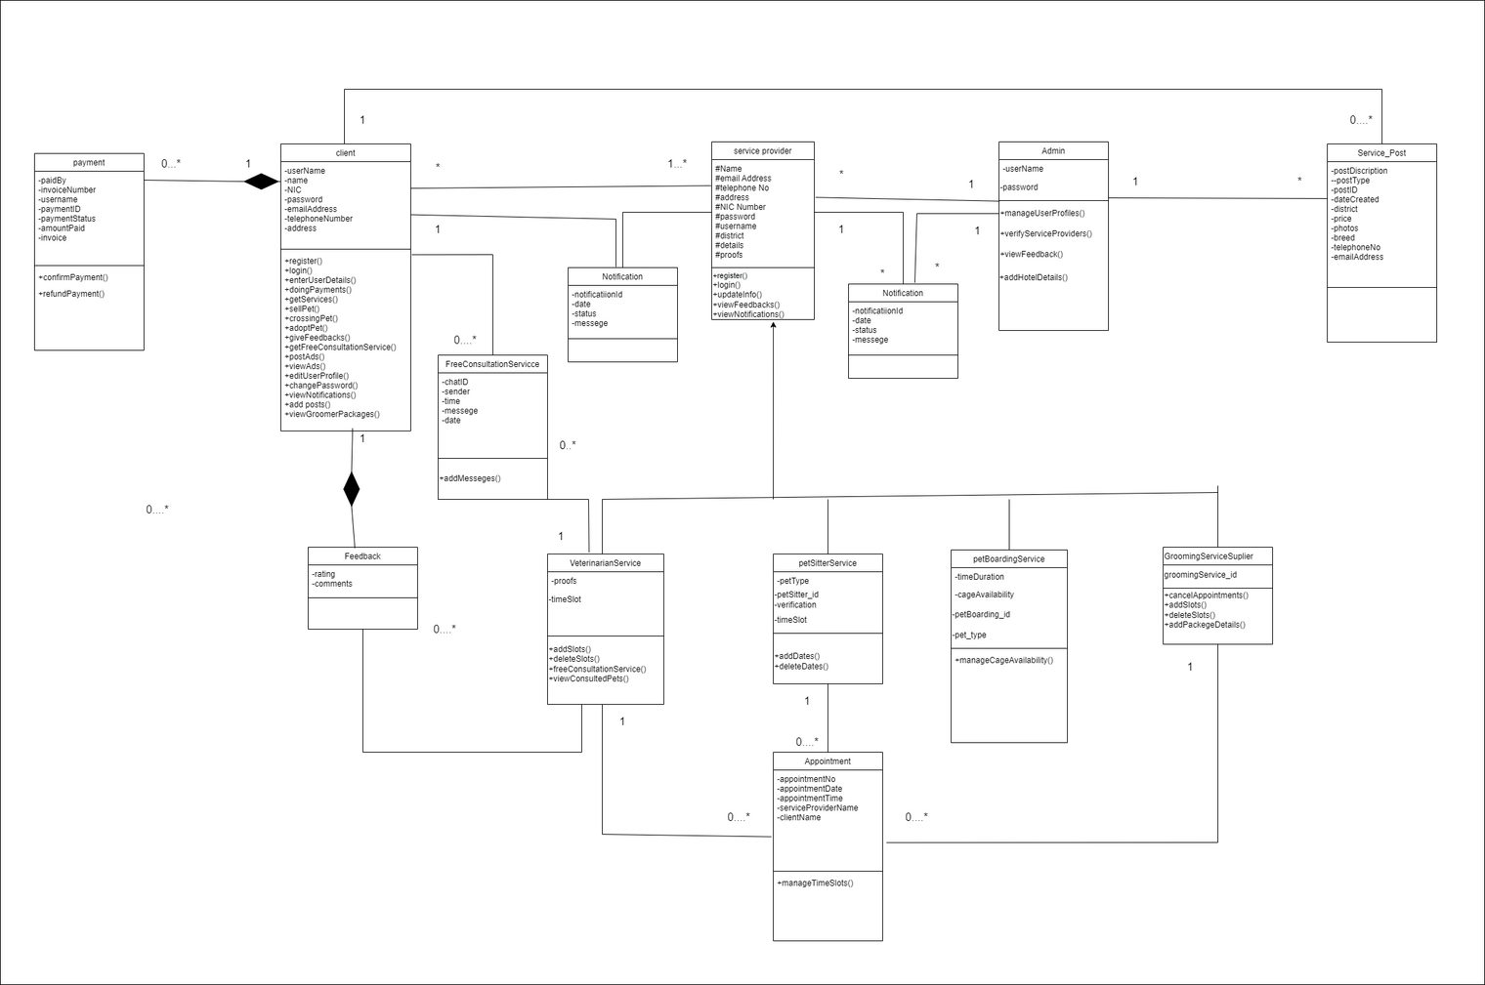
Pet Assure
Class Diagram

Slide 12
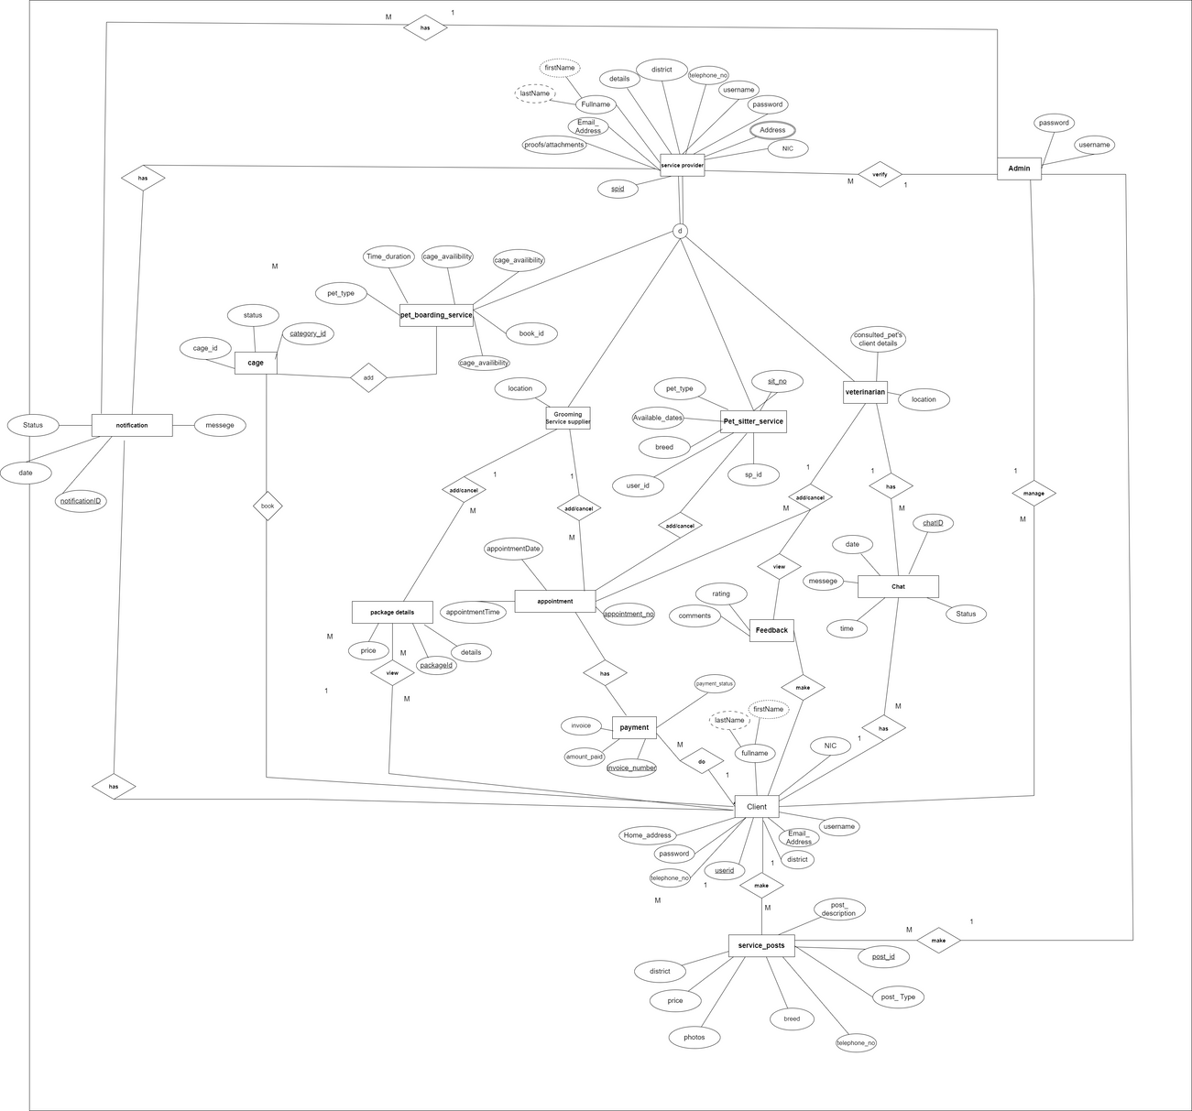
Pet Assure
ER Diagram

Slide 13
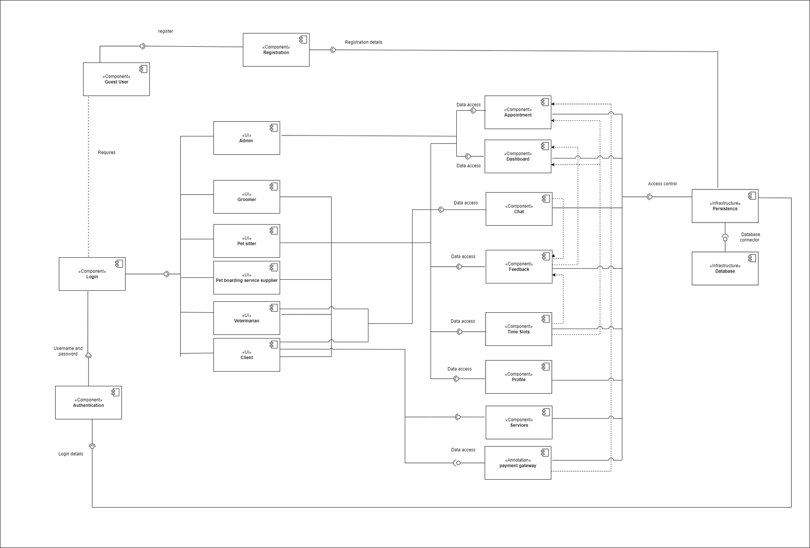
Pet Assure
Component Diagram

Slide 14
Pet Assure
5

Slide 15
Pet Assure
Demonstration.

Slide 16
Pet Assure
Thank you

